Slide 1
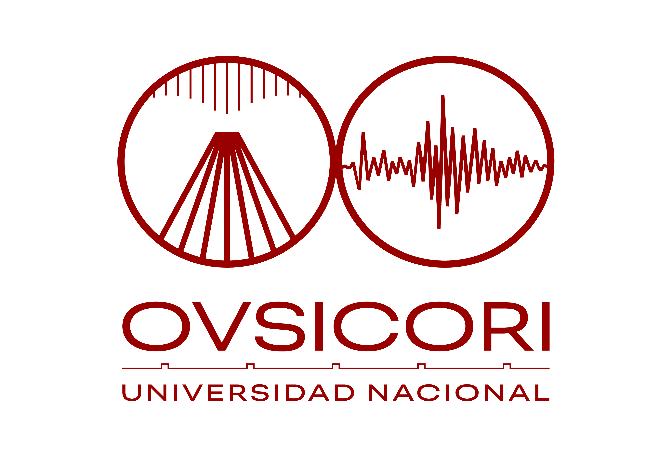
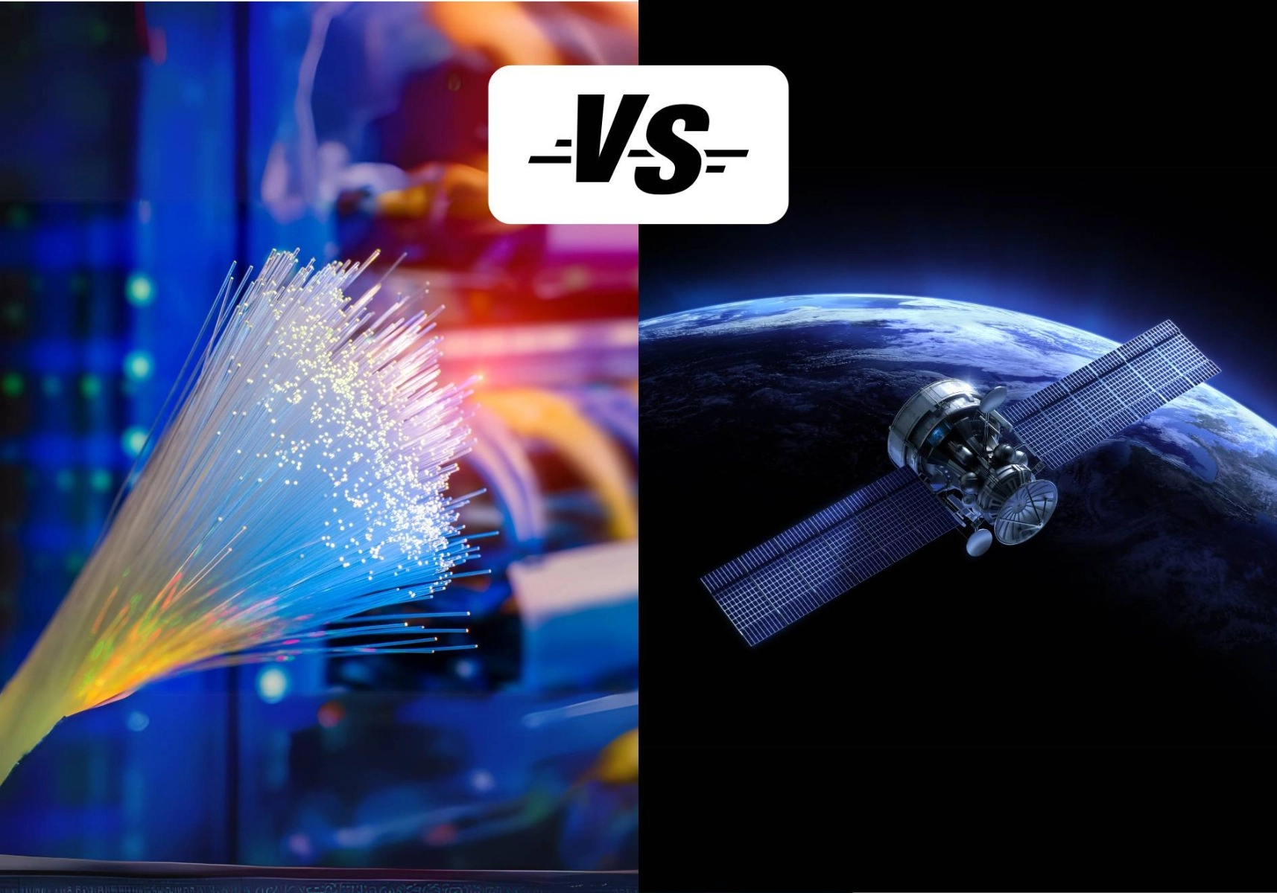
Costa Rica has problems with VSAT system related with the tropical weather.
We planing instal a redundant communication system in optical fiber.
Redundant communications in the tropic
John Bolaños
Volcanological and Seismological Observatory of Costa Rica (OVSICORI)
at Universidad Nacional
Master. Christian Garita Hidalgo

Slide 2
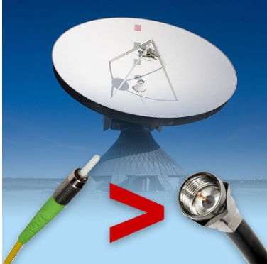
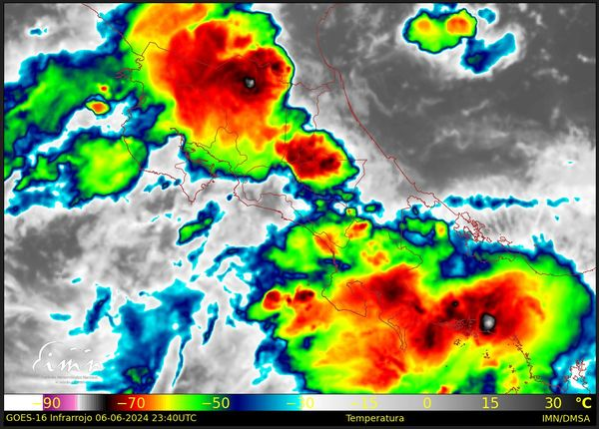
Decreasing the impact of tropical climate on station data transmission to NDC and IDC
Increased data transmission speed and increased bandwidth capacity
Redundant communications in the tropic
Introduction
Methods/Data
Results
During the rainy season in Costa Rica there are problems with satellite communications, this is
due to the large amount of rain and bad weather conditions there is.
It is analyzed as follows; The frequencies used in a VSAT with the IDC are between 4.172GHz to 4.174GHz and between 6.397 and 6.399GHz, using the formula we can find that the wavelength of these frequencies are 71.9mm and 46.89mm.
.
Considering the above and that the annual average of the rainfall exceeds 4000 mm in the area
where the JTS station is located, there are periods of time in which the attenuation of the
satellite signal is very high and could affect the communication.
Therefore, it is proposed to place a secondary communication system that does not transmit
through the air like a business fiber optic service, whose main characteristic is that the
provider guarantees its stability to a minimum of 95% (considering breakdowns).
The above, added to a parallel communication of the data to our NDC and subsequently to the
IDC, we would obtain backup in the communication and storage of data, as well as its continuity in a reliable manner.
Master. Christian Garita Hidalgo

