Slide 1


P4.4-804
Building the International Monitoring System Sustainment Strategy through international expert consultation and collaboration
Xyoli Perez Campos, Michelle Grobbelaar, Guillermo Rocco, IMS Team
Comprehensive Nuclear-Test-Ban Treaty Organization (CTBTO)
Although more than 90% of the International Monitoring System (IMS) has been installed, over the next decade a large proportion of IMS stations will reach the milestone of 20+ years post-certification with continuous operation.
The CTBTO examined various sources of information and expertise that could be utilized to build upon its inhouse expertise and to obtain a solid basis for the IMS sustainment strategy. One such source of information was a group of international experts that formed the Guidance Committee for IMS Sustainment. The experts have proved to be crucial as “sounding boards” for guiding our understanding of the best methods to utilize within the sustainment strategy.
DISCLAIMER: The views expressed on this e-poster are those of the authors and do not necessarily reflect the view of the CTBTO.

Slide 2
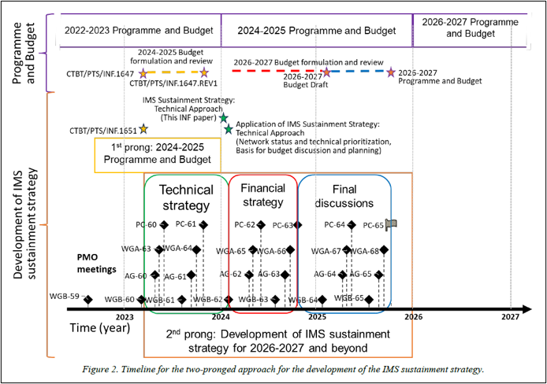
PLEASE DON‘T FORGET TO PUT THE E-POSTER TITLE AND YOUR NAME IN THE PRESENTATION HEADER.
DUPLICATE THIS SLIDE IF YOUR E-POSTER HAS MORE THAN 1 PAGE
P4.4-804
Building the International Monitoring System Sustainment Strategy through international expert consultation and collaboration
Xyoli Perez Campos, Michelle Grobbelaar, Guillermo Rocco, IMS Team
5 INF papers
227 pages
89 figures
20 tables
Two-pronged approach
INF.1651
WGB-60/Feb.2023
Technical approach
INF.1685
WGB-62/Feb.2024
Long term requirements
INF.1712
WGB-63/Aug. 2024
Sounding boards:
Informal consultations (WGB 60 – WGB 65 and WGA)
Questionnaires
Guidance committee on IMS sustainment
Financial scenarios, risks, sensitivities
INF.1717/Corr. (Sept. 2024)
INF.1723 (Jan. 2025)
WGB-64/Feb.2025
DISCLAIMER: The views expressed on this e-poster are those of the authors and do not necessarily reflect the view of the CTBTO.

