Slide 1


P4.4-802
Collaborating with Station Operators for Developing the International Monitoring System Sustainment Strategy
Xyoli Perez Campos, Michelle Grobbelaar, Guillermo Rocco, IMS Team
Comprehensive Nuclear-Test-Ban Treaty Organization (CTBTO)
Collaborating with station operators and representatives from national data centres has been an important part in developing a sustainment strategy for the International Monitoring System (IMS).
A questionnaire was distributed to all station operators and representatives from national data centres. About 60% of stations might require some level of work on their infrastructure, mainly related to the power system or housing. The participants identified that the main risk the stations face is related to the environment, and an increased frequency of extreme weather events, highlighting a further upgrade to the station infrastructure to mitigate against climate change.
DISCLAIMER: The views expressed on this e-poster are those of the authors and do not necessarily reflect the view of the CTBTO.

Slide 2
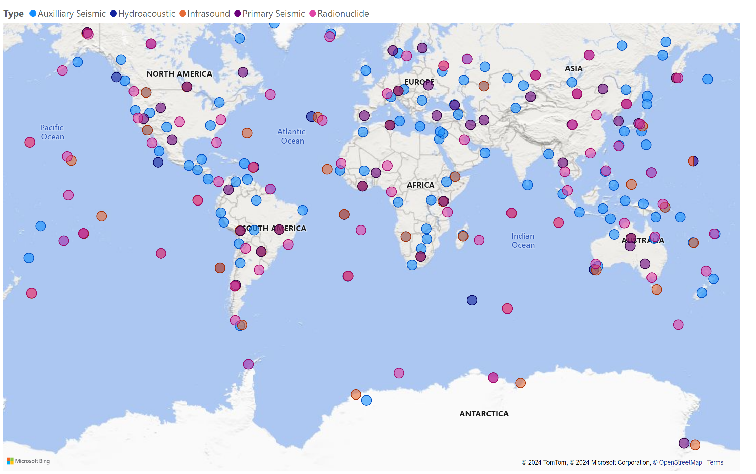
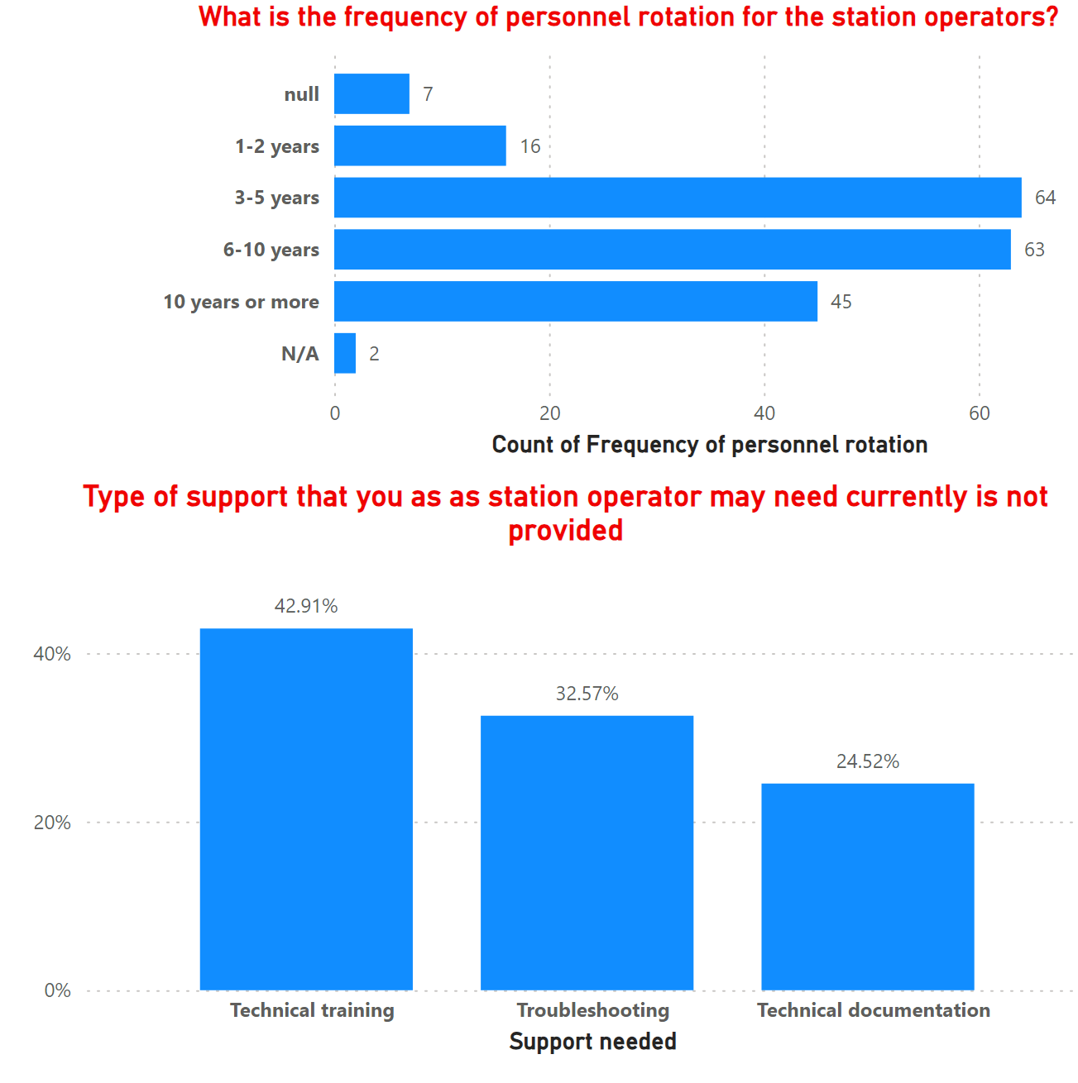
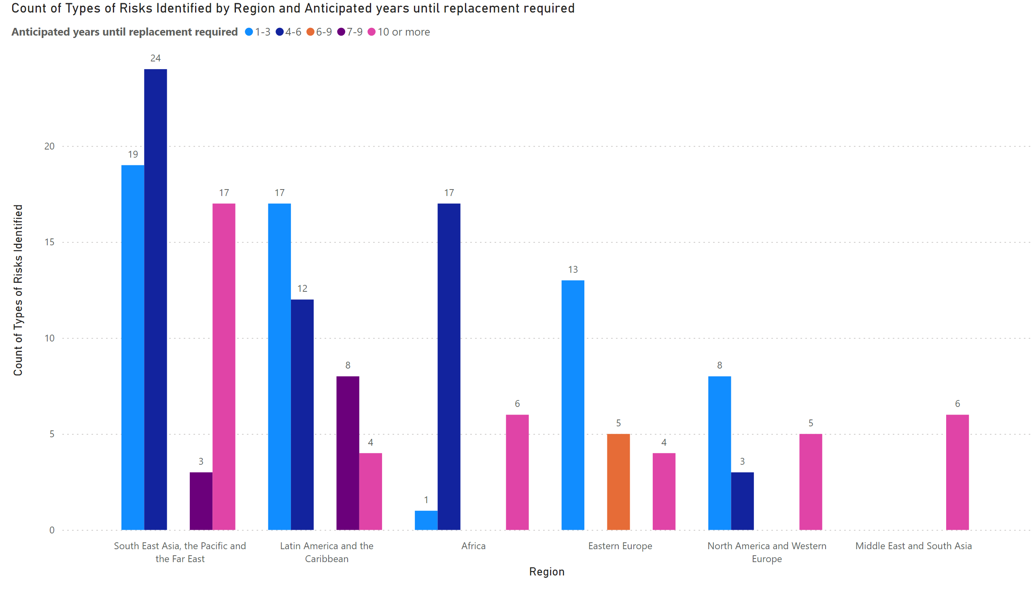
PLEASE DON‘T FORGET TO PUT THE E-POSTER TITLE AND YOUR NAME IN THE PRESENTATION HEADER.
DUPLICATE THIS SLIDE IF YOUR E-POSTER HAS MORE THAN 1 PAGE
P4.4-802
Collaborating with Station Operators for Developing the International Monitoring System Sustainment Strategy
Xyoli Perez Campos, Michelle Grobbelaar, Guillermo Rocco, IMS Team
Participating station operators
Identified Risks
SO turnover
Mainly environmental and anticipate in next 1-6 years, and the highest being rainfall/flooding and temperature fluctuations, with wind and snow close behind.
Observed increase in frequency of extreme weather events and rising temperatures. Implications on infrastructure upgrades.
Renovations to power, roofing, walls and security.
Theft is the most common vandalism, followed by damaged infrastructure from vandalism.
Large number of station operators responding (feet on the ground).
Majority of the stations have not been revalidated, or have only been revalidated once.
Most of the systems have been in operation for more than 16 years. Thus, the SO experience is useful, but also it raises a flag for the infrastructure.
Main reasons for revalidation are deterioration owing to changes in station environment, and end of life replacement.
Sharing of protocol/guidelines that SO’s use in their networks
The majority of the stations have 5 people assisting with O&M and the rotations are between 3-5. Thus we need to make sure that we have regular training interventions to insure transfer of knowledge.
DISCLAIMER: The views expressed on this e-poster are those of the authors and do not necessarily reflect the view of the CTBTO.

