Slide 1
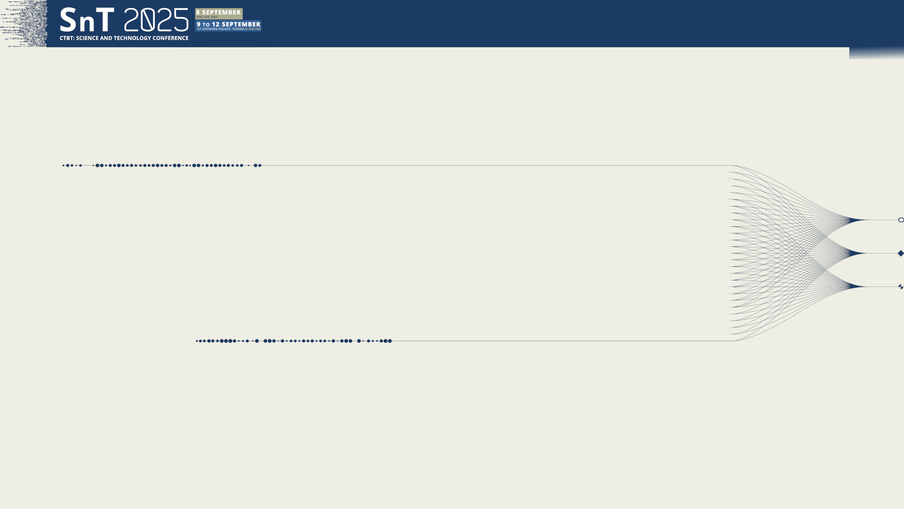

O4.4-273
Full Chain In-Situ Calibration of Hydroacoustic Hydrophone Stations
Ata Can CORAKCI, Mario ZAMPOLLI, Dirk METZ
CTBTO / IMS / ED
09 September 2025
The views expressed on this presentation are those of the authors and do not necessarily reflect the view of the CTBTO.

Slide 2
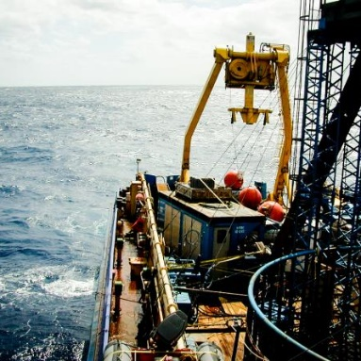
O4.4-273
Full Chain In-Situ Calibration of Hydroacoustic Hydrophone Stations
Ata Can CORAKCI, Mario ZAMPOLLI, Dirk METZ
Content
CTBTO - Hydroacoustic Network
Overview of Calibration Capabilities at Hydrophone Stations
Importance of Full Chain In-Situ Calibration
Review of Past Studies
Envisaged In-Situ Calibration Methodologies
Key Challenges
Future Actions
The views expressed on this presentation are those of the authors and do not necessarily reflect the view of the CTBTO.

Slide 3
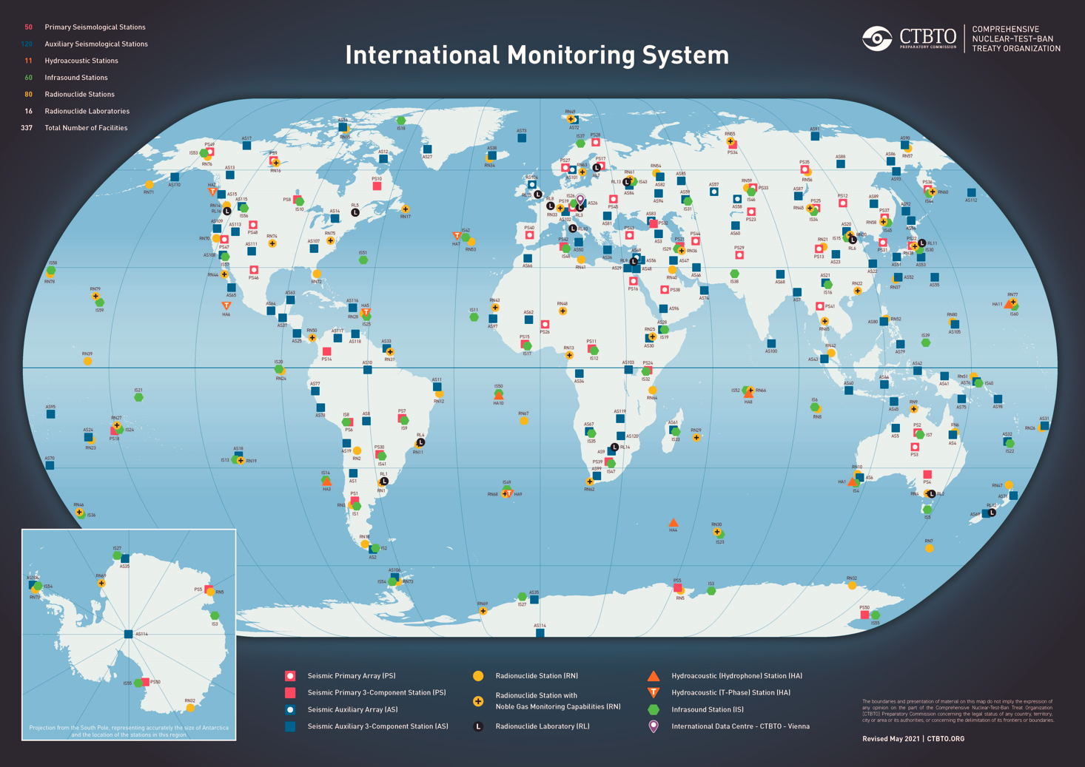
O4.4-273
Full Chain In-Situ Calibration of Hydroacoustic Hydrophone Stations
Ata Can CORAKCI, Mario ZAMPOLLI, Dirk METZ
IMS Network
4 Monitoring Technologies
3 Waveform Technologies
11 hydroacoustic stations (all stations certified)
50 primary and 120 auxiliary seismic stations (155 stations certified)
60 infrasound stations (54 stations certified)
Radionuclide Technology (Particulate & Noble Gas)
80 radionuclide stations + 16 radionuclide laboratories (73 stations and 14 laboratories certified)
40 radionuclide stations also have noble gas monitoring capability (26 stations certified)
The views expressed on this presentation are those of the authors and do not necessarily reflect the view of the CTBTO.

Slide 4
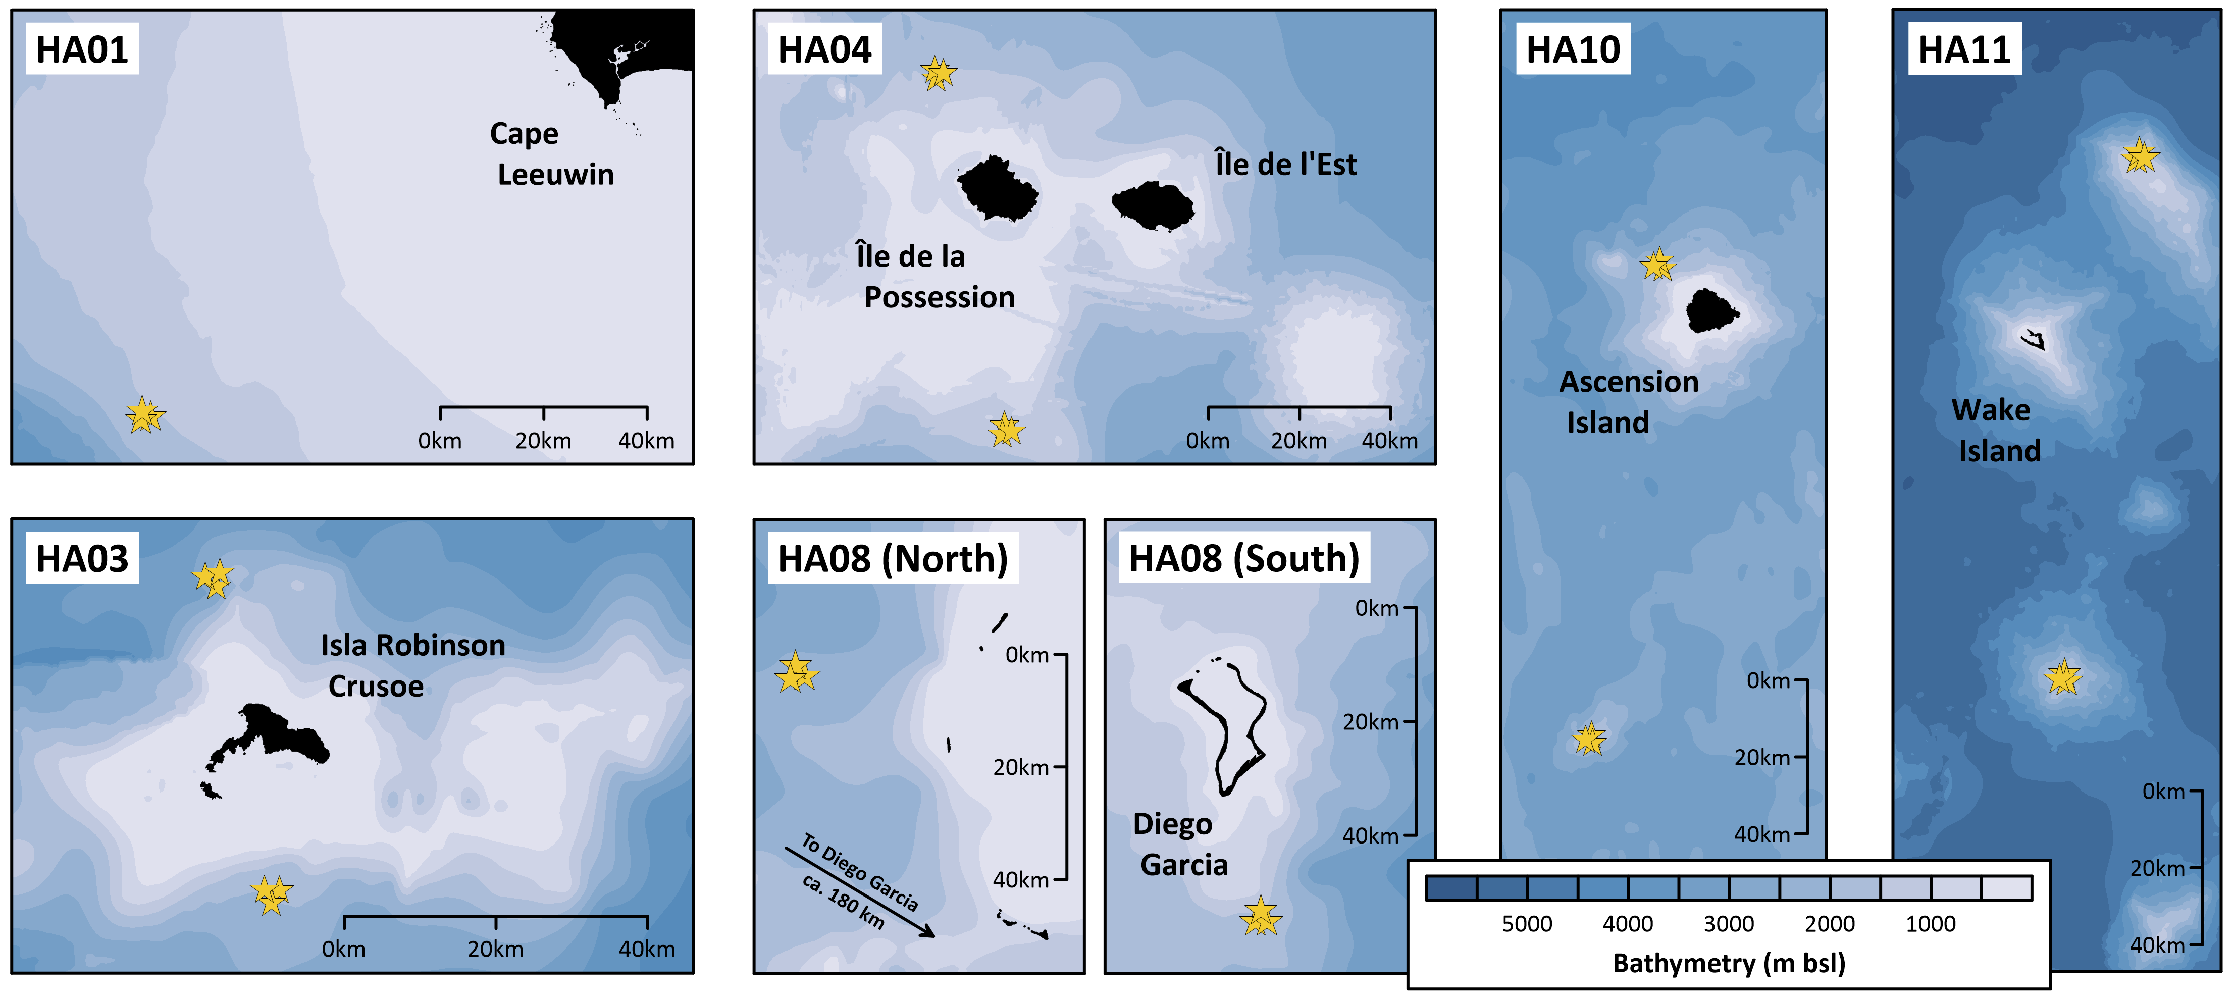
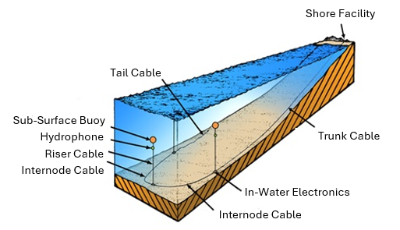
O4.4-273
Full Chain In-Situ Calibration of Hydroacoustic Hydrophone Stations
Ata Can CORAKCI, Mario ZAMPOLLI, Dirk METZ
Hydroacoustic Network
Schematic outline of an IMS hydrophone station – Not to Scale
6 Hydrophone Stations
Bottom-moored triplets of hydrophones at SOFAR depth, which are very sensitive to acoustic pressure variations in ocean, detect signals traveling in the ocean.
5 T-Phase Stations
Land-based seismometers, which are more sensitive to ground vibrations, detect hydroacoustic waves transmitted through the Earth's crust.
The views expressed on this presentation are those of the authors and do not necessarily reflect the view of the CTBTO.

Slide 5
O4.4-273
Full Chain In-Situ Calibration of Hydroacoustic Hydrophone Stations
Ata Can CORAKCI, Mario ZAMPOLLI, Dirk METZ
Overview of Calibration Capability at Hydrophone Stations
Initial Calibration – Before Deployment: “Full chain” system calibration during the acceptance tests under operation depth and temperature.
  Hydrophone (including preamp) in low frequency tank facility
  UWS digitizer electronics: input from riser cable to laser output in the laboratory
After Deployment: UWS digitizer electronics calibration is performed from the CRF, it does not include the contribution of the analog part that contains information related to the hydrophone and the riser cable.
The views expressed on this presentation are those of the authors and do not necessarily reflect the view of the CTBTO.

Slide 6
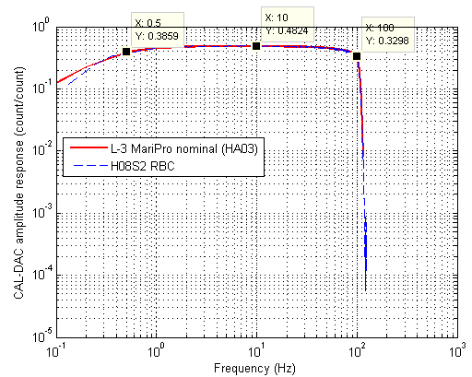
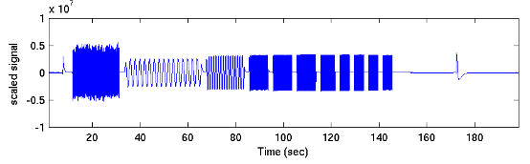
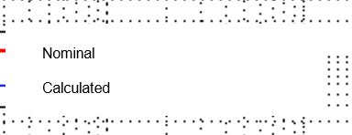
O4.4-273
Full Chain In-Situ Calibration of Hydroacoustic Hydrophone Stations
Ata Can CORAKCI, Mario ZAMPOLLI, Dirk METZ
Overview of Calibration Capability at Hydrophone Stations
UWS Digitizer Electronics Calibration in-situ – After Deployment.
3) Data received at the shore and sent to Vienna via the satellite link. Processed to check if there are changes in the response over time.
2) Known pre-stored analog waveform is injected via a D/A converter.
Sequence consists of:
Pseudo-random noise (RBC)
CW sinusoid chirps
Hydrophone
Pre-amplifier
1) A command from the CRF triggers the system for calibration and switches it into calibration mode.
Electronic Bottle
High Pass Filter
Low Pass Filter
A/D Convertor
The views expressed on this presentation are those of the authors and do not necessarily reflect the view of the CTBTO.

Slide 7
O4.4-273
Full Chain In-Situ Calibration of Hydroacoustic Hydrophone Stations
Ata Can CORAKCI, Mario ZAMPOLLI, Dirk METZ
Importance of Full Chain In-Situ Calibration
Hydrophone is the primary sensing element, and its acoustic performance is critical. Potential source of hydrophone instability: Sensor material ageing, electronic component degradation, water ingress, external impact.
The analog part of the system (hydrophone and riser cable) may degrade over time, and this potential degradation is currently not accounted for in the system’s traceability.
This is particularly important as IMS sustainment foresees operating HA Hydrophone stations well beyond their design life, as full chain calibration can help in early identification of underwater system issues/aging.
Assessing the state of health of the full signal chain through in-situ calibration from the hydrophone to the on-land electronics would help us evaluate station sustainability and maintenance needs.
It would be a key check to ensure the performance consistency and long-term reliability of the hydroacoustic network.
The views expressed on this presentation are those of the authors and do not necessarily reflect the view of the CTBTO.

Slide 8
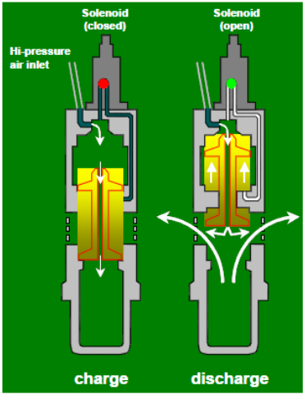
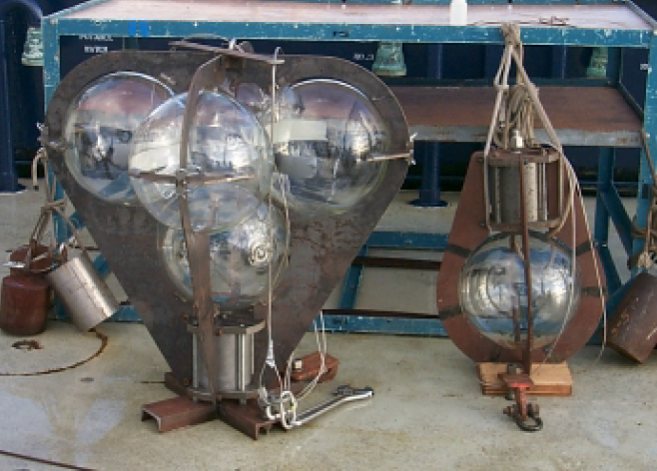
O4.4-273
Full Chain In-Situ Calibration of Hydroacoustic Hydrophone Stations
Ata Can CORAKCI, Mario ZAMPOLLI, Dirk METZ
Review of Past Studies - 1 & 2
Air gun survey, Ascension Island, May 1999, J.C. Ross
Purpose: Calibrate & locate 3 existing hydrophones (installed 1957)
Direct arrival phase, contaminated by bottom reflections & scattering, clipped received signals
Seismic air guns, designed for near-surface operation, may not couple into SOFAR channel
Imploding spheres, alternative method to energize SOFAR channel
Signal spectra, broad peak 200–800 Hz
Source frequencies higher than hydrophone network sensitivity (1–100 Hz) → low frequencies absent
The views expressed on this presentation are those of the authors and do not necessarily reflect the view of the CTBTO.

Slide 9
O4.4-273
Full Chain In-Situ Calibration of Hydroacoustic Hydrophone Stations
Ata Can CORAKCI, Mario ZAMPOLLI, Dirk METZ
Calibration Methodologies – IEC 60565 – 1: 2020
Free Field three transducer spherical wave reciprocity calibration – Primary Method
  Requires 3 transducers at least one of which must be reciprocal (receiver ⬄ projector).
  Not easy to conduct under ocean conditions due to detailed calibration procedure (At least 3 pairs of electrical transfer impedance (Z) measurements).
  Lowest possible measurement uncertainty (most accurate result) due to being the primary method.
Free Field calibration by comparison with an acoustic reference device – Secondary Method
  3 Types of comparison calibration method
    Hydrophone calibration by comparison with a reference hydrophone.
    Hydrophone calibration using a calibrated projector.
    Projector calibration using a calibrated hydrophone.
  Much easier to conduct; however, it has higher measurement uncertainty compared to the primary method.
The views expressed on this presentation are those of the authors and do not necessarily reflect the view of the CTBTO.

Slide 10
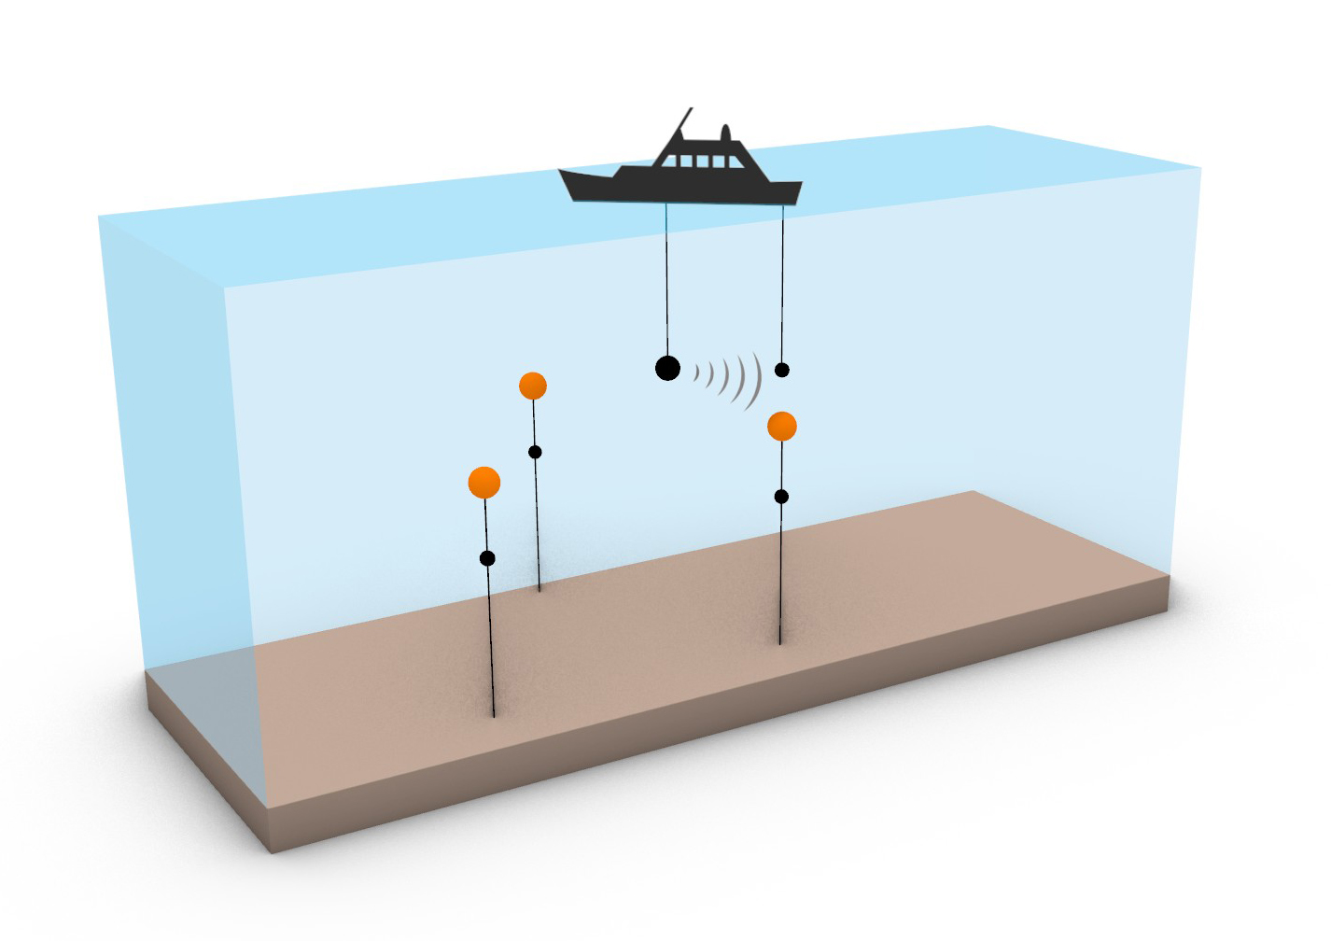
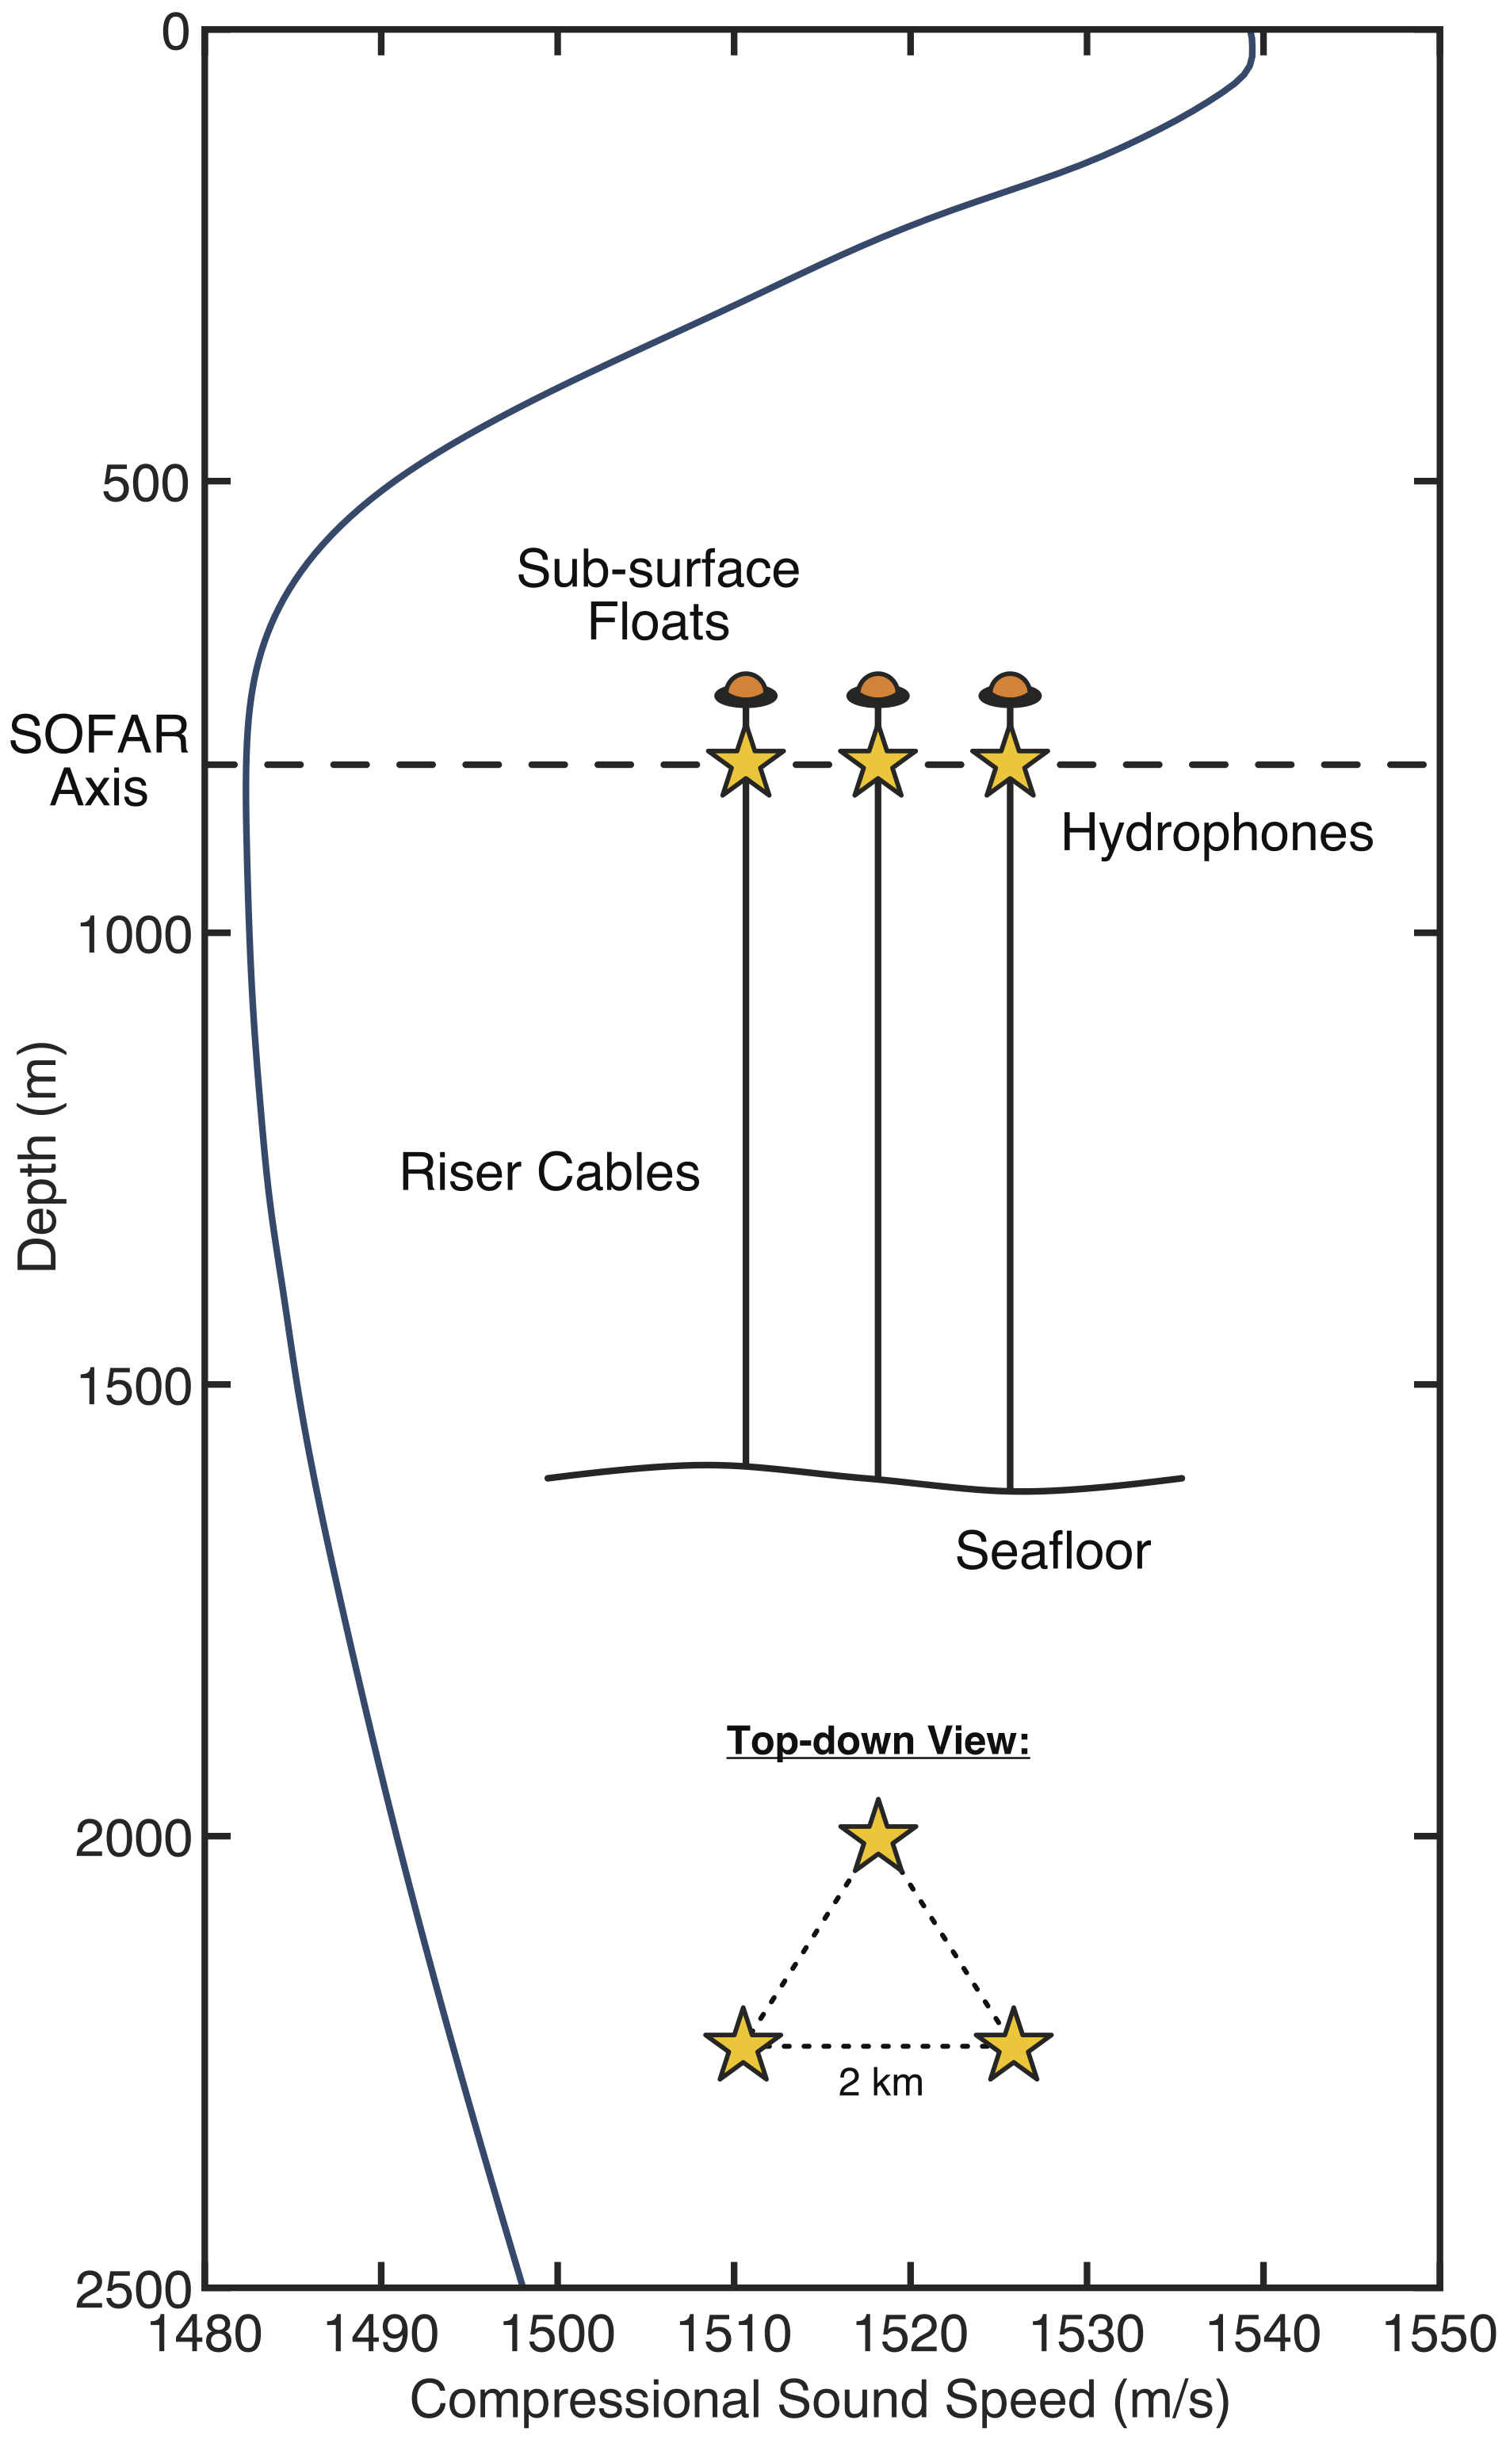
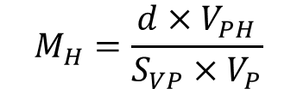
O4.4-273
Full Chain In-Situ Calibration of Hydroacoustic Hydrophone Stations
Ata Can CORAKCI, Mario ZAMPOLLI, Dirk METZ
Envisaged In-Situ Calibration Methodologies - 1
Hydrophone calibration using a calibrated projector
Calibration of the projector at the frequency of interest is essential. Very low frequencies can be challenging.
Sound propagation in the measurement site should be carefully considered. Models can be used to predict how sound travels in situ.
Measurements are highly dependent on the distance between the projector and the hydrophone under test, unless an additional monitoring hydrophone is moored from a second platform near the known position of the hydrophone triplet.
This method requires only one platform during the measurement process, which holds both the projector and the hydrophone (for monitoring).
$$M_{H}=\frac{d×V_{PH}}{S_{VP}×V_{P}}$$
The views expressed on this presentation are those of the authors and do not necessarily reflect the view of the CTBTO.

Slide 11
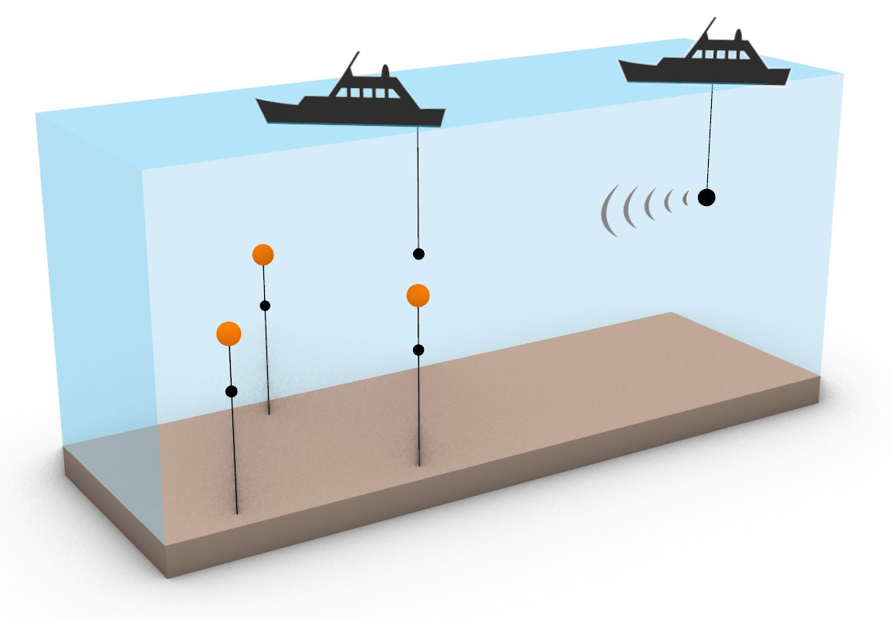
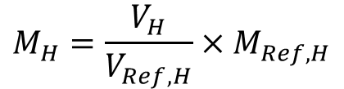
O4.4-273
Full Chain In-Situ Calibration of Hydroacoustic Hydrophone Stations
Ata Can CORAKCI, Mario ZAMPOLLI, Dirk METZ
Envisaged In-Situ Calibration Methodologies - 2
Hydrophone calibration by comparison with a reference hydrophone.
The sound source used for the calibration does not need to be a calibrated device. However, a calibrated hydrophone is still required for comparison measurements.
Calibration of a reference hydrophone at very low frequency is generally challenging.
This method depends on whether both the hydrophone under test and the calibrated hydrophone are exposed to the same acoustic field.
This method may offer more stability of the measurement under open ocean conditions.
This method requires two platforms during the calibration process. This adds additional logistical and financial burdens.
$$M_{H}=\frac{V_{H}}{V_{Ref, H}}×M_{Ref,H}$$
The views expressed on this presentation are those of the authors and do not necessarily reflect the view of the CTBTO.

Slide 12
O4.4-273
Full Chain In-Situ Calibration of Hydroacoustic Hydrophone Stations
Ata Can CORAKCI, Mario ZAMPOLLI, Dirk METZ
Key Challenges of In Situ Calibration
Calibration at very low frequencies (1–100 Hz); availability and metrological traceability of the projectors and hydrophones are limited.
The lower number of oscillations at the hydrophone side without any overlap due to reflections require the use of signal processing techniques to reconstruct a sufficiently long waveform for identifying the signal’s amplitude and phase, especially at frequencies below 20 Hz or adaptation of such a method.
Deep-water deployment (up to 1400 m); the measurement platform must be properly equipped to deploy instruments to the SOFAR channel depth.
There are no standard calibration procedures for in-situ deep ocean underwater acoustic calibration methods.
Accurate knowledge of the coordinates of the hydrophone triplet and variability from ocean currents.
Open ocean ambient and propagation conditions.
Remote station locations and associated logistical challenges and cost.
The views expressed on this presentation are those of the authors and do not necessarily reflect the view of the CTBTO.

Slide 13
O4.4-273
Full Chain In-Situ Calibration of Hydroacoustic Hydrophone Stations
Ata Can CORAKCI, Mario ZAMPOLLI, Dirk METZ
Future Actions
Feasibility / Preparation
Cooperation and joint work with other institutions operating in offshore marine areas: contributing to calibration efforts, providing logistical support at remote stations, and addressing station-specific permitting issues.
Exploration of equipment and their proper calibrations. A custom-designed product may be necessary to meet the frequency and the operational depth specifications.
Establishment of a calibration methodology and procedure.
Sea Test
Open sea test in realistic conditions at an accessible location, collaboration with partners would be necessary before testing it in remote locations.
Calibration Work
HA01 Cape Leeuwin (Australia) is the most accessible HA hydrophone station in this sense.
The views expressed on this presentation are those of the authors and do not necessarily reflect the view of the CTBTO.

Slide 14
O4.4-273
Full Chain In-Situ Calibration of Hydroacoustic Hydrophone Stations
Ata Can CORAKCI, Mario ZAMPOLLI, Dirk METZ
THANK YOU
The views expressed on this presentation are those of the authors and do not necessarily reflect the view of the CTBTO.

