Slide 1
Integration of mass position monitoring and auto centering on Indonesian seismic networks
A Systems Integration Approach for REGIONAL Seismic Networks
By Amir Julian Bahari Gunawan

Slide 2
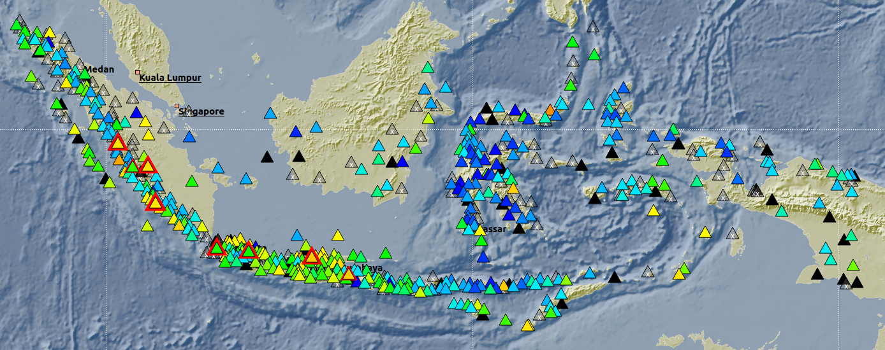
Indonesian Seismic Network Overview

Slide 3
The Challenges
Maintaining optimal performance in large, diverse seismic networks.
Fragmentation: Different manufacturers use incompatible interfaces.
Inconsistent Monitoring: Manual data collection and health checks are inefficient and unreliable.
Geographic Scale: Large networks like Indonesia's exacerbate these challenges.
Core Issue: Compromised sensor mass position leads to poor seismic data quality.

Slide 4
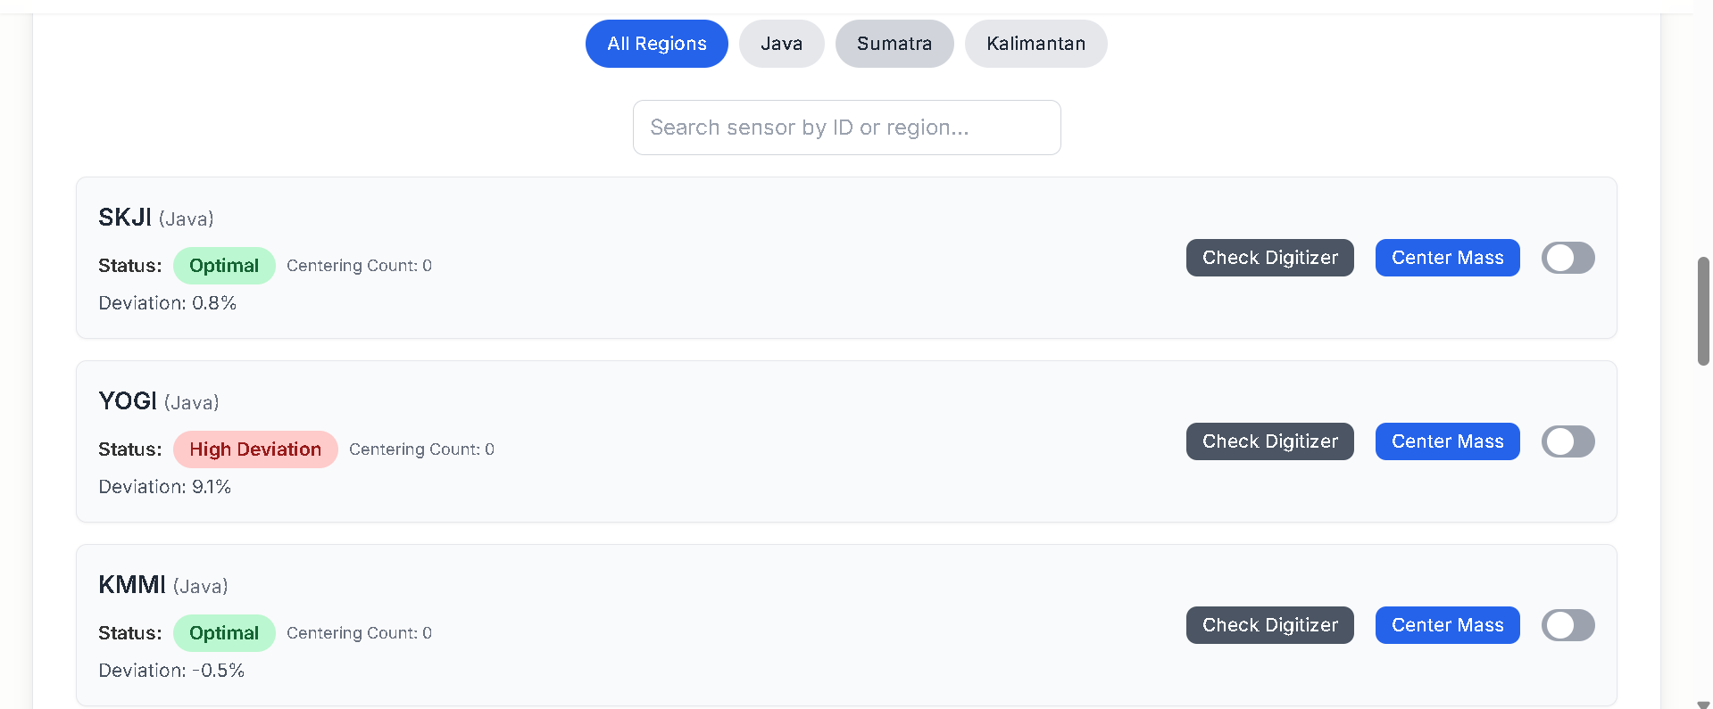
Our Solution: Systems Integration
A Unified Approach for a Fragmented Environment.
Unified Dashboard: A web-based platform that aggregates critical data from all digitizer interfaces into one place.
Integrated Controller: An intelligent system that automates key maintenance tasks.

Slide 5
Unified Dashboard
From Disparate Data to a Cohesive View.
Centralized, real-time monitoring of sensor health and mass position.
Intuitive data visualization to identify trends and anomalies instantly.
Filtering capabilities to explore data by region or sensor.

Slide 6
Integrated Controller
Automating Proactive Maintenance.
Automated Re-centering: The controller automatically adjusts the sensor mass position when a deviation is detected.
Shifting from Reactive to Predictive: This system prevents data quality issues before they occur.
Reduced Interventions: Significantly lowers the need for manual, on-site repairs, saving time and resources.

Slide 7
Benefits and Impacts
Maximizing Efficiency, Data Quality, and Reliability.
Enhanced Operational Efficiency: Centralization and automation streamline processes.
High-Quality Data: Ensures the integrity and reliability of seismic signals.
Minimized Downtime: Proactive maintenance prevents costly and time-consuming repairs.
Scalable Blueprint: A proven model for optimizing any multi-vendor seismic network globally.

