Slide 1

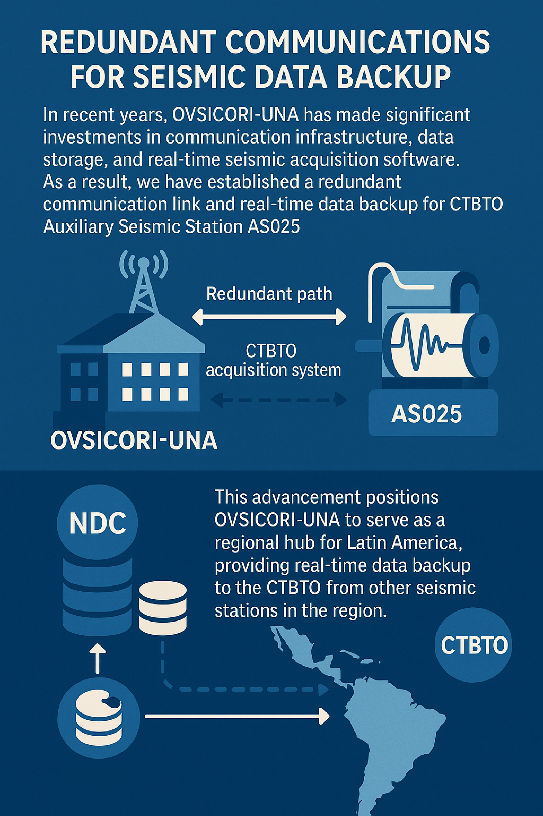
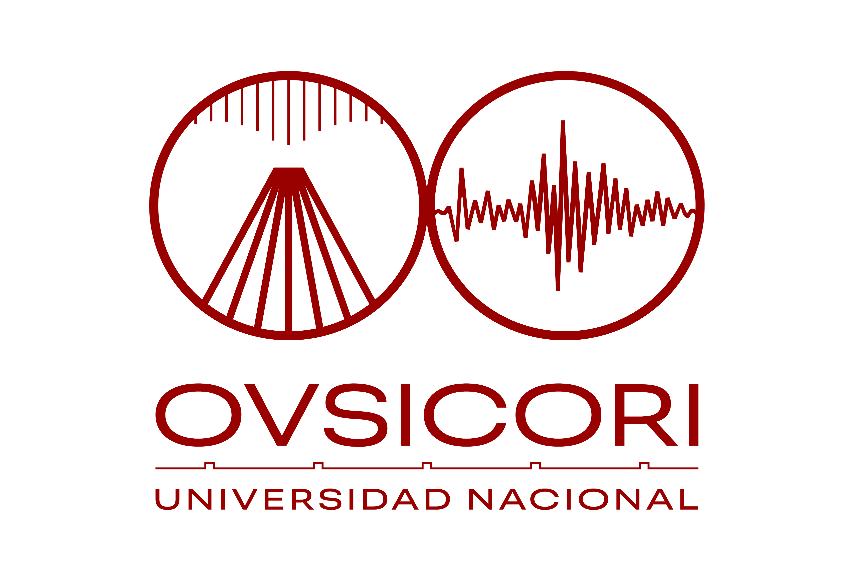
P4.2-107
NDC Costa Rica and GCI-Link for IDC data recovery
Christian Garita Hidalgo
OVSICORI-UNA
In recent years, OVSICORI-UNA has made significant investments in communication infrastructure, data storage, and real-time seismic acquisition software.
As a result, we now operate a secure infrastructure with redundant communication links and real-time backup for our data and the CTBTO Auxiliary Seismic Station AS025.
We propose the development of an additional communication path for the IMS.
Once operational, this will allow us to serve as a redundant communication hub for Latin America.
If you’d like to learn more, please come by and visit us at our poster.

