Slide 1
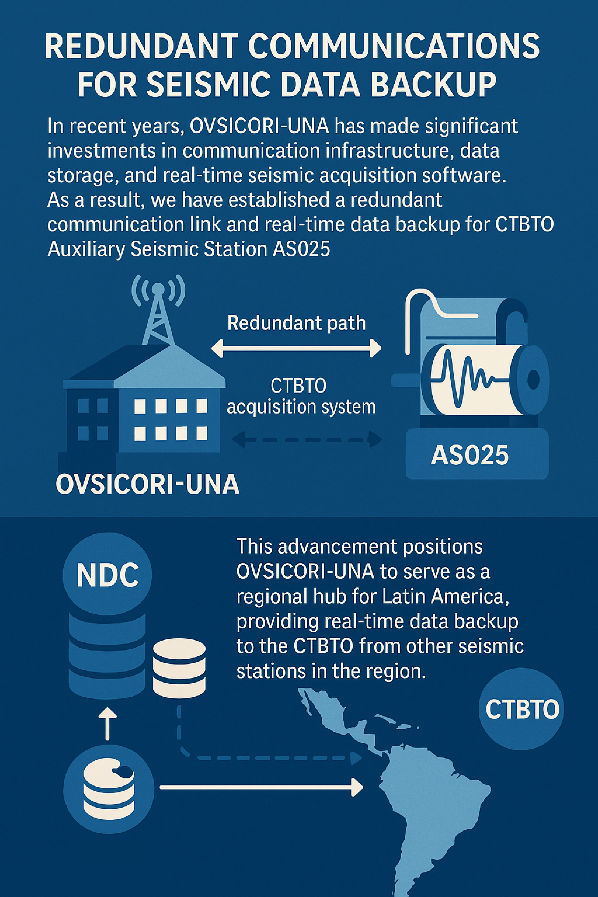
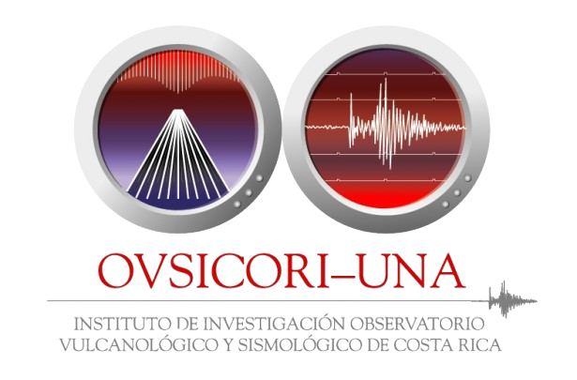
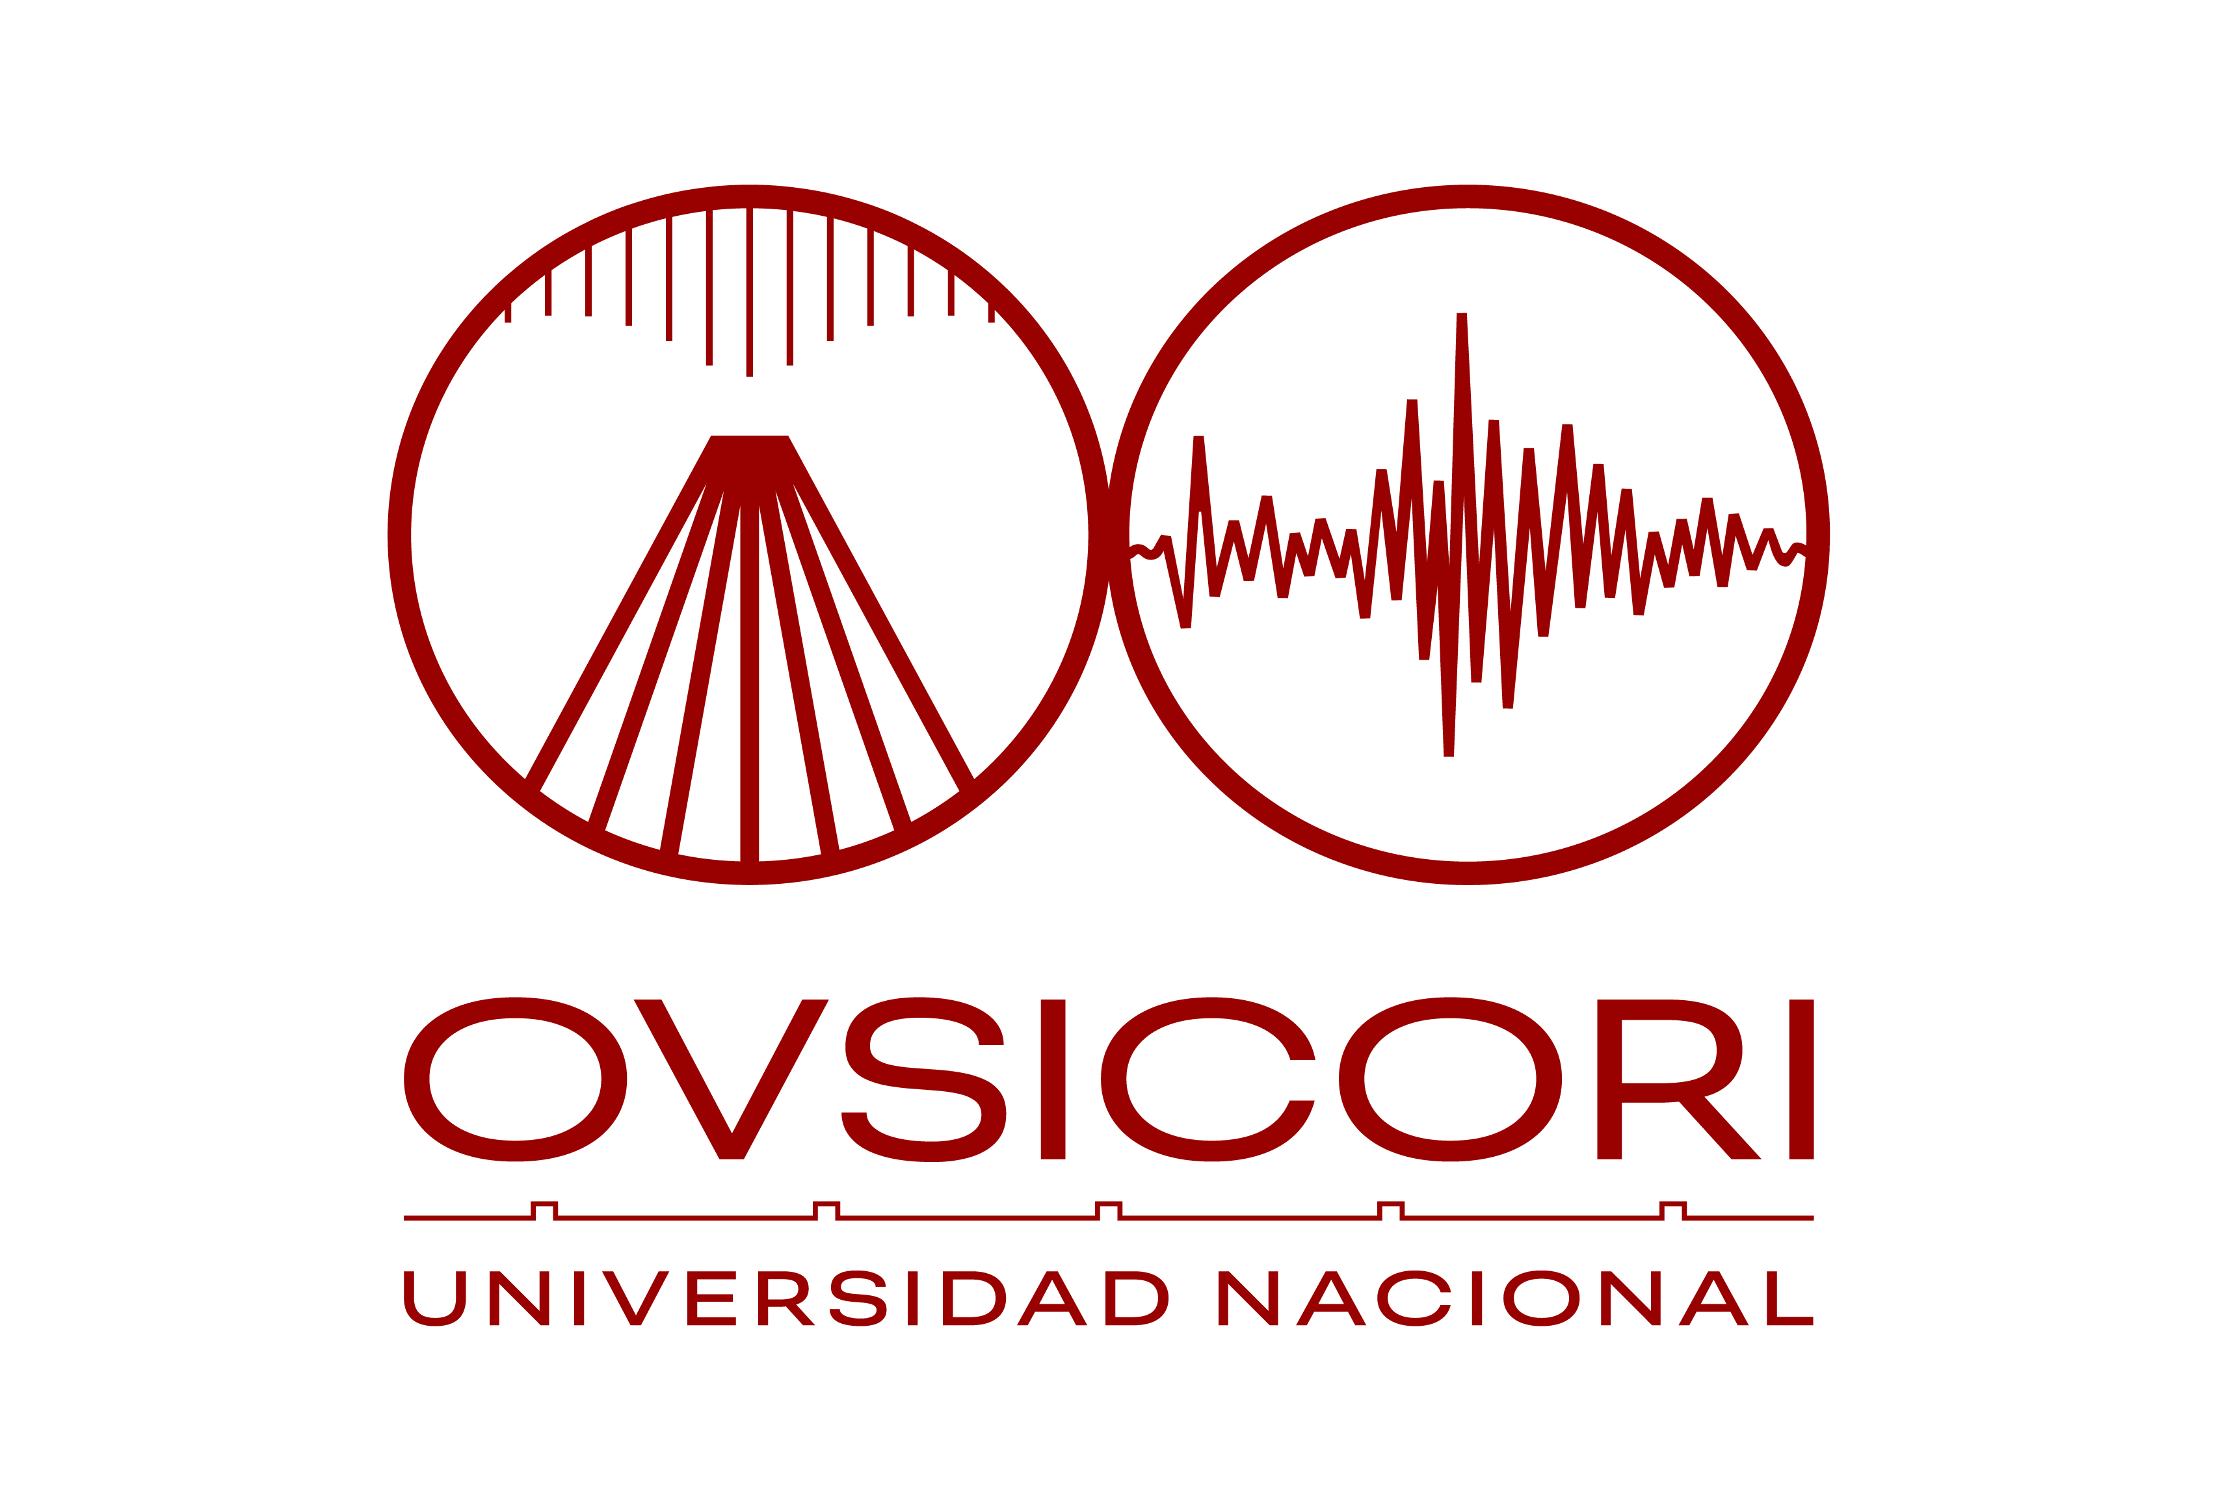
P4.2-107
NDC Costa Rica and GCI-Link
for IDC data recovery
Christian Garita
Volcanological and Seismological Observatory of Costa Rica (OVSICORI)
at Universidad Nacional
Master. Christian Garita Hidalgo

Slide 2
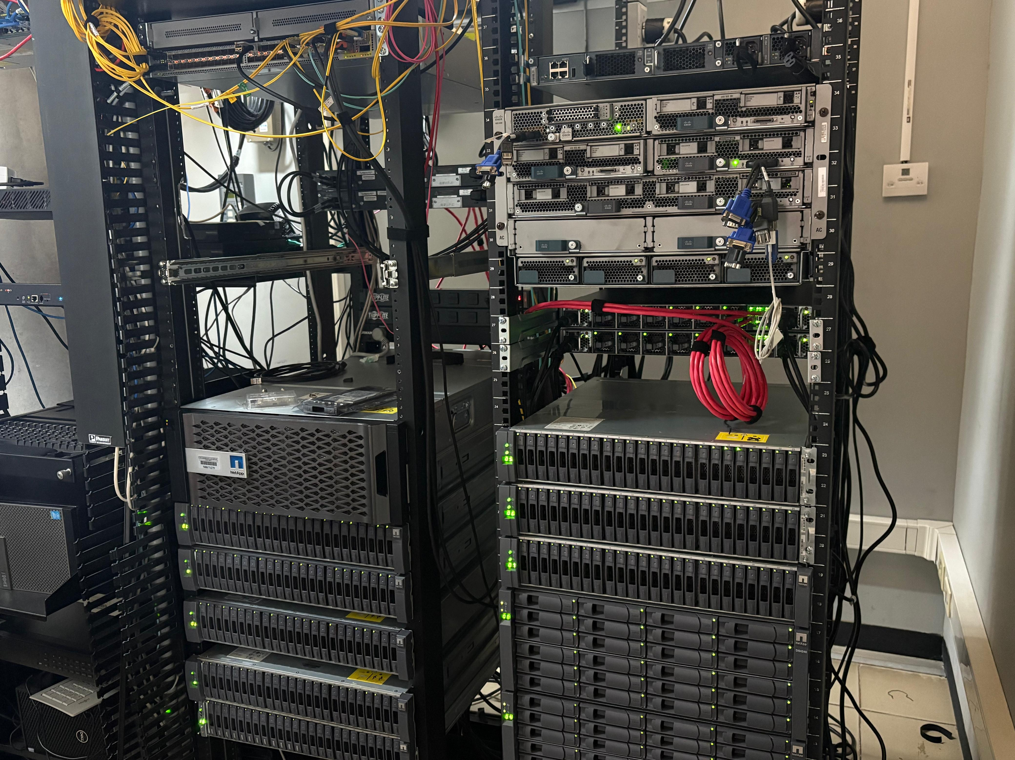
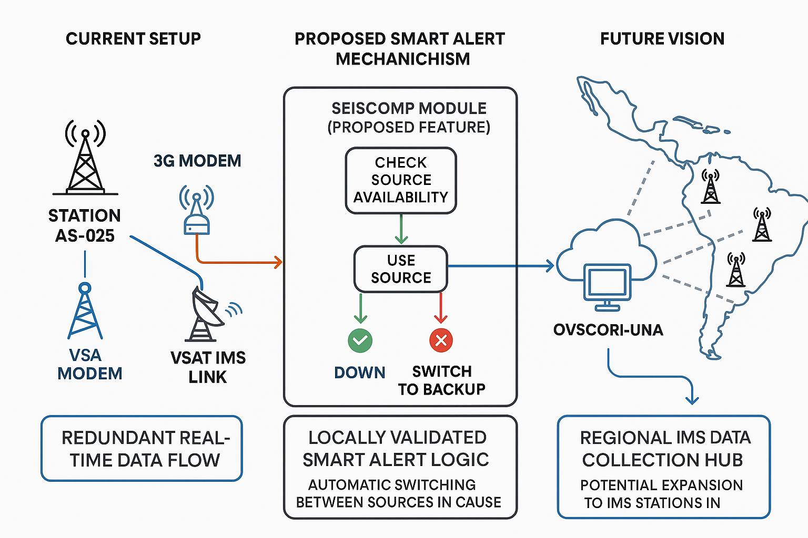

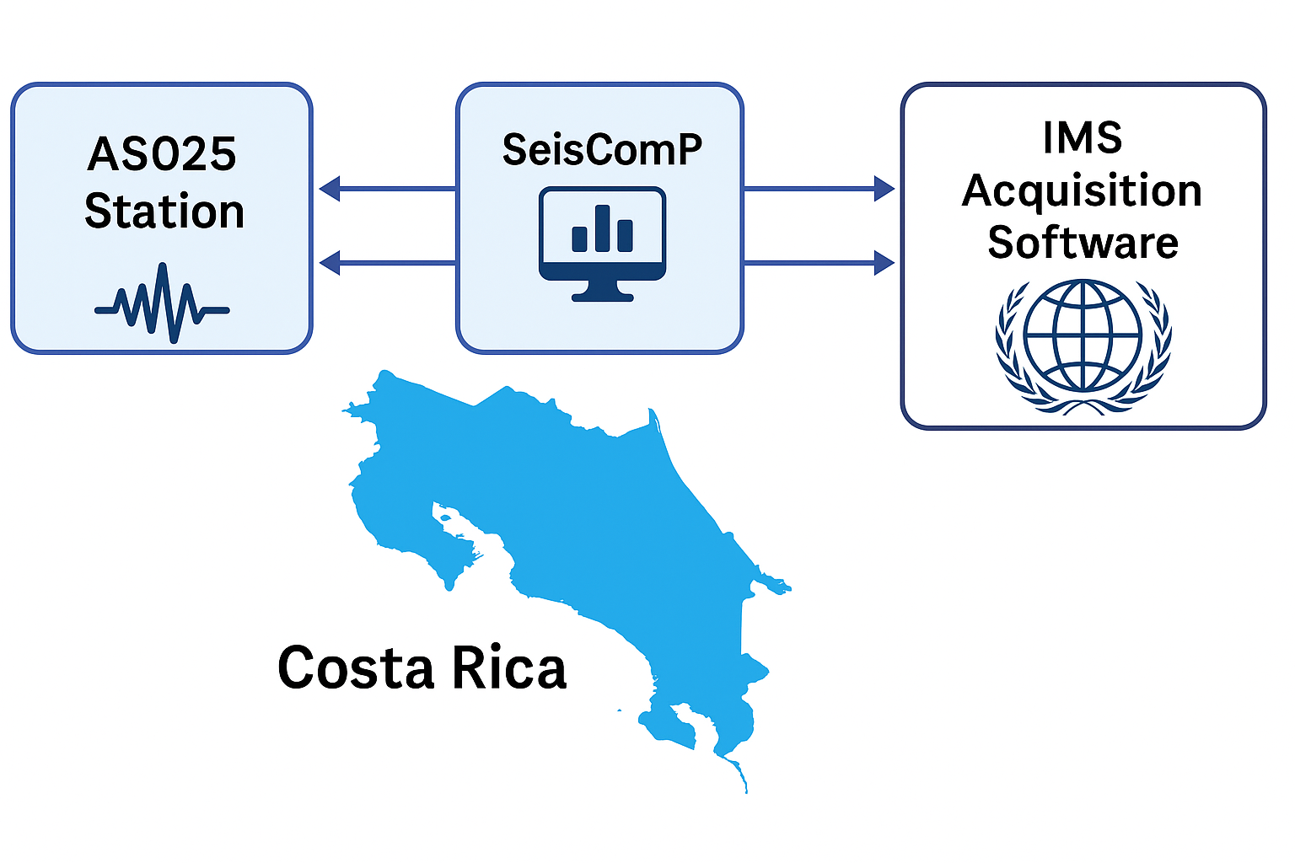
P4.2-107
A redundant communication setup has been successfully established at auxiliary station AS-025, effectively integrating two transmission channels (3G and IMS VSAT) into the SeisComP acquisition system. This configuration has been validated under real operational conditions.
A smart-switching functionality is currently under development to enable automatic selection of the active data source based on availability, enhancing the continuity of real-time data flow to the CTBTO.
These technical achievements strengthen the collaboration between OVSICORI-UNA and the CTBTO and lay the groundwork for future implementations within the IMS environment and potential regional contributions from Latin America.
NDC Costa Rica and GCI-Link for IDC data recovery
Master. Christian Garita Hidalgo
Introduction
Methods/Data
Results
In recent years, OVSICORI-UNA has made significant investments in communication infrastructure, data storage, and real-time seismic acquisition software. As a result, we now have a redundant communication link and real-time backup for the CTBTO Auxiliary Seismic Station AS025.
With the establishment of a GCI link at our NDC, we now have the capability to promote and support a new communication protocol that could serve as a redundant path for CTBTO’s data acquisition system.
Once this system is fully operational, OVSICORI-UNA could act as a regional hub for Latin America, receiving real-time seismic data from the region and forwarding it to the CTBTO as a backup data source.
Currently, station AS-025 has two independent communication links with OVSICORI-UNA: one via a 3G device and the other through the VSAT connection of the International Monitoring System (IMS). Both links are configured within our SeisComP data acquisition system.
We propose to develop a smart alert mechanism within SeisComP that enables or disables the active data source based on its availability. Once validated locally, this feature could potentially be implemented within the IMS acquisition software.
Given the strength of our IT infrastructure, a future stage of the project could involve providing data collection services for IMS seismic stations across Latin America.
Master. Christian Garita Hidalgo

