Slide 1


P4.2-199
Virtual GCI for NDC (VPN Docker)
Marius Popa
CTBTO
A new Docker-based VPN solution secures data delivery to NDCs via cloud infrastructures. Deployable in minutes on any Linux platform, it ensures strong security, automated monitoring, alerting, and disaster recovery. Compatible with any internet connection, it reduces setup from months to minutes, supports multiple NDCs, simplifies migration, and eliminates physical networking needs at low cost.
DISCLAIMER:
The views expressed on this e-poster are those of the author and do not necessarily reflect the view of the CTBTO

Slide 2
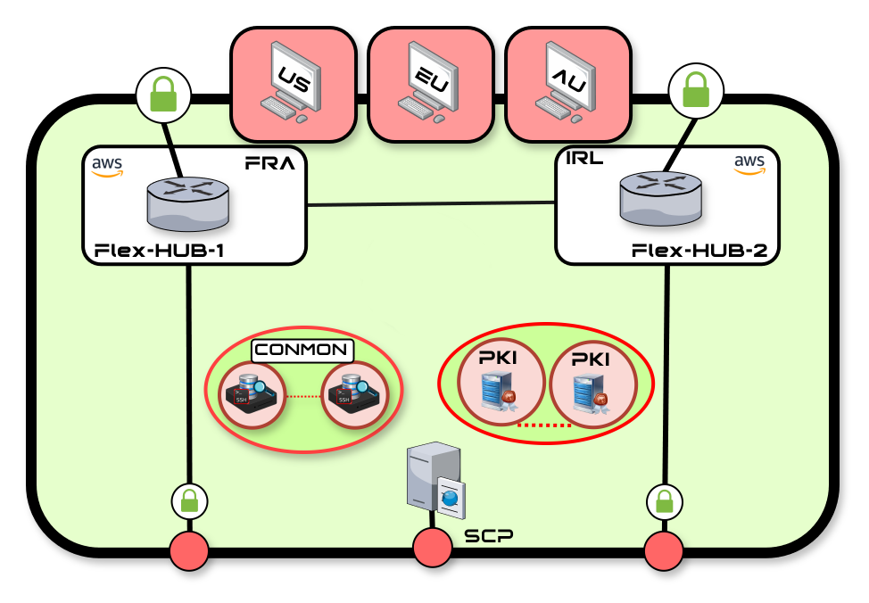
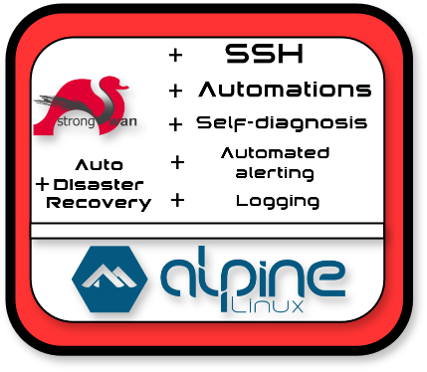
P4.2-199
Virtual GCI for NDC (VPN Docker)
Marius Popa
Traditional hardware-based network deployments and their challenges:
High Level technical project description
Traditional hardware-based network deployments present several challenges that limit agility and increase operational overhead. Hardware rollouts often require long lead times due to procurement, shipping, and physical installation. In addition, global embargo restrictions can delay or prevent access to specific commercial hardware or software, creating bottlenecks in NDC link deployments leaving member states for a prolonged period without the verification data.
From a logistical standpoint, deploying hardware is costly and resource-intensive: rack space, power, cooling, and even physical infrastructure such as dishes or antenna mounts must be planned and maintained. These dependencies add complexity and reduce flexibility, especially when the deployments are geographically scattered all over the world.
Hardware migrations or decommissioning activities involve a complex planning process and extra resources. They often cause downtime, require manual work, and raise error risks, slowing network evolution with industry needs. Finally, as cryptographic standards continue to evolve, hardware devices may require complete replacement in order to support stronger and more secure cryptographic algorithms.
The VPN Docker is a secure VPN ecosystem developed by the CTBTO GCI team.
It is built around two main components:
- Docker containers, deployed as software at the National Data Center (NDC), either on its own server or on one provided by CTBTO through NDC-for-alll.
- The CORE network, a redundant central VPN hub where the VPN Dockers interconnect to transmit data over an encrypted communication channel.
The VPN Docker containers are based on Alpine Linux, a lightweight distribution designed following the “security through simplicity” philosophy. Within this environment, a router-like ecosystem has been tailored for CTBTO’s requirements, including customized scripts that ensure the server hosting the VPN Docker remains continuously connected. For securing the data transfer, the system uses StrongSwan, an open-source solution that implements the modern and flexible IKEv2 protocol suite to establish robust and reliable VPN tunnels.
The CORE network is built based on Cisco 8000v VPN HUB routers deployed as software, supported by a set of Alpine Linux based servers operating in sync with each other over IKEv2 and SSH tunnels.
Its primary role is to serve as the central hub where all VPN Dockers connect.
From the VPN hubs, connectivity to the IDC is established through additional VPN tunnels.
DISCLAIMER
The views expressed on this e-poster are those of the author and do not necessarily reflect the view of the CTBTO

Slide 3
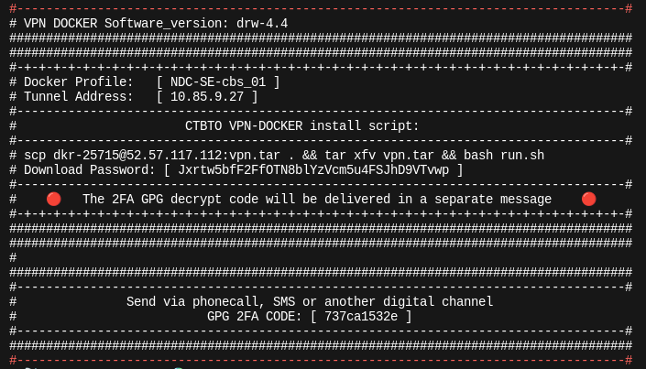
P4.2-199
Virtual GCI for NDC (VPN Docker)
Marius Popa
CORE Network server roles
VPN Docker features
- VPN HUB Routers
The design supports the addition of multiple VPN HUBs, enabling a globally distributed infrastructure that can significantly reduce data delivery delay.
- CON-MON Servers
A paired server setup that serves as the central point for monitoring VPN Dockers and connections. They also provide SSH access inside the dockers for upgrades and updates.
- PKI Servers
Responsible for generating and storing the cryptographic keys and certificates used to authenticate VPN Dockers.
- SCP Server
Hosts the prepared VPN Docker TAR images, making them available for download and installation.
- Jump Servers
Deployed across multiple continents to minimize the risk of a total network outage. Their functions include CORE monitoring, acting as a backup for the CORE network, and serving as an entry point to access the other CORE components. They play a vital role in the Disaster Recovery process.
At the time of the writing, the Jump Servers are located in North America, Europe and Australia.
A unique VPN Docker profile is automatically built or removed within the CORE network through the interaction of the Linux Core servers exchanging signals and data.
The process produces a TAR image stored on the SCP Server in a custom, ephemeral user profile.
The contents of the TAR file is GPG-encrypted, adding an extra layer of security.
The end-user will receive the VPN Docker in the following format:
This validated approach enables fully scripted, efficient deployments while minimizing the risk of human error.
- Supports highly complex VPN designs
- Certificate-based authentication with potential for Post-
Quantum Encryption
- One-minute deployment without requiring advanced
technical skills
- Compatible with any operating system
- Open-source, creating a trust boundary
- Works over any type of Internet connection
- Deployable without shipping hardware
- Supports multiple NDCs per country
- No imposed bandwidth limitations
- Centralized platform management
- Unique Disaster Recovery capability
- Simplified data path, reducing data delivery delays
- Modular and flexible, allowing new features and
functions to be developed
- Small footprint: ~50 MB (as of version 4.4)
- Advanced security features
- Easily upgradable
- Low resource usage
- Connects to the VPN infrastructure in 5 seconds
Using open-source software helps build a trust bridge between the CTBTO and the NDC user. The NDC user can access the Docker for software review purposes.
DISCLAIMER
The views expressed on this e-poster are those of the author and do not necessarily reflect the view of the CTBTO

Slide 4
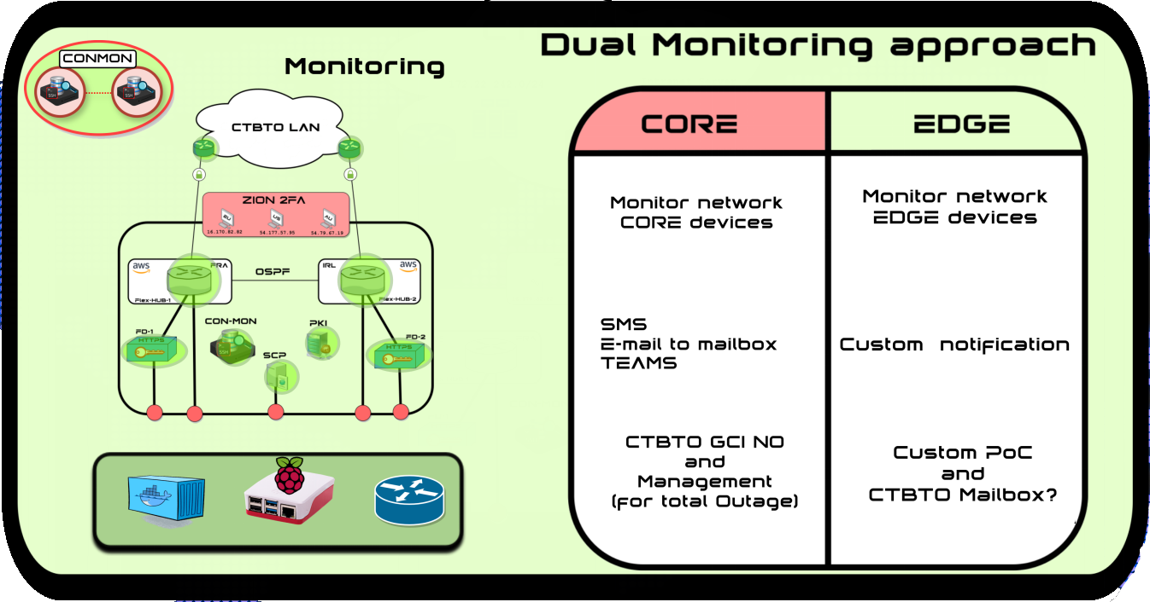
P4.2-199
Virtual GCI for NDC (VPN Docker)
Marius Popa
Security
System Monitoring
For enhanced security, a general rule of “no passwords whenever possible” will be enforced. Access to the CORE Servers and VPN Dockers will rely solely on ECDSA keys.
The VPN CORE Docker interacts with the Internet at several points:
- ZION Servers
Secured with strong encryption and 2FA. excessive login attempts will be blocked.
- VPN HUB Routers
Respond to IPSEC requests from any IP address. The IKEv2 cookie challenge helps with the prevention of potential Denial-of-Service attacks.
- SCP Server
Uses a randomly generated username and a long and complex password. User profiles are created with rssh shell, restricting login access solely to downloading the TAR file required for installation. The user account is ephemeral and automatically disabled once the CON-MON Server can reach the VPN Tunnel IP of the corresponding Docker, limiting exposure.
VPN Docker traffic will be strictly limited to receiving verification data from the IDC and will not be allowed to communicate with other VPN Dockers or the CORE infrastructure.
The dual monitoring approach provides separated automated platform alerts based on VPN link UP or DOWN events for the CORE and EDGE Network VPN Docker installations in NDC's.
It consists of 2 Monitoring types:
- CORE monitoring
Performed by the JUMP Servers, it will continuously monitor the CORE network and will send E-mail alerts in a scenario where one or multiple CORE components are unreachable.
The CORE Servers connect to the VPN HUBS through an isolated VPN restricting the access only to CORE server intercommunications.
In the event of a Jump Server outage, monitoring responsibilities are instantly transferred to the next closest server.
For optimal system availability, Jump Servers should be deployed globally, spanning different continents and cloud providers.
- EDGE monitoring
Operating in an active–standby setup, the CON-MON Servers continuously synchronize to maintain accurate system status.
The primary CON-MON server will monitor the tunnel IP addresses of VPN Dockers located in NDC's, triggering automatic email alerts issued when a Docker node goes offline.
For this purpose, it is advisable to include the NDC contact in the alerting process, as the failure is most likely caused by one of the following scenarios:
- NDC Internet outage
- NDC Power outage
- NDC Server failure
This hierarchical monitoring design, combined with a highly redundant Jump Server setup, ensures a robust system with minimal risk of unnoticed failure.
DISCLAIMER
The views expressed on this e-poster are those of the author and do not necessarily reflect the view of the CTBTO

Slide 5
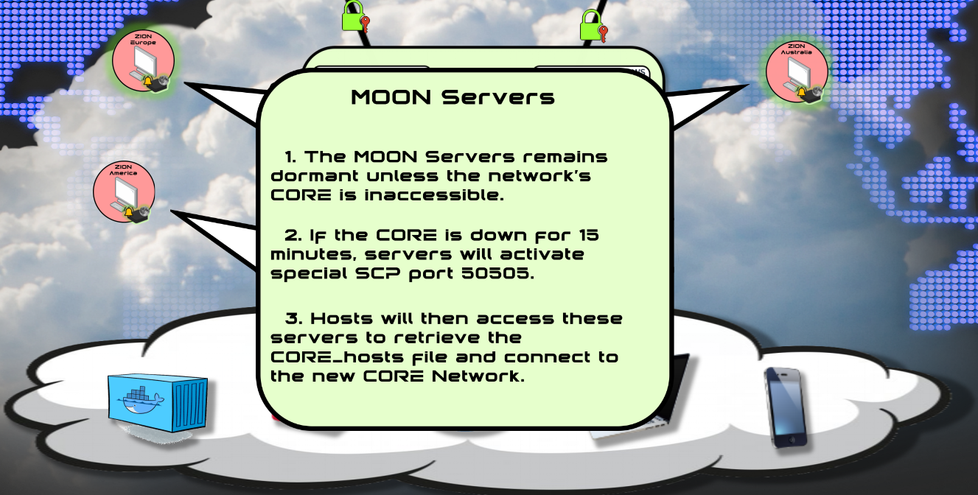
P4.2-199
Virtual GCI for NDC (VPN Docker)
Marius Popa
Disaster Recovery (DR) Procedure
Because TCP/IP was originally designed to maintain continuous data flow under large scale disruptions, it can automatically reroute traffic across the remaining available paths. This makes the Internet the ideal medium for data transport in Disaster Recovery scenarios.
This network architecture was designed to allow the entire system to be fully backed up and restored at any location worldwide, whether in a data center or cloud environment using a single USB stick and installation script. After restoration, VPN Dockers are expected to reconnect automatically to the CORE network, requiring NDC intervention only in exceptional circumstances.
One such scenario could involve an NDC with strict security policies, where UDP ports 500 and 4500, used by IPsec VPN protocols must be opened to ensure the connection to the newly established CORE network.
The Disaster Recovery process is automatically triggered from both the JUMP Servers and the VPN Dockers whenever the CORE Network VPN HUBS become unavailable, provided there is still an active Internet connection. Background scripts running on both the JUMP Servers and VPN Dockers continuously monitor network availability.
Step 1: Detection and Alert
If the CORE Network remains unreachable for 15 minutes, the JUMP Servers will trigger an e-mail alert.
Step 2: Secure Access Setup
All JUMP Servers will open TCP port 50505, dedicated to the SSH process. Each VPN Docker stores a universal ECDSA key that allows it to only retrieve the new system configuration file. Because TCP 50505 remains closed while the CORE Network is reachable, the exposure of this key poses minimal risk.
Step 3: Configuration Retrieval by VPN Dockers
VPN Dockers periodically retrieve the system configuration file from randomly selected JUMP Servers containing node IPs. If it matches the current setup, no action is taken, and a randomized sleep timer will prevent simultaneous SCP traffic spikes. This loop continues until a new configuration file is detected.
Step 4: CORE Network Restoration
Once an outage is confirmed, the CTBTO network engineer retrieves the stored configuration from the JUMP Server archives and, using a scripted procedure, the CORE Network is reconstructed.
Step 5: Distribution of Updated Configuration
The network engineer recreates the updated system configuration file and uploads it to a single JUMP Server. That JUMP Server then replicates the configuration file to all other JUMP Servers.
Step 6: VPN Dockers Update
VPN Dockers download the new system configuration file, apply the updates, restart the necessary processes, and reconnect to the restored VPN CORE.
Additional Notes for Highly Secured Environments
In environments with strict security policies, the NDC network engineer must ensure that UDP ports 500 and 4500 and the IP addresses of the new CORE are unblocked.
This information is presented as a login banner when the NDC engineer logs into the VPN Docker.
DISCLAIMER
The views expressed on this e-poster are those of the author and do not necessarily reflect the view of the CTBTO

Slide 6
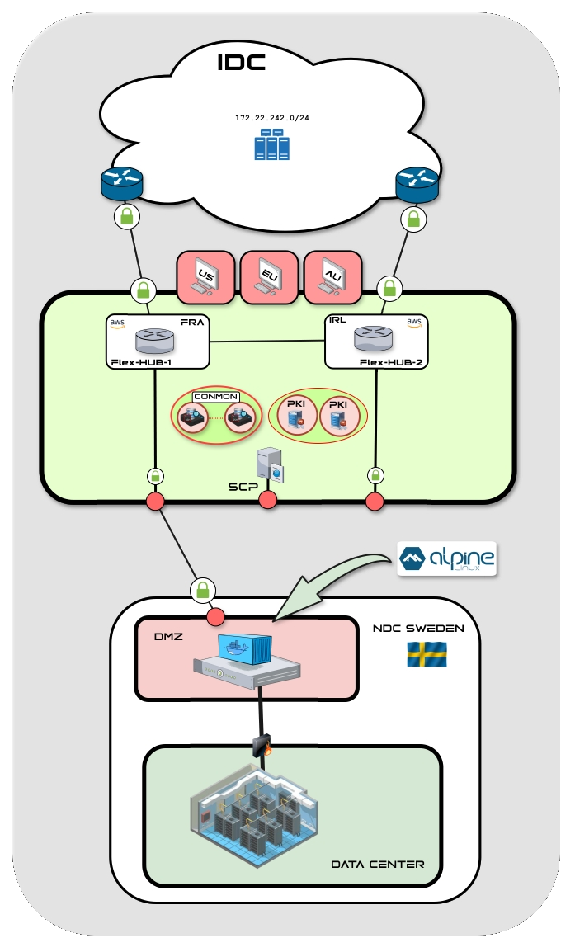
P4.2-199
Virtual GCI for NDC (VPN Docker)
Marius Popa
Recommended NDC Architecture
The ideal NDC deployment relies on a shared responsibility model, where all components work together to ensure the fastest possible response in restoring the continuous data transfer of the verification data. This design optimizes efficiency and minimizes downtime during disruptions.
Prerequisites for VPN Docker Operation:
- Power supply
- Internet access
- A host server
Outages are most likely to occur in one of these three areas, and local NDC staff are best positioned to provide immediate support. Compared to sending a network engineer to troubleshoot on site, local technical staff can restore connectivity much faster, reducing downtime significantly.
Leveraging an Internet Service Provider (ISP) ensures continuous data flow even under large-scale disruptions. TCP/IP’s ability to reroute traffic automatically makes the Internet the ideal medium for reaching the CORE VPN HUBS during a Disaster Recovery scenario, unlike dedicated circuits or satellite links that require on site intervention.
A good example is NDC Sweden, where the VPN Docker is deployed in the Data Center DMZ, restricting traffic to the Internet while controlling access to the secure internal areas of the Data Center.
The VPN link is established, and continuous data is forwarded securely via an SSH tunnel to the secure part of the NDC.
Leveraging multiple Internet Service Providers further enhances network resilience, ensuring faster and more reliable recovery without the need for intervention.
DISCLAIMER
The views expressed on this e-poster are those of the author and do not necessarily reflect the view of the CTBTO

