Slide 1

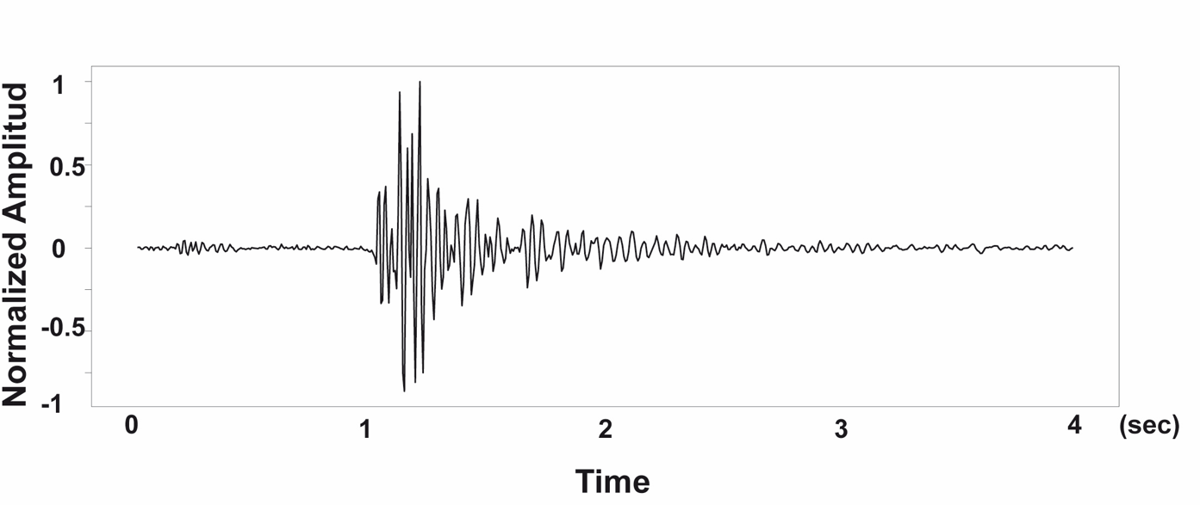

RELATION ABOUT LIGHTENING – ELECTRICITY AND MONITORING SYSTEMS
Author: Ing. Darío García Castillo, Msc.
Instituto Geofísico - Escuela Politécnica Nacional Quito - Ecuador
P4.2-446
My poster is about Lightening Electronic System Protection and the relation with seismic volcanic stations.
I am going to tell you why the design about system protection protects life and helps to discriminate the wave on a network systems alert.
I have analyzed the register waveform on seismometer to understand the lightening impacts on the ground.
The most important result of this project is to show you many designs for lightening protection with the IEC 62305, and by the other hand it is useful to establish a relation of storms and volcanic activity.
If you want to find out more, come over for a chat in front of my poster.
LIGHTNING STORM
DISCLAIMER: The presentation is only for illustration porpoise copyright IGEPN

