Slide 1


P4.2-446
RELATION ABOUT LIGHTENING – ELECTRICITY AND MONITORING SYSTEMS
Ing. Darío García Castillo, Msc.
Instituto Geofísico - Escuela Politécnica Nacional Quito - Ecuador
The project focusses to show how the systems protection against Lightning take importance trough the analysis of ground, “Wenner” electric method are used for describe the layers inside ground.
Another important aspect is the study of impact lightning recorder by the seismic station, that helps to classified the wave for a correct seismic-volcanic monitoring system.
DISCLAIMER: The presentation is only for illustration porpoise copyright IGEPN

Slide 2
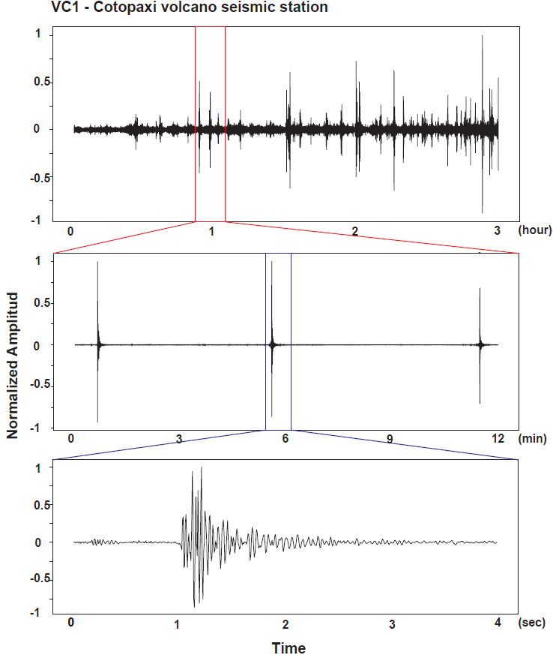
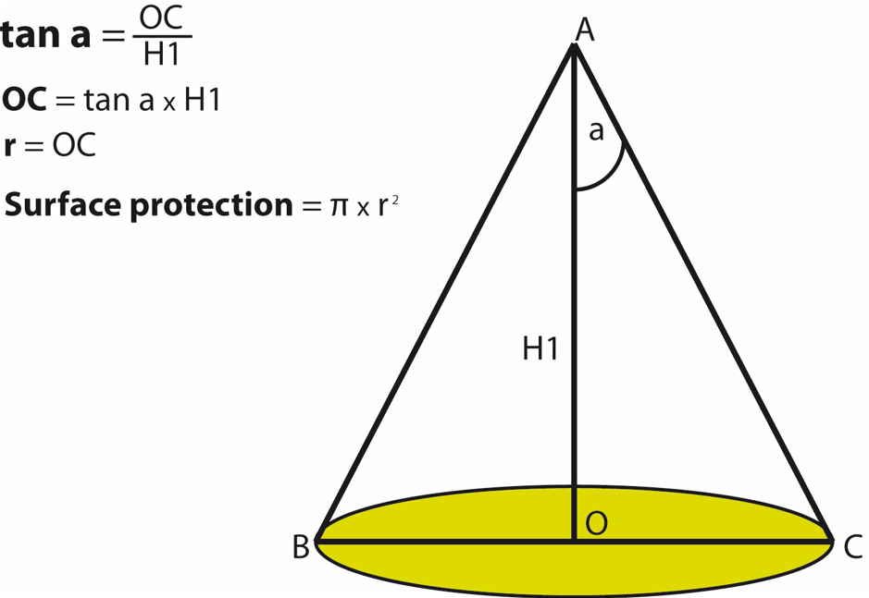
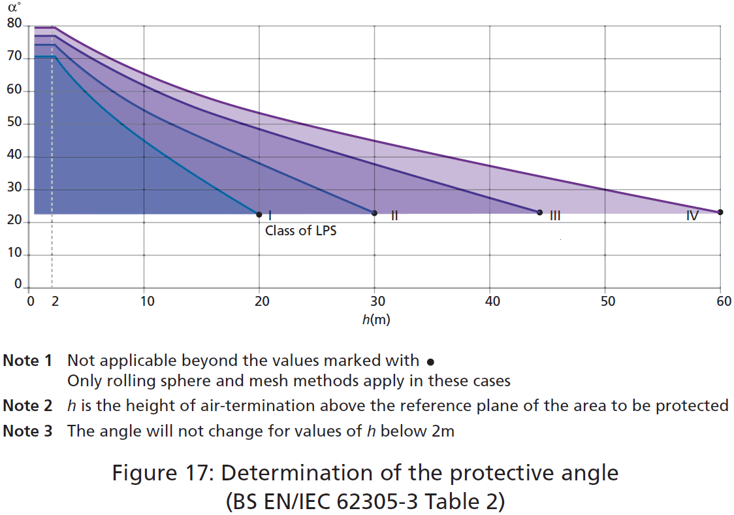
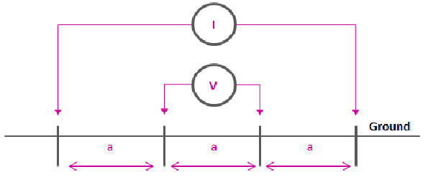
RELATION ABOUT LIGHTENING – ELECTRICITY AND MONITORING SYSTEMS
Author: D. García
P4.2-446
Introduction
Surface Protection and Grounding System
Lightning recorder on a volcanic seismic monitoring station
The project focusses on showing how the Lightening System Protection (LPS), take importance through the analysis of ground, “Wenner” is a method for describing the layers inside ground.
The LPS is important for protecting life and equipment, IEC (International Electrotechnical Commission) standard 62305 is used for designs. The standard classifies levels between risk analysis and damage, and categorizes the protection into four levels (Figure 1.)
Figure 1. Level Protection standard IEC 62305.
The LPS aims to intercept lightning strikes using a lightning-capture device, to conduct and dissipate lightning currents in the ground, and reduce step and touch potentials by insulating conductive surfaces and decreasing ground resistivity
To avoid such impacts, it is necessary to calculate the surface protection, through the determination of class and angle, which is shown in (figure 2).
Figure 2. Surface Protection standard IEC 62305
Proper grounding system design is crucial to ensure the effective lightning conduction.
To achieve this, the system must maintain the lowest possible resistance on the ground. The depth to install the grounding system can be determined with a tellurometer, using the Wenner method, as showed on (figure 3).
Figure 3. Wenner Method connection
Figure 4. Register storm Cotopaxi Volcano VC1 station. A. Cordova-IGEPN (Nov. 2024)
Another important aspect is the study of impact lightning recorder by the seismic station, that helps to classify the waveform for the seismic volcanic monitoring system
Level or Class
DISCLAIMER: The presentation is only for illustration porpoise copyright IGEPN

Slide 3
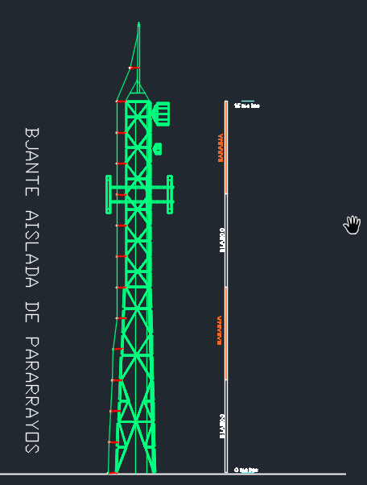
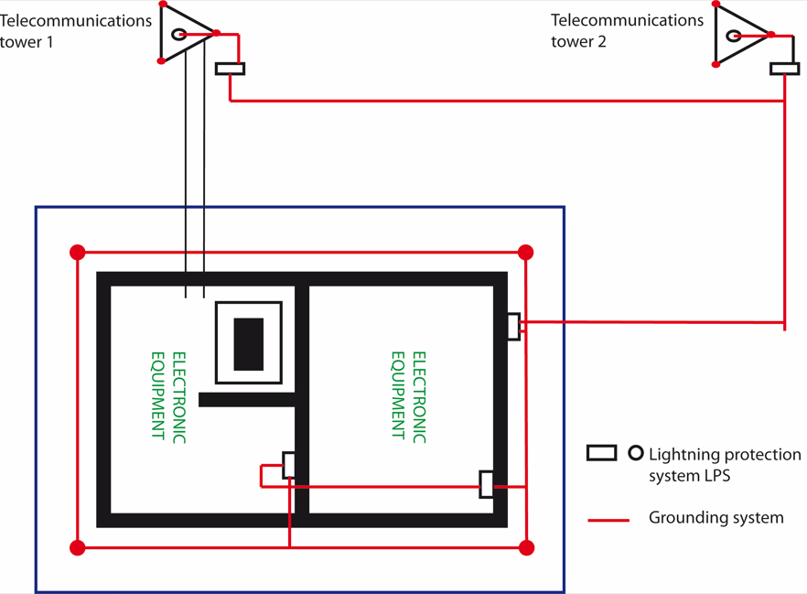
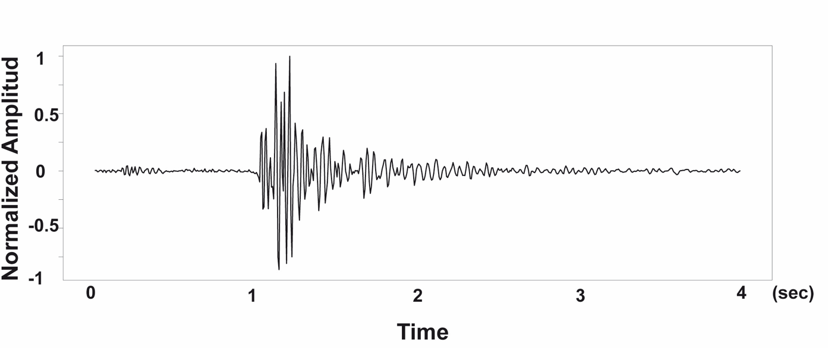
RELATION ABOUT LIGHTENING – ELECTRICITY AND MONITORING SYSTEMS
Author: D. García
P4.2-446
Summary
Results
Lightning signals (10–25 μs) can be distinguished from volcanic or tectonic events, and histogram classification further supports this separation, improving the reliability of seismic and volcanic monitoring.
Figure 6. Lightning impact recorder by seismic station
Reference
[1]Instituto Colombiano de normas técnicas, Protección contra descargas eléctricas atmosféricas. Colombia, 20008, p. 78.
[2]IEC - AENOR, Protecciones contra el rayo principios generales. Madrid España, 2010, p. 72.
[3]IEC-AENOR, Protecciones contra el rayo, daño físico a estructuras y riesgo humano. Madrid España, 2010, p. 152.
The project highlights the crucial role of Lightning Protection Systems (LPS) by characterizing the subsurface using the Wenner method to determine ground resistivity profiles.
LPS are essential for mitigating lightning-related risks, ensuring the protection of human life, structural assets, and sensitive equipment (electronic).
The IEC 62305 standard establishes the design methodology for LPS, integrating probabilistic risk and damage assessment.
This standard defines four distinct protection levels (I–IV), each corresponding to specific risk tolerances and structural vulnerability.
The primary function of the LPS is the interception of lightning strikes using air terminals or capture devices.
Lightning currents are safely transported to the ground through down conductors and dissipated into the ground using optimized grounding systems.
Step and touch voltages are minimized by engineering countermeasures such as surface insulation of conductive elements and improved soil resistivity.
Figure 5. Application of IEC 62305 on a telecom tower- Cotacachi-IGEPN.
The application of IEC 62305-based lightning protection systems (LPS) improved the safety and reliability of Ecuador’s geophysical monitoring stations by reducing equipment failures caused by lightning and ensuring the continuity of telecommunications connections.
These measures protect sensitive instrumentation and personnel, reinforce elevated telecommunications nodes, and improve the monitoring of Ecuador’s seismic and volcanic early-warning network.
The project shows a correlation between lightning strikes, storm activity, and seismic station records. By analyzing waveform timing.
Figure 4. Register storm Cotopaxi Volcano VC1 station. A. Cordova-IGEPN (Nov. 2024)
DISCLAIMER: The presentation is only for illustration porpoise copyright IGEPN

