Slide 1

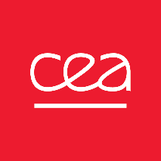
P4.2-323
Perspective for SPALAX-NG improvement
G. Couchaux, A. Der Mesrobian-Kabakian, P. Gross, S. Topin
CEA, DAM, DIF, F-91 297 Arpajon, France
In the context of the Comprehensive Nuclear Test Ban Treaty (CTBT), CEA/DAM developed the SPALAX-NG (Système de Prélèvement Automatique en Ligne avec l'Analyse du Xénon – New Generation) which was certified in 2021. From this date, it began to be introduced in the International Monitoring System to detect xenon releases following a nuclear explosion.
This system is still under continuous improvement. In particular, CEA/DAM continues to work on several aspects (detection, materials, heating components, etc.) in order to improve its working and technical robustness. This presentation aims to provide an overview of the different ways to improve SPALAX-NG technologies.

Slide 2
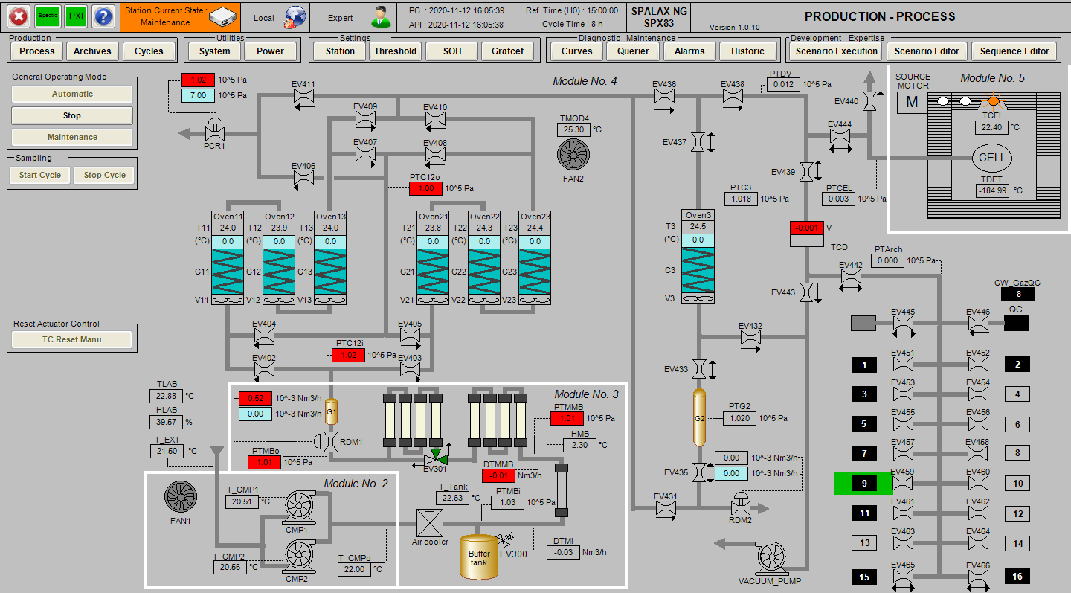
PLEASE DON‘T FORGET TO PUT THE E-POSTER TITLE AND YOUR NAME IN THE PRESENTATION HEADER.
DUPLICATE THIS SLIDE IF YOUR E-POSTER HAS MORE THAN 1 PAGE
P4.2-323
Perspective for SPALAX-NG improvement
G. Couchaux, A. Der Mesrobian-Kabakian, P. Gross, S. Topin
Context
Operating system
❶
Since the certification of SPALAX-NG in 2021, we have had to manage some changes, particularly those related to suppliers who have either changed or stopped the production of critical items used in the SPALAX-NG systems. The management of these changes has also provided an opportunity for continuous improvement of the system.
In this presentation, we have chosen to highlight 5 of the main improvements made to the system.
With the end of the sales of Windows 10 licenses, we had to ensure, test, and make some changes to ensure that the stations are compatible with the new operating system, Windows 11. These modifications not only ensure compatibility with the new operating system, but also bring general benefits such as improved performance and security.
The manufacturers have changed the power consumption reference for their new models, resulting in an increase compared to previous models. This necessitated some changes in energy management, in particular the adaptation of the variable speed drive. These modifications not only ensure compatibility with the new power consumption reference, but also bring general benefits such as improved energy efficiency and cost savings.
Previously, 8 nitrogen membranes (reference NM-C10A) were used. However, the supplier stopped the production of these membranes, which directly affects the production of future stations. We found a new reference from the same manufacturer that guarantees the same level of performance. We replaced the 8 previous membranes with 4 new membranes. The new membranes are more efficient and have a higher pressure loss, but we only need to use 4 of them instead of 8, resulting in a more cost-effective solution. These modifications not only ensure the continuity of the production but also bring general benefits such as improved efficiency and cost savings.
Compressors
❷
Nitrogen membranes
❸
❶
❸
❷

Slide 3
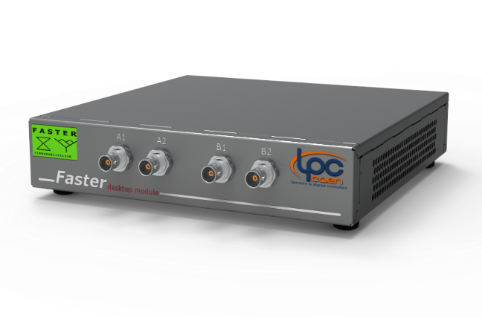
PLEASE DON‘T FORGET TO PUT THE E-POSTER TITLE AND YOUR NAME IN THE PRESENTATION HEADER.
DUPLICATE THIS SLIDE IF YOUR E-POSTER HAS MORE THAN 1 PAGE
P4.2-323
Perspective for SPALAX-NG improvement
G. Couchaux, A. Der Mesrobian Kabakian, P. Gross, S. Topin
Detection
❺
The Pixie 4 digitizer, used in previous SPALAX-NG stations, is no longer being supplied. As a result, we performed comparison tests on 4 other similar pieces of equipment: PixieNet and PixieNet-XL from XIA, Faster from LPC-Caen and V1725SB from CAEN and we identified the Faster digitizer as a good alternative to replace the Pixie 4 digitizer.
The Faster digitizer not only provides a solution to the production stop, but also brings better characteristics such as a better cut energy, which opens up new perspectives in terms of regions of interest (ROI). This example illustrates how a difficulty (production stop) can be turned into an opportunity for improvement.
In conclusion, the continuous improvement of the SPALAX-NG system is a crucial aspect of its development. The examples presented in this presentation illustrate how the team has turned challenges into opportunities for improvement, resulting in general benefits such as improved efficiency and cost savings. The identification of a new adsorbent for Xe concentration is also a promising development that could bring additional benefits.
❺
❹
Adsorbent
❹
The supplier has changed its reference of activated charcoal, necessitating the need to find and test another one to ensure the continued functioning of the system. This change also presents an opportunity to study and potentially find a better adsorbent for the concentration step of the process.
At this step of the process, the fraction of Xe is important and CEA/DAM continue its research of the most suitable adsorbent materials.
These modifications not only ensure the continuity of the system, but also bring the potential for improved efficiency and cost savings by finding a more suitable adsorbent for the concentration step.
Conclusion

