Slide 1

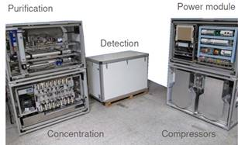

P4.2-323
Perspective for SPALAX-NG improvement
G. Couchaux, A. Der Mesrobian-Kabakian, P. Gross, S. Topin
CEA, DAM, DIF, F-91 297 Arpajon, France
This poster is about the continuous improvement of the SPALAX-NG system
Discover how we turned challenges into opportunities for progress!
We present 5 examples of modifications we made to the system, each with general benefits such as improved efficiency and cost savings
These adjustments made to the system answered to changes with providers and feedback, each with the goal of:
  maintaining the functioning,
  adapting items in case of change of characteristics,
  and continuing R&D to improve the robustness of the system.
If you want to find out more on how we have adapted and improved the system, come over for a chat in front of our poster!

