Slide 1


P4.1-152
Forest fires and IMS network: A case study of wildfire outbreak in Canada in the summer of 2023
Tatiana MEDINSKAYA; Dr. Sigitas MICKEVICIUS
International Data Centre, CTBTO Preparatory Commission, Vienna, Austria
The 2023 wildfire season was a record-breaking event in Canadian history: the total area burned exceeded 17 million hectares and was the largest recorded number in the last fifty years. The Northwest Territories were among the most affected by forest fires regions. Wildfires disrupted the operation of some IMS facilities deployed at this region and affected their data quality and availability.
DISCLAIMER The views expressed on this e-poster are those of the author and do not necessarily reflect the view of the CTBTO

Slide 2
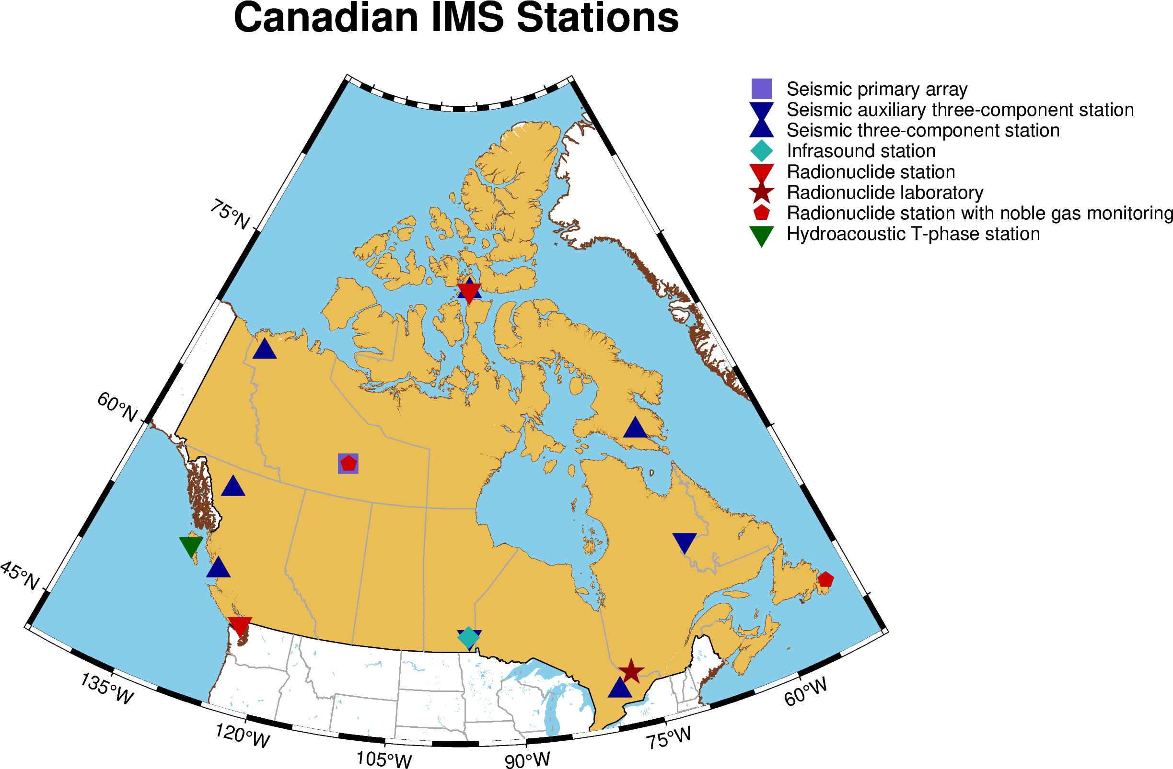
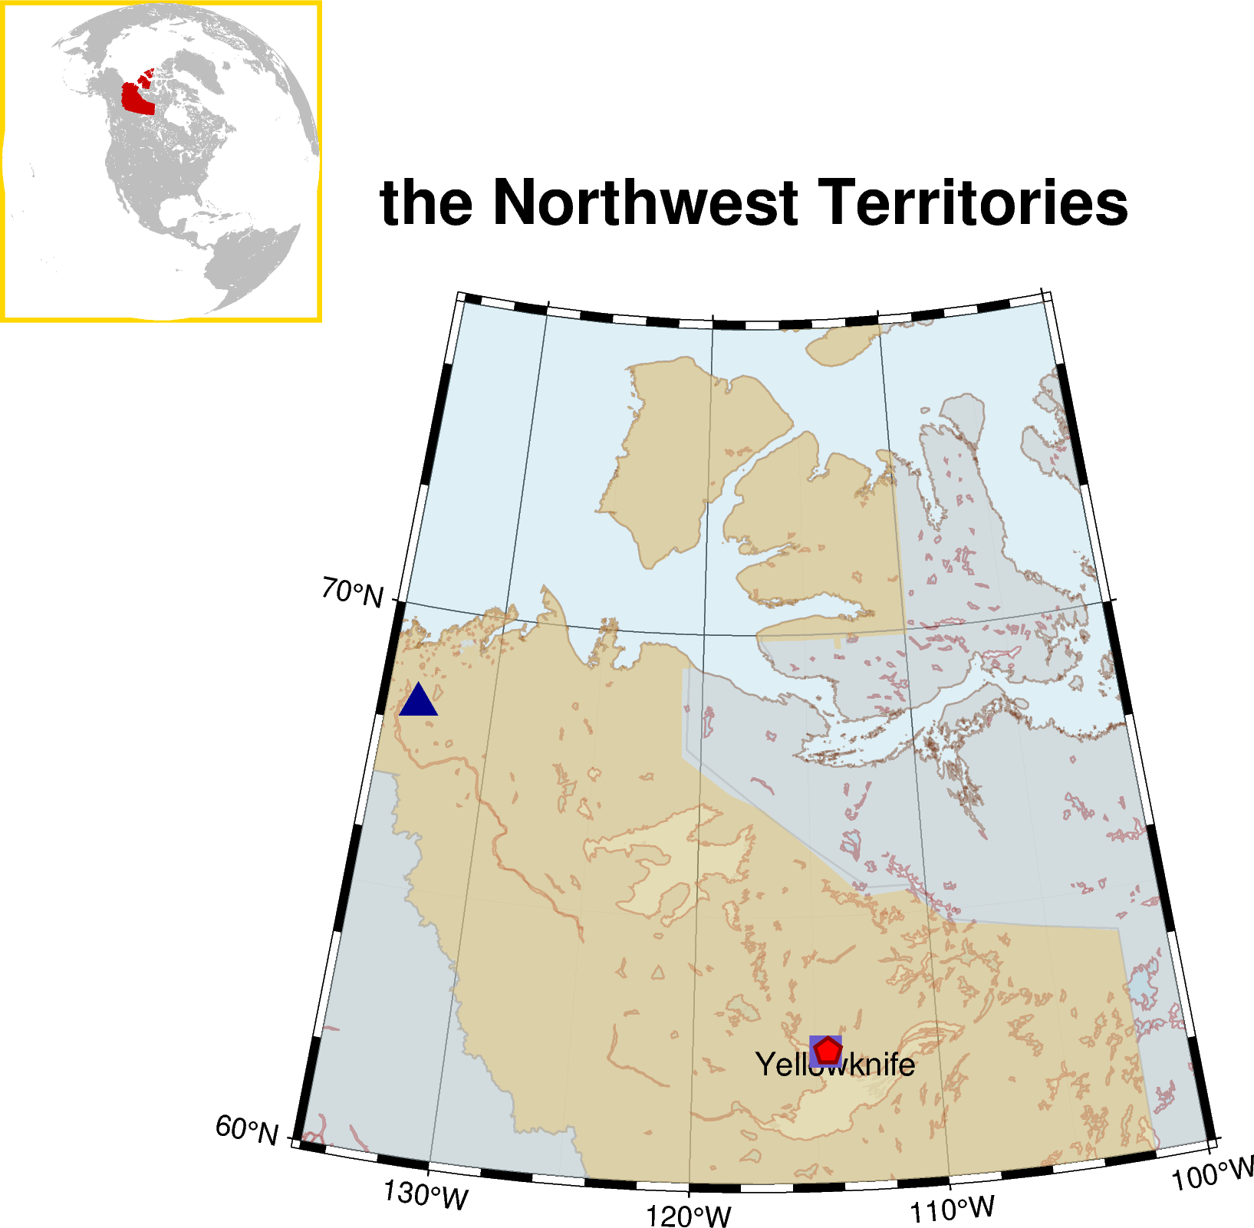

P4.1-152
Forest fires and IMS network: A case study of wildfire outbreak in Canada in the summer of 2023
IMS stations in Canada
Tatiana MEDINSKAYA; Dr.Sigitas MICKEVICIUS
Case study objectives:
Canadian segment of IMS facilities consists of 15 monitoring stations and one radionuclide laboratory RL5 in Ottawa.
It covers all verification technologies: seismic, infrasound, hydroacoustic, radionuclide.
explore operational capabilities of two IMS stations located in the Northwest Territories
examine how the wildfire season 2023 affected the performance of these stations
Case study region
The region is distinguished with its boreal forests and semi-arid subarctic climate. Temperatures ranging from lows of -50ºC to highs of +20ºC.

Slide 3
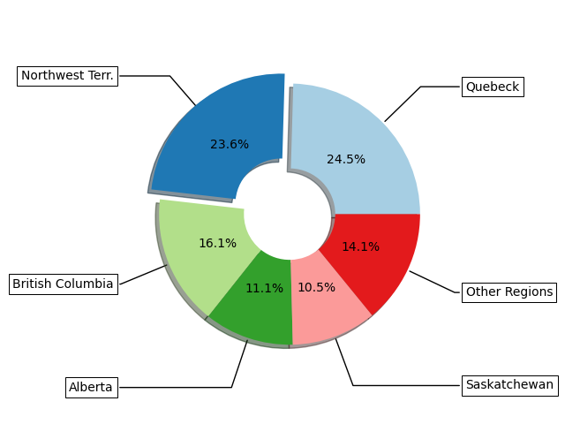
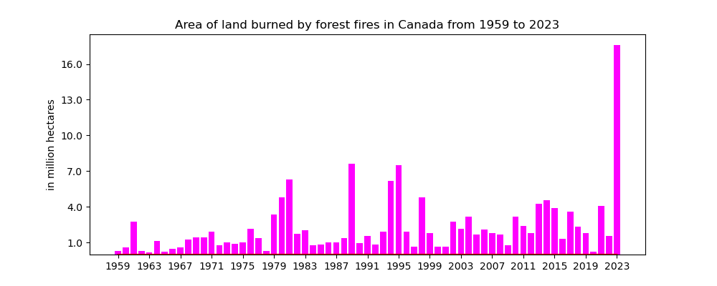
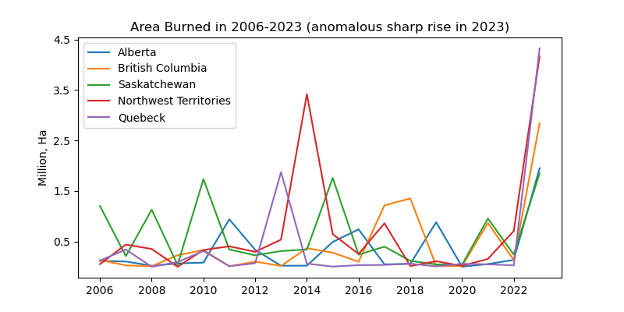
P4.1-152
Forest fires and IMS network: A case study of wildfire outbreak in Canada in the summer of 2023
Tatiana MEDINSKAYA; Dr. Sigitas MICKEVICIUS
Background information
The 2023 wildfire season was a record-breaking event in Canadian history - the total area burned exceeded 17 million hectares and was the largest recorded number in the last fifty years.
Extreme weather conditions: early snowmelt, hot weather and drought led to this unprecedented situation.
Four largest provinces by area registered their highest recorded annual area burned. Together with the Northwest Territories these regions showcased anomalous sharp rise of forest area burned and account for about 85% of annual area burned.

Slide 4
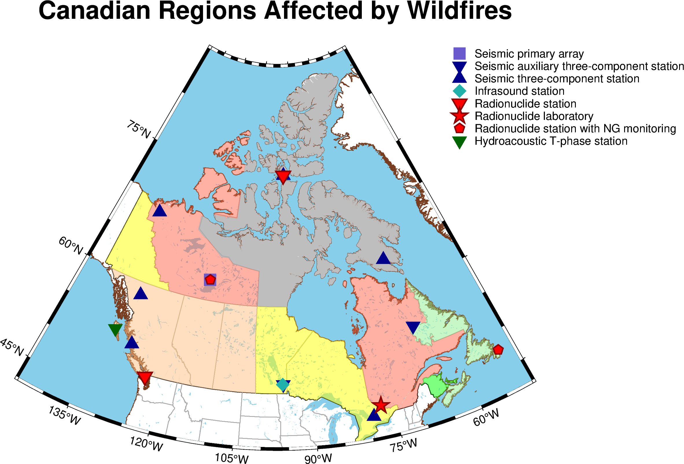
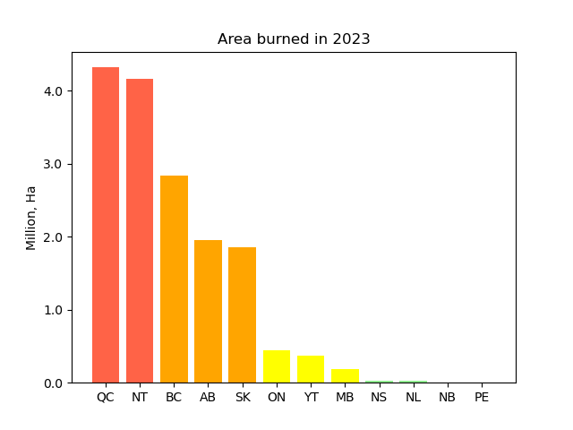
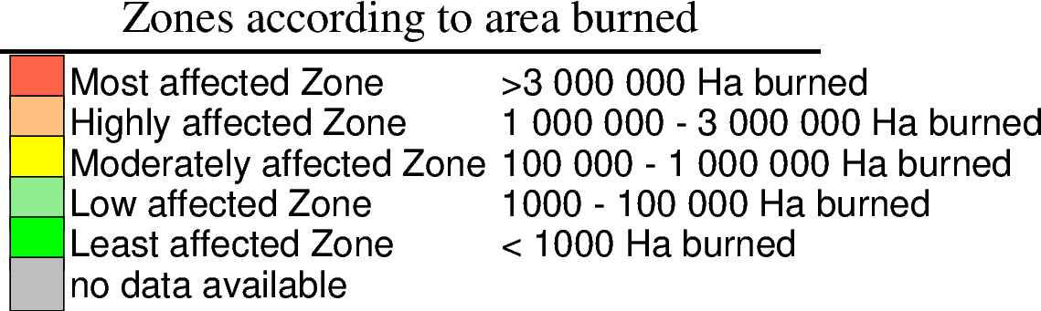
P4.1-152
Forest fires and IMS network: A case study of wildfire outbreak in Canada in the summer of 2023
Problem statement
Tatiana MEDINSKAYA; Dr. Sigitas MICKEVICIUS
The Northwest Territories regarded as the second most affected by wildfires region.
Case study region
Historical records show that the region has already experienced the outbreak of wildfires in 2014. That suggests that the impact of natural disasters and environmental challenges on stations’ infrastructure should be studied and considered during recapitalisation.
For our case study two IMS stations were selected: seismic array PS9 (YKA) and radionuclide station RN16. Both facilities are deployed in the same area and represent different verification technologies.

Slide 5
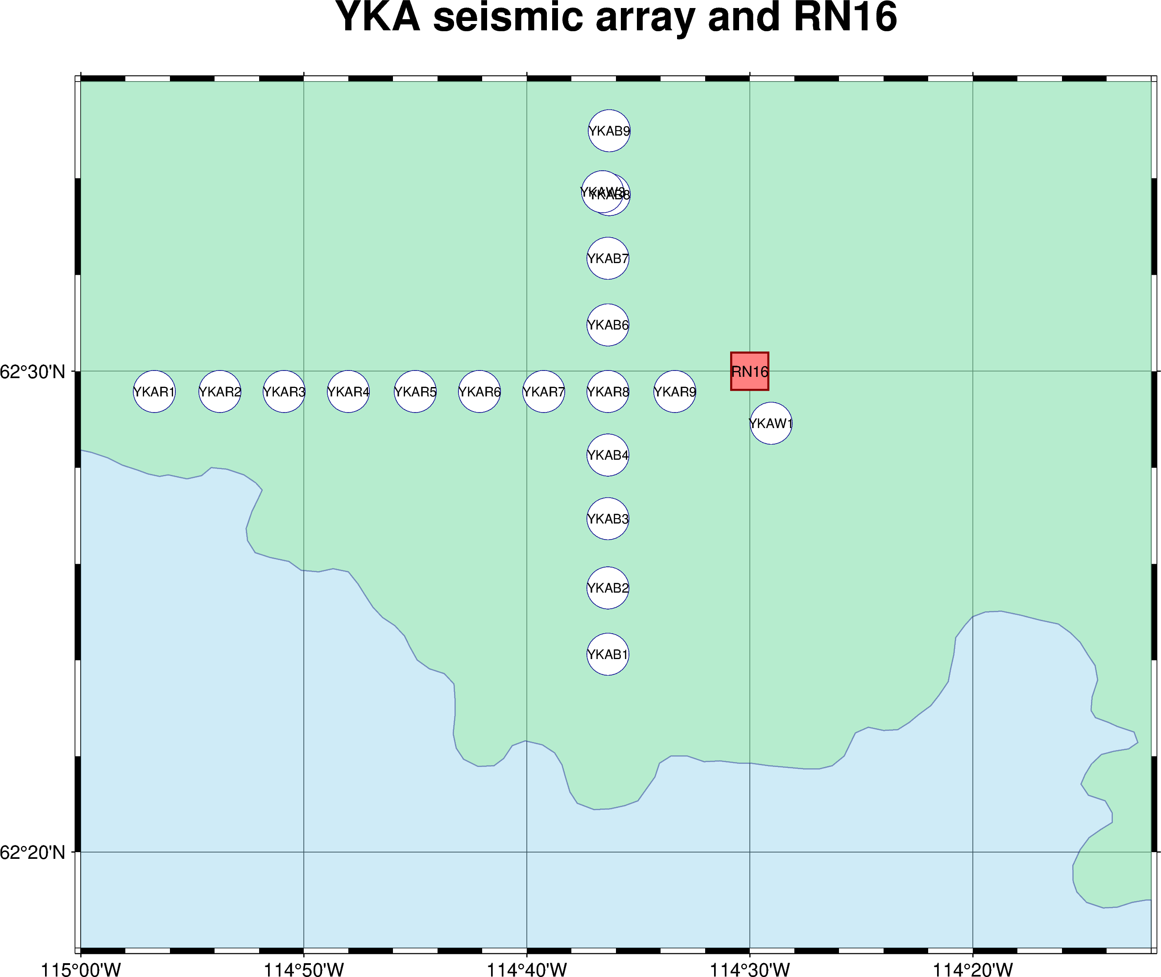
P4.1-152
Forest fires and IMS network: A case study of wildfire outbreak in Canada in the summer of 2023
Tatiana MEDINSKAYA; Dr. Sigitas MICKEVICIUS
Operational capabilities of selected IMS stations
Primary seismic array PS9 (YKA) in Yellowknife:
established in 1962
certified in 2000.
modernized in 2014
consists of 18 short period and 2 broadband elements
operated by the Geological Survey of Canada.
Key points of modernization:
Installation of new seismometers Geotech S-13 for short period elements and Guralp CMG3T for broadband ones
Installation of new vaults.
Access to the station: in summer it is sometimes possible only by helicopter and in winter only with four-wheel drive, all-terrain vehicles or snow-mobiles.
Array components are arranged in the form of a cross, with a distance of 2,5 km between individual short period stations. The North-South line for YKAB1-YKAB9 and the East-West line for YKAR1-YKAR9 elements. The two 25 km long lines intersect each other. The broadband station YKW3 located at the north side of the array.
Radionuclide station RN16 is operated by Canada’s Radiation Protection Bureau. RN16 consists of two types of system: CAP16 particulate 3M manual station and CAX16 noble gas station equipped with the SPALAX system capable to detect and measure Xe isotopes in the atmosphere.

Slide 6
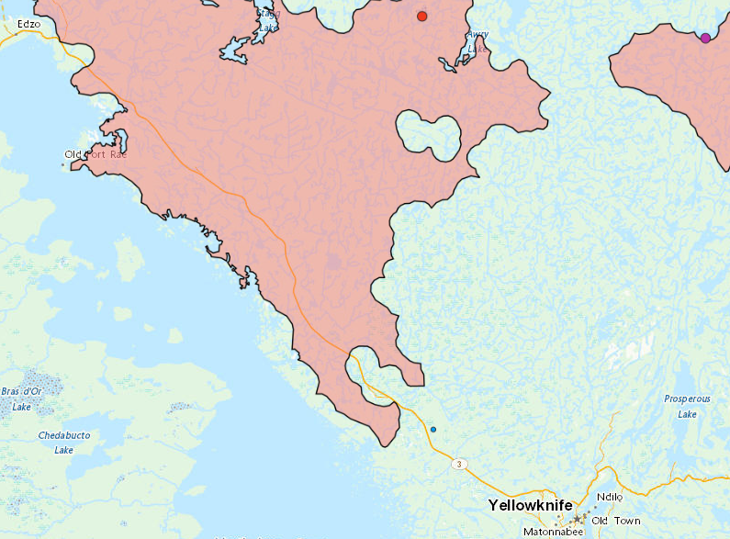
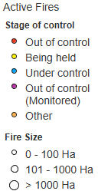
P4.1-152
Forest fires and IMS network: A case study of wildfire outbreak in Canada in the summer of 2023
IMS facilities during evacuation period
Tatiana MEDINSKAYA; Dr. Sigitas MICKEVICIUS
The extreme forest fire situation around Yellowknife affected personnel working at the IMS facilities in the area. On August 16, a Territorial State of Emergency was declared for the entire region, and the entire city Yellowknife was evacuated due to safety and orders from the Government. Between August 16 and 18, approximately 20.000 residents left the city. The local team remained on site until August 18, moving critical RN16 equipment and spares to a safe location.
The most danger came from wildfire ZF015-23, first detected approximately 60 kilometers northwest of Yellowknife. It spread southward, threatening value assets south of the wildfire perimeter.
ZF015-23 Wildfire and its assessed perimeter on 26.08.2023
ZF015-23 wildfire released heavy smoke and approached the YKA seismic array from the northwest.
ZF015-23 was considered contained on September 13, 2023. The wildfire’s size is assessed at 170,785 hectares, representing 4% of the area burned in the Northwest Territories.

Slide 7

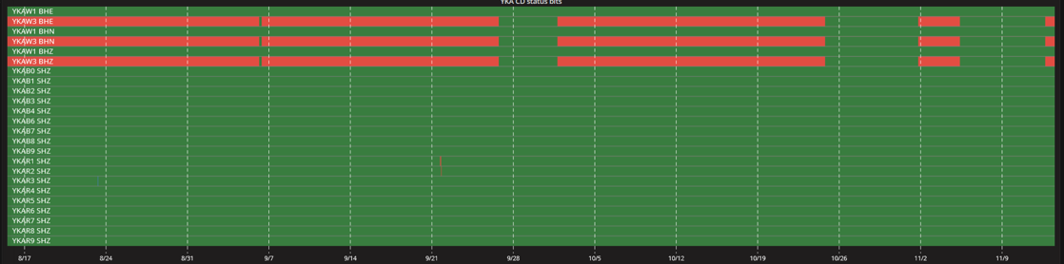
P4.1-152
Forest fires and IMS network: A case study of wildfire outbreak in Canada in the summer of 2023
Situation at the YKA (PS9) during wildfire
Tatiana MEDINSKAYA; Dr. Sigitas MICKEVICIUS
Overall, the wildfire situation around the seismic array YKA did not affect its operational capabilities and data availability. However, some elements were still under impact of the fire approaching to western-most side. The YKW3 broadband element located at the northern part also experienced issues with its vault, which was fitted with the tamper switch required by the IMS.
But vault door alarm at YKAW3 reappeared on 01.10.2023 – 24.10.2023,
01.11.2023 – 05.11.2023,
and then again on 12.11.2023
Starting from 12.08.2023 YKW3 flagged vault open. The vault door alarm at YKAW3 cleared on 26.09.2023..

Slide 8
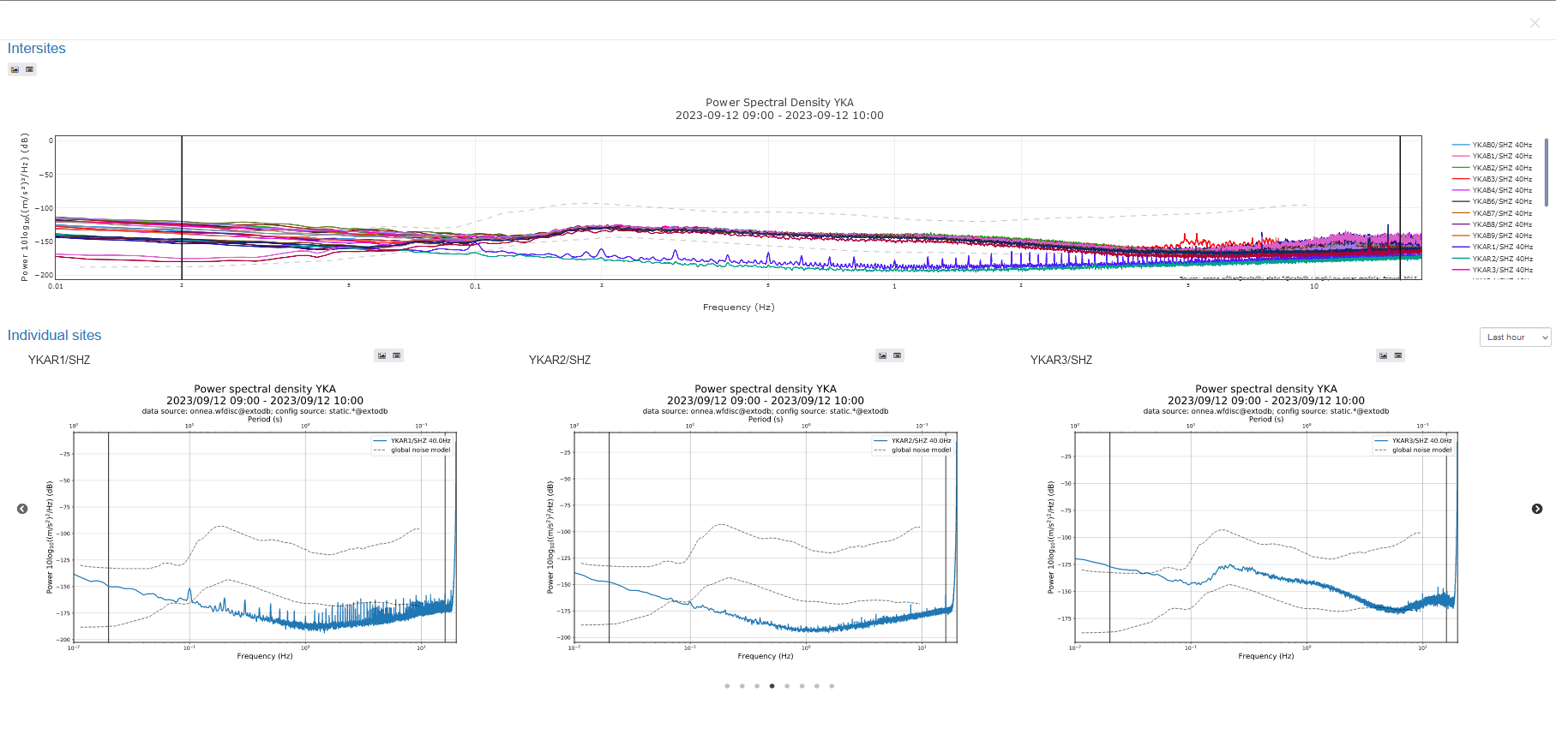
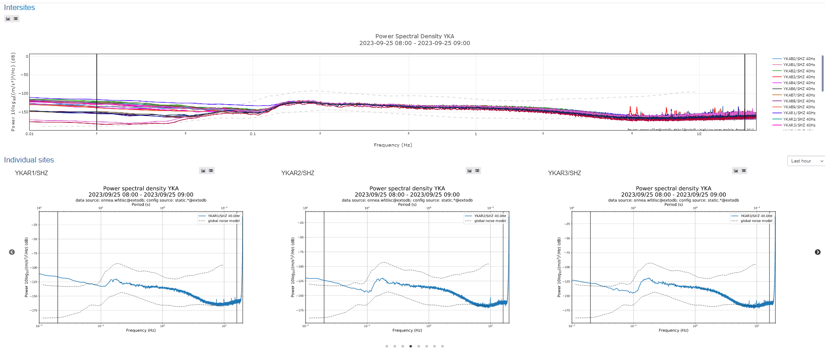
P4.1-152
Forest fires and IMS network: A case study of wildfire outbreak in Canada in the summer of 2023
Tatiana MEDINSKAYA; Dr. Sigitas MICKEVICIUS
Situation at the YKA (PS9) during wildfire (cont.)
Another fragile element of the array - cables linking the instruments in the vault to the digitizer.
Starting 12th of August YKAR1, YKAR2 data quality (the western-most short period elements of the array) was affected by fire. It was suspected that extreme heat could have melted the rubber insulation inside the cables armored with a metal protective outer layer.
Data quality issues cleared after Yellowknife field operations team was able to visit sites YKAR1 and YKAR2 on Sept 21 2023 and replace the cables and tamper switches that had been affected. After cable replacement data quality was improved and the sites were calibrated.

Slide 9
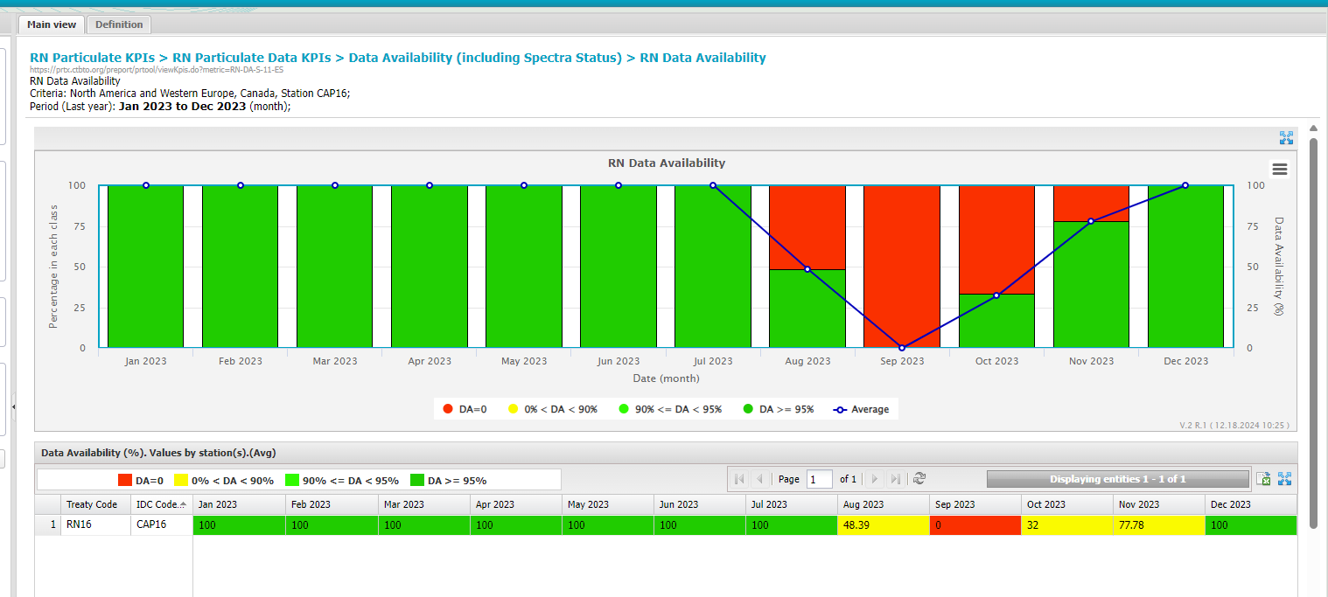
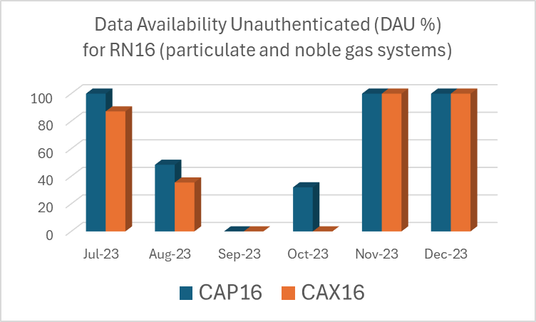
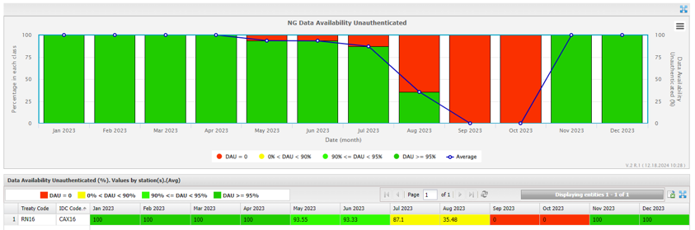
P4.1-152
Forest fires and IMS network: A case study of wildfire outbreak in Canada in the summer of 2023
Situation at the RN16 during wildfire
Tatiana MEDINSKAYA; Dr. Sigitas MICKEVICIUS
As wildfires approached the sampling station, sever air quality caused by smoke led to fault of the VFD (SnowWhite aerosol sampler) on 16.08.2023. On August 18,.2023 an evacuation order was issued in the city Yellowknife, resulting in the total shutdown of the RN16 to prevent any further damage to key equipment.
.
The station was restored (mostly) to full operation in the period 15 -21 October 2023. Cause diagnostic could only be organized after necessary specialists returned from the evacuation and was completed only on 17.11.2023
RN16 particulate system
RN16 noble gas system

Slide 10
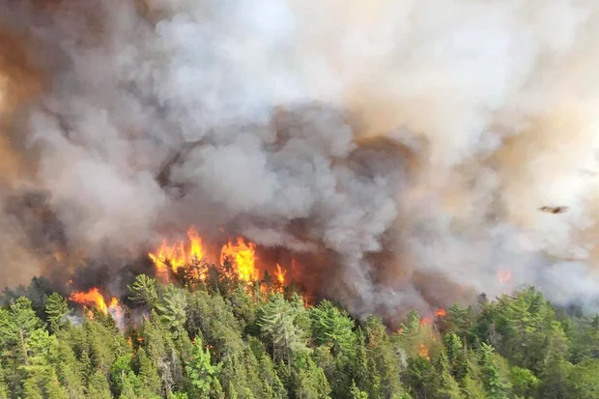
P4.1-152
Forest fires and IMS network: A case study of wildfire outbreak in Canada in the summer of 2023
Possible solutions for station damage prevention:
Wildfire season 2023 in Canada affected an uncommonly large area and showcased coast-to-coast activity. The Northwest Territories with its boreal forests were among the most affected by forest fires regions. The operation of some IMS network facilities deployed at this region was disrupted: the radionuclide station RN16 was shut down and re-installed after two months.
The main result of our work is the classification of possible impacts of forest fires on an IMS station and proposed solutions to prevent station damage.
Impact | Solution for radionuclide stations
Health issues | Installation of an indoor air filtration systems to withstand extreme conditions outside. These systems create positive air pressure (overpressure) within a shelter, ensuring that toxic air cannot enter without passing through a multi-stage filtration process. Such technical means enable to protect local staff and valuable equipment from forest fires until they will be evacuated to an off-site location.
Fault of air sampler | Use of semi-permeable filters. Semi-permeable filters are designed to allow certain particles to pass through and block others based on their size, charge, or chemical properties. They differ from HEPA filters, which are based on the physical size exclusion. The IMS particulate stations use HEPA filters, such as BM5379-20F type. The ability to customize semi-permeable filters can be a promising solution for separating radioactive aerosols from soot and ash.
.
direct
  Loss of property
  Infrastructure damage
Wildfire Impacts on
an IMS facility
indirect
  Health issues caused by smoke exposure (ash, carbon monoxide, ozone, nitrogen dioxide and sulfur dioxide can be harmful to local operators.
  Shortage of personnel capable to operate and maintain a station, repair it and maintain diagnostic tests due to local evacuations.
  Air quality deterioration (ash and particulates can cause the filter clogging and air sampler to fault)
  Drop of data availability caused by an IMS station shutdown
Impact | Solution for seismic stations
Damage to instruments | Installation of vaults that ensure sufficient thermal stability of the environment inside
 | Use of heat-resistant cables specially developed for extreme temperatures.
For radionuclide stations..
Installation of an indoor air filtration systems to withstand extreme conditions outside. These systems create positive air pressure (overpressure) within a shelter, ensuring that toxic air cannot enter without passing through a multi-stage filtration process. Such technical means enable to protect local staff and valuable equipment from forest fires until they will be evacuated to an off-site location.
Use of semi-permeable filters. Semi-permeable filters are designed to allow certain particles to pass through and block others based on their size, charge, or chemical properties. They differ from HEPA filters, which are based on the physical size exclusion. The IMS particulate stations use HEPA filters, such as BM5379-20F type. The ability to customize semi-permeable filters can be a promising solution for separating radioactive aerosols from soot and ash in the air.
For seismic stations.
Installation of vaults, which ensure sufficient thermal stability of the environment inside.

Slide 11
Forest fires and IMS network: A case study of wildfire outbreak in Canada in the summer of 2023
THANK YOU!

