Slide 1


P4.1-872
Radionuclide IMS Network QA/QC programme
Marina NIZAMSKA, Martina ROZMARIC, Rodrigo VILLARREAL, Felix PINO
CTBTO Vienna International Centre, P.O. Box 1200, 1400 Vienna Austria
An additional element of the radionuclide (RN) stations’ quality assurance (QA) programme is the verification of station performance through the independent measurements and analysis of network quality control (QC) samples. These samples are sent from the International Monitoring System (IMS) RN stations to certified radionuclide laboratories (RLs). The objective of this Network QA/QC Programme is to assess station performance and ensure the reliability of sample handling and shipment procedures at the stations. The evaluation is based on ⁷Be metrics, as this nuclide is consistently present in adequate concentrations in station samples. A global overview of the Network QA/QC results and Level 5 statistics for 2023 and 2024 is presented. The presentation provide the verified metrics used by PTS. Overall, the 2023–2024 data demonstrate that the IDC and RLs results for Network QA/QC and Level 5 samples are in good agreement, confirming the reliability and effectiveness of the ⁷Be-based metrics.
DISCLAIMER: The views expressed on this e-poster are those of the author(s) and do not necessarily reflect the view of the CTBTO..

Slide 2
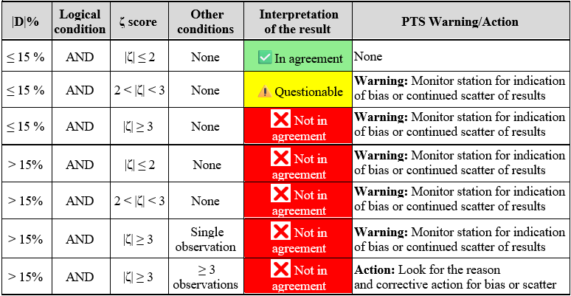
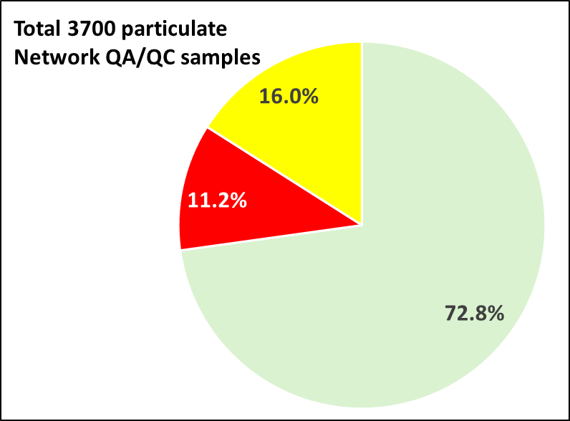
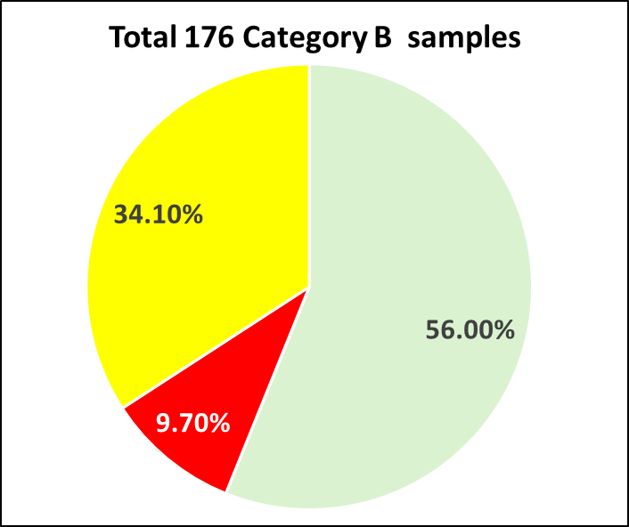
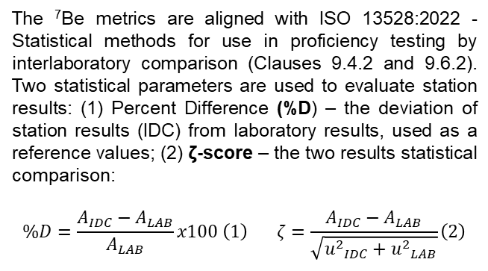
PLEASE DON‘T FORGET TO PUT THE E-POSTER TITLE AND YOUR NAME IN THE PRESENTATION HEADER.
DUPLICATE THIS SLIDE IF YOUR E-POSTER HAS MORE THAN 1 PAGE
Radionuclide IMS Network QA/QC programme
Marina NIZAMSKA, Martina ROZMARIC, Rodrigo VILLARREAL, Felix PINO
P4.1-872
Introduction
Laboratory and sample selection criteria
The table below summarizes the Network QA/QC metrics, their interpretation, and the corresponding PTS
warnings and recommended actions.
The PTS operates the Network QA/QC programme on a periodic and ongoing basis. Network QA/QC particulate samples are randomly selected from station samples that have been reviewed and categorized as Level 1–4 (Category A) or Level 5 (Category B) for reanalysis, in order to verify system calibrations. Typically, one sample per quarter from each certified station (73 IMS stations) is sent to one certified radionuclide laboratory (14 RLs). All selected Network QC samples meet the minimum requirements specified for IMS radionuclide stations. Level 5 samples are considered as high-priority, as they are related to the verification regime. At the station, each Level 5 sample is split into two parts: the first half of the samples is sent to the geographically closest laboratory, while the second to a randomly selected one.
In general, the selection is randomized.
Some RLs may be excluded due to:
• being not operational or not available;
• Proficiency Test Exercise (PTE) failure;
• deselection rules (the State Party hosting the station is allowed to deselect not more than 25% of the certified laboratories to which the sample may be sent).
Sample selection is randomized from the list of last 20 samples for which the spectrum has been released by the IDC. A category priority is given to samples with detected anthropogenic radionuclides (Level 3 and Level 4 samples).
Verification of the metrics
The above-described metrics were verified using the received RLs reports (RLRs) for the analysed station samples. A total of 3 876 reports received until 28 July 2025 were analysed: 3 700 ⁷Be results for Network QA/QC Category A and 176 for Category B samples. A summary of the analysis based on the dual criteria (%D and ζ-score) is presented in the following figures:
Result comparison metrics
Samples category
The ⁷Be metrics are aligned with ISO 13528:2022 - Statistical methods for use in proficiency testing by interlaboratory comparison (Clauses 9.4.2 and 9.6.2). Two statistical parameters are used to evaluate station results: (1) Percent Difference (%D) – the deviation of station results (IDC) from laboratory results, used as a reference values; (2) ζ-score – the two results statistical comparison:
$$\%D=\frac{A_{IDC}−A_{LAB}}{A_{LAB}}x100 \left(1\right) ζ=\frac{A_{IDC}−A_{LAB}}{\sqrt{{u^{2}}_{IDC}+{u^{2}}_{LAB}}}\left(2\right)$$
The presentation is focused of the following two types samples category send for analysis at a RLs:
Category A: Network QC samples: routine samples regularly sent from IMS radionuclide particulate stations to assess the performance of the RN network (Level 1 to Level 4).
Category B: High priority samples: samples categorized as Level 5 within the International Data Centre (IDC) event categorization and screening process, or routine samples from stations exercised as high priority samples to maintain preparedness and necessary procedures.

Slide 3
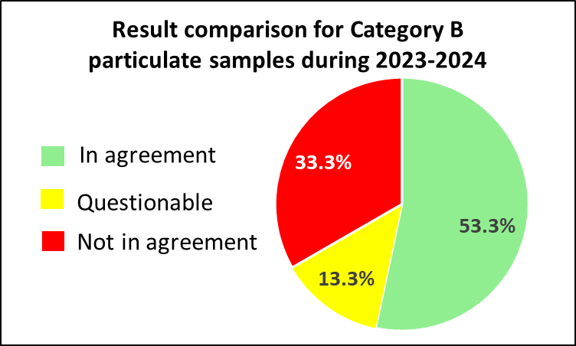
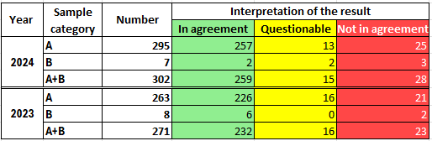



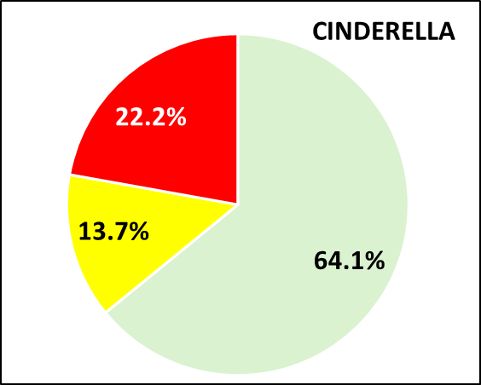
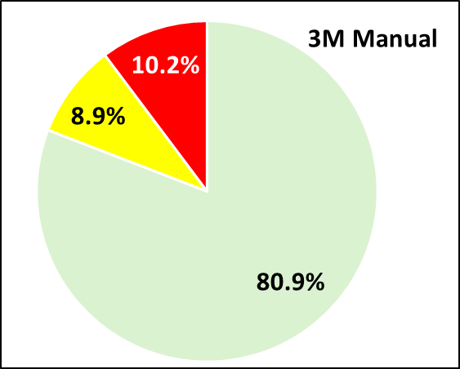
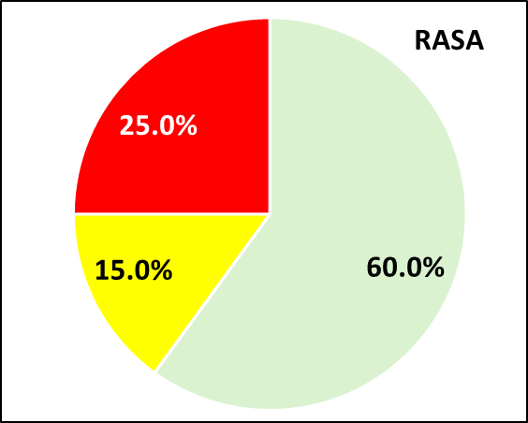
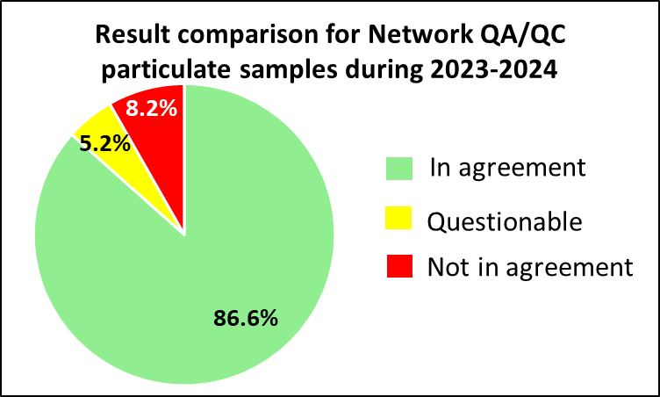
PLEASE DON‘T FORGET TO PUT THE E-POSTER TITLE AND YOUR NAME IN THE PRESENTATION HEADER.
DUPLICATE THIS SLIDE IF YOUR E-POSTER HAS MORE THAN 1 PAGE
Radionuclide IMS Network QA/QC programme
P4.1-872
Marina NIZAMSKA, Martina ROZMARIC, Rodrigo VILLARREAL, Felix PINO
The verification of metrics for Category A samples showed that 72.8% of results were in agreement with the laboratory analyses, 11.2% were classified as questionable, and 16.0% were not in agreement. For Category B samples, 56.3% of results were in agreement, 34.1% were classified as questionable, and 9.7% were not in agreement. These results indicate that while the majority of stations demonstrate satisfactory performance, a notable proportion of results require further review and potential corrective actions to ensure consistent compliance with the established metrics.
The verification of metrics was also conducted separately by RN technology (CINDERELLA, 3M MANUAL and RASA). The results are as follows:
Overall, these confirms that the PTS has appropriately selected the ⁷Be-based result comparison metrics for assessing a station performance.
Result comparison for Network QA/QC and Category B samples (2023 and 2024)
The result comparison for the Category B samples showed that 53.3% of results were in agreement with laboratory analyses, 13.3% were classified as questionable, and 33.3% were not in agreement (see the figure below).
In 2023 and 2024, a total of 573 particulate samples - 483 Network QA/QC samples and 15 Category B samples, were analysed by 14 certified RLs. A summary of the result comparison is provided in the table below.
The result comparison for the Network QA/QC Category A samples showed that 86.6% of results were in agreement with laboratory analyses, 5.2% were classified as questionable, and 8.2% were not in agreement (see the figure below)
Sample analysis cancellation
During the period 2023–2024, the analysis of 46 samples was cancelled due to various issues encountered during the shipment, which prevented the samples from reaching the RLs. The primary reasons for these cancellations include:
Extended shipment durations;
Lack of available postal services;
Samples returned to the station due to customs issues;
Loss of samples during the transportation;
Laboratory detector malfunctions;
Incorrect samples sent by the stations;
Restrictions related to COVID-19 (up to 05 May 2023*).
*WHO declared that COVID-19 was no longer a Public Health Emergency of International Concern.

Slide 4
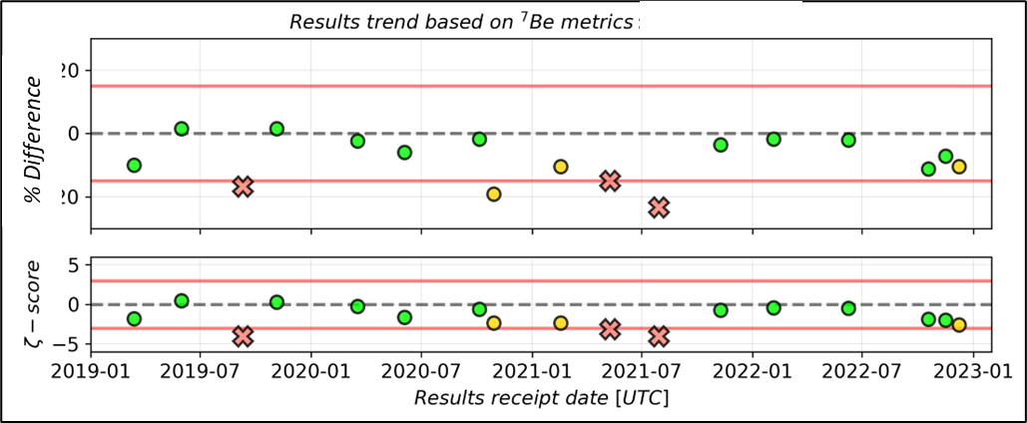
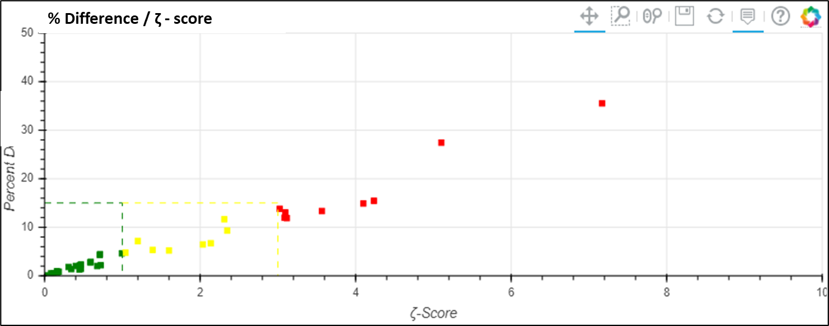
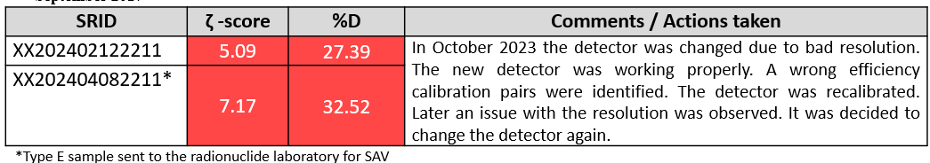
PLEASE DON‘T FORGET TO PUT THE E-POSTER TITLE AND YOUR NAME IN THE PRESENTATION HEADER.
DUPLICATE THIS SLIDE IF YOUR E-POSTER HAS MORE THAN 1 PAGE
Radionuclide IMS Network QA/QC programme
Marina NIZAMSKA, Martina ROZMARIC, Rodrigo VILLARREAL, Felix PINO
P4.1-872
Examples of PTS Warning/Actions
Example 3: No any technical issues were identified with the station detection system.
The IMS Particulate Network QA/QC Programme is an effective tool for identifying issues at the IMS station level.
The QA/QC ⁷Be metrics, established in accordance with the ISO 13528:2022 – Statistical methods for use in proficiency testing by interlaboratory comparison, have been proven to be effective in detecting potential issues at stations or laboratories that require immediate actions.
Example 1: A seasonal sandstorms during the boreal summer coincided with the discrepant results. The samples may have exhibited higher variability in final thickness and mass density.
SRID | ζ -score | %D
XX202311230611 | 4.02 | -17.54
XX202403070611 | 4.40 | -18.87
It was decided to conduct a new calibration of the detector with expert support from the PTS, as this was the second calibration of the detector (the previous one was performed in 2022 by the SO). Following the recalibration, the QC result comparison returned to acceptable values.
References
CTBT/WGB/TL-11,17/18/Rev.7 Operational Manual for Radionuclide Monitoring and the International Exchange of Radionuclide Data
CTBT/PTS/INF.96/Rev.10 Certification and Surveillance Assessment of Radionuclide Laboratories for Particulate and Noble Gas Sample Analysis
IDC-QMS-PLN-850 Particulate and Noble Gas Quality Assurance Plan
ISO 13528:2022(E) Statistical methods for use in proficiency testing by interlaboratory comparison
IDC-ENG-SPC-103-Rev.8 Formats and Protocols for Messages
Conclusion
Example 2: Detector resolution degradation at the station was identified.
Overall, the 2023–2024 data demonstrate that the IDC and radionuclide laboratory results for Network QA/QC and Level 5 samples are in a good agreement, confirming reliable operation of the IMS network.
For Category B split samples, the discrepancies in result comparison are larger as the activity may not be homogeneously distributed within the sample volume.
Radionuclide laboratories provide high-quality and timely services in supporting the IMS Network.
Strong collaboration between Station Operators, Radionuclide Laboratories, and the PTS ensures the successful implementation of the Network QA/QC Programme, despite occasional challenges related to the sample shipment process, including various environmental and political conditions.

