Slide 1

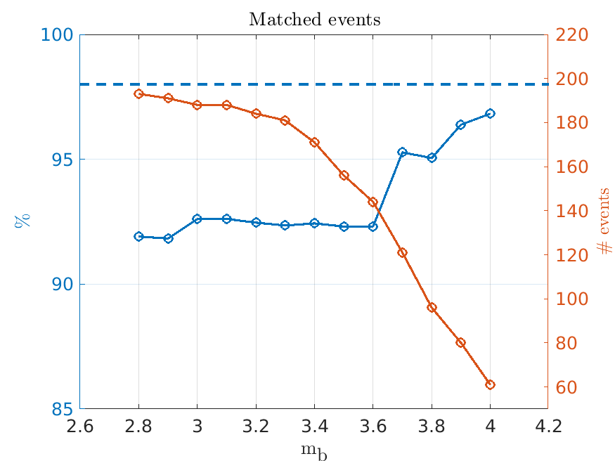
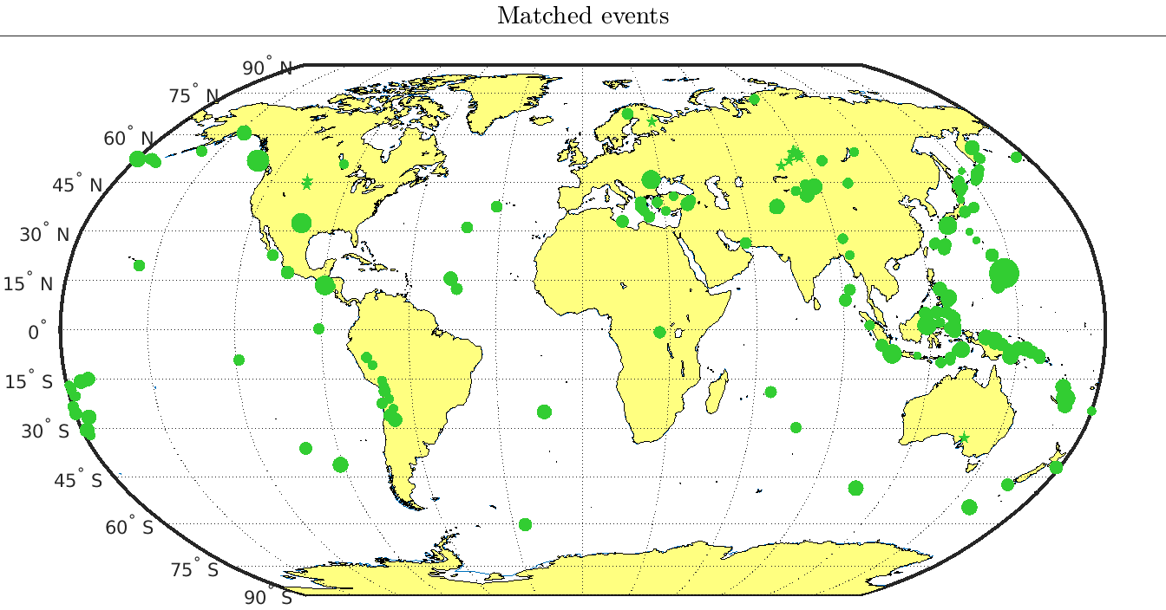
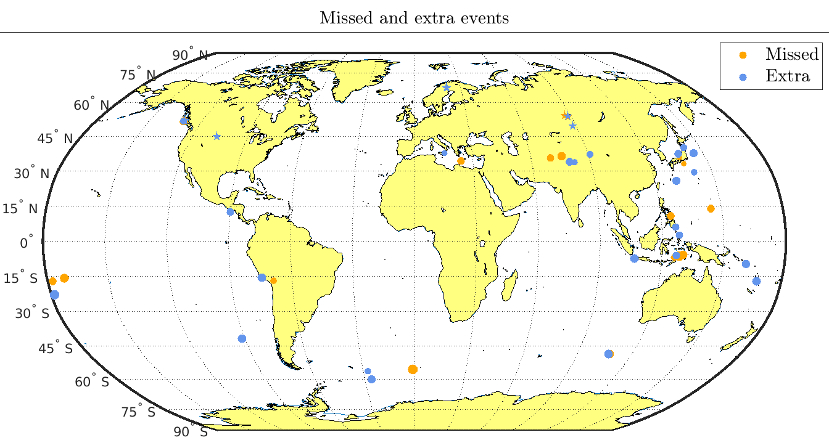

A comparison of IDC Reviewed Event Bulletins with a baseline
from the results of the 2024 Experiment
C. Saragiotis, C. Fernando, H. Hassani, J. Chaput and G. Graham
Preparatory Commission for the Comprehensive Nuclear-Test-Ban Treaty Organization
P4.1-856
Our poster is about the comparison of the REB with a baseline bulletin which was performed in the context of the 2024 Experiment (September 2024) …
The events between the two bulletins were matched (or not) using a bulletin comparison software, the BulCMP.
Pre-specified metrics and requirements were used to assess the REB.
We discuss the results and the challenges met during this comparison
If you want to find out more, come over for a chat in front of our poster
The views expressed on this e-poster are those of the author and do not necessarily reflect the view of the CTBTO

