Slide 1

P4.1-856
A comparison of IDC Reviewed Event Bulletins with a baseline from the results of the 2024 Experiment
C. Saragiotis, C. Fernando, H. Hassani, J. Chaput and G. Graham
Preparatory Commission for the Comprehensive Nuclear-Test-Ban Treaty Organization
The 2024 Experiment, took place in September 2024 as part of the validation and acceptance test plan of the Provisional Technical Secretariat. Part of it was the comparison of the Reviewed Event Bulletin produced by IDC analysts with a baseline bulletin using prespecified metrics and requirements.
In this e-poster we present this comparison, the main results and findings, and conclusions drawn.
The views expressed on this e-poster are those of the author and do not necessarily reflect the view of the CTBTO

Slide 2
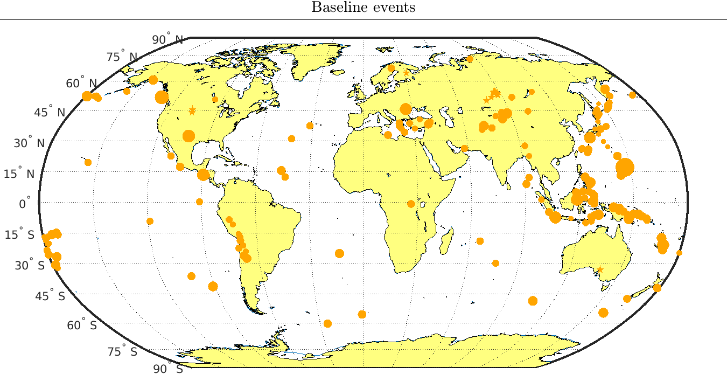
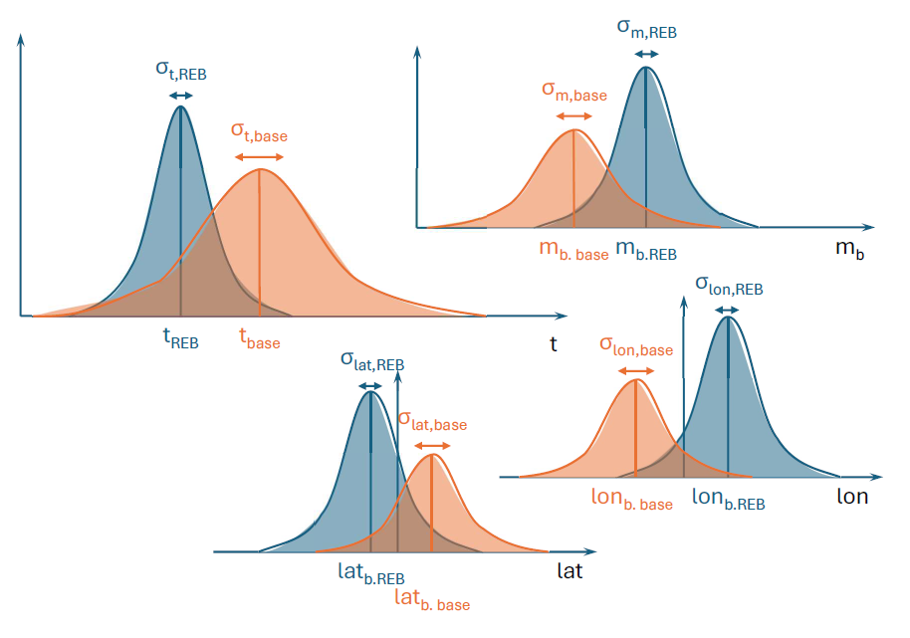
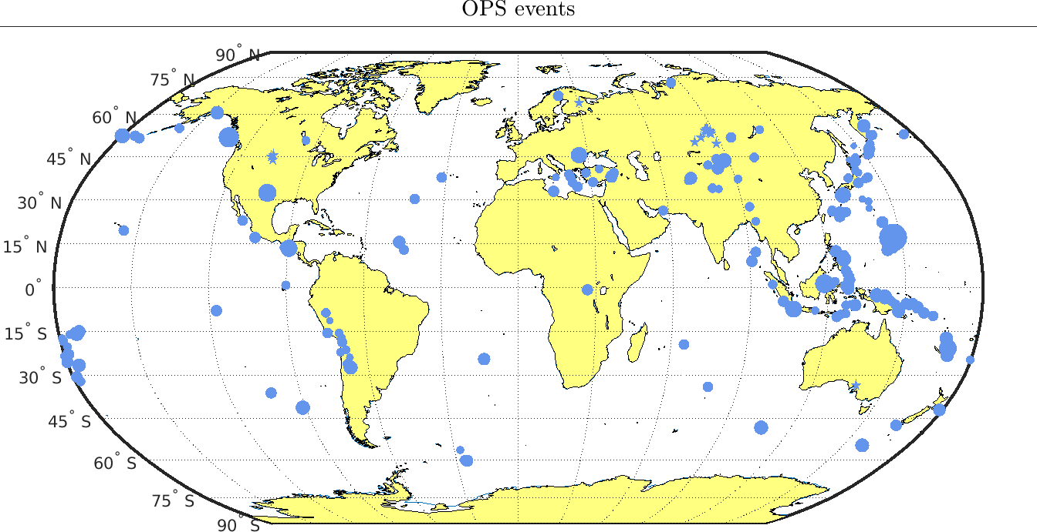
PLEASE DON‘T FORGET TO PUT THE E-POSTER TITLE AND YOUR NAME IN THE PRESENTATION HEADER.
DUPLICATE THIS SLIDE IF YOUR E-POSTER HAS MORE THAN 1 PAGE
A comparison of IDC Reviewed Event Bulletins with a baseline from the results of the 2024 Experiment
C. Saragiotis, C. Fernando, H. Hassani, J. Chaput and G. Graham
P4.1-856
Introduction
Comparison methodology
Distribution of events
The 2024 Experiment was conducted during 16–27 September 2024 and included validation tests (VTs) covering several aspects of the IDC processing (automatic and interactive). In particular, for the purposes of “VT-IDC-3.1.3 Interactive analysis of SHI data and REB”, the REB produced for Sep 15–17 2024 with a baseline bulletin independently produced several weeks later.
Metrics used and their requirements:
Matched events rate: the percentage of baseline events listed in the REB (≥ 98%)
Extra events rate: the percentage of REB events not listed in the baseline (≤ 4%)
Error ellipse coincidence. (≥ 96%)
The comparison of the two bulletins was made using BulCMP, the software that is used at the heart of the performance reporting software, PRTool.
BulCMP matches considers event time, latitude and longitude and magnitude of events from different bulletins and matches them using a probabilistic technique [3] referred to as dynamic event matching.
Baseline bulletin events
REB events
Figure. The size of the discs denotes m_{b} magnitude.
Figure. Parameters used by BulCMP to match evens.
The views expressed on this e-poster are those of the author and do not necessarily reflect the view of the CTBTO

Slide 3
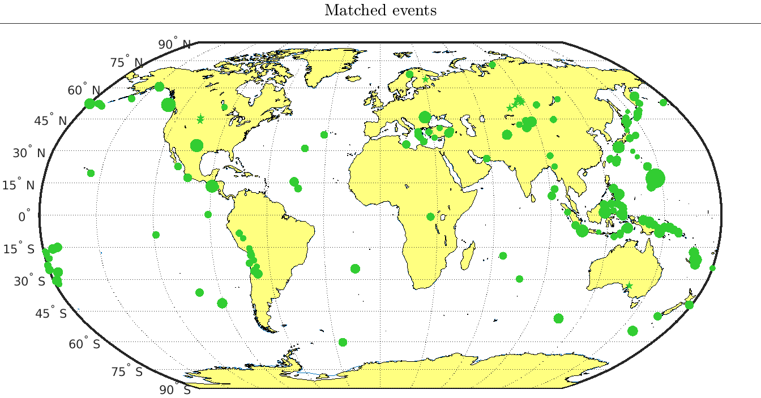
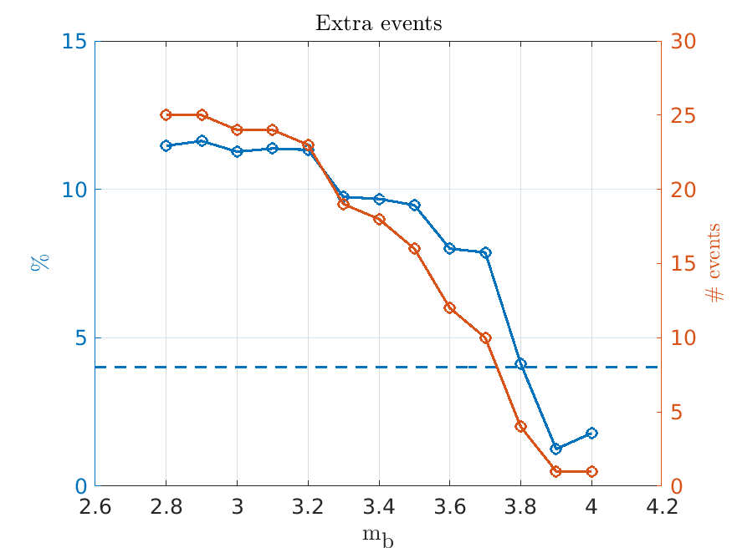
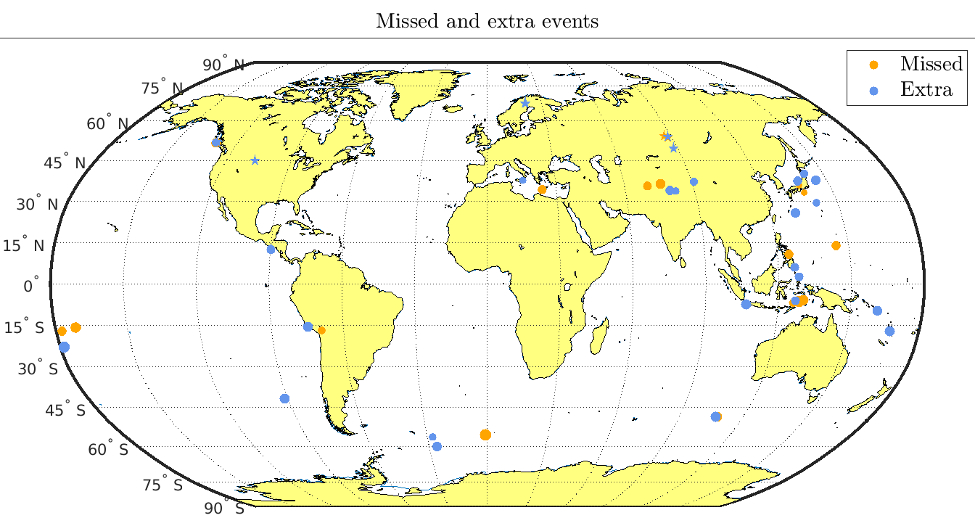
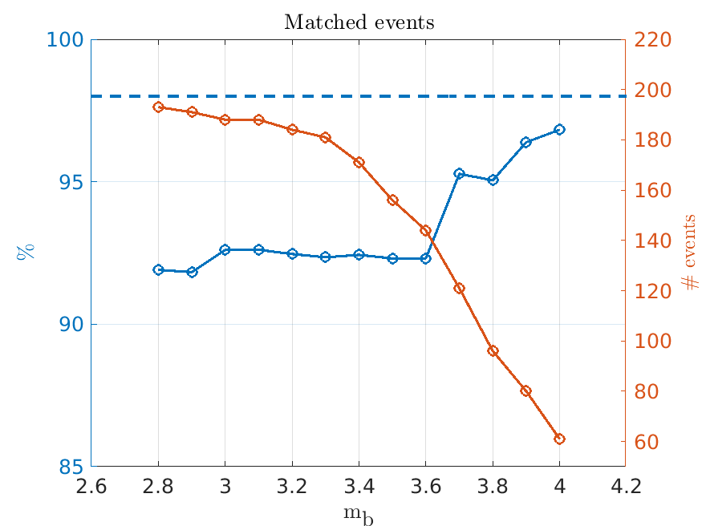
A comparison of IDC Reviewed Event Bulletins with a baseline from the results of the 2024 Experiment
C. Saragiotis, C. Fernando, H. Hassani, J. Chaput and G. Graham
P4.1-856
Distribution of events (cont’d)
Metrics with respect to magnitude
When assessing whether the requirements have been met, several factors must be considered, including the estimated magnitudes. The number of events increases exponentially with decreasing magnitude (Gutenberg-Richter law) therefore comparing bulletins at low magnitudes is not meaningful. A magnitude threshold could be m_{b} 3.5, which is that considered for standard event screening. On the other hand, assuming underground nuclear explosions, tamped in hard rock and with no effort for concealment, a body wave m_{b} of 3.5 can correspond (depending on the geology) to yields of the order of 0.1 kt, that is, at the low end of the very-low yield range, which is 0.01 kt to 2 kt.
A magnitude m_{b} of 4.0 corresponds to a yield of 0.25 kt to 0.4 kt, still in the very low yield range. Thus, a threshold of m_{b} of 4.0 also is reasonable.
It is also noted that BulCMP considers the magnitude to match events. However, pure hydroacoustic or infrasonic events have no magnitude estimated at all and are therefore not considered by BulCMP. Furthermore, seismic events detected only by stations at regional distances (Δ < 20 deg) also do not have m_{b} magnitude estimates.
Matched events
Missed and extra events
The views expressed on this e-poster are those of the author and do not necessarily reflect the view of the CTBTO

Slide 4
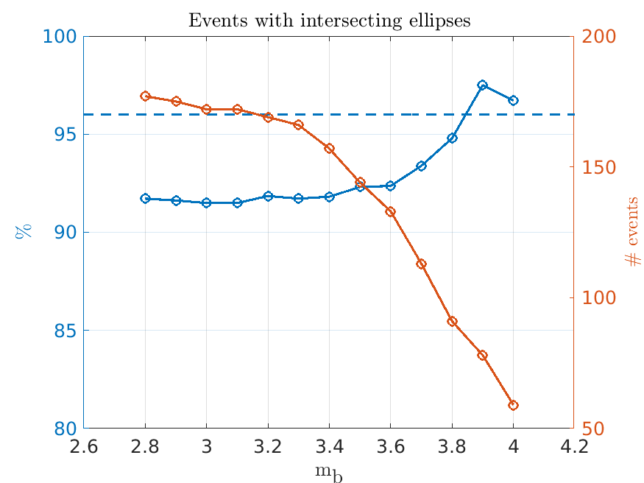
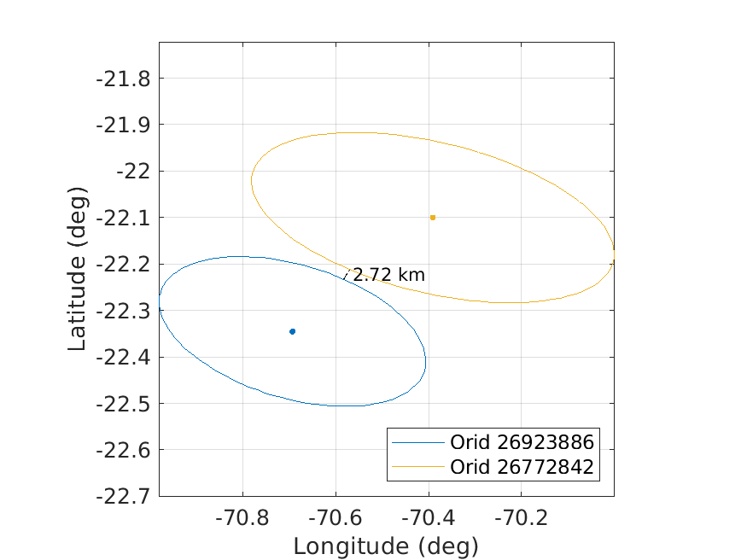
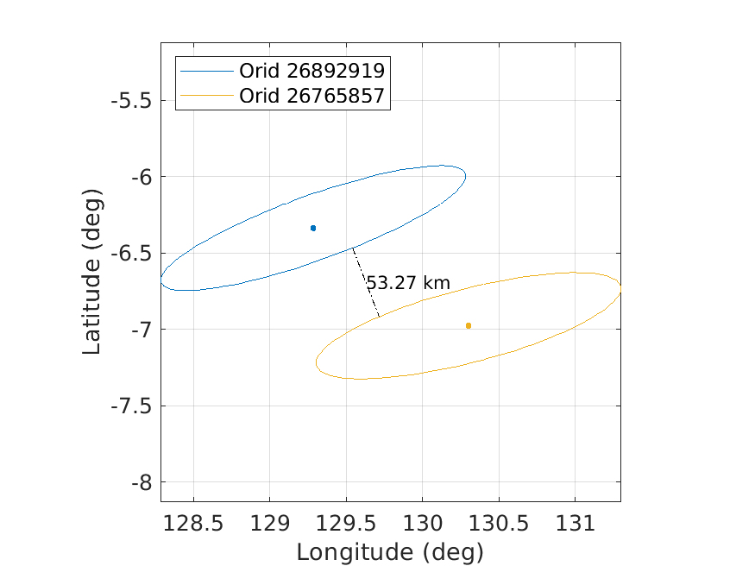
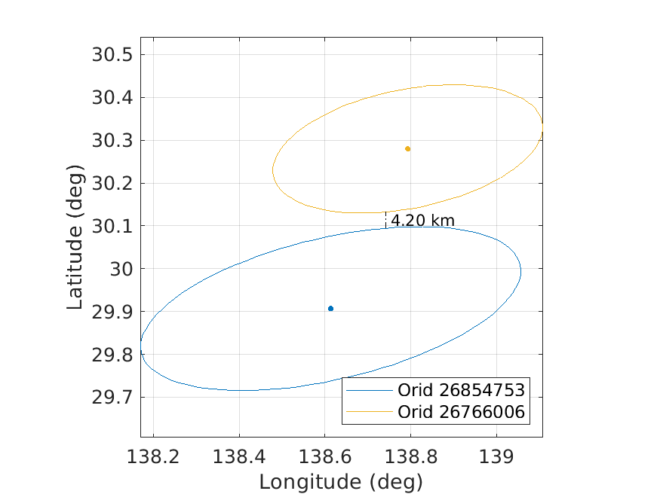
PLEASE DON‘T FORGET TO PUT THE E-POSTER TITLE AND YOUR NAME IN THE PRESENTATION HEADER.
DUPLICATE THIS SLIDE IF YOUR E-POSTER HAS MORE THAN 1 PAGE
A comparison of IDC Reviewed Event Bulletins with a baseline from the results of the 2024 Experiment
C. Saragiotis, C. Fernando, H. Hassani, J. Chaput and G. Graham
P4.1-856
Metrics with respect to magnitude (cont’d)
Examples of non-overlapping ellipses
Events with overlapping ellipses
References
Summary of baseline and REB bulletins comparison
 | Target | mb ≥ 4.0 | mb ≥ 3.5 | All events
Events in baseline |  | 63 | 169 | 238
Events in REB |  | 62 | 172 | 251
Matched | ≥ 98% | 61 (96.8%) | 156 (92.3%) | 215 (90.3%)
Extra | ≤ 4% | 1 (1.6%) | 1 6 (9.3%) | 36 (16.7%)
Overlapping ellipses | ≥ 96% | 59 (96.7%) | 144 (92.3%) | 193 (89.4%)
[1] National Academy of Sciences (2002). Technical issues related to the Comprehensive Nuclear Test Ban Treaty. Washington DC: The National Academies Press.
[2] Provisional Technical Secretariat of the CTBTO Preparatory Commission (2024). IDC processing of seismic, hydroacoustic and infrasonic data. Rev. 3.1. IDC Documentation, IDC/OPS/MAN/001/Rev.3.1.
[3] Wüster, Jan et al. (2000). “GSETT-3: Evaluation of the detection and location capabilities of an experimental global seismic monitoring system”. Bull. Seismol. Soc. Am. 90.1, pp. 166–186.
The views expressed on this e-poster are those of the author and do not necessarily reflect the view of the CTBTO

