Slide 1



P4.1-385
Identifying Misformed Events Using Classification Techniques and Likelihood-Based Model Fit Scores
Shahar Cohen¹, David M. Steinberg¹, Yael Radzyner², Yochai Ben-Horin²
¹Department of Statistics and Operations Research, Tel-Aviv University, Tel-Aviv, Israel.
²National Data Center, Soreq Nuclear Research Center, Yavne, Israel.
Analysis of 2014-2023 data shows that less than 50% of events reported in SEL1 bulletin were also included in the LEB. Reducing the number of misformed events could significantly ease analyst workloads. To address this, we introduce a method for assessing the legitimacy of proposed events. A key feature is whether or not the station should be expected to detect the event, which we model for each station utilizing data from the LEB. Scoring functions are then created from classifiers trained to determine whether an event from SEL1 would pass an analyst’s review. These classifiers use features extracted by evaluating the likelihood of the model for the proposed events and their corresponding detection patterns. A classifier based on our scoring function, applied to one year of independent SEL1 test data was able to identify 72.05% of false events while falsely flagging just 5% of legitimate ones. Additionally, for many events with low scores retained by the analysts, the scores provided valuable insights and pointed to important data corrections. These events had much higher scores in the LEB.

Slide 2
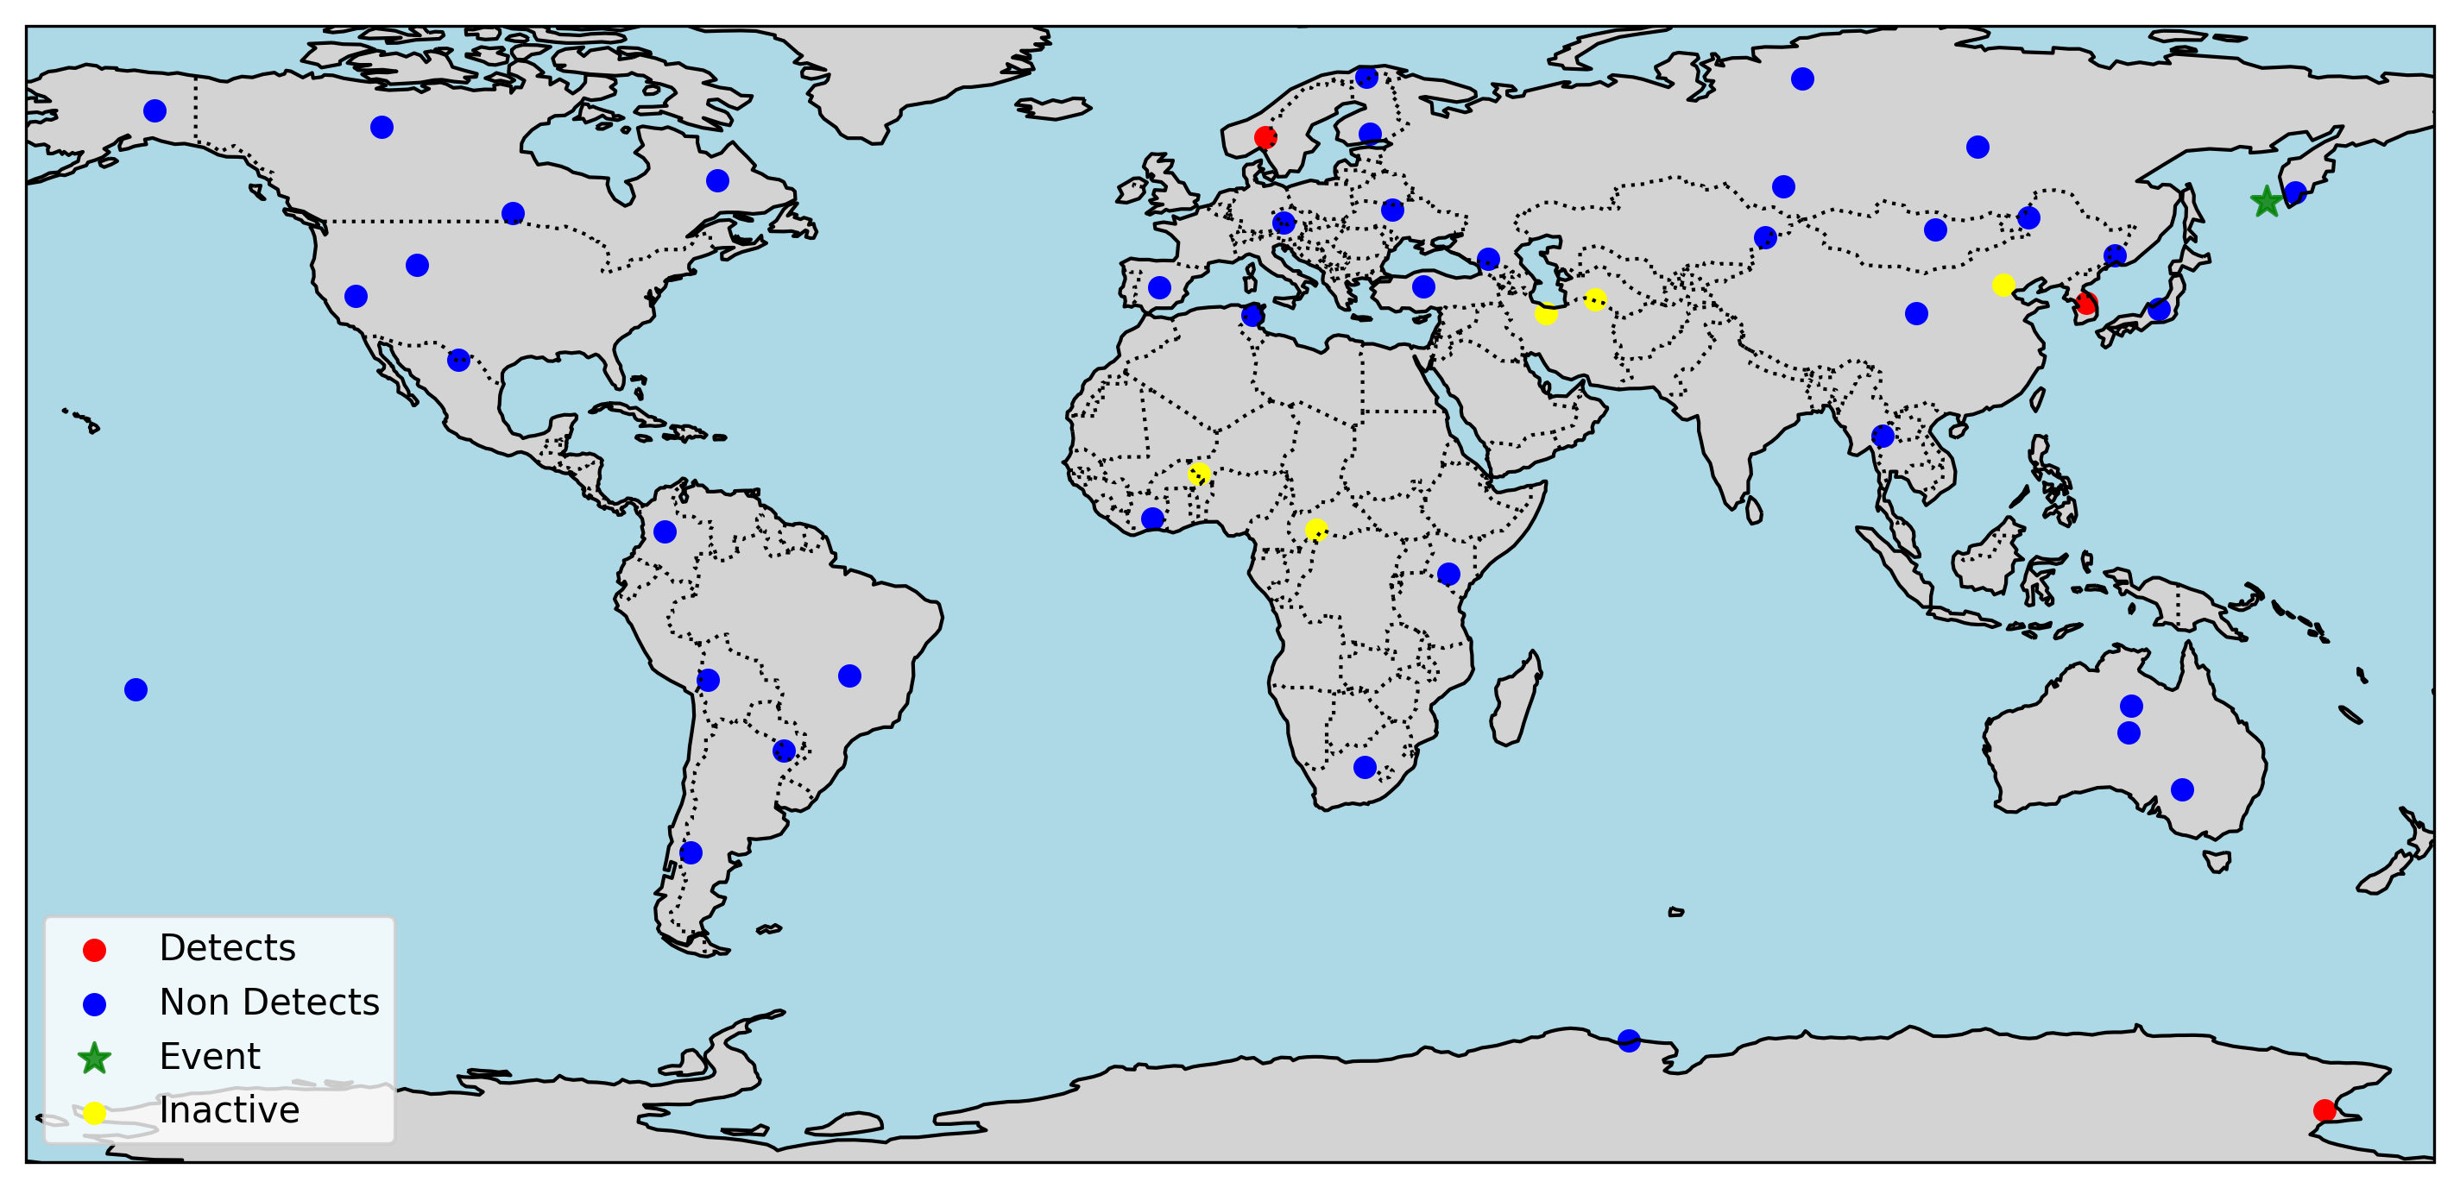
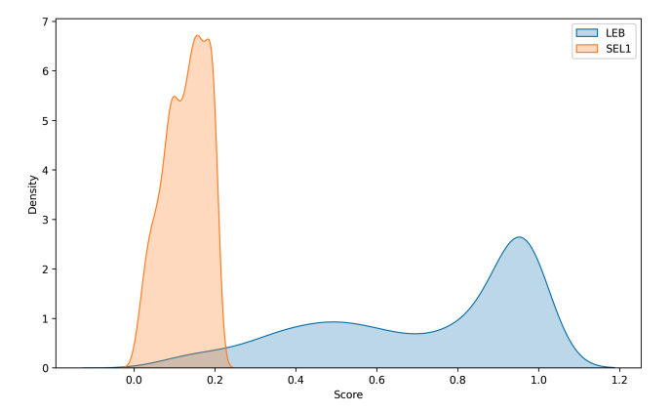

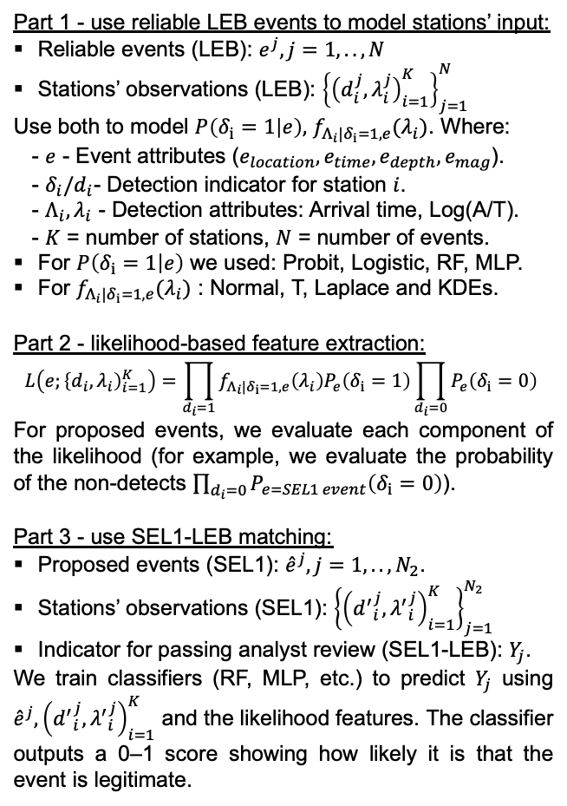
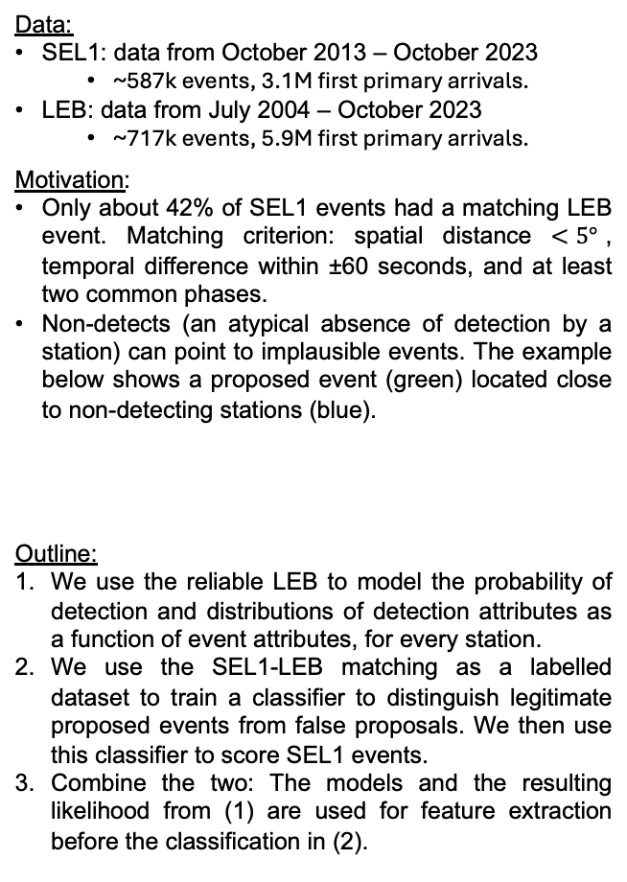
PLEASE DON‘T FORGET TO PUT THE E-POSTER TITLE AND YOUR NAME IN THE PRESENTATION HEADER.
DUPLICATE THIS SLIDE IF YOUR E-POSTER HAS MORE THAN 1 PAGE
P4.1-385
Identifying Misformed Events Using Classification Techniques and Likelihood-Based Model Fit Scores
Shahar Cohen, David M. Steinberg, Yael Radzyner, Yochai Ben-Horin
Introduction, Data and Motivation
Methodology
Results
Data:
SEL1: data from October 2013 – October 2023
  ~587k events, 3.1M first primary arrivals.
LEB: data from July 2004 – October 2023
  ~717k events, 5.9M first primary arrivals.
Motivation:
Only about 42% of SEL1 events had a matching LEB event. Matching criterion: spatial distance $<5°$, temporal difference within ±60 seconds, and at least two common phases.
Non-detects (an atypical absence of detection by a station) can point to implausible events. The example below shows a proposed event (green) located close to non-detecting stations (blue).
Outline:
We use the reliable LEB to model the probability of detection and distributions of detection attributes as a function of event attributes, for every station.
We use the SEL1-LEB matching as a labelled dataset to train a classifier to distinguish legitimate proposed events from false proposals. We then use this classifier to score SEL1 events.
Combine the two: The models and the resulting likelihood from (1) are used for feature extraction before the classification in (2).
Part 1 - use reliable LEB events to model stations’ input:
Reliable events (LEB): $e^{j}, j=1,..,N$
Stations’ observations (LEB): ${\left\{{\left(d_{i}^{j},λ_{i}^{j}\right)}_{i=1}^{K}\right\}}_{j=1}^{N}$
Use both to model $P\left(δ_{i}=1 | e\right),$ $f_{Λ_{i}|δ_{i}=1,e}(λ_{i})$. Where:
- $e$ - Event attributes ($e_{location},e_{time},e_{depth},e_{mag}$).
- $δ_{i}/d_{i}$- Detection indicator for station $i$.
- $Λ_{i},λ_{i}$ - Detection attributes: Arrival time, Log(A/T).
- $K$ = number of stations, $N$ = number of events.
For $P\left(δ_{i}=1 | e\right)$ we used: Probit, Logistic, RF, MLP.
For $f_{Λ_{i}|δ_{i}=1,e}(λ_{i})$ : Normal, T, Laplace and KDEs.
Part 2 - likelihood-based feature extraction:
$$L\left(e;{\left\{d_{i},λ_{i}\right)}_{i=1}^{K}\right)=\prod_{d_{i}=1}{f_{Λ_{i}|δ_{i}=1,e}\left(λ_{i}\right)P_{e}\left(δ_{i}=1\right)}\prod_{d_{i}=0}{P_{e}\left(δ_{i}=0\right) }$$
For proposed events, we evaluate each component of the likelihood (for example, we evaluate the probability of the non-detects $\prod_{d_{i}=0}{P_{e=SEL1 event}\left(δ_{i}=0\right)}$).
Part 3 - use SEL1-LEB matching:
Proposed events (SEL1): ${\hat{e}}^{j}, j=1,..,N_{2}$.
Stations’ observations (SEL1): ${\left\{{\left({d^{′}}_{i}^{j},{λ^{′}}_{i}^{j}\right)}_{i=1}^{K}\right\}}_{j=1}^{N_{2}}$
Indicator for passing analyst review (SEL1-LEB): $Y_{j}$.
We train classifiers (RF, MLP, etc.) to predict $Y_{j}$ using ${\hat{e}}^{j}, {\left({d^{′}}_{i}^{j},{λ^{′}}_{i}^{j}\right)}_{i=1}^{K}$ and the likelihood features. The classifier outputs a 0–1 score showing how likely it is that the event is legitimate.
Significant results:
Identifying over 72% (45%, 59%, 82%) of the false events with less than 5% (1%, 2.5%, 10%) of legitimate events falsely flagged over a year-long dataset (2022-2023) unseen during training.
Test set AUC of 0.96.
Event score changes:
Events that were falsely flagged showed significant score improvement in their matching LEB event. Plot below shows KDE of the score distribution in SEL1 (orange) and their matching LEB event (blue).
Low scores point to important data corrections. Specifically, many cases have non-detecting stations that become detects in the matching LEB event due to changes in the associated arrivals.

Slide 3
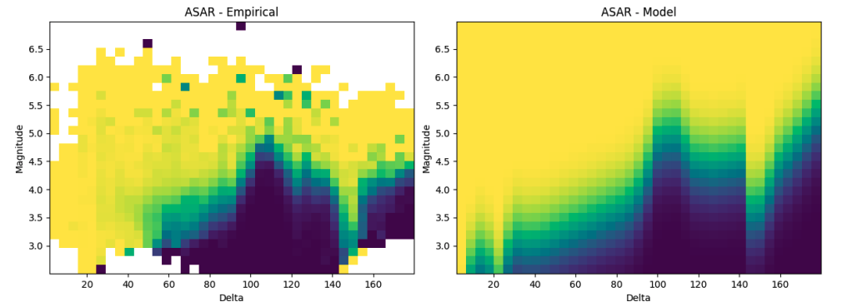
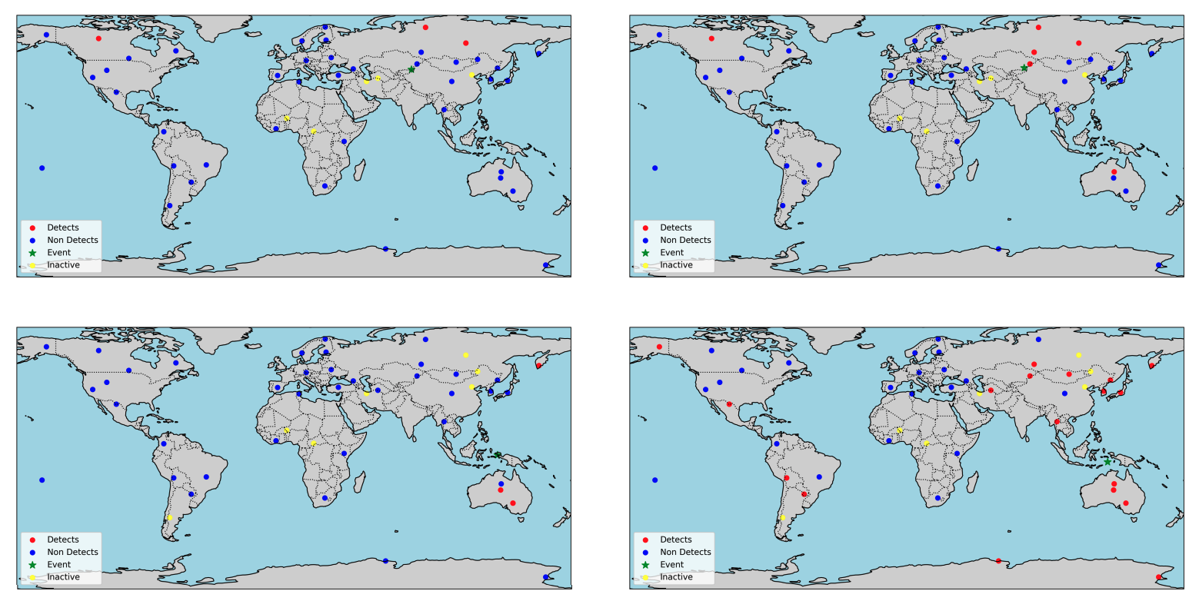
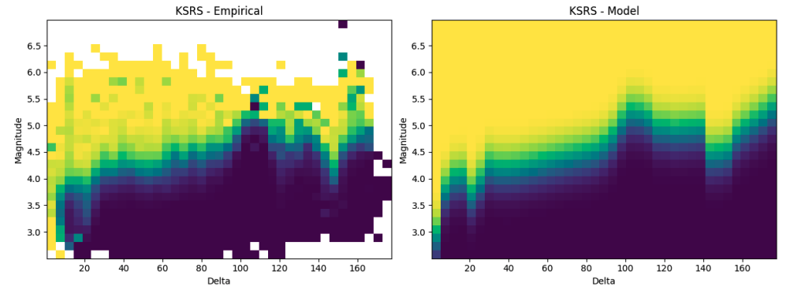
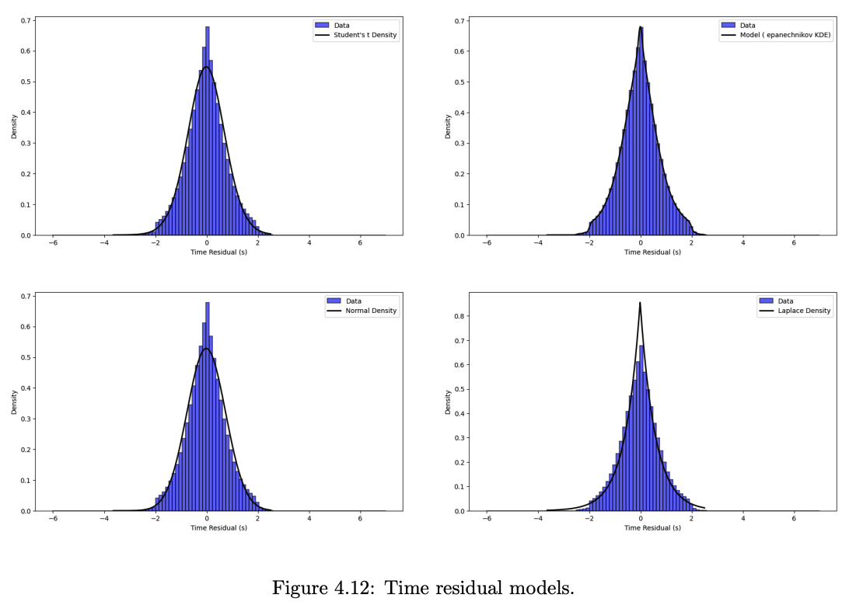
PLEASE DON‘T FORGET TO PUT THE E-POSTER TITLE AND YOUR NAME IN THE PRESENTATION HEADER.
DUPLICATE THIS SLIDE IF YOUR E-POSTER HAS MORE THAN 1 PAGE
P4.1-385
Identifying Misformed Events Using Classification Techniques and Likelihood-Based Model Fit Scores
Shahar Cohen, David M. Steinberg, Yael Radzyner, Yochai Ben-Horin
Misformed Event – Example
Models – Example
Low Score Event – Example
An example of a SEL1 misformed event, i.e., a proposed event from SEL1 with no existing matching LEB event.
Detection probability for ASAR (top) and KSRS (bottom), models (right) and empirical detection probabilities (left):
A SEL1 proposed event with low score, and its matching LEB event. Two non-detecting stations in SEL1 are corrected to detects in SEL1, leading to a significant score improvement.
Travel time residual model (black line) with empirical histogram:

Slide 4
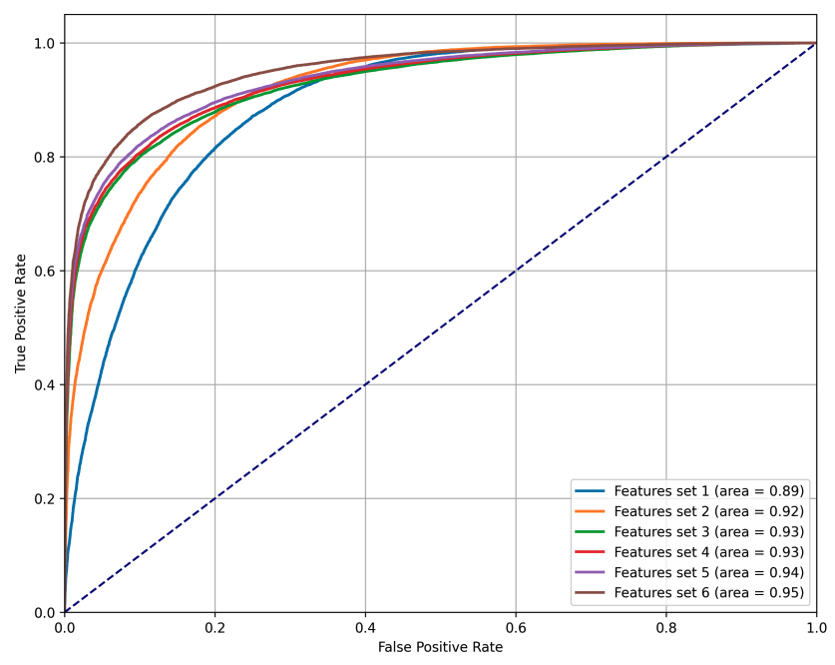
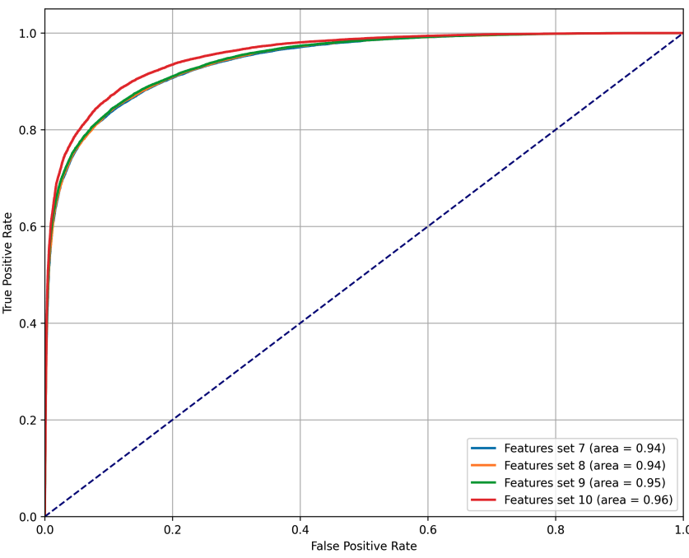
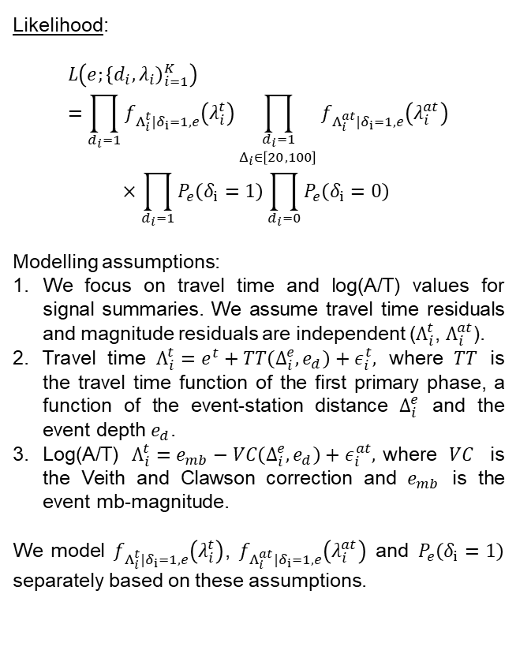
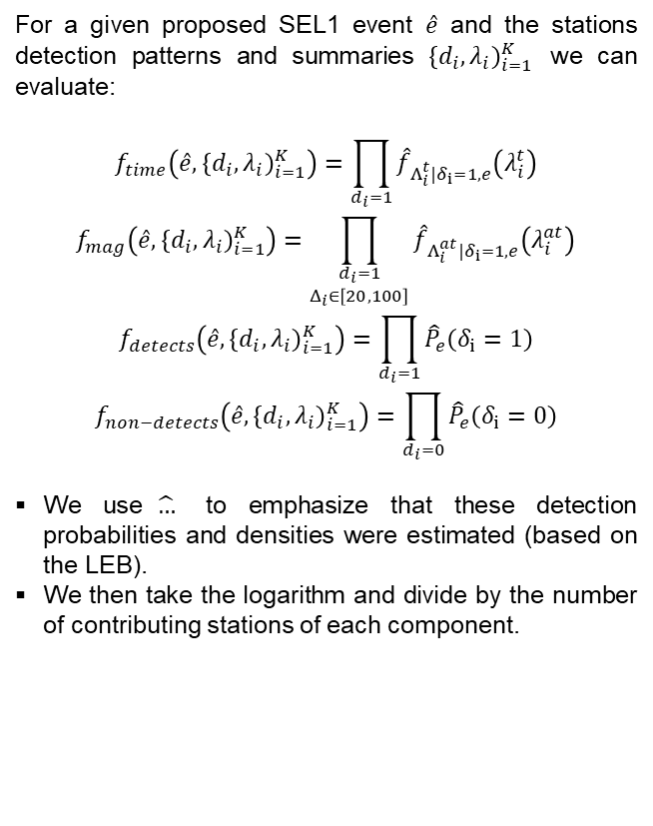
PLEASE DON‘T FORGET TO PUT THE E-POSTER TITLE AND YOUR NAME IN THE PRESENTATION HEADER.
DUPLICATE THIS SLIDE IF YOUR E-POSTER HAS MORE THAN 1 PAGE
P4.1-385
Identifying Misformed Events Using Classification Techniques and Likelihood-Based Model Fit Scores
Shahar Cohen, David M. Steinberg, Yael Radzyner, Yochai Ben-Horin
Model Assumptions
Feature Extraction – Details
Classifiers’ ROC Curves – Examples
Likelihood:
$$L\left(e;{\left\{d_{i},λ_{i}\right)}_{i=1}^{K}\right)=\prod_{d_{i}=1}{f_{Λ_{i}^{t}|δ_{i}=1,e}\left(λ_{i}^{t}\right)}\prod_{\begin{aligned}d_{i}=1 \\ Δ_{i}∈\left[20,100\right]\end{aligned}}{f_{Λ_{i}^{at}|δ_{i}=1,e}\left(λ_{i}^{at}\right)}$$
$$×\prod_{d_{i}=1}{P_{e}\left(δ_{i}=1\right)}\prod_{d_{i}=0}{P_{e}\left(δ_{i}=0\right) }$$
Modelling assumptions:
We focus on travel time and log(A/T) values for signal summaries. We assume travel time residuals and magnitude residuals are independent ($Λ_{i}^{t}$, $Λ_{i}^{at}$).
Travel time $Λ_{i}^{t}=e^{t}+TT\left(Δ_{i}^{e},e_{d}\right)+ε_{i}^{t},$ where $TT$ is the travel time function of the first primary phase, a function of the event-station distance $Δ_{i}^{e}$ and the event depth $e_{d}$.
Log(A/T) $Λ_{i}^{t}=e_{mb}−VC\left(Δ_{i}^{e},e_{d}\right)+ε_{i}^{at},$where $VC$ is the Veith and Clawson correction and $e_{mb}$ is the event mb-magnitude.
We model $f_{Λ_{i}^{t}|δ_{i}=1,e}\left(λ_{i}^{t}\right)$, $f_{Λ_{i}^{at}|δ_{i}=1,e}\left(λ_{i}^{at}\right)$ and $P_{e}\left(δ_{i}=1\right)$ separately based on these assumptions.
For a given proposed SEL1 event $\hat{e}$ and the stations detection patterns and summaries ${\left\{d_{i},λ_{i}\right)}_{i=1}^{K}$ we can evaluate:
$$f_{time}\left(\hat{e},{\left\{d_{i},λ_{i}\right)}_{i=1}^{K}\right)=\prod_{d_{i}=1}{{\hat{f}}_{Λ_{i}^{t}|δ_{i}=1,e}\left(λ_{i}^{t}\right)}$$
$$f_{mag}\left(\hat{e},{\left\{d_{i},λ_{i}\right)}_{i=1}^{K}\right)=\prod_{\begin{aligned}d_{i}=1 \\ Δ_{i}∈\left[20,100\right]\end{aligned}}{{\hat{f}}_{Λ_{i}^{at}|δ_{i}=1,e}\left(λ_{i}^{at}\right)}$$
$$f_{detects}\left(\hat{e},{\left\{d_{i},λ_{i}\right)}_{i=1}^{K}\right)=\prod_{d_{i}=1}{{\hat{P}}_{e}\left(δ_{i}=1\right)}$$
$$f_{non−detects}\left(\hat{e},{\left\{d_{i},λ_{i}\right)}_{i=1}^{K}\right)=\prod_{d_{i}=0}{{\hat{P}}_{e}\left(δ_{i}=0\right)}$$
We use$\hat{…}$ to emphasize that these detection probabilities and densities were estimated (based on the LEB).
We then take the logarithm and divide by the number of contributing stations of each component.

