Slide 1


P3.6-372
Comparison Between IMS Radionuclide Station and Laboratory Results for Particulate Filters
Annie Rae, Daniel Chester, Matthew A. Goodwin
AWE, Reading, UK
16 laboratories around the world are certified to support CTBTO sample analysis with gamma spectroscopy when necessary. The CTBTO are able to request the station to send the corresponding sample to one of 16 laboratories globally in order to get a secondary verification. The UK National Data Centre (NDC) has been set up to receive raw data from the International Data Centre (IDC) in order to provide a more in-depth thorough analysis. This poster discusses a comparison between lab results and station results from the UK NDC data.
UK Ministry of Defence © Crown Owned Copyright 2025/AWE

Slide 2
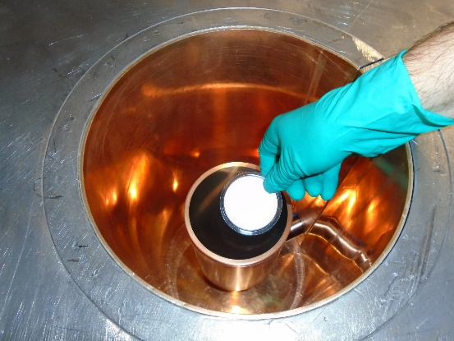
P3.6-372
Comparison Between IMS Radionuclide Station and Laboratory Results for Particulate Filters
Annie Rae, Daniel Chester, Matthew A. Goodwin
Aims
MDC Results
One theme often discussed is the comparability of laboratory results with the automated IMS station output received by the UK National Data Centre (NDC). Such questions discussed include:
How well do labs agree with the station data?
Which radionuclides benefit from lab re-measurement?
Are there any common false positives at stations?
Compare Minimum Detectable Concentrations (MDCs)?
What are the impacts of transport sample delays on lab measurements?
A thorough comparison between results produced from automated spectral processing by the UK NDC data and numerous years of Radionuclide Laboratory Reports (RLRs) has been conducted from samples such as the CANA sample shown in Figure 1. The aim of this analysis is to provide evaluation into the comparative sensitivity and detection limit of both types of measurements.
Initial results shown in Table 1 evidence that when investigating the MDC values of both station and laboratory data we can see vast improvement of MDC values for the majority of isotopes when measured at labs. This can be attributed to a variety of reasons, such as:
Nuclides with short half-lives - these nuclides are more likely to be seen in station measurements due to delivery time between stations and labs. For example, naturally occurring radionuclides such as Pb-212 and Bi-212 have half lives of 11 hours. The large amount of isotopic decay contributes to the Compton background therefore elevating the background count of station spectra.
Labs potentially have better shielding than stations - this could be assessed from further investigation into backgrounds and a comprehensive comparison between lab and station background measurements compared with the shielding capabilities.
Difference in counting times - stations count samples for 1 day, whereas labs count samples for a minimum of 3 days, with the CTBTO allowing labs to count up to a maximum 7 days.
Interestingly, I-131 has a vastly lower percentage improvement rate. One factor that may be contributing to this issue could be the short half life of 8 days; it may take several half-lives for a sample to get to a lab. In addition to this, the high volatility of iodine could also mean more is lost during the time delay of transit.
Table 1. MDC comparison between lab and station data
Isotope | Improved | Unimproved | Total | Percentage improved (%)
Be-7 | 563 | 10 | 573 | 98
Cs-137 | 566 | 0 | 566 | 100
K-40 | 358 | 1 | 359 | 99
I-131 | 148 | 421 | 569 | 26
Na-22 | 399 | 7 | 406 | 98
Figure 1. CANA sample on detector
UK Ministry of Defence © Crown Owned Copyright 2025/AWE

Slide 3
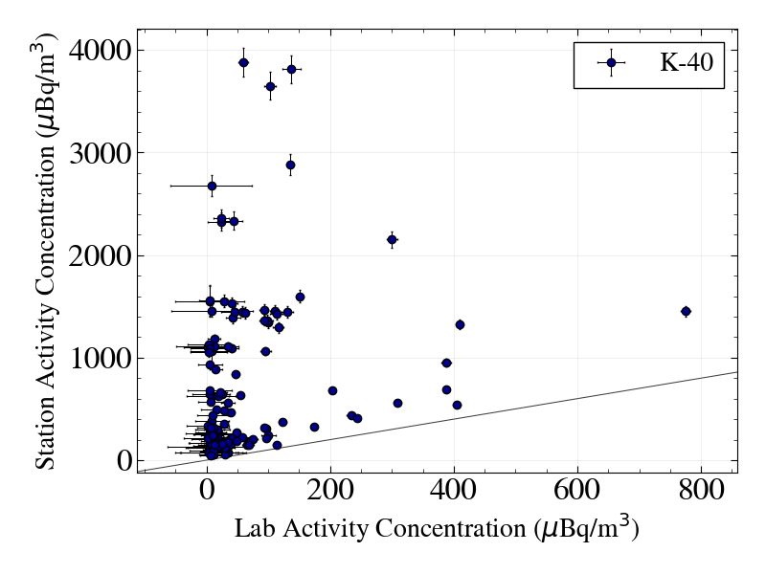
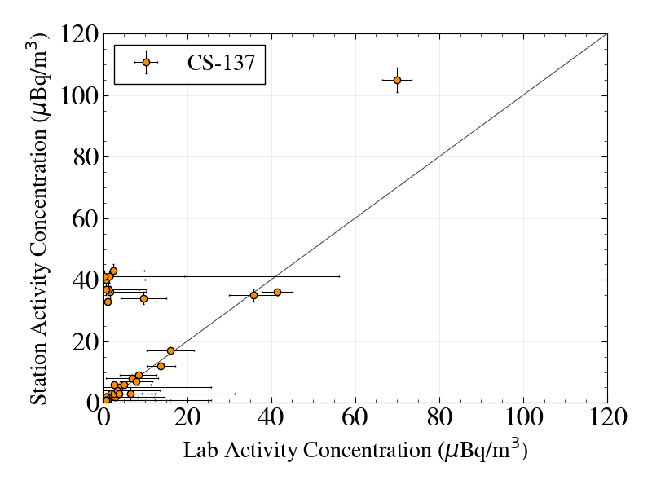
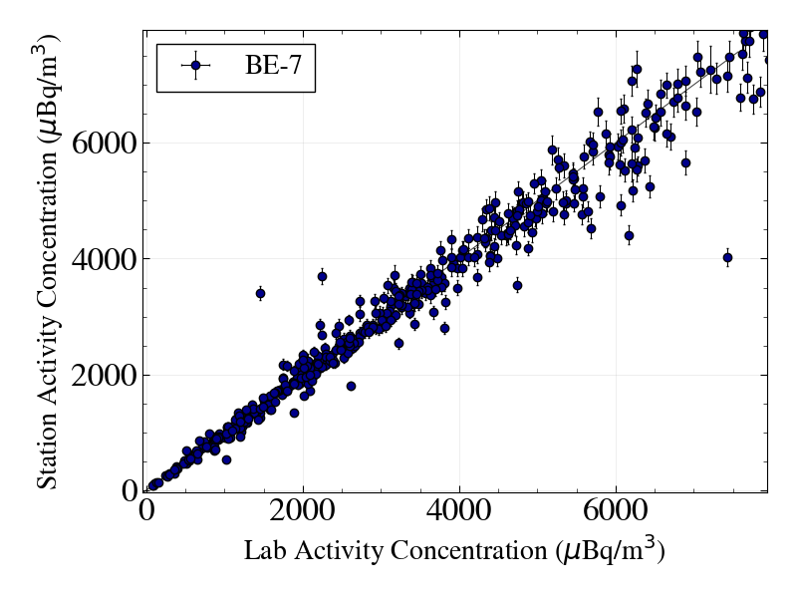
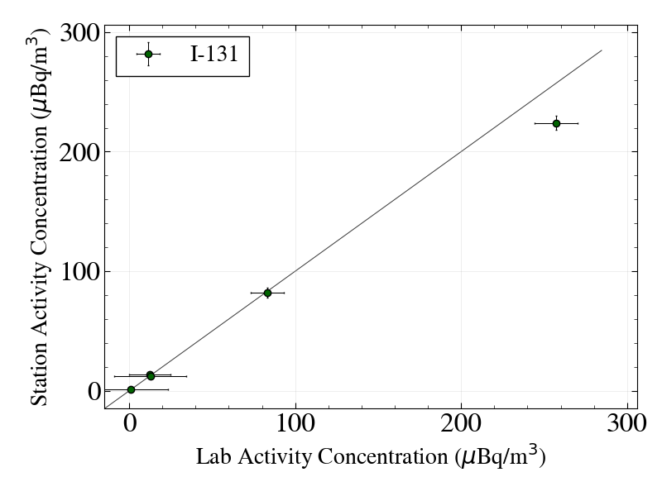
P3.6-372
Comparison between IMS Radionuclide Station and Laboratory results for Particulate Filters
Annie Rae, Daniel Chester, Matthew A. Goodwin
Activity Concentration Results
Conclusions and Future Work
Figures 2 and 3 show that when comparing activity concentrations of Be-7 and I-131, both labs and stations have similar results. A line of y = x has been plotted to allow for easier comparison between data points. Although the data for I-131 is more limited as an isotope of interest we can see that the limited data points are in agreement.
Conversely, the common isotope K-40 shows little agreement between lab and station data (Figure 4). Station data shows far higher activity concentrations than that of the lab. This can be attributed to a lack of background measurements being taken into account when finalising station results.
Interestingly, the Cs-137 isotope shows the majority of data between labs and stations is in good agreement (Figure 5). However, a small section can be seen where the stations measured approx. 30-40 μBq/m³ and the labs measured close to 0 μBq/m³. There is no obvious consistency with regards to these anomalous points; further investigation should be conducted for any trends.
The inconsistency between lab and station data can be attributed to 3 possible causes:
Nuclides with short half-lives.
Labs have more shielding than stations; which could be assessed from investigation into backgrounds.
Difference in counting times with stations counting for 1 day and labs for a minimum of 3 days.
This work is ongoing and full evaluations of the datasets are to be completed, including comparison of results of key radionuclides of interest.
This work can be taken further by investigating into more comparisons of data such as:
Minimum Detectable Activity (MDA) comparisons for key radionuclides.
Radionuclide uncertainties.
With more information on common alternative radionuclides a thorough comparison can be conducted to include IDC (International Data Centre) data as well as UK NDC data to probe further into the processing and provides the opportunity to analyse differences in the lab / station data and identify potential areas for improvement. Furthermore, exploration should be conducted into the impact of time delays (due to sample shipping to labs) when comparing station and lab-based data.
Figure 4. K-40 comparison of activity concentration between lab and station data
Figure 2. Be-7 comparison of activity concentration between lab and station data
Figure 3. I-131 comparison of activity concentration between lab and station data
Figure 5. Cs-137 comparison of activity concentration between lab and station data
UK Ministry of Defence © Crown Owned Copyright 2025/AWE

