Slide 1

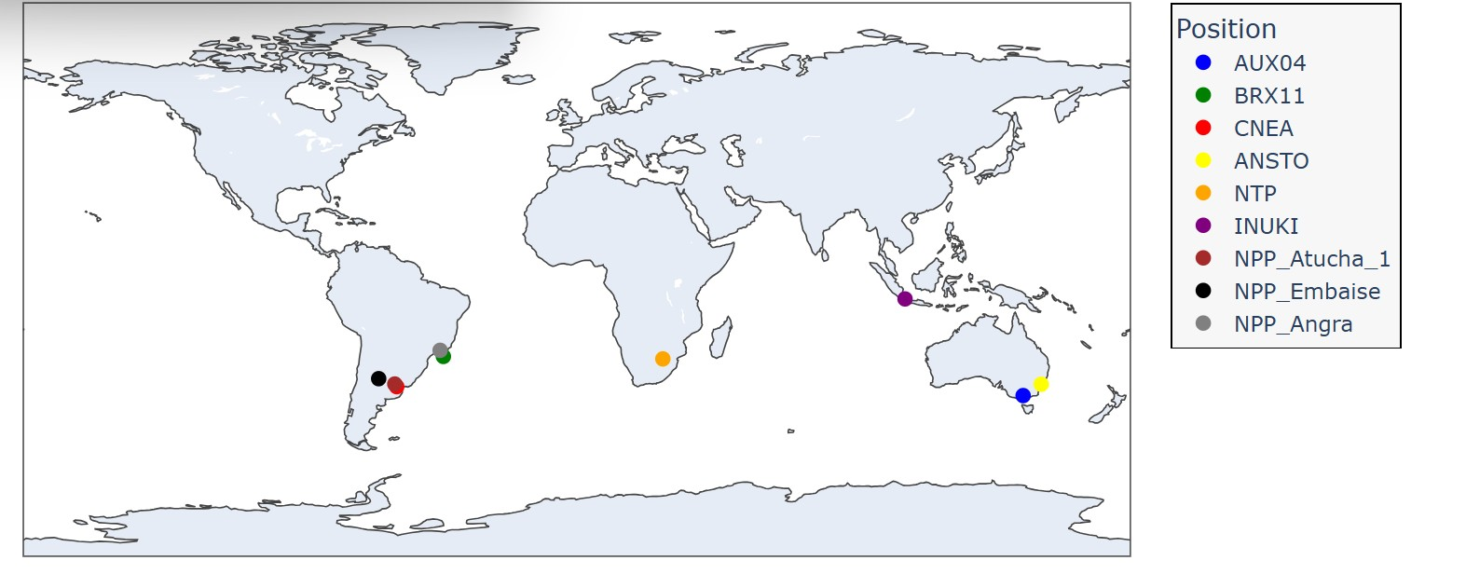
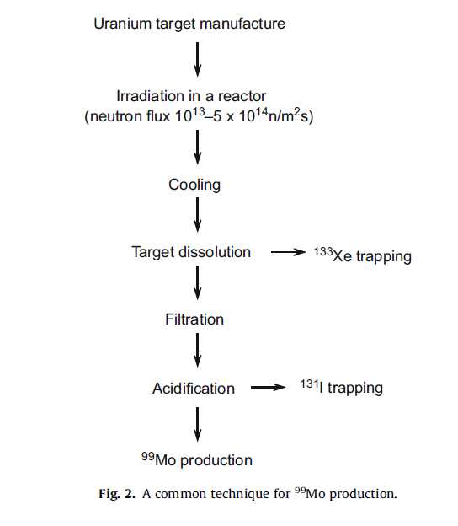
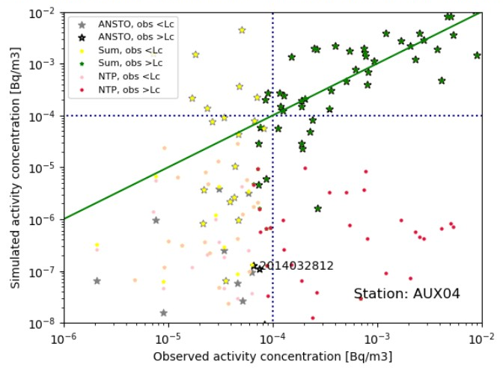

P3.6-017
Assessment of the influence of radioxenon releases from civil nuclear activities on measured air concentrations by CTBTO IMS stations using atmospheric transport modeling (ATM)
Modou Niangª, Martin B. Kalinowski^{b},Ndeye Arame BOYE FAYEª
ªSenegalese Authority for Radiation Protection, Nuclear Safety, and Security
^{b}Peace Science Collaboration
The purpose of this study was to estimate the releases from the medical isotope facilities located in the Southern Hemisphere.
Atmospheric transport of ¹³³Xe was modeled using Continuously Emitting Sources (CES).
NTP source strength [Bq/d]: 3.06e+15 in 2014.
Compare with the value of Eslinger et al. (2014) [Bq/y]: 2.30e+16, i.e. daily release [Bq/d]: 6.30e+13
Reference: SAEY and al, 2010.
DISCLAIMER: The views expressed on this presentation are those of the authors and do not necessarily reflect the view of any organization the authors are currently of have been previously affiliated with.

