Slide 1


P3.6-017
Assessment of the influence of radioxenon releases from civil nuclear activities on measured air concentrations by CTBTO IMS stations using atmospheric transport modeling (ATM)
Modou Niangª, Martin B. Kalinowski^{b},Ndeye Arame BOYE FAYEª
ªSenegalese Authority for Radiation Protection, Nuclear Safety, and Security
^{B}Peace Science Collaboration
This study used sampling data at two IMS radionuclide sampling locations (AUX04, BRX11) to estimate the contribution of Southern Hemisphere medical isotope producers to the long-term ¹³³Xe background.
The source strength of NTP is the least well-known parameter so far, but it is thought to be the strongest source worldwide. In fact, we have determined the upper range of daily discharges from NTP.
DISCLAIMER: The views expressed on this presentation are those of the authors and do not necessarily reflect the view of any organization the authors are currently of have been previously affiliated with.

Slide 2
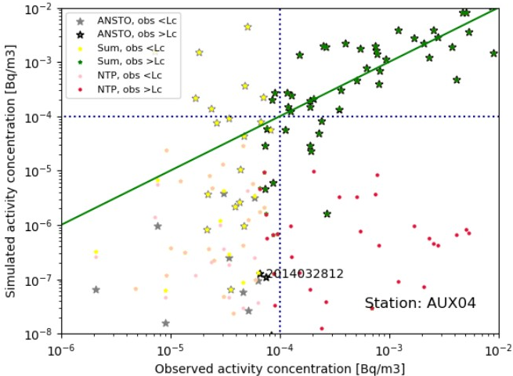
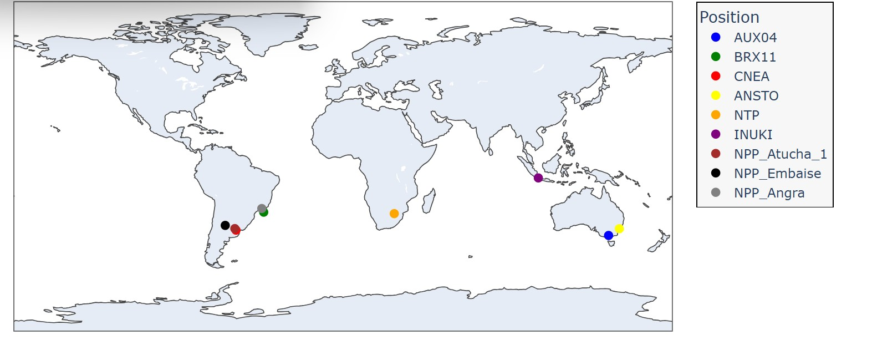

P3.6-017
Assessment of the influence of radioxenon releases from civil nuclear activities on measured air concentrations by CTBTO IMS stations using atmospheric transport modeling (ATM)
Modou Niang, Martin B. Kalinowski,Ndeye Arame BOYE FAYE
Material and methods
1.1 Sampling data
1.2. Atmospheric transport modeling
 | NTP |  | INUKI
 | AUX04 | BRX11 | AUX04
2014 | 3.06e+15 | 1.37e+15 | -------
2015 | 3.92e+15 | 1.60e+16 | 2.97e+14
2016 | 1.01e+16 | -------- | 3.04e+14
2017 | 4.39e+15 | 4.26e+16 | -------
2018 | 1.40e+16 | 5.76e+15 | 2.29e+14
2019 | 1.53e+15 | 7.99e+14 | --------
2020 | 2.43e+16 | -------- | 4.48e+14
2021 | 8.47e+15 | 3.28e+15 | -------
2022 | 2.29e+16 | 2.38e+16 | 5.91e+13
Eslinger et al.(2014) | 6.30e+13 |  | 6.30e+11
2. Results
This study used ¹³³Xe concentration data collected over eight years from two sampling locations (AUX04, BRX11).The xenon samplers at these IMS stations are Swedish Automatic Units for Noble gas Analysis (SAUNA) units developed at the Swedish Defense Research Agency. These samplers extract xenon from the atmosphere and convert it into liquid form before determining the amount of radioactivity in the sample. They use a 12-h xenon collection period and report two concentration estimates per day.
In addition, data were downloaded via the RNtoolkit software (V.0.3.5) from the CTBTO website. RNToolkit is a web software tool to provide CTBTO authorized users fast and easy access to radionuclide detections of the IMS network based on IDC analysis. The below figure shows the locations of the medical isotope production facilities and IMS stations that are being considered in this study.
Atmospheric transport of ¹³³Xe was modeled using Continuously Emitting Sources (CES). The CES functionality calculates the predicted concentrations of a set of continuously emitting sources like medical facilities in samples of selected IMS station using the corresponding source-receptor sensitivity (SRS) fields.
The below figure shows the example of observed and simulated concentrations at AUX04 in the year 2014. Concentrations not explained by ANSTO emissions with strong influence from NTP were used to infer the source strength of that medical isotope production facility.
The daily release estimates from NTP in South Africa for AUXO4 vary from 3.06e+15 to 2.43e+16 (in average 1.03e+16 for AUX04 and 1.34e+16 for BRX11). While, the daily release from INUKI in Indonesia vary from 5.91e+13 to 4.48e+14 in average source 2.67e+14 for AUXO4.These are higher than the release estimate by Eslinger. This is consistent with the experience that short-term peak emissions are higher than averages based on annual total releases.
Disclaimer
The views expressed on this presentation are those of the authors and do not necessarily reflect the view of any organization the authors are currently of have been previously affiliated with.

