Slide 1

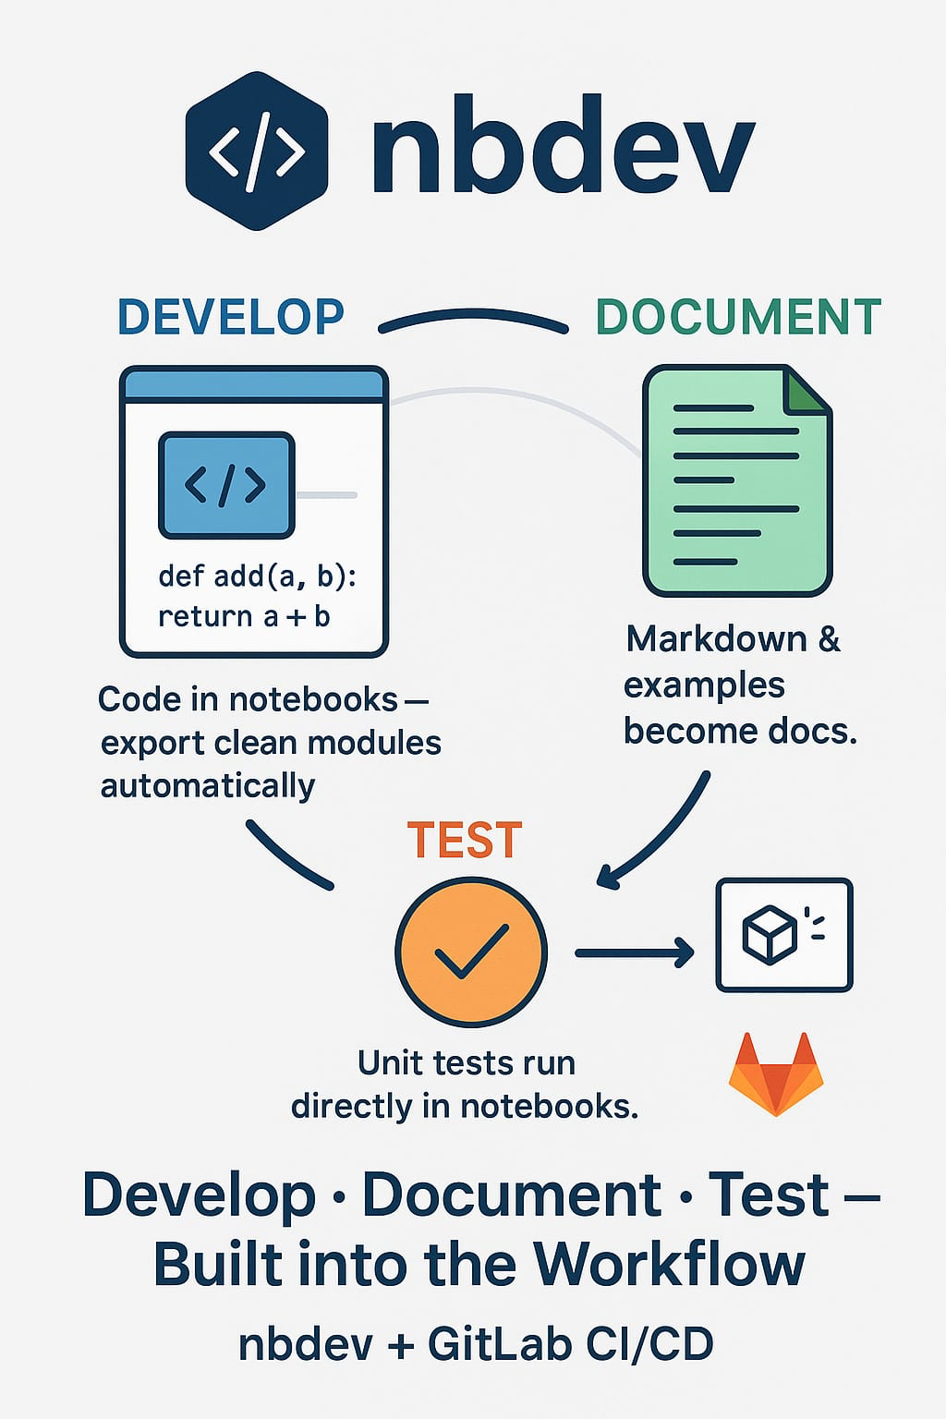

P3.6-550
(Re)Development of IDC software for particulate and HPGe noble gas analysis
Ian Hoffman, Niall Murphy, Aleksandr Shashkin
Provisional Technical Secretariat, CTBTO Preparatory Commission
Our poster is about updating and modernizing the IDC radionuclide software for particulate and HPGe noble gas analysis.
I am going to tell you what design requirements are important, and talk about use of nbdev, an exciting approach to software development.
Nbdev is an exploratory notebook environment that is self-documenting, with integrated software tests that can be fully integrated into CI/CD deployments
If you want to find out more, come over for a chat in front of our poster
DISCLAIMER DISCLAIMER The views expressed on this e-poster are those of the author and do not necessarily reflect the view of the CTBTO Preparatory Commission

