Slide 1


P3.6-550
(Re)Development of IDC software for particulate and HPGe noble gas analysis
Ian Hoffman, Niall Murphy, Aleksandr Shashkin
Provisional Technical Secretariat, CTBTO Preparatory Commission
The particulate and HPGe noble gas analysis engine, Autosaint, has been in use at the International Data Centre (IDC) for over a decade. This code is the last RN analysis component written in C, with Python 3 being the current standard. This presentation will show the requirements, technical considerations, planned features and functions of the new analysis engine under development in the IDC.
DISCLAIMER The views expressed on this e-poster are those of the author and do not necessarily reflect the view of the CTBTO Preparatory Commission

Slide 2
PLEASE DON‘T FORGET TO PUT THE E-POSTER TITLE AND YOUR NAME IN THE PRESENTATION HEADER.
DUPLICATE THIS SLIDE IF YOUR E-POSTER HAS MORE THAN 1 PAGE
P3.6-550
(Re)Development of IDC software for particulate and HPGe noble gas analysis
Ian Hoffman, Niall Murphy, Aleksandr Shashkin
Introduction
Mandatory Requirements
Potential Improvements
The Comprehensive Nuclear-Test-Ban Treaty (CTBT) was opened for signature in 1996. The technological underpinnings of the verification regime were developed in this context. The current RN particulate operational software in use at the IDC, Autosaint, was developed to meet the early needs of the IDC.
With the ongoing migration of the software in use at the Provisional Technical Secretariat to Python, it is timely to formulate requirements and capabilities for the next generation particulate and high-purity germanium (HPGe) noble gas analysis platform.
Since 1996, radionuclide measurement technology has advanced. Higher sensitivity measurements using multiple detectors¹, cosmic veto and Compton suppression have improved the sensitivity of laboratory measurements. Further advances such as list mode analyses where individual pulses can be analysed and interpreted have allowed for valuable inferences into the underlying genesis mechanism of aerosols². These inferences can assist in screening relevant samples.
Simultaneously, further elaboration of policies and procedures, such as Expert Technical Analysis have meant that the software of the future should be flexible to support capabilities beyond current requirements.
The software used at the IDC should:
Be open source and python-based, for consistency with other IDC software and long-term maintainability
Be fit for the purpose of treaty monitoring (CTBT relevant radionuclides fully supported)
Have CTBT tailored identification rules for aerosol/air filter analysis (e.g. parent-daughter, in-growth, half-life)
Use Natural radionuclides present for QA/QC, calibration, while supporting civil and scientific applications
Provide easy metrics that show if sample requirements are met (timely, sufficient air flow, etc.)
Have metrics and criteria for peak identification based upon risk level
Support Expert Technical Analysis requirements (i.e. non-standard algorithms through modular software environment)
Support future changes in technology and analysis procedures (e.g. IDC should be able to see raw laboratory results in the case of dual detector systems (T-list))
A change in operational software should improve, augment or expand upon existing capabilities. Some of the areas where improvements could be made are:
Use derivative method for peak location, but remain flexible to other approaches (e.g. correlation)
Improve calibration process and provide analysts with better tools and information (fitting metrics, residuals) to visualize calibration source options
Default energy/resolution calibration from naturals present in spectra, compare with other calibration data sources (QC, SPHDF file, GrandSIM Monte Carlo simulation)
Generalised calibration fitting functions (e.g. degree of polynomial, √ polynomial) with goodness of fit metrics (i.e. reduced Χ²)
Increased peak fitting flexibility (e.g. Gaussian high/low tail independent, Voigt peak shape for x-rays, annihilation)
Multiplet fitting/deconvolution capability with residuals
Implement Absolute Total Efficiency calibration capability for improved isotope quantification
PREL spectra peak area evolution for nuclide ID support
Summation peak, escape peak identification
DISCLAIMER The views expressed on this e-poster are those of the author and do not necessarily reflect the view of the CTBTO Preparatory Commission

Slide 3
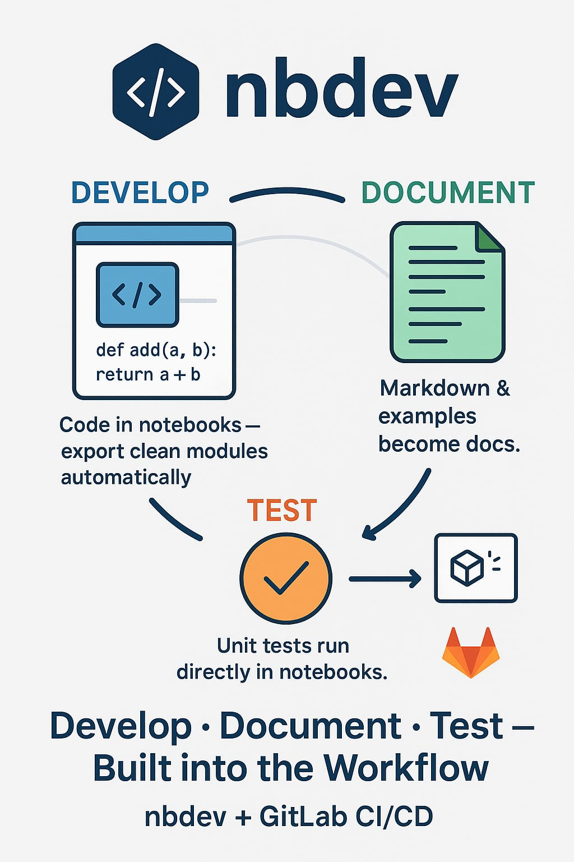
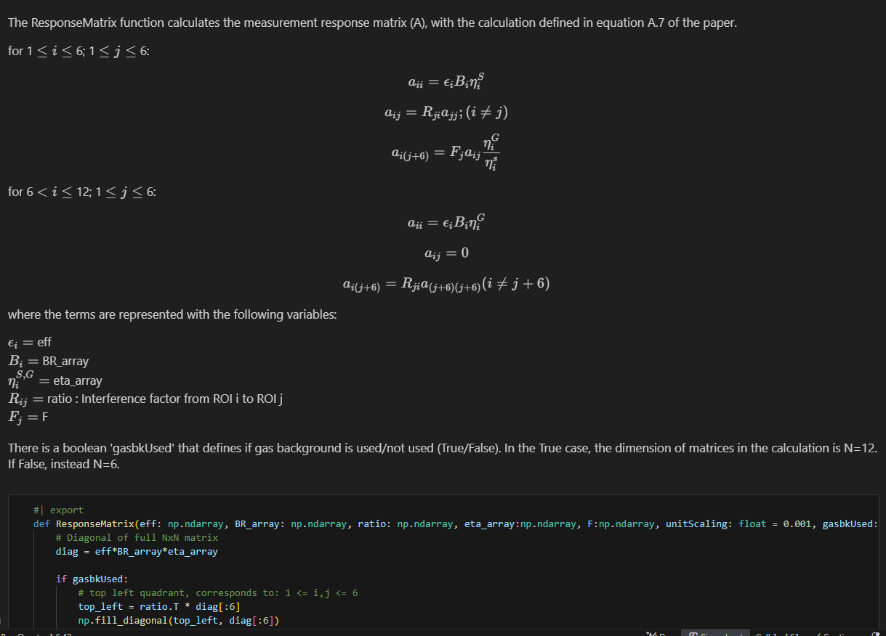
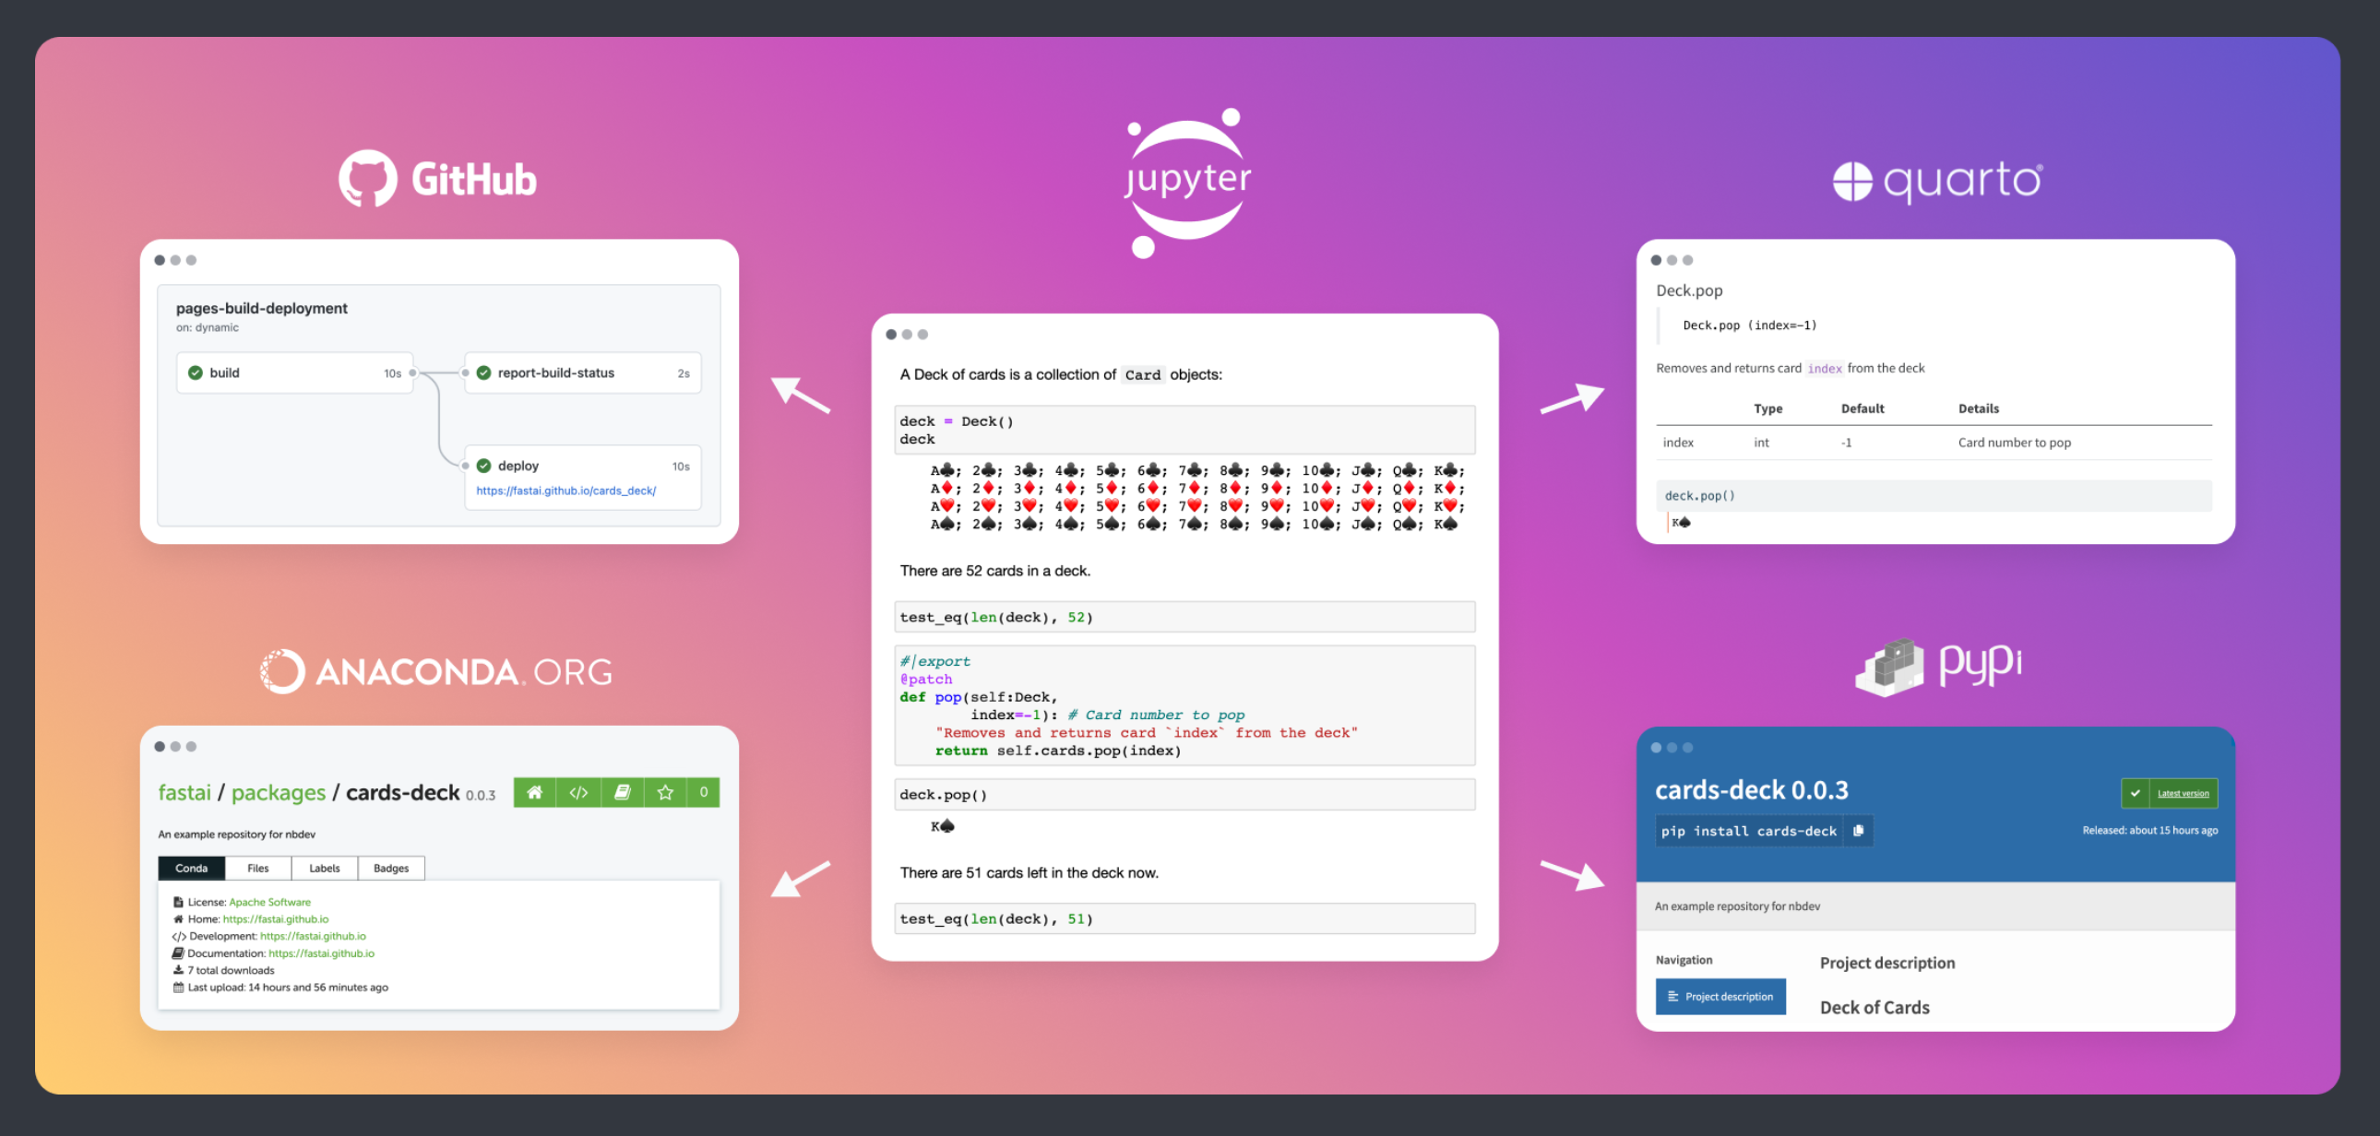
PLEASE DON‘T FORGET TO PUT THE E-POSTER TITLE AND YOUR NAME IN THE PRESENTATION HEADER.
DUPLICATE THIS SLIDE IF YOUR E-POSTER HAS MORE THAN 1 PAGE
P3.6-550
(Re)Development of IDC software for particulate and HPGe noble gas analysis
Ian Hoffman, Niall Murphy, Aleksandr Shashkin
Proposed Architecture
Nbdev Features
The code should be maintainable and upgradeable (python libraries)
Use/expand upon common library of pre-existing scientific functions (pyrnbase)
Modular design to support data and analysis exploration
Unit and Functional tests using curated synthetic spectra and certified spiked samples to ensure deployment quality
Leverage nbdev (https://nbdev.fast.ai/) – notebook environment for self-documenting code that is fully integrated
Code tests fully integrated into CI/CD deployment process.
Git (software repository) fully supported
Quarto (https://quarto.org/) for technical publications - manuals, graphs, journal manuscripts.
Inline (markdown) and automatically generated external documentation (pdf, html, doc, ePub)
Notebook fully syncs with plaintext source code
Markdown (Inline) Documentation
Conclusion
The adoption of this framework will result in a code base that improves modularity, performance, extensibility and maintainability. The new software should allow analysts to focus on spectra of interest and reduce analysis burden for normal/natural spectra.
References
¹. R. Britton, A.V. Davies,
Next-generation particulate monitoring, Applied Radiation and Isotopes, Volume 184,2022,110156, ISSN 0969-8043, https://doi.org/10.1016/j.apradiso.2022.110156
². Ian Hoffman, et al. Determination of the source location of anthropogenic radionuclides collected in Finland and Sweden in June 2020 using a multi-technology analysis, Journal of Environmental Radioactivity, Volume 278, 2024, 107508, ISSN 0265-931X, https://doi.org/10.1016/j.jenvrad.2024.107508
DISCLAIMER The views expressed on this e-poster are those of the author and do not necessarily reflect the view of the CTBTO Preparatory Commission
Code

