Slide 1

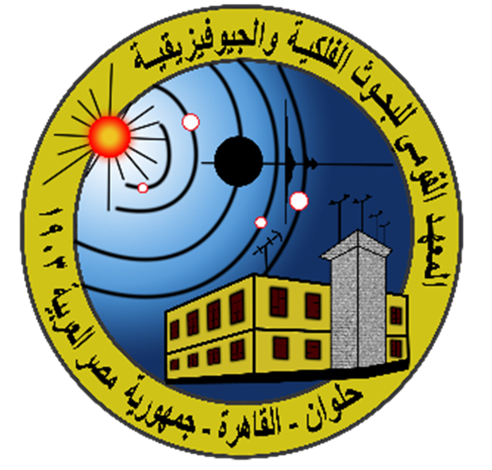
P3.5-342
Earthquake-nuclear-explosion Discrimination using Discrete Wavelet Transform Machine Learning (DWTML) supervised techniques
Shimaa H. Elkhouly, Ghada Ali & Mahmoud Salam
National Research Institute of Astronomy and Geophysics
Our study focuses on the classification of earthquakes and nuclear explosions using the Discrete Wavelet Transform (DWT) in conjunction with multiple machine learning (ML) techniques.
By integrating various wavelet filters, we aimed to enhance the performance and accuracy of the ML algorithms in this investigation.
We extracted 26 frequency bands from the seismic signals and used them as inputs for eight different ML models resulting in a total of 208 trained models.
From this analysis, 11 frequency bands achieved AUC values greater than 80%, while two specific bands reached the highest performance with AUC values of 83%.These results demonstrate the effectiveness of combining wavelet-based signal decomposition with diverse ML models for accurate seismic event classification.
. WELCOME TO OUR POSTER TO LEARN MORE

