Slide 1

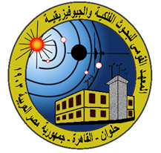
P3.5-342
Earthquake-nuclear-explosion Discrimination using Discrete Wavelet Transform Machine Learning (DWTML) supervised techniques
Shimaa H. Elkhouly^{(1*)}, Ghada Ali⁽¹⁾ & Mahmoud Salam⁽¹⁾
⁽¹⁾ National Research Institute of Astronomy and Geophysics (NRIAG)
Accurately distinguishing between nuclear explosions and earthquakes by manual discrimination or automatic discrimination is crucial in the field of seismic signal analysis. Multi resolution analysis (MRA) of Discrete Wavelet Transform (DWT) has emerged as an innovative approach to differentiate between seismic activities caused by earthquakes and those triggered by nuclear explosions. Utilizing waveforms from 295 nuclear explosions and 369 earthquakes, the proposed algorithm attains an 83% discrimination accuracy.
.
DISCLAIMER: The views expressed on this e-poster are those of the author and do not necessarily reflect the views of the CTBTO

Slide 2
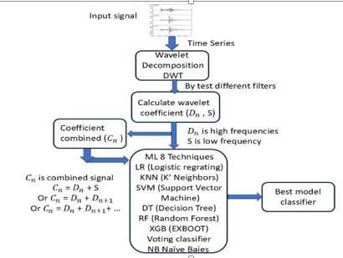
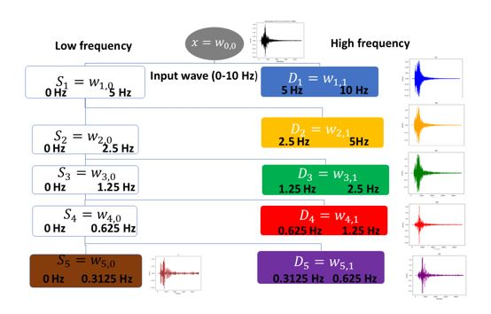
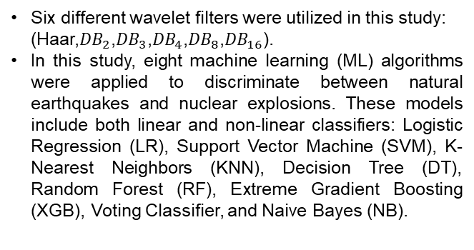
Earthquake-nuclear-explosion Discrimination using Discrete Wavelet Transform Machine Learning (DWTML) supervised techniques
Shimaa H. Elkhouly, Ghada Ali & Mahmoud Salam
P3.5-342
Introduction
Methodology
We aim to employ the wavelet transform technique for the precise classification of seismic events. The dataset consists of waveforms from 295 underground nuclear explosions conducted in different regions worldwide with 369 natural earthquakes from neighboring regions. All events fall within the same magnitude range of 4 ≤ mb ≤ 6.5.
In this work, we propose a method to extract discriminative features using a wavelet filter bank. The algorithm is based on analyzing the energy distribution of seismic signals in the time-frequency domain using MRA which decomposes the signal into approximation components (low-frequency content, denoted as S) and detail components (high-frequency content, denoted as D) across multiple levels of resolution.
Figure (2). Proposed Model of this Study
Six different wavelet filters were utilized in this study: (Haar,${DB}_{2}$,${DB}_{3}$,${DB}_{4}$,${DB}_{8}$,${DB}_{16}$).
In this study, eight machine learning (ML) algorithms were applied to discriminate between natural earthquakes and nuclear explosions. These models include both linear and non-linear classifiers: Logistic Regression (LR), Support Vector Machine (SVM), K-Nearest Neighbors (KNN), Decision Tree (DT), Random Forest (RF), Extreme Gradient Boosting (XGB), Voting Classifier, and Naive Bayes (NB).
Figure (3). Haar filter effect on earthquake and nuclear explosion at AAK station
Figure (1). Frequency bands of each detail and smooth

Slide 3
PLEASE DON‘T FORGET TO PUT THE E-POSTER TITLE AND YOUR NAME IN THE PRESENTATION HEADER.
DUPLICATE THIS SLIDE IF YOUR E-POSTER HAS MORE THAN 1 PAGE
P3.5-342
Earthquake-nuclear-explosion Discrimination using Discrete Wavelet Transform Machine Learning (DWTML) supervised techniques
Shimaa H. Elkhouly, Ghada Ali & Mahmoud Salam
Results
Among the tested Multi-Resolution Analysis (MRA) levels, the third detail component extracted using the DB3 wavelet filter in combination with the Random Forest (RF) algorithm demonstrated the most effective performance, consistently outperforming other configurations with an AUC of 77.5%.
The smooth component (Sₘ) delivered outstanding accuracy when used with Support Vector Machines (SVM) and K-Nearest Neighbors (KNN), while the third and fifth detail levels continued to show high accuracy with the Random Forest model
Figure 5: Display the effectiveness of the combined frequency bands on AUC accuracy.
These results demonstrate that combining relevant frequency components can significantly improve the model’s ability to discriminate between seismic event types, especially when using optimized wavelet filters and robust ML algorithms like Random Forest.
Conclusion
Based on the findings, the third detail component extracted using the DB3 wavelet filter in combination with the Random Forest (RF) algorithm demonstrated the most effective individual performance, achieving an AUC of 77.5%. Notably, this performance is equivalent to the accuracy obtained when applying time-domain waveforms discriminating between earthquakes and nuclear explosions.
This study applied 20 different combined input C1 & C7 achieved the highest AUC accuracy reaching 83%. These results highlight the effectiveness of combining multiple frequency component to enhance the discriminative power of machine learning models in seismic event classification.
In the future, we aim to apply the same methodology using a larger dataset and explore additional
machine learning algorithms to further enhance classification performance.
Figure 4: AUC of the different details for the eight ML models.
In this study, 20 different combined inputs were generated by merging various combinations of detail and smooth components, resulting in 26 unique frequency band inputs. Each of these was used to train eight different ML techniques, and all were processed through six different DWT filters.

