Slide 1

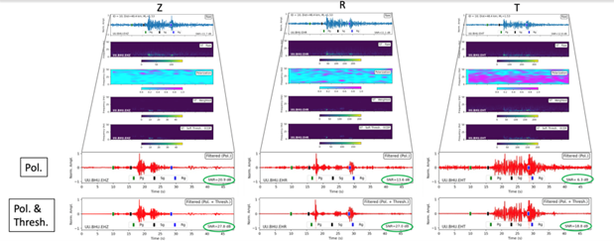


Using Nonlinear Thresholding of Stockwell Transforms to Denoise Seismic Waveforms
Rigobert Tibi
Sandia National Laboratories (SNL)
P3.5-179
Come over to see our poster if you would like to find more about:
The advantage that the Stockwell Transform (ST) provides compared with the wavelet or the Fourier transform,
Signal enhancement approaches, such as thresholding and polarization filtering in the ST domain, and
How thresholding can be used to remove noise that persist after polarization filtering, improving the signal-to-noise ratio further and allowing an effective exploitation of the different phases.
ACKNOWLEDGMENTS: Sandia National Laboratories is a multimission laboratory managed and operated by National Technology and Engineering Solutions of Sandia, LLC, a wholly owned subsidiary of Honeywell International, Inc., for the U.S. Department of Energy’s National Nuclear Security Administration under contract DE-NA-0003525. The views expressed here do not necessarily reflect the views of the United States Government, the United States Department of Energy. This research was funded by the National Nuclear Security Administration, Defense Nuclear Nonproliferation Research and Development (NNSA DNN R&D). SAND2025-11153C
.

