Slide 1




P3.5-179
Using Nonlinear Thresholding of Stockwell Transforms to Denoise Seismic Waveforms
Rigobert Tibi
Sandia National Laboratories (SNL)
Stockwell transform (ST) is an extension of the continuous wavelet transform (CWT). In contrast to CWT and short-time Fourier transform, however, ST provides a better time and frequency resolution. We leveraged that advantage by implementing signal enhancement approaches in the ST domain. Thresholding in ST domain appears to be an efficient method for noise suppression and can be used to remove noise that persists after polarization filtering.
ACKNOWLEDGMENTS: Sandia National Laboratories is a multimission laboratory managed and operated by National Technology and Engineering Solutions of Sandia, LLC, a wholly owned subsidiary of Honeywell International, Inc., for the U.S. Department of Energy’s National Nuclear Security Administration under contract DE-NA-0003525. The views expressed here do not necessarily reflect the views of the United States Government, the United States Department of Energy. This research was funded by the National Nuclear Security Administration, Defense Nuclear Nonproliferation Research and Development (NNSA DNN R&D). SAND2025-11152C

Slide 2
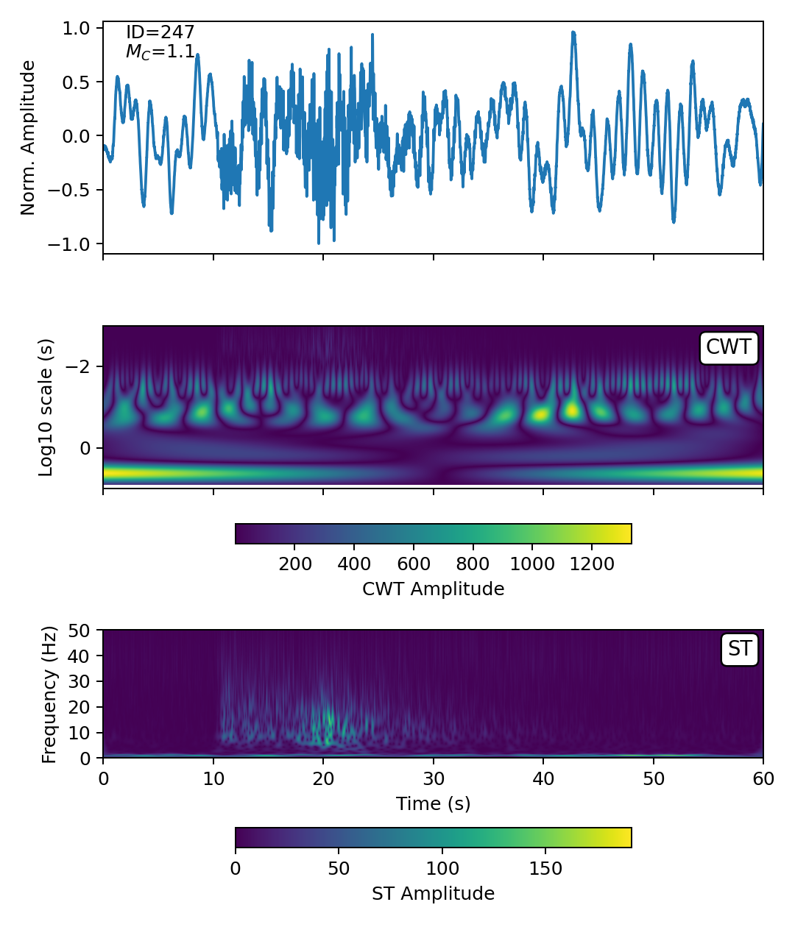
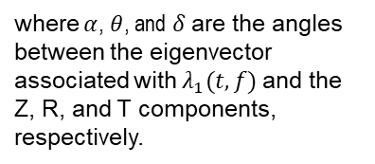
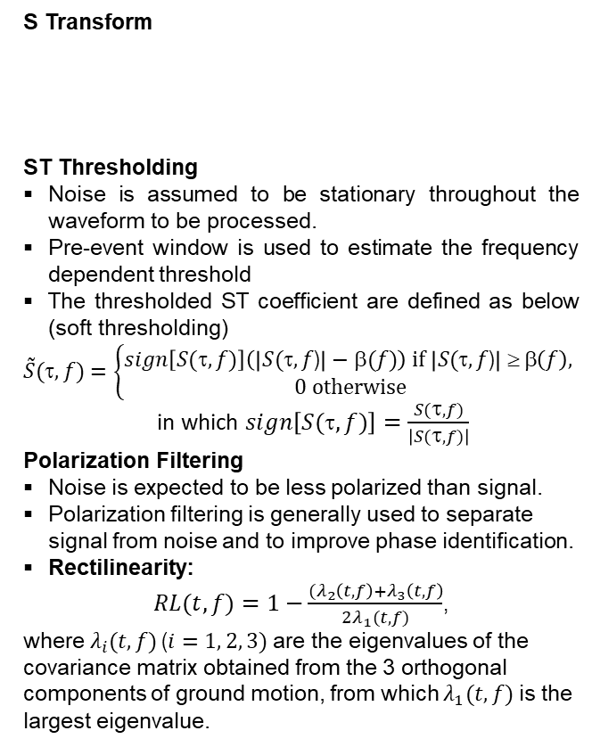
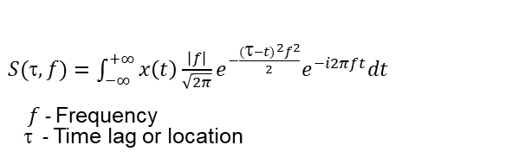
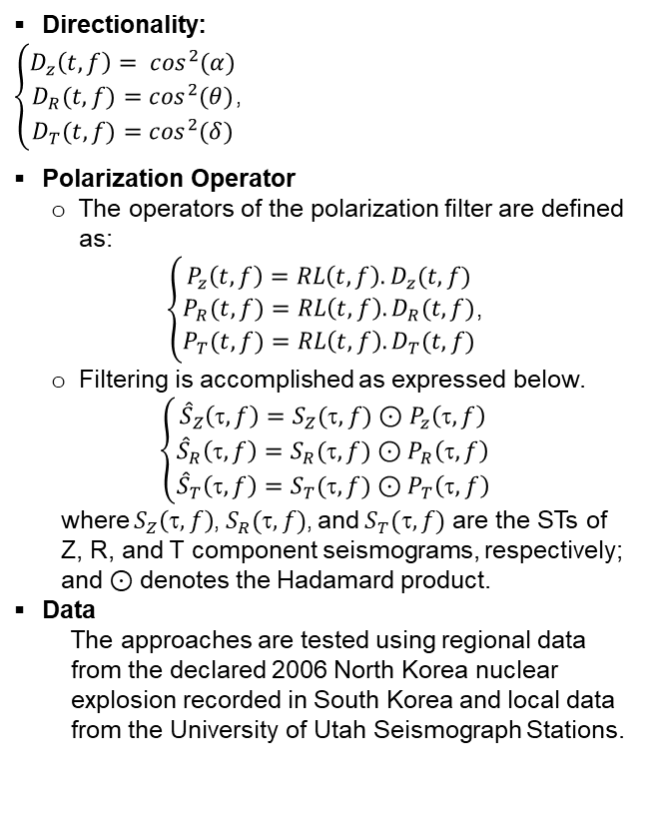
Using Nonlinear Thresholding of Stockwell Transforms to Denoise Seismic Waveforms
Rigobert Tibi
P3.5-179
Introduction
Methods and Data
Methods and Data (continued)
Despite significant progress in seismic data analysis, the separation of signal and noise remains a fundamental problem.
In the seismology community, frequency filtering (FF) is the most commonly used method for noise suppression.
When the signal of interest and noise share the same frequency band, noise cannot be filtered out with FF without infringing on the signal of interest.
Therefore, there is a need for alternative methods for noise suppression.
S Transform
ST Thresholding
Noise is assumed to be stationary throughout the waveform to be processed.
Pre-event window is used to estimate the frequency dependent threshold
The thresholded ST coefficient are defined as below (soft thresholding)
$\tilde{S}(τ,f)$ $=\left\{\begin{aligned}sign\left[S(τ,f)\right]\left(\left|S(τ,f\text{)}\right|−β(f)\right) if \left|S(τ,f\text{)}\right| ≥ β\left(f\right), \\ 0 otherwise\end{aligned}\right.$ in which $sign\left[S(τ,f)\right]=\frac{S(τ,f)}{\left|S(τ,f)\right|}$
Polarization Filtering
Noise is expected to be less polarized than signal.
Polarization filtering is generally used to separate signal from noise and to improve phase identification.
Rectilinearity:
    $RL(t, f)=1−\frac{{(λ}_{2}\left(t,f\right)+λ_{3}\left(t,f\right)}{2λ_{1}(t,f)}$,
    where$λ_{i}(t,f)$ ($i=1, 2, 3)$ are the eigenvalues of the covariance matrix obtained from the 3 orthogonal components of ground motion, from which $λ_{1}(t,f)$ is the largest eigenvalue.
  where $α$, $θ$, and $δ$are the angles between the eigenvector associated with $λ_{1}(t,f)$ and the Z, R, and T components, respectively.
Directionality:
  $\left\{\begin{aligned}D_{z}\left(t,f\right)= \cos^{2}(α) \\ D_{R}(t,f)=\cos^{2}(θ) \\ D_{T}(t,f)=\cos^{2}(δ)\end{aligned}\right.$,
Polarization Operator
  The operators of the polarization filter are defined as:
    $\left\{\begin{aligned}P_{z}\left(t,f\right)=RL\left(t,f\right).D_{z}(t,f) \\ P_{R}(t,f)=RL\left(t,f\right).D_{R}(t,f) \\ P_{T}(t,f)=RL\left(t,f\right).D_{T}(t,f)\end{aligned}\right.$,
  Filtering is accomplished as expressed below.
  $$\left\{\begin{aligned}{\hat{S}}_{Z}\left(,f\right)=S_{Z}(,f)⊙P_{z}\left(,f\right) \\ {\hat{S}}_{R}\left(,f\right)=S_{R}(,f)⊙P_{R}\left(,f\right) \\ {\hat{S}}_{T}\left(,f\right)=S_{T}(,f)⊙P_{T}\left(,f\right)\end{aligned}\right.$$
        where $S_{Z}\left(τ,f\right)$, $S_{R}(,f)$, and $S_{T}(,f)$ are the STs of Z, R, and T component seismograms, respectively; and $⊙$ denotes the Hadamard product.
        Data
          The approaches are tested using regional data from the declared 2006 North Korea nuclear explosion recorded in South Korea and local data from the University of Utah Seismograph Stations.
$S(τ, f)=\int_{−∞}^{+∞}{x\left(t\right)\frac{\left|f\right|}{\sqrt{2π}}e^{−\frac{{(τ−t)}^{2}f^{2}}{2}}e^{−i2πft}dt }$ $f$- Frequency
      - Time lag or location
Objectives
Stockwell transform (ST) is an extension of the continuous wavelet transform (CWT). In contrast to CWT and short-time Fourier transform, however, ST provides a better time and frequency resolution.
The objectives of this work is to leverage the advantage in terms of resolution provided by ST by exploring signal enhancement approaches in that domain.
ACKNOWLEDGMENTS: Sandia National Laboratories is a multimission laboratory managed and operated by National Technology and Engineering Solutions of Sandia, LLC, a wholly owned subsidiary of Honeywell International, Inc., for the U.S. Department of Energy’s National Nuclear Security Administration under contract DE-NA-0003525. The views expressed here do not necessarily reflect the views of the United States Government, the United States Department of Energy. This research was funded by the National Nuclear Security Administration, Defense Nuclear Nonproliferation Research and Development (NNSA DNN R&D).

Slide 3
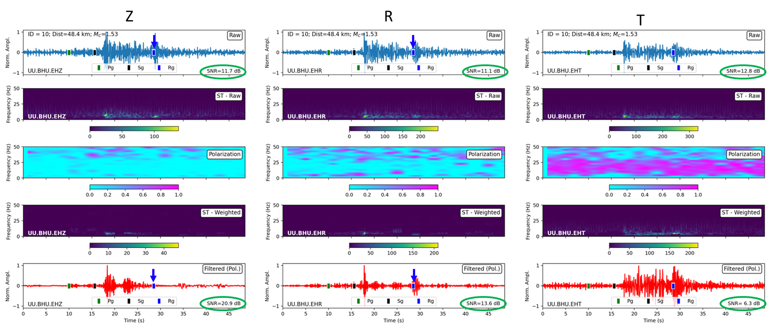
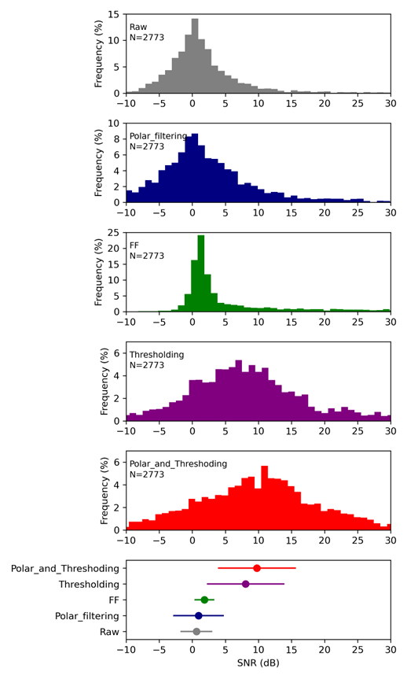
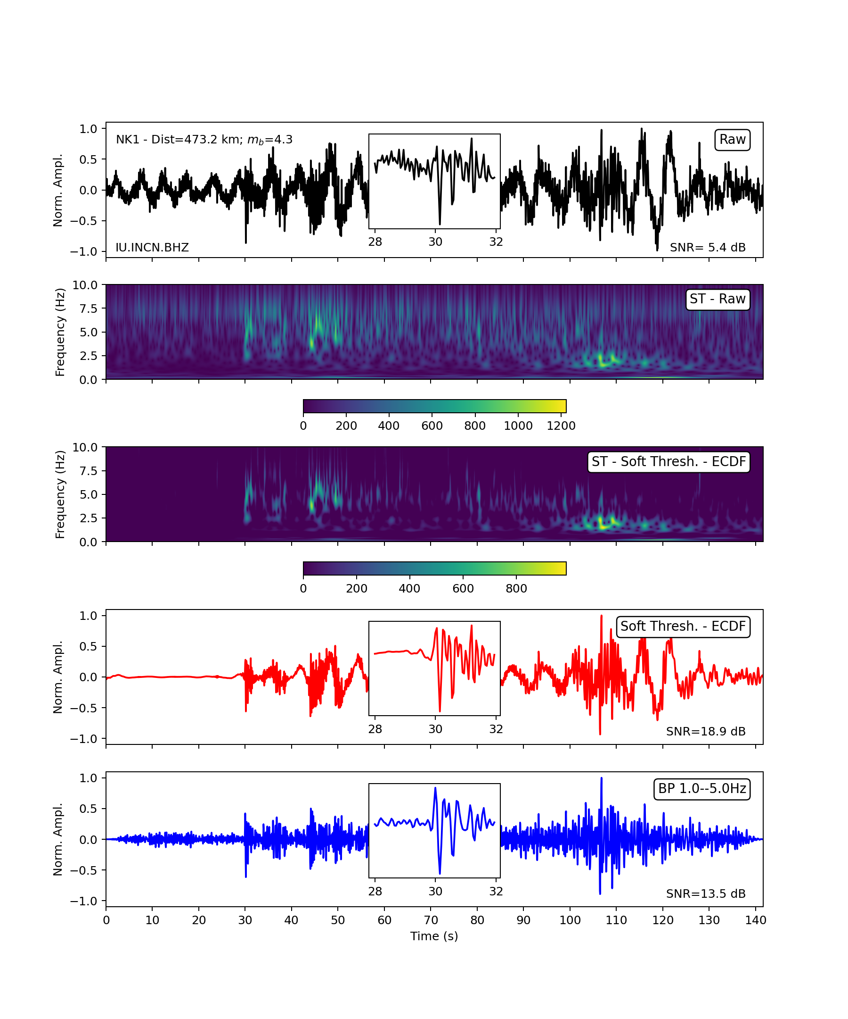
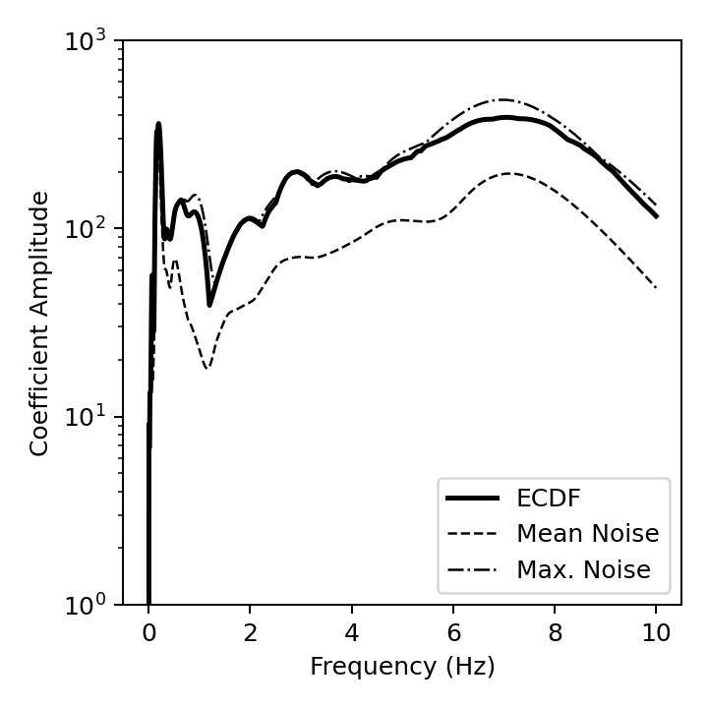
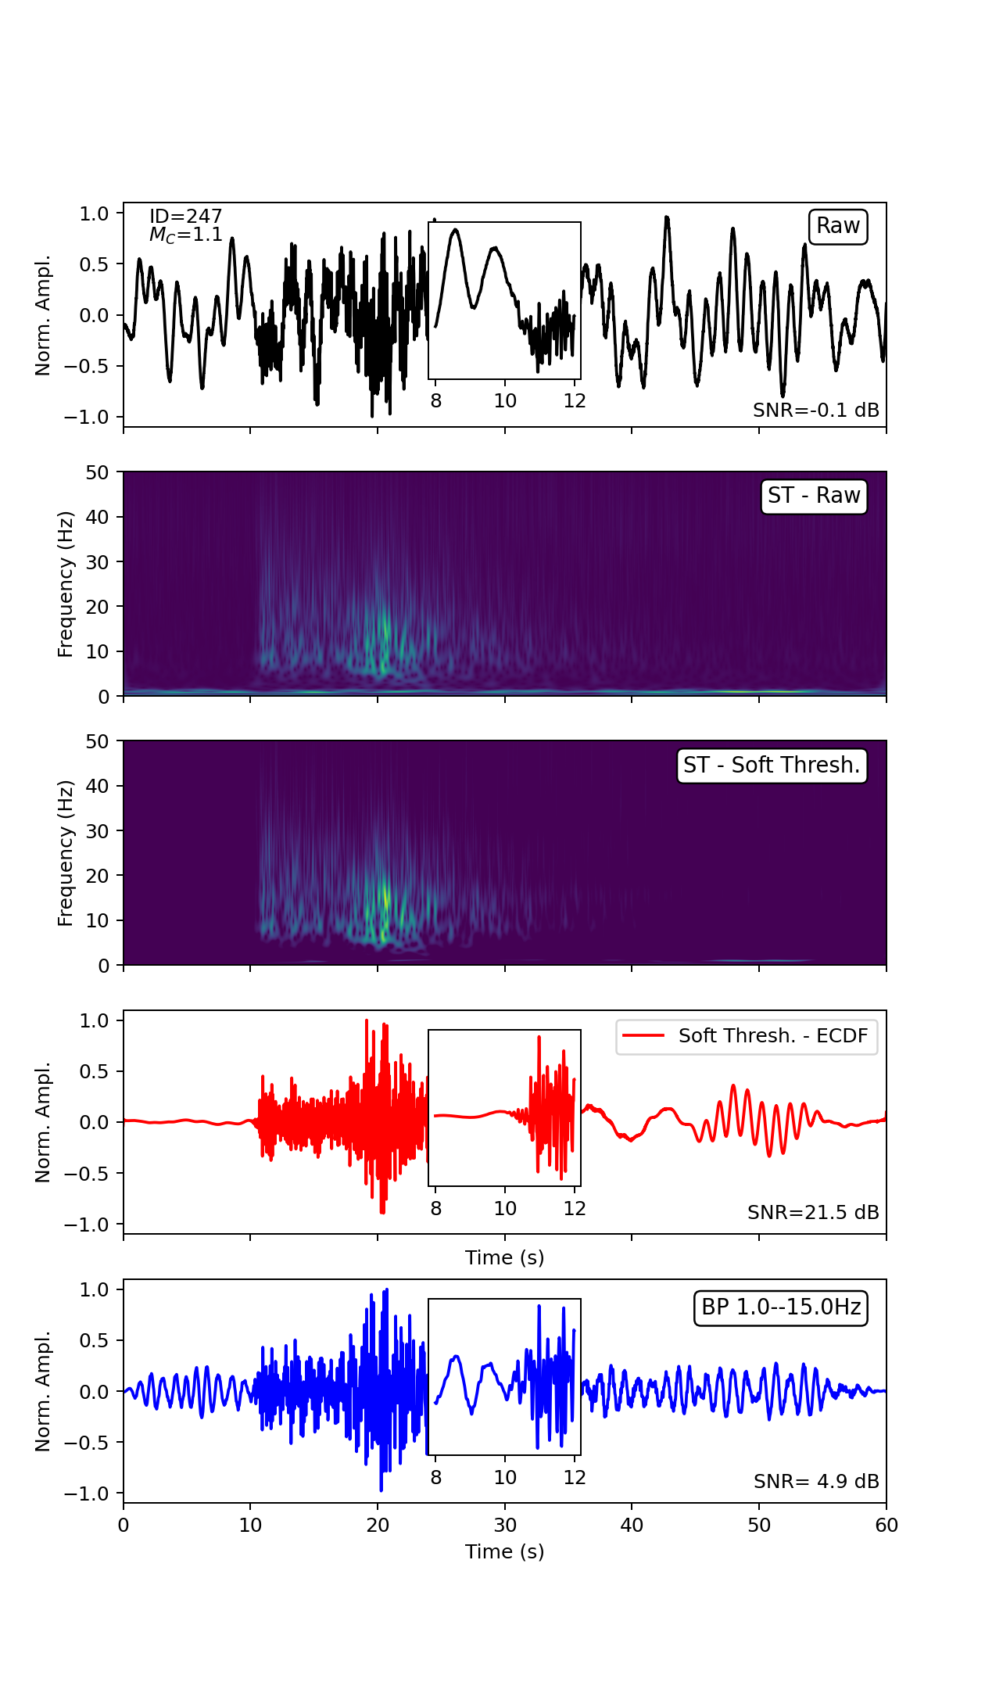
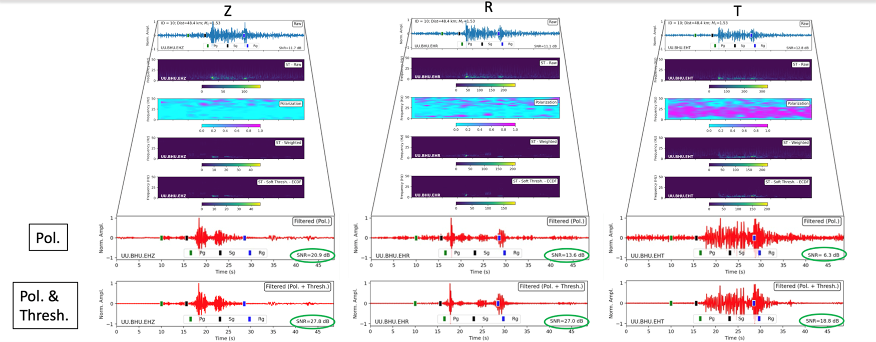
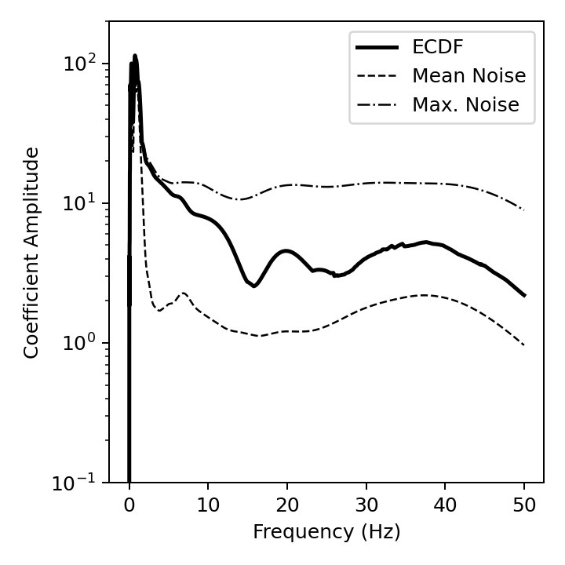
Using Nonlinear Thresholding of Stockwell Transforms to Denoise Seismic Waveforms
Rigobert Tibi
P3.5-179
Results
Results (continued)
Results (continued)
Examples ST Thresholding
Example Polarization Filtering
Regional Data
Distribution of SNR for the different approaches for a dataset of 2773 waveforms. The bottom plot shows for each method the median value of SNR and the associated median absolute deviation.
Data from the 2006 declared North Korea nuclear test recorded at station INCN located in South Korea.
The polarization filter in this case is tailored to improve signals that are linearly polarized. For that reason, Rg signals, which are elliptically polarized, are significantly reduced are fully suppressed. After polarization filtering, some noise still persists.
Local Data
Conclusions
This work is at its early stage; but based on handful of examples, the approaches are promising.
Thresholding in ST domain appears to be an efficient method for noise suppression and can be used to remove noise that persists after polarization filtering, improving the SNR further and allowing an effective exploitation of the different phases.
Future work includes evaluating the implement polarization filtering using synthetic data containing signals with known polarization attributes.
Data from a local event in Utah.
Noise that persists after polarization filter is removed using ST-thresholding as shown in this figure, further improving the SNR.
ACKNOWLEDGMENTS: Sandia National Laboratories is a multimission laboratory managed and operated by National Technology and Engineering Solutions of Sandia, LLC, a wholly owned subsidiary of Honeywell International, Inc., for the U.S. Department of Energy’s National Nuclear Security Administration under contract DE-NA-0003525. The views expressed here do not necessarily reflect the views of the United States Government, the United States Department of Energy. This research was funded by the National Nuclear Security Administration, Defense Nuclear Nonproliferation Research and Development (NNSA DNN R&D).

