Slide 1



P3.5-140
Automatic determination of the detection threshold of CTBTO seismological network
Jottin M. Leonel C.
Centro Nacional de Sismología de la Universidad Autónoma de Santo Domingo (CNS-UASD)
The effective detection threshold of the CTBTO seismological network is a key tool for prioritizing repairs of primary and auxiliary seismic stations. We develop an algorithm that automates its calculation, generating maps in seconds and updating them whenever a station goes offline. Although prior studies have used SNR-based approaches to construct seismic threshold maps, here we use the 2024 SSEB catalogue and apply the methodology of Moreno et al. (2002), which assumes a homogeneous, ideal Earth to simplify the computations. Our algorithm reproduces the expected global pattern—lower thresholds where IMS station density is higher and ambient noise is more favorable—and it also flags a recurring inconsistency in which very small magnitudes are reported at unexpectedly large epicentral distances.

Slide 2
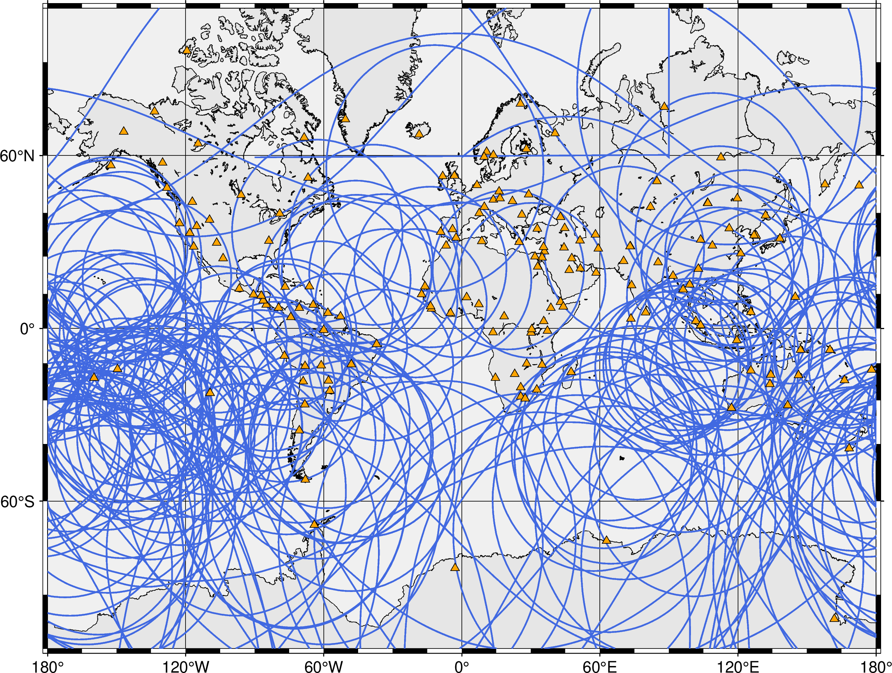
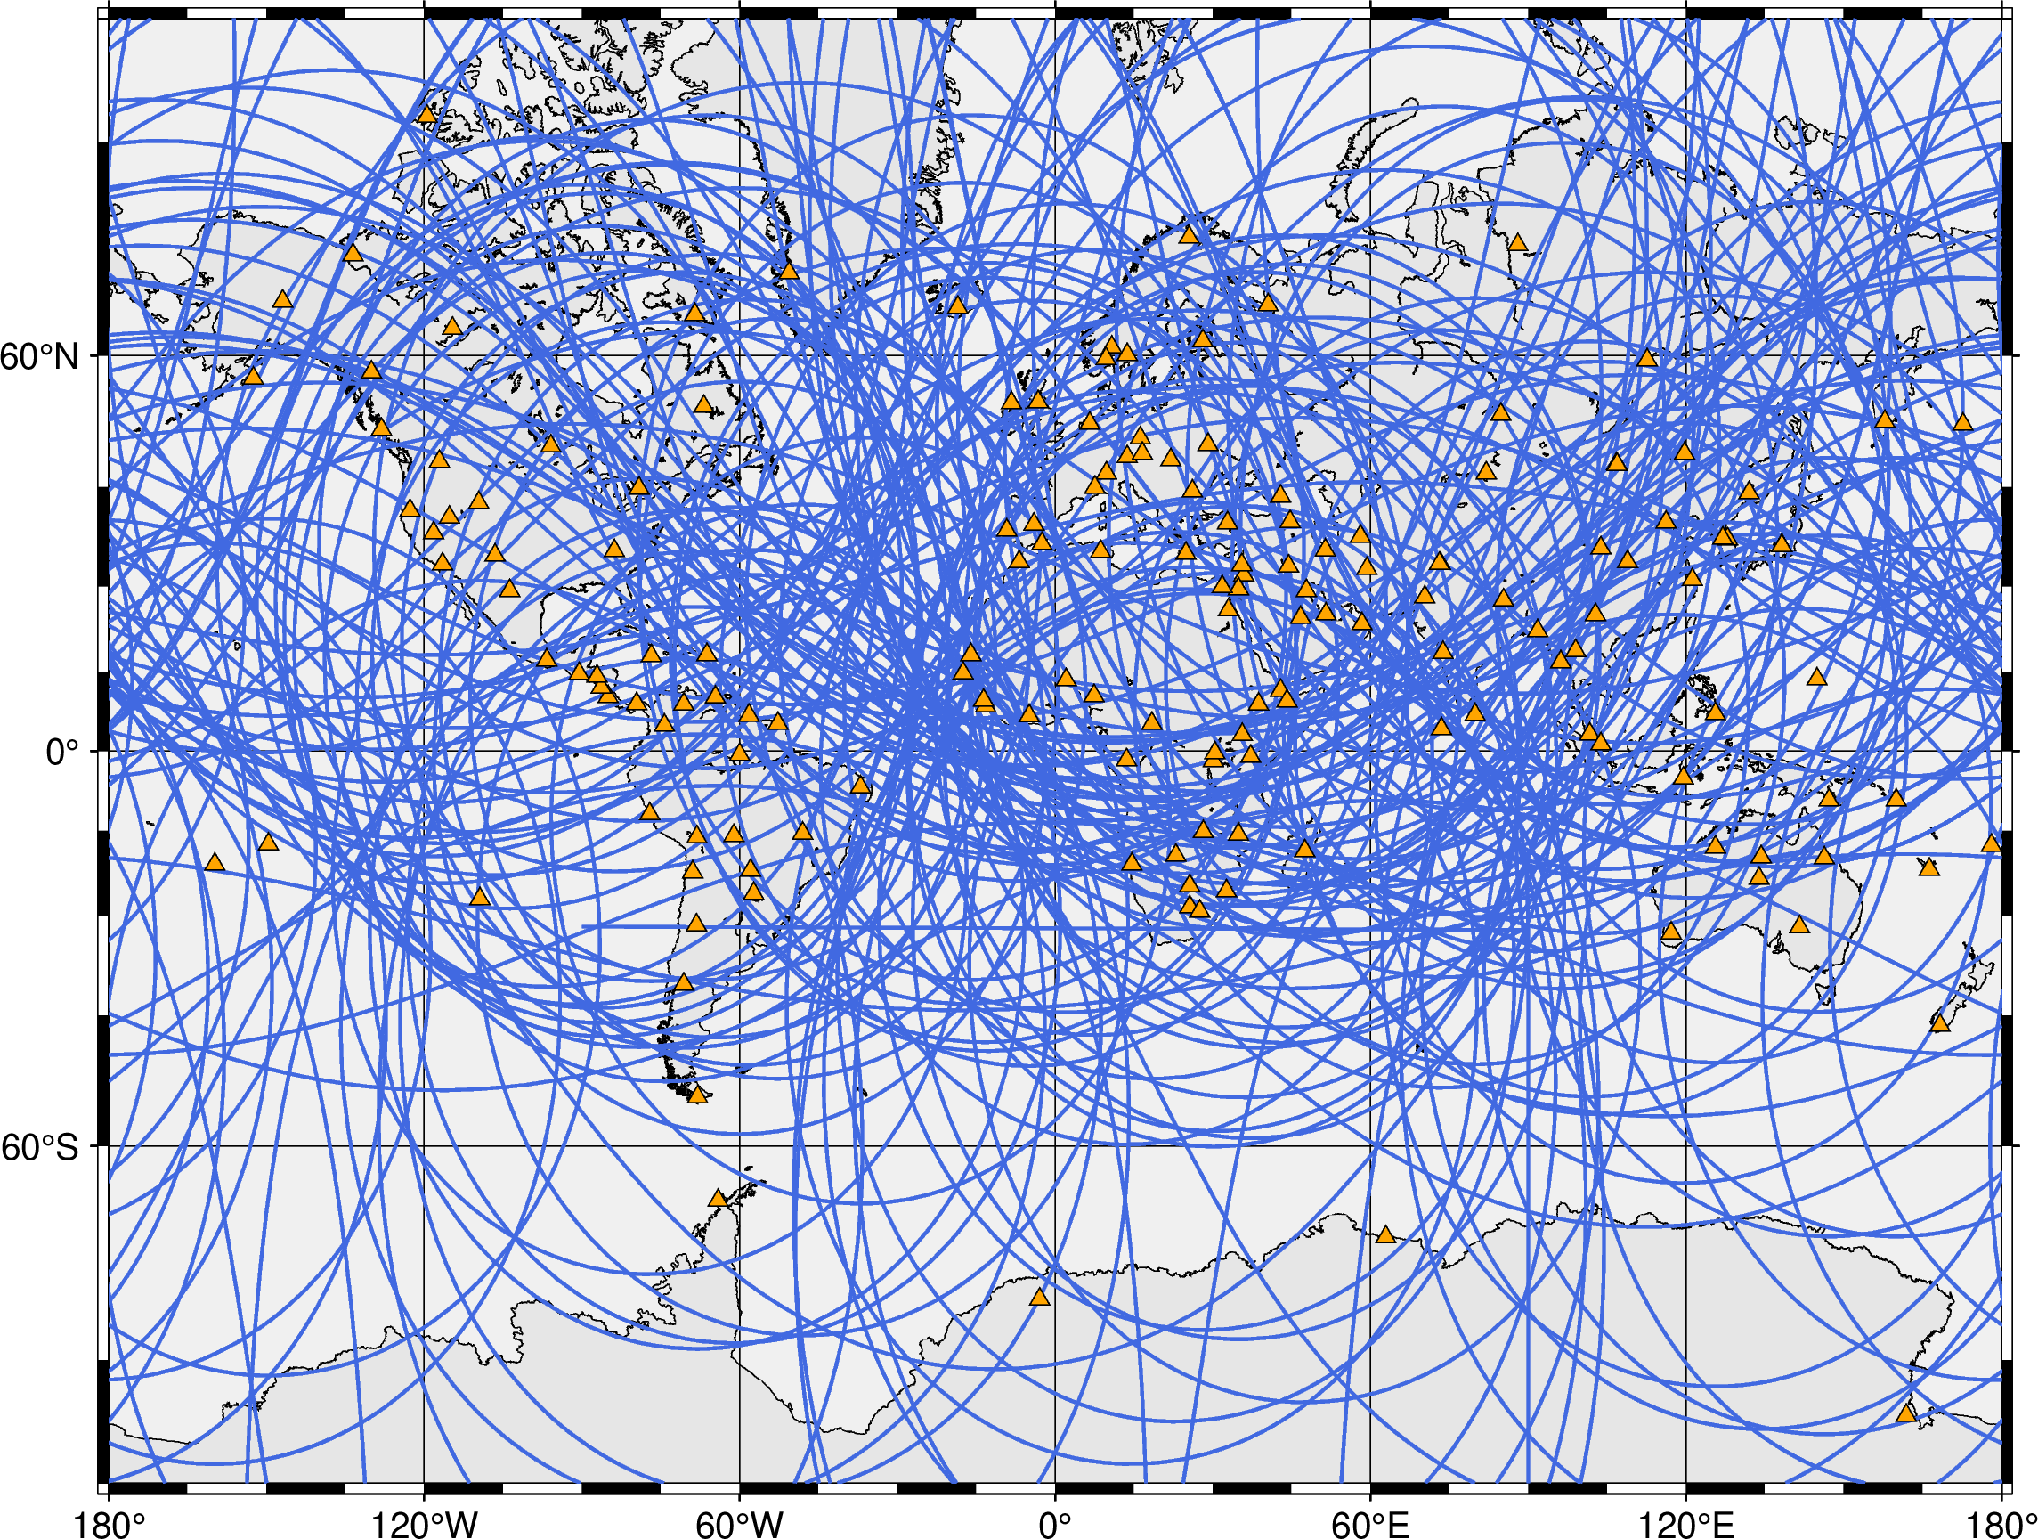

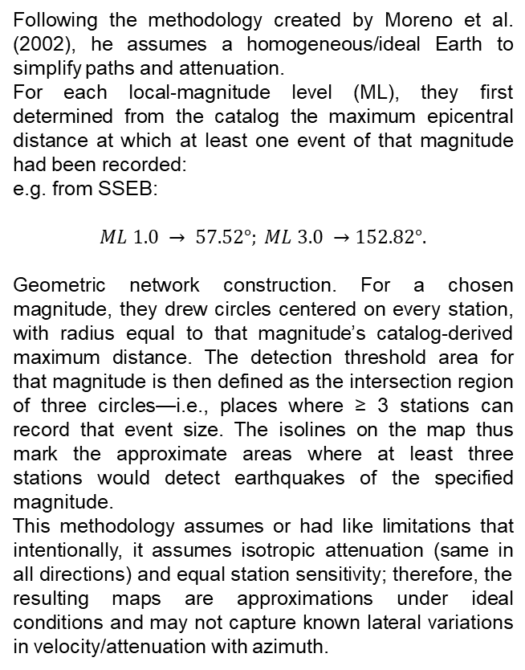
P3.5-140
Automatic determination of the detection threshold of CTBTO seismological network
Jottin Leonel
Previous studies:
Methodology
Result
Kværna and Ringdal (2013) quantify the detection capability of the IMS seismological network using the International Data Centre’s Reviewed Event Bulletin (REB) from 2001 to 2011. They estimate, for each primary and auxiliary station, a regionalized detection threshold and rank station performance. The authors used three methods that combine detection percentages by magnitude bin, Gaussian maximum-likelihood fitting, use of observed SNR, and corrections for non-detections to avoid bias.
Gaebler & Ceranna (2021) estimate the global detection capability of the IMS seismic network using a deterministic threshold-monitoring method driven by station ambient-noise measurements and distance-dependent mb correction curves. Evaluated the noise and array gains finding that primary (PS) network alone, an average global threshold of mb ≈ 4.0; adding auxiliary (AS) stations slightly improves performance, while including PKP arrivals (>120°) substantially lowers thresholds. Thay also report no systematic hourly or monthly variability. Comparisons with REB magnitudes indicate the method is conservative, implying that actual detection thresholds can be lower. The importantly, the study provides reproducible global maps and a framework to track network performance and impacts of configuration changes.
Following the methodology created by Moreno et al. (2002), he assumes a homogeneous/ideal Earth to simplify paths and attenuation.
For each local-magnitude level (ML), they first determined from the catalog the maximum epicentral distance at which at least one event of that magnitude had been recorded:
e.g. from SSEB:
$$ML 1.0 → 57.52°; ML 3.0 →152.82°.$$
Geometric network construction. For a chosen magnitude, they drew circles centered on every station, with radius equal to that magnitude’s catalog-derived maximum distance. The detection threshold area for that magnitude is then defined as the intersection region of three circles—i.e., places where ≥ 3 stations can record that event size. The isolines on the map thus mark the approximate areas where at least three stations would detect earthquakes of the specified magnitude.
This methodology assumes or had like limitations that intentionally, it assumes isotropic attenuation (same in all directions) and equal station sensitivity; therefore, the resulting maps are approximations under ideal conditions and may not capture known lateral variations in velocity/attenuation with azimuth.
We found that the threshold is around $ML≈2.4$ using the primary and auxiliary stations.
Its important take a note that poles are not graphed in Mercator’s projection. Before this threshold magnitude the data looks inconsistent, showing distance greater than bigger earthquakes. The next steps is making a contours lines to see in which part can be lower than 2.
ML=2.4
The scrips used can be found in: https://drive.google.com/drive/folders/1cxDgunt8N-2bUcM6KP3XdXQWWk2r6MBI?usp=drive_link
ML=1.0

