Slide 1

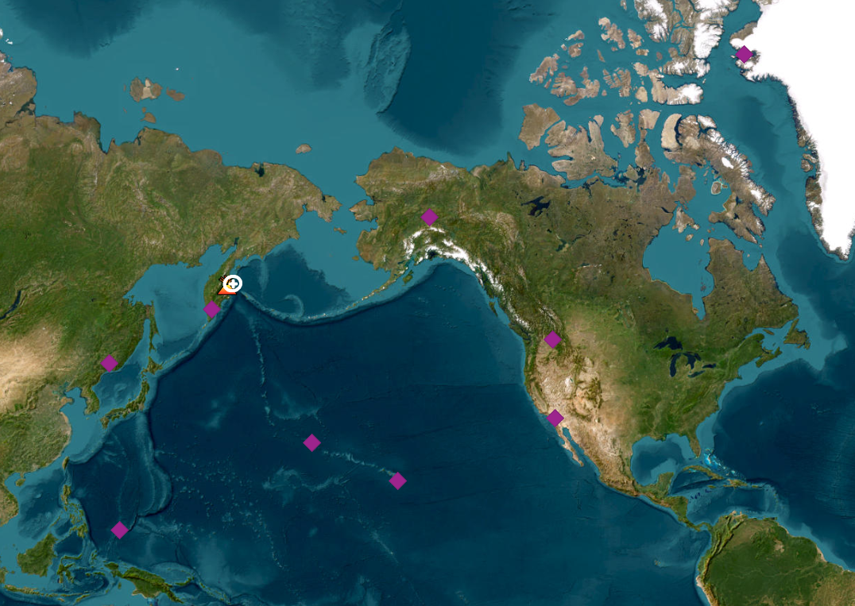
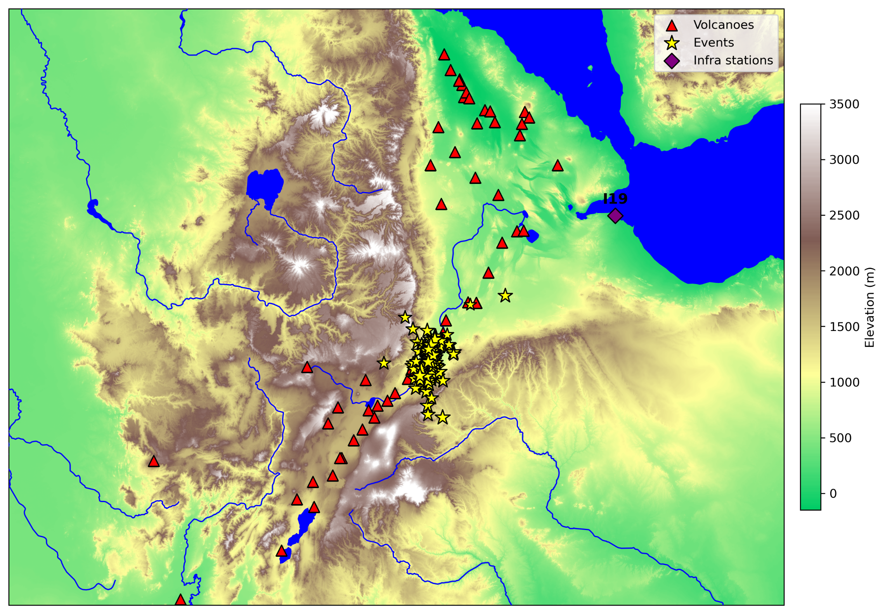
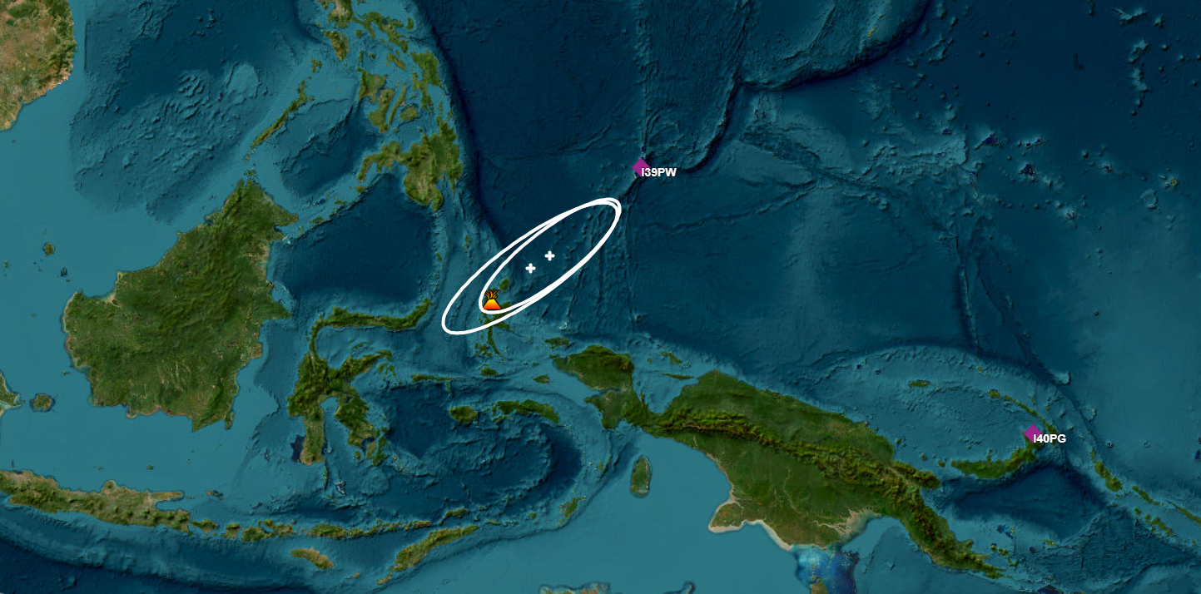
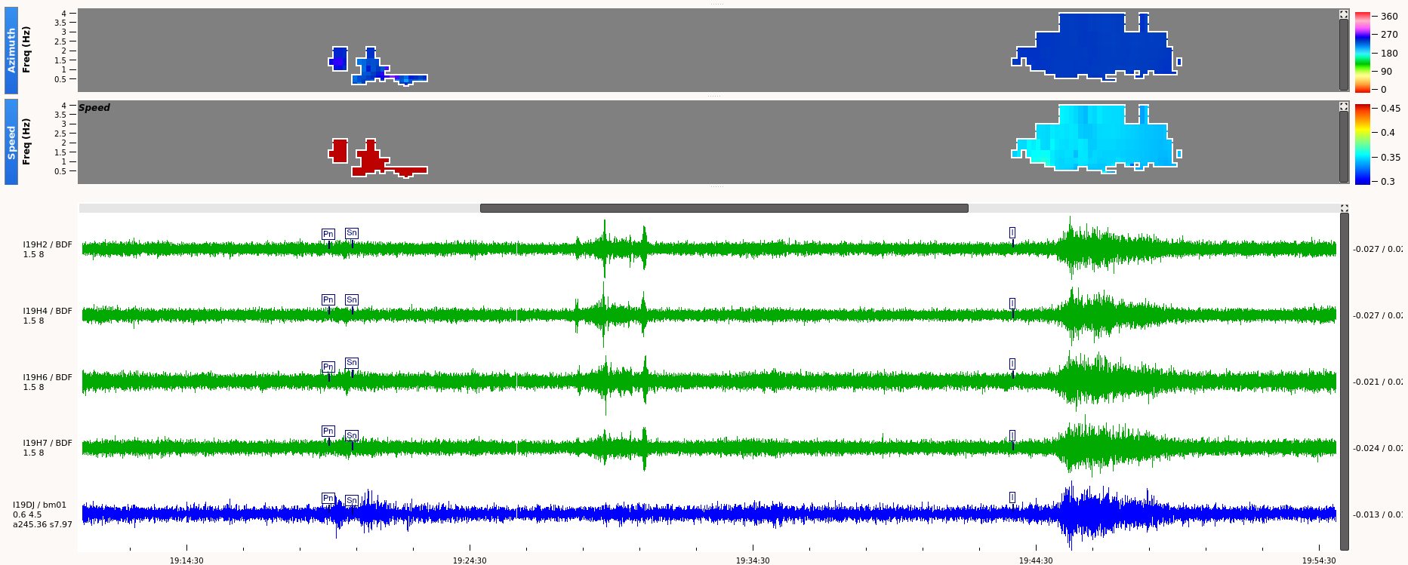
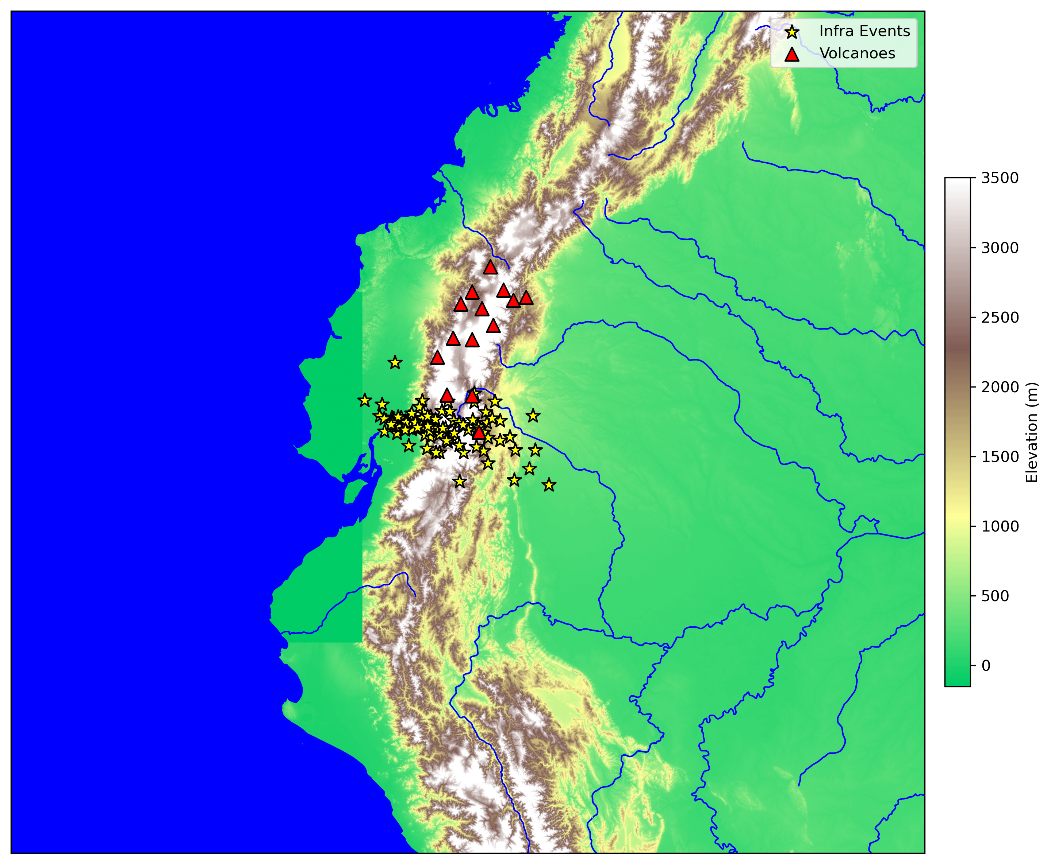

Global Detection of Volcanic Activities at the International Data Centre
Ehsan Qorbani Chegeni, Paulina Bittner, Marcela Villarroel
International Data Center, CTBTO, Vienna, 1400 Austria
P3.5-676
This study presents results from infrasound data analyses and event reviews conducted at the International Data Centre (IDC), with a focus on detecting volcanic activity across multiple regions.
We present examples of volcanic detections, including the Shiveluch eruption in Russia, recent activity at the Fentale–Dofen complex in Ethiopia and at Sangay in Ecuador, as well as at Dukono in Indonesia.
This study highlights the potential of the IMS infrasound network for global monitoring.
We addresses key challenges in analyzing and identifying volcanic infrasound signals.
The views expressed on this e-poster are those of the author and do not necessarily reflect the view of the CTBTO

