Slide 1


P3.5-676
Global Detection of Volcanic Activities at the International Data Centre
Ehsan Qorbani Chegeni, Paulina Bittner, Marcela Villarroel
International Data Center, CTBTO, Vienna, 1400 Austria
This study presents IDC infrasound data analyses and event reviews focused on detecting volcanic activity across multiple regions. It highlights the potential of the IMS infrasound network for global monitoring and addresses key challenges in analyzing and interpreting volcanic infrasound signals.
The views expressed on this e-poster are those of the author and do not necessarily reflect the view of the CTBTO

Slide 2
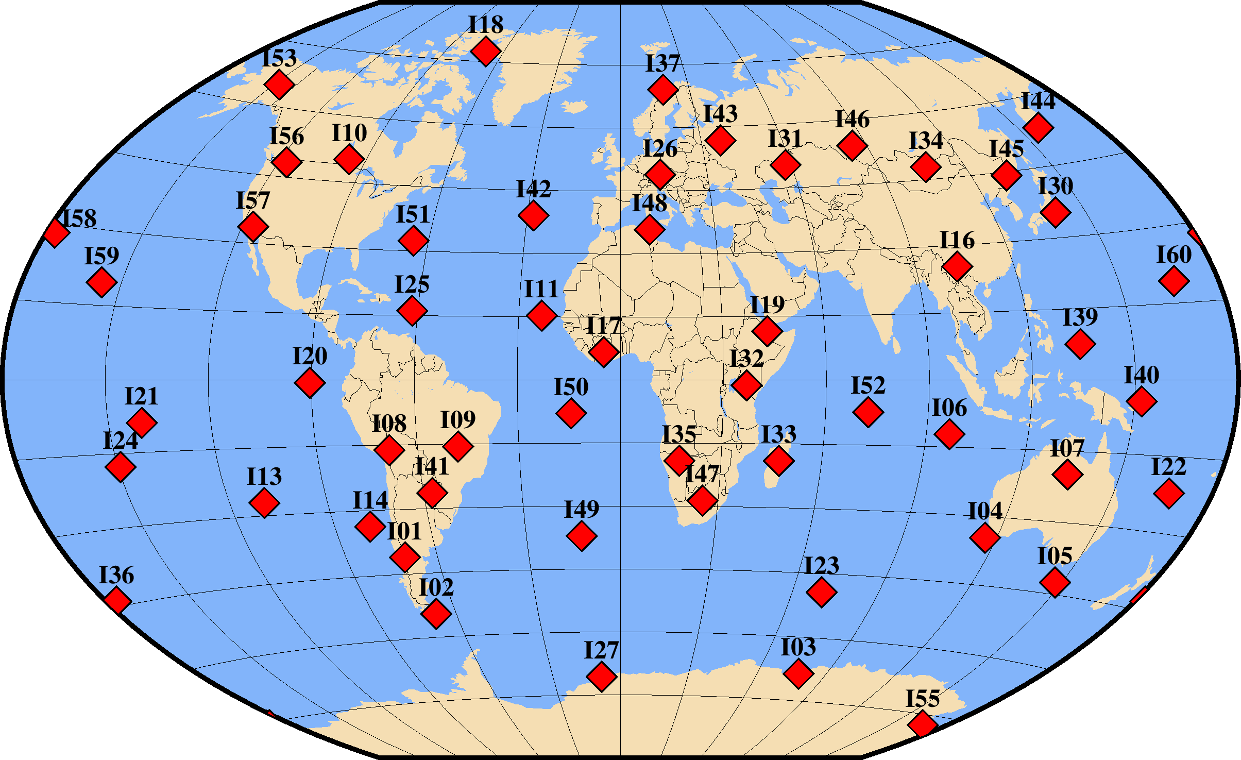
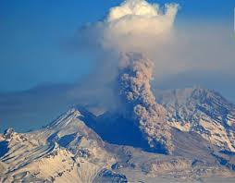
PLEASE DON‘T FORGET TO PUT THE E-POSTER TITLE AND YOUR NAME IN THE PRESENTATION HEADER.
DUPLICATE THIS SLIDE IF YOUR E-POSTER HAS MORE THAN 1 PAGE
Global Detection of Volcanic Activities at the International Data Centre
E. Qorbani Chegeni, P. Bittner, M. Villarroel
Introduction
IMS infrasound network
P3.5-676
Volcanic eruptions generate infrasound, low-frequency acoustic waves below 20 Hz, which provide a valuable tool for monitoring volcanic activity, especially in regions where local seismic or geophysical networks are limited or absent. The expansion of the International Monitoring System (IMS) infrasound network, together with advances in infrasound signal processing and data analysis, has greatly enhanced the ability to detect and characterize volcanic events. This study presents results from infrasound data analyses and event reviews conducted at the International Data Centre (IDC), with a particular focus on detecting volcanic activity across multiple regions.
The IMS infrasound network is the only global system of its scale dedicated to monitoring low-frequency acoustic signals. It currently comprises 54 certified and operational array stations, each consisting of four or more sensing elements arranged in optimized geometric configurations. Stations are equipped with a meteorological unit, a central processing system, and a secure communication link for continuous data transmission to the International Data Centre (IDC). To reduce wind-related noise, each sensing element is connected to a noise-reduction system, typically consisting of multiple pipe structures that channel air from distributed inlet ports into a shared chamber or manifold.
Detection of Volcanic Activities
A significant number of volcanic events are detected by the CTBTO IMS network. Infrasound stations play a key role in capturing the low-frequency acoustic signals generated by eruptions, while seismic stations record seismic events and swarms associated with volcanic activity. Here, we present examples of volcanic detections, including the Shiveluch eruption, recent activity in Ethiopia and Ecuador, and the Dukono volcano in Indonesia.
Shiveluch
(https://www.legacyias.com/russian-volcano)
The map shows the IMS infrasound network, including 54 operational stations (out of 60 planned). Data from these stations are routinely used for infrasound analysis at the IDC. For the full IMS network map, please visit https://www.ctbto.org/our-work/ims-map.

Slide 3
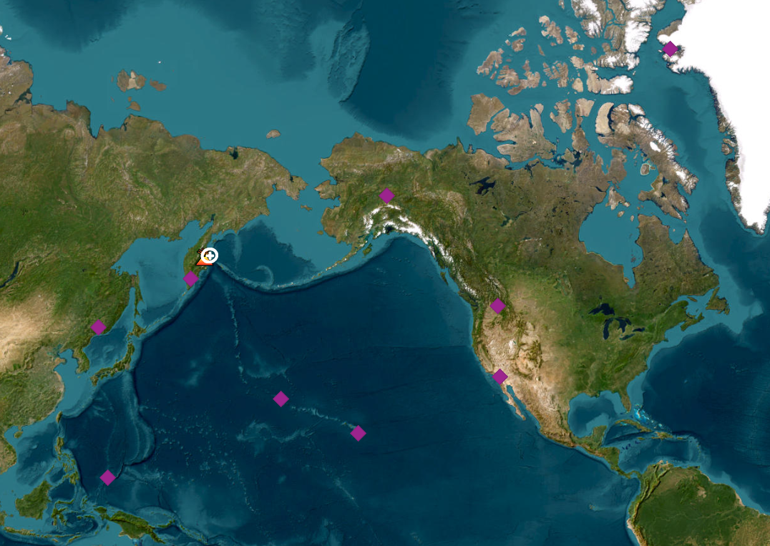
PLEASE DON‘T FORGET TO PUT THE E-POSTER TITLE AND YOUR NAME IN THE PRESENTATION HEADER.
DUPLICATE THIS SLIDE IF YOUR E-POSTER HAS MORE THAN 1 PAGE
Global Detection of Volcanic Activities at the International Data Centre
E. Qorbani Chegeni, P. Bittner, M. Villarroel
1. Shiveluch volcano eruption
P3.5-676
Shiveluch is located in the northern part of the Kamchatka volcanic arc, which is formed by the subduction of the Pacific Plate beneath the North American Plate at the Kuril–Kamchatka trench. The Pacific Plate converges toward Kamchatka at a rate of 8-9 cm/year, making it one of the fastest subduction zones on Earth. This rapid subduction generates strong volcanic and seismic activity across the Kamchatka Peninsula.
The Shiveluch volcano erupted strongly on 7 November 2024, producing ash plumes that rose to approximately 8 km altitude. This eruption was recorded by nine IMS infrasound stations at distances ranging from 5° to 58°.
Delta=4.7 °
I44RU
I45RU
Delta=23.1 °
I53US
Delta=24.7 °
I58US
Delta=31.8 °
I18DK
I18DK
Delta=42.2 °
I53US
I56US
Delta=46.8 °
I44RU
I45RU
I56US
I59US
Delta=48 °
I58US
I57US
I39PW
Delta=53.9 °
I59US
I39PW
Delta=57.7 °
I57US
Map showing the location of the Shiveluch volcano eruption on 7 November 2024. IMS infrasound stations that detected the event are marked with purple diamonds.
Infrasound signals from the Shiveluch volcano eruption on 7 November 2024, recorded at nine IMS infrasound stations

Slide 4
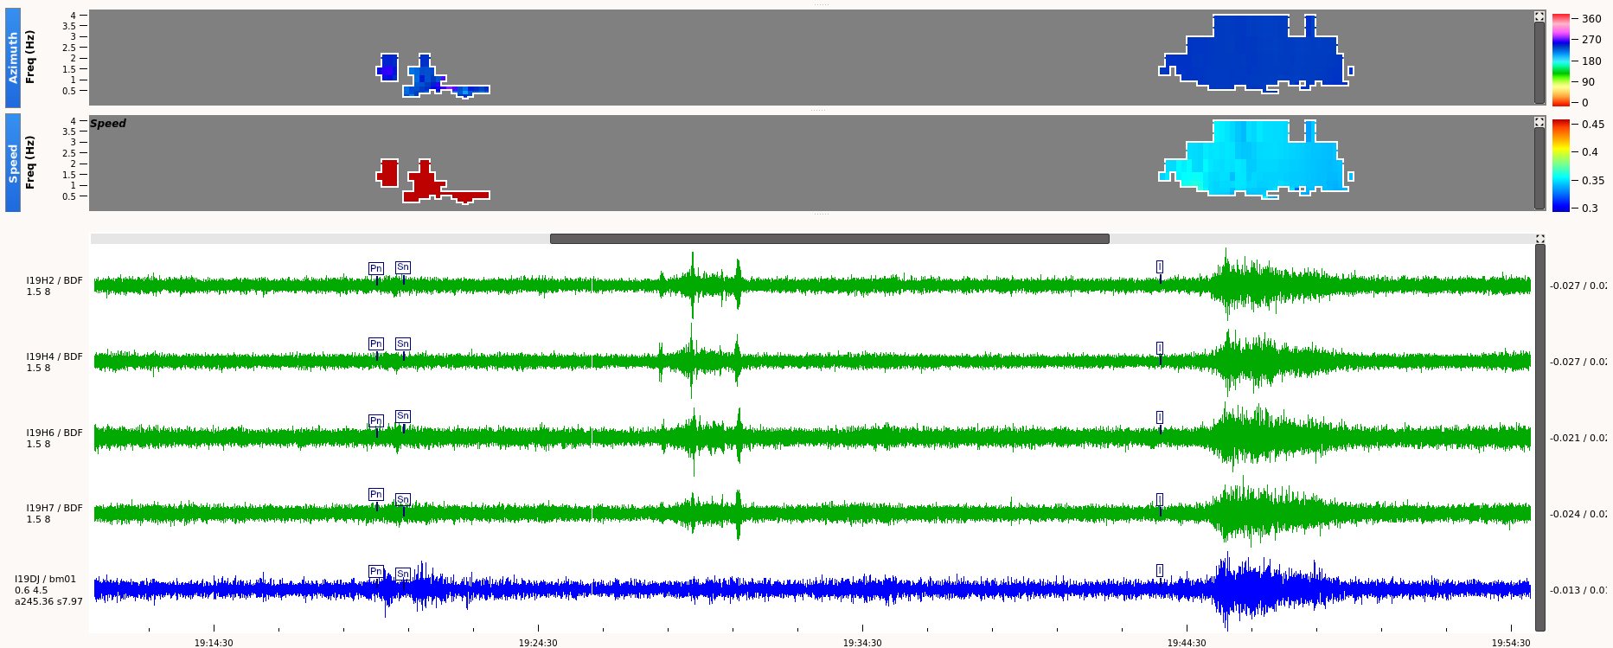
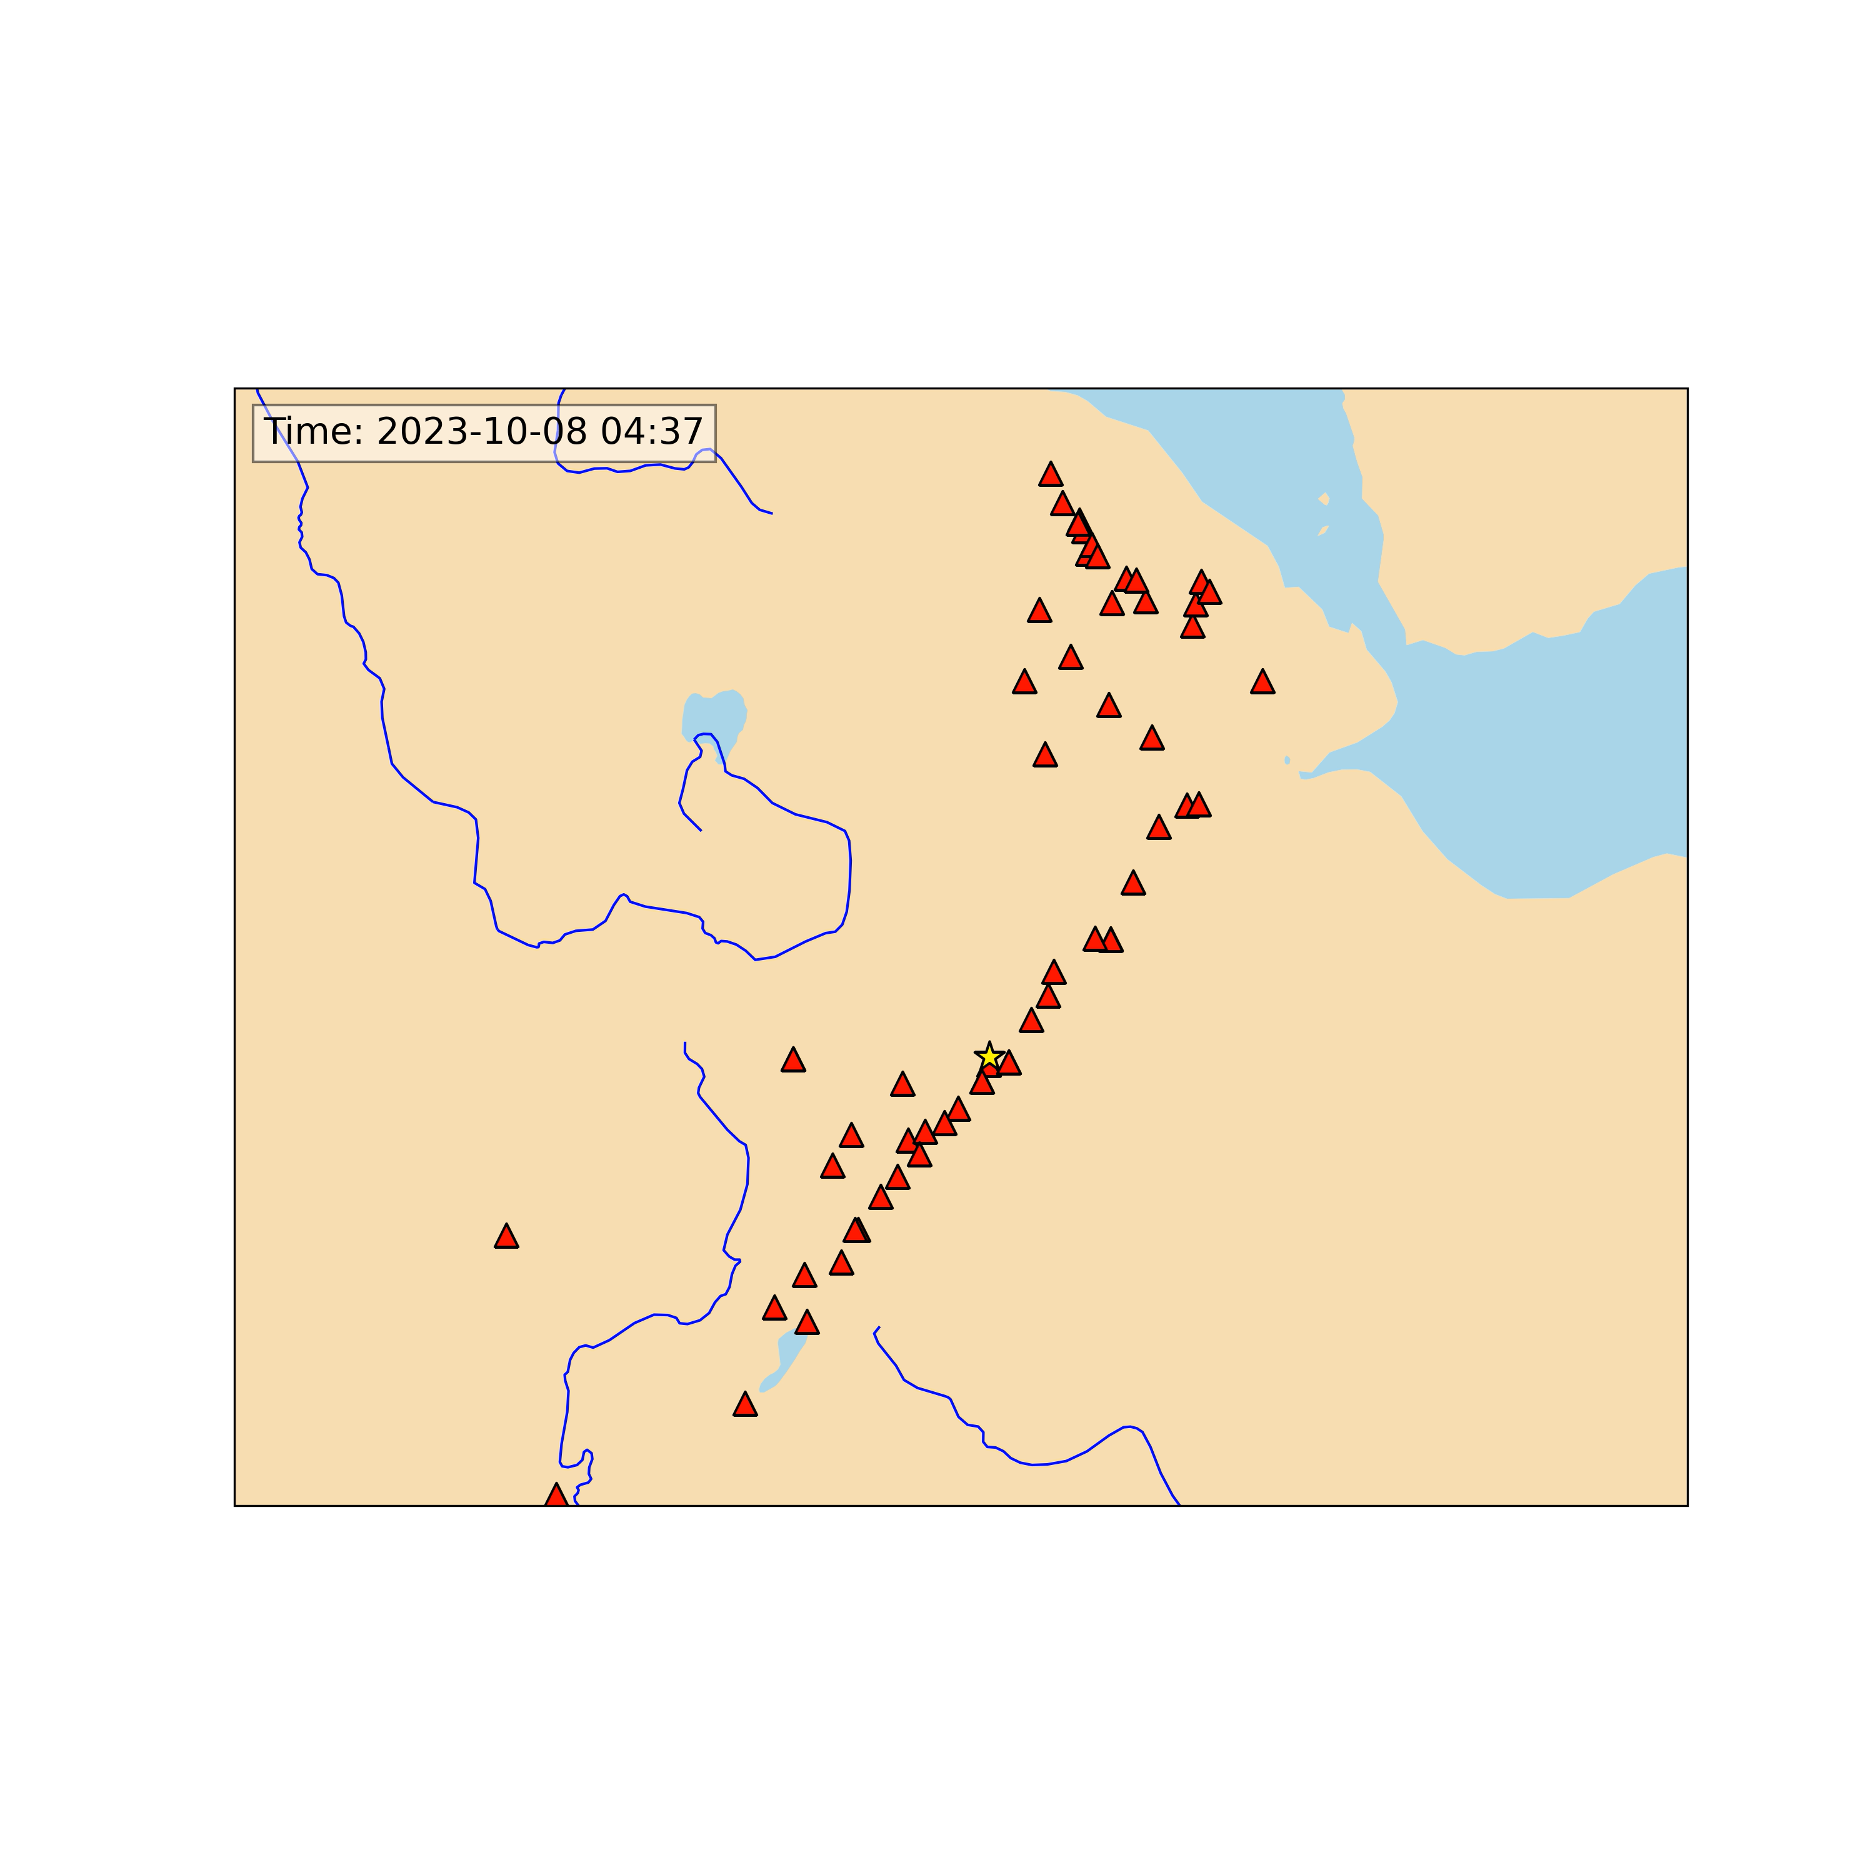
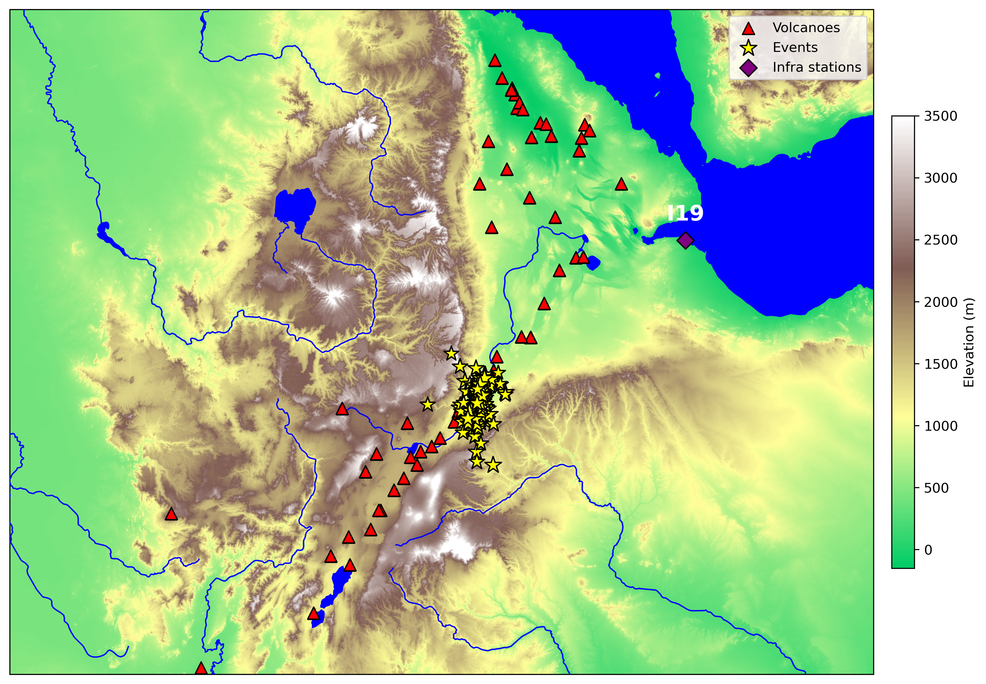
PLEASE DON‘T FORGET TO PUT THE E-POSTER TITLE AND YOUR NAME IN THE PRESENTATION HEADER.
DUPLICATE THIS SLIDE IF YOUR E-POSTER HAS MORE THAN 1 PAGE
Global Detection of Volcanic Activities at the International Data Centre
E. Qorbani Chegeni, P. Bittner, M. Villarroel
2. Volcanic activity in Ethiopia
I19DJ
P3.5-676
The Fentale–Dofen region represents the most seismically and volcanically active sector of the Northern Main Ethiopian Rift. Mount Fentale, a stratovolcano in Ethiopia’s Afar Region, features a 350-meter-wide summit crater and persistent fumarolic activity. Recent volcanic activity at Mount Dofen is thought to be linked to magma intrusion between Fentale and Dofen. The dike intrusion connecting the two volcanoes likely facilitated upward magma movement, resulting in increased fumarolic activity and minor eruptions at Dofen. Beginning in 2024, the area experienced a significant seismic swarm. These events produced both seismic and infrasound signals, many of which were detected by IMS seismic and infrasound stations and subsequently analyzed at the IDC. The map below shows events detected by both seismic and infrasound stations from late 2023 through August 2025. These events are most likely associated with a seismic swarm caused by magma intrusion.
Figure (top):
Infrasound (I phase) and seismic (Pn and Sn) signals recorded at the I19DJ infrasound station.
Left panel:
Time-lapse animation of seismic swarm events that have been detected by both IMS seismic and infrasound stations from late 2023 to August 2025.
I19DJ
Dofen
Fentale

Slide 5
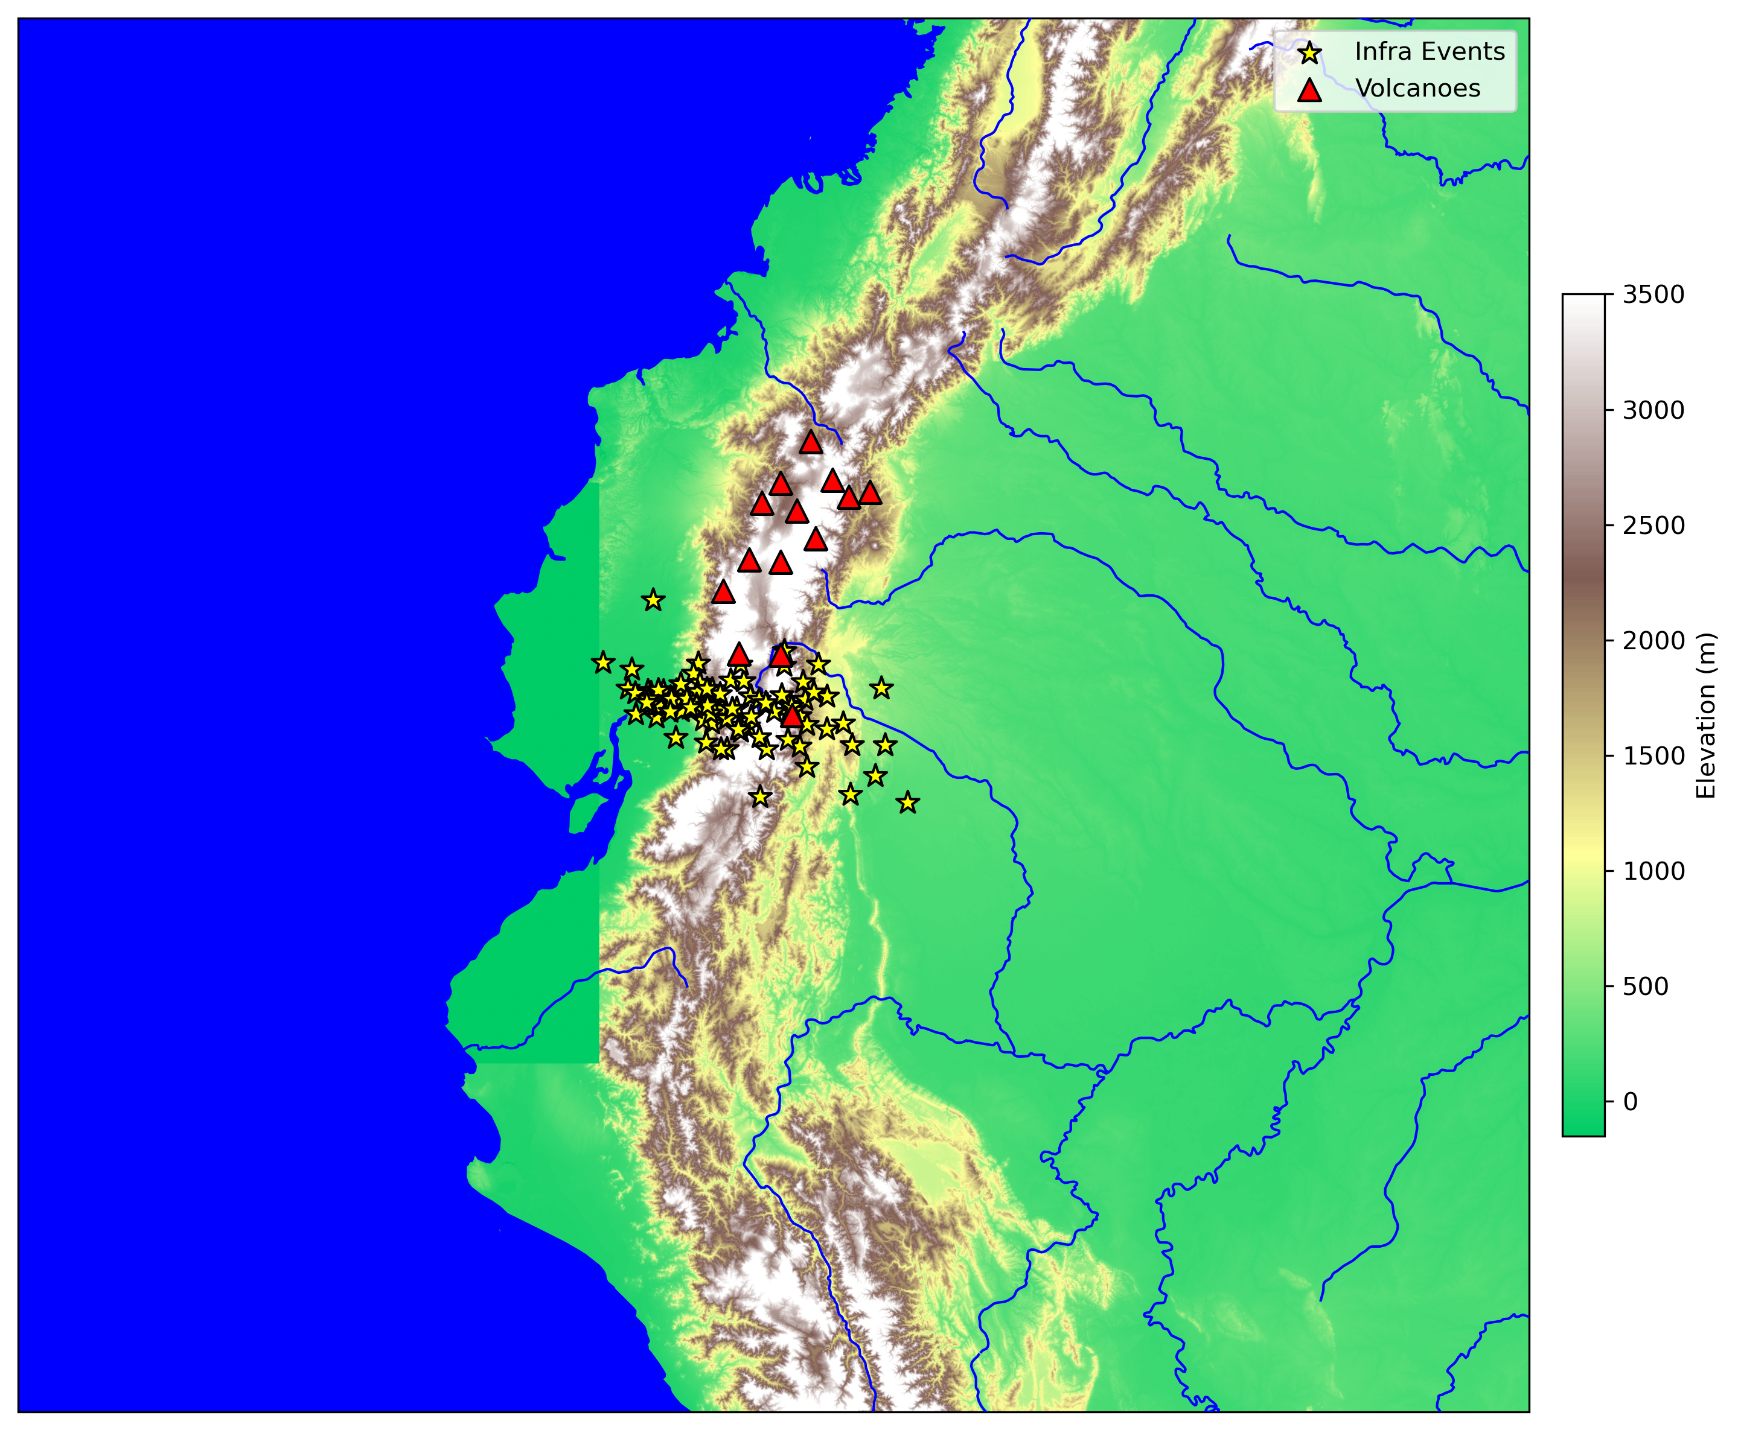
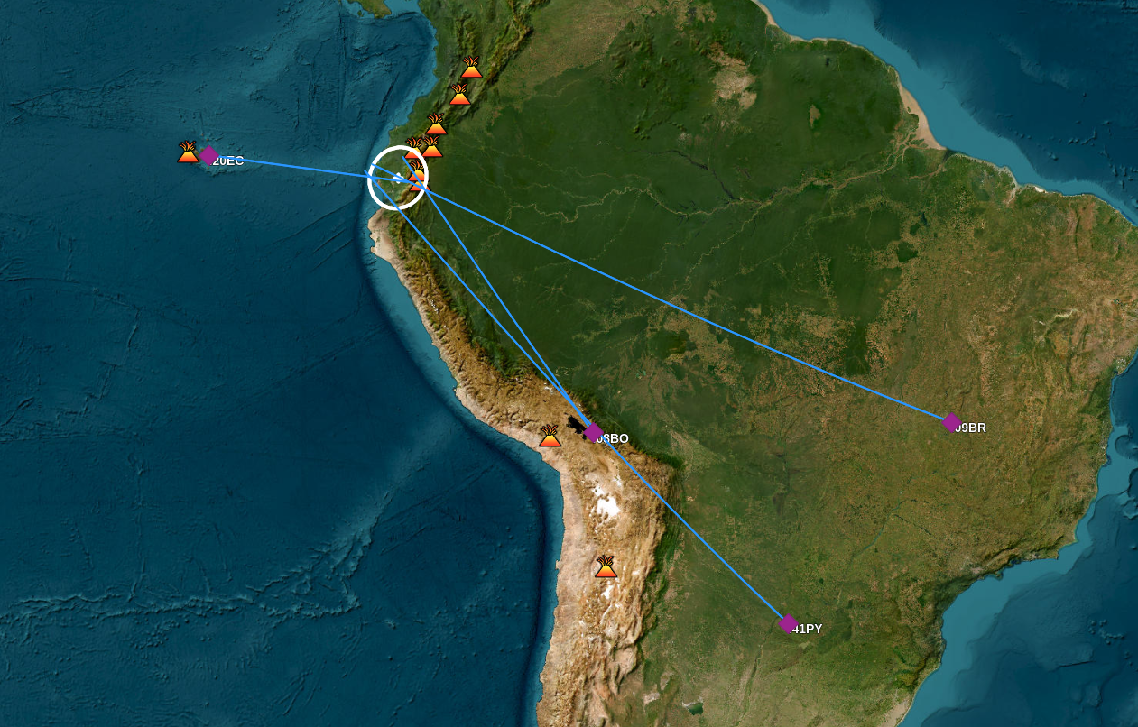
PLEASE DON‘T FORGET TO PUT THE E-POSTER TITLE AND YOUR NAME IN THE PRESENTATION HEADER.
DUPLICATE THIS SLIDE IF YOUR E-POSTER HAS MORE THAN 1 PAGE
Global Detection of Volcanic Activities at the International Data Centre
E. Qorbani Chegeni, P. Bittner, M. Villarroel
3. Sangay Volcano, Ecuador
P3.5-676
Sangay Volcano, situated in the eastern Andes of Ecuador, has exhibited a high level of activity from early 2024 through August 2025. This sustained activity is marked by frequent explosive eruptions, ash emissions, and lava flows. The volcano’s continuous activity is largely due to its location at the boundary between older, thermally stable oceanic crust in southern Ecuador and younger, more thermally active crust to the north, a geological setting that promotes persistent eruptions. Numerous events associated with Sangay’s activity have been detected by IMS infrasound stations and analyzed at the IDC. The below map displays events recorded from early 2024 to Aug 2025, with data from a minimum of three infrasound stations.
I20EC
Delta=10.9 °
I08BO
Delta=17.9 °
I41PY
Delta=32.4 °
I09BR
Delta=34 °
Infrasound signals from event related to Sangay volcanic eruption on 12 May 2025, recorded at four IMS infrasound stations
Map showing the location of the infrasound event on 12 May 2025. IMS infrasound stations that detected the event are marked with purple diamonds.
I20EC
I08BO
I09BR
I41PY

Slide 6
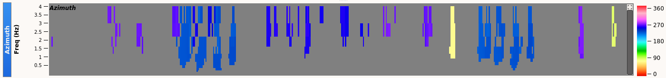
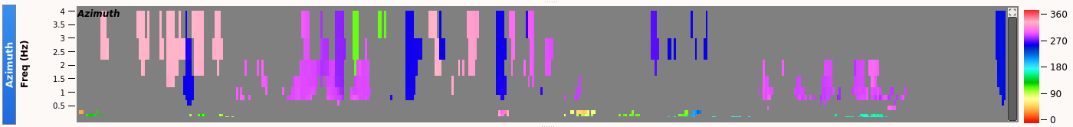
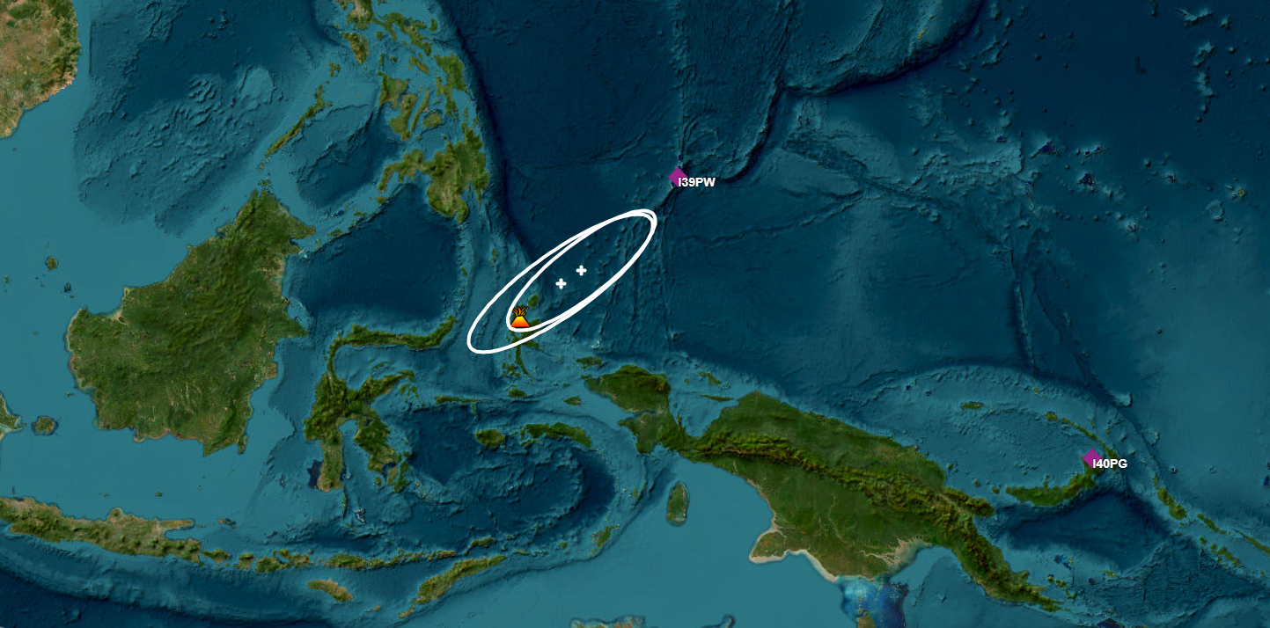
PLEASE DON‘T FORGET TO PUT THE E-POSTER TITLE AND YOUR NAME IN THE PRESENTATION HEADER.
DUPLICATE THIS SLIDE IF YOUR E-POSTER HAS MORE THAN 1 PAGE
Global Detection of Volcanic Activities at the International Data Centre
E. Qorbani Chegeni, P. Bittner, M. Villarroel
4. Dukono volcano, Indonesia
P3.5-676
Event 1
Event 2
I39PW
Delta=5.6 °
Mount Dukono, located on Halmahera Island in Indonesia's North Maluku province, is one of the country’s most active volcanoes and has been in almost continuous eruption since 1933. Its activity is marked by frequent explosive eruptions, sustained ash emissions, and occasional lava flows. This persistent behavior is linked to its tectonic setting at the boundary between older, more stable oceanic crust to the south and younger, thermally active crust to the north.
On April 21, 2025, two events related to Dukono Volcano were detected 46 minutes apart. Identifying the signals against background noise was particularly challenging, especially at station I39PW during these events.
Figure (top): Infrasound signals recorded at stations I39PW and I40PG, with the two events marked.
Figure (bottom): Locations of the detected events associated with Dukono’s volcanic activity.
Delta=22.9 °
I40PG
I39PW
I40PG

Slide 7
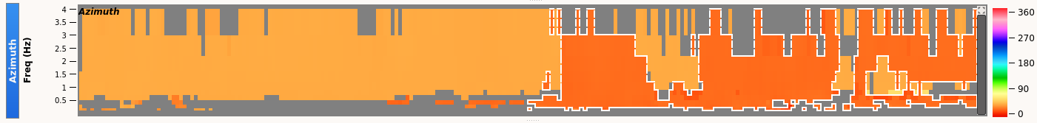
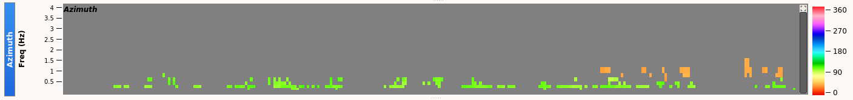
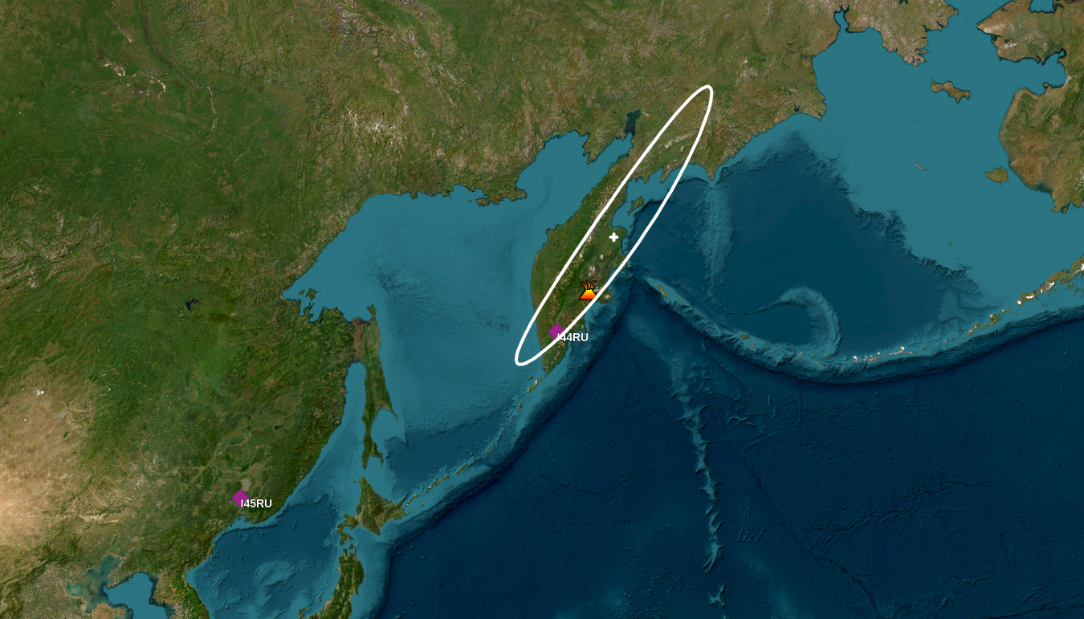
PLEASE DON‘T FORGET TO PUT THE E-POSTER TITLE AND YOUR NAME IN THE PRESENTATION HEADER.
DUPLICATE THIS SLIDE IF YOUR E-POSTER HAS MORE THAN 1 PAGE
Global Detection of Volcanic Activities at the International Data Centre
E. Qorbani Chegeni, P. Bittner, M. Villarroel
Infrasound signal detection of volcanic activity
P3.5-676
Volcanic activity includes effusive processes (e.g., lava flows and sustained degassing) and explosive processes driven by overpressure of magmatic gases, phreatomagmatic interaction when magma contacts external water, or phreatic explosions from superheated groundwater.
I44RU
I45RU
Infrasound detectability depends on
source amplitude
signal duration
spectral content
and on
network geometry and
atmospheric propagation
(e.g., wind and temperature structure)
Discriminating volcanic infrasound from background noise is often challenging, particularly for long-duration, low-amplitude signals, which are more easily masked by environmental and wind noise or ocean-generated microbaroms.
Infrasound signals from event most likely related to Klyuchevskoy volcanic activity on 05 August 2025, recorded at two IMS infrasound stations, I44RU and I45RU.
I44RU
I45RU

Slide 8
PLEASE DON‘T FORGET TO PUT THE E-POSTER TITLE AND YOUR NAME IN THE PRESENTATION HEADER.
DUPLICATE THIS SLIDE IF YOUR E-POSTER HAS MORE THAN 1 PAGE
Global Detection of Volcanic Activities at the International Data Centre
E. Qorbani Chegeni, P. Bittner, M. Villarroel
Conclusion remarks
P3.5-676
The CTBTO International Monitoring System (IMS) infrasound network and International Data Centre (IDC) data analysis demonstrate strong potential for detecting volcanic eruptions on a global scale, supporting efforts to enhance volcanic hazard monitoring and mitigation.
Challenges and parameters affecting infrasound detectability:
Background noise - Volcanic signals can be masked by atmospheric sources such as wind, ocean waves (microbaroms), storms, or human activity, making detection and identification difficult.
Signal attenuation and propagation: Infrasound signals weaken and distort as they travel long distances. Atmospheric conditions (temperature, wind, stratification) can bend, scatter, or block signals, reducing clarity.
Signal identification - Discriminating volcanic infrasound from background noise is particularly difficult for long-duration, low-amplitude activity, such as continuous degassing or tremor-like events.
Station Coverage and Geometry - A limited number or uneven distribution of infrasound stations near a volcano can reduce detection capability and make event localization less precise.
Small-Scale Events - Low-energy eruptions or weak degassing may produce signals below the detection threshold of regional or global infrasound networks.
Complex Source Mechanisms - Different volcanic processes (e.g., explosions, lava fountaining, pyroclastic flows) can generate overlapping signals, complicating signal identification.
I44
I45
The authors acknowledge the CTBTO IMS and the IDC sections for their assistance and support with infrasound data analysis. The analysis of infrasound data and events was carried out using the DTKGPMCC software (Commissariat à l'Energie Atomique et aux Energies Alternatives, CEA/DASE, Bruyères-le-Châtel, 91297 Arpajon Cedex, France)

