Slide 1

Introduction Slide Title goes here [Font: Arial Bold/Size: 16]
P3.5-144
The application of artificial intelligence in exploration seismology
Babayev G.R., Malikov R.I., Aliyev M.M.
Geology and Geophysics Institute
Ministry of Science and Education of Azerbaijan
This presentation provides an overview of how artificial intelligence (AI) is applied in exploration seismology, with a focus on seismic data processing, interpretation, and reservoir characterization. It highlights specific challenges and opportunities in Azerbaijan’s Caspian Basin, showcasing how AI can enhance efficiency, reduce costs, and improve subsurface imaging.
DISCLAIMER: This presentation has been generated for illustration purposes only.

Slide 2
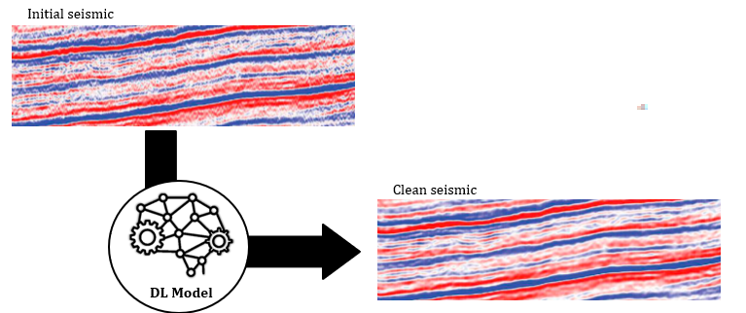
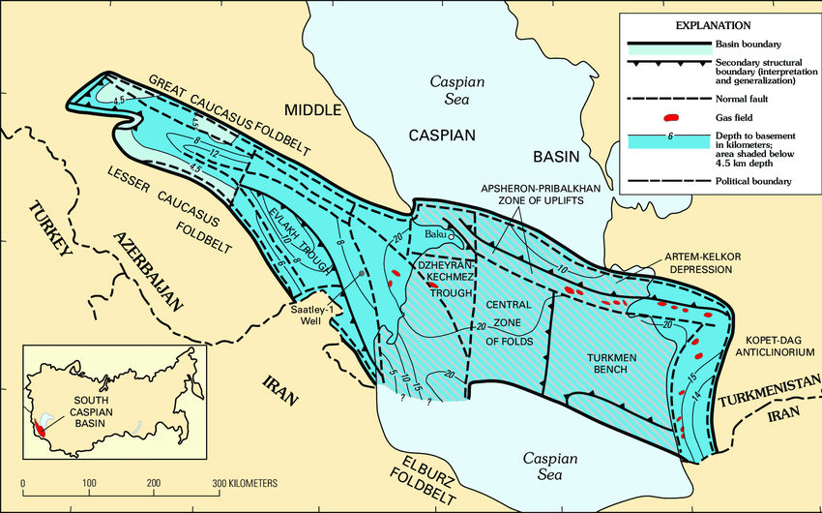
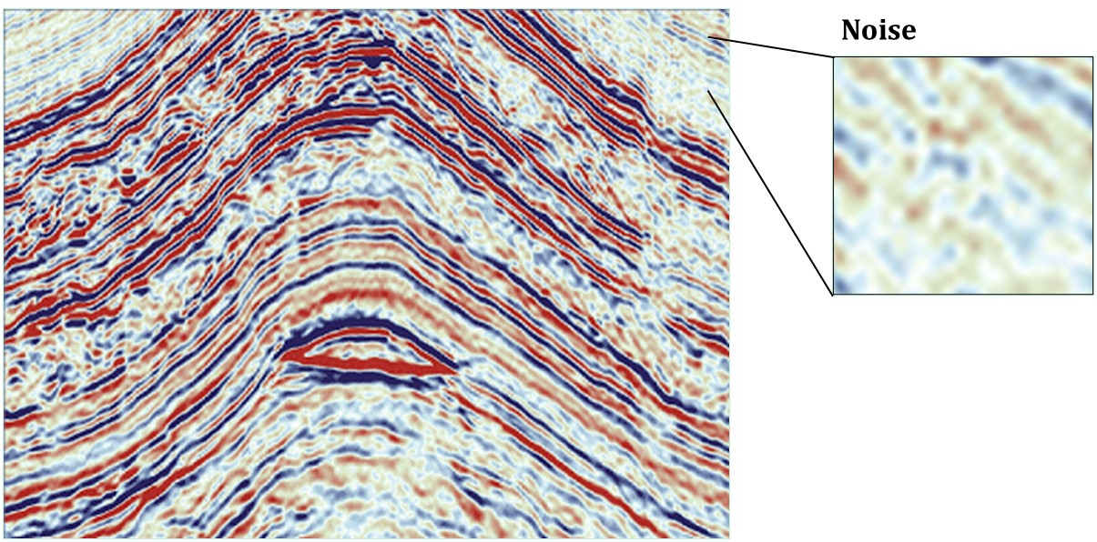
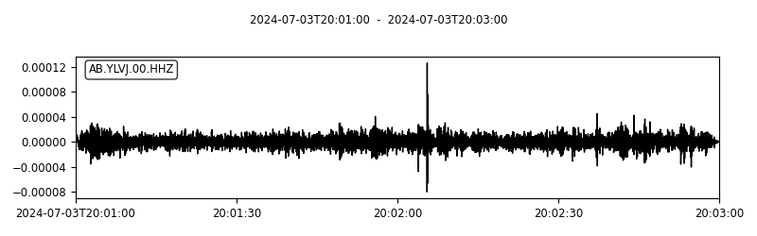
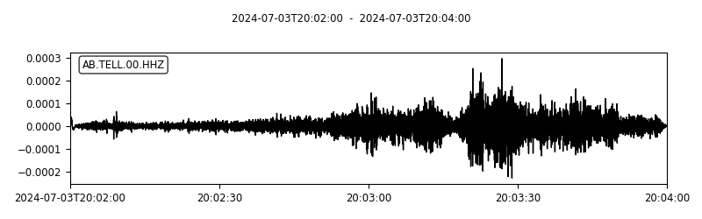
The application of artificial intelligence in exploration seismology
Introduction
Babayev G.R., Malikov R.I., Aliyev M.M
P3.5-144
Exploration seismology plays a vital role in hydrocarbon exploration and development, particularly in Azerbaijan’s Caspian Basin, Absheron Peninsula, and Kura Depression. However, traditional seismic methods face major challenges, including vast data volumes, low signal-to-noise ratios, and the complexity of subsurface structures such as salt tectonics. Artificial intelligence (AI) has emerged as a transformative approach, offering new opportunities for improved accuracy, efficiency, and cost reduction in exploration workflows.
Methods/Data
In this study, AI techniques—ranging from machine learning algorithms to deep learning architectures such as convolutional neural networks—are applied to seismic reflection profiles, well logs, and geological models from Azerbaijan. Key workflows include:
Seismic data denoising to enhance weak signals.
Automated fault and horizon detection for faster and more reliable structural mapping.
Seismic facies classification and lithology prediction using supervised learning.
Velocity model building accelerated with AI-driven inversion techniques.
Reservoir characterization integrating seismic attributes and well-log data.
Results
The integration of AI in exploration seismology demonstrates clear advantages in Azerbaijan’s geological context:
Improved seismic imaging beneath salt domes and complex tectonic zones.
Faster and more accurate identification of faults, horizons, and hydrocarbon traps.
Enhanced prediction of reservoir quality, including porosity and fluid distribution.
Reduced uncertainty in exploration decisions, leading to fewer dry wells and optimized drilling strategies.
Lower exploration costs, which is particularly significant for offshore Caspian projects.
Conclusions
AI has strong potential to transform exploration seismology in Azerbaijan, providing higher accuracy and efficiency. AI offers significant long-term benefits. Future developments include real-time seismic monitoring, cloud-based AI models, and expansion into CO₂ storage and geohazard risk assessment.
DISCLAIMER: This presentation has been generated for illustration purposes only

