Slide 1

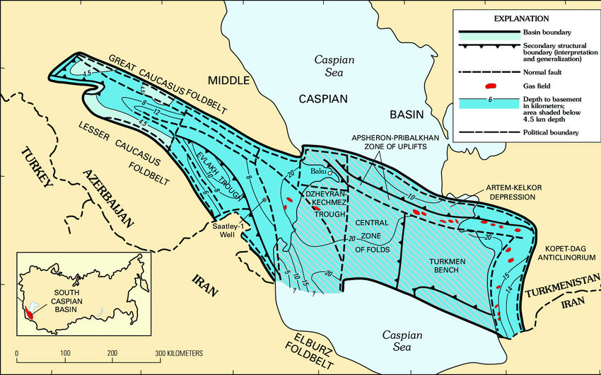
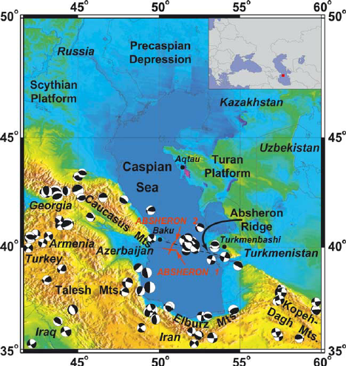
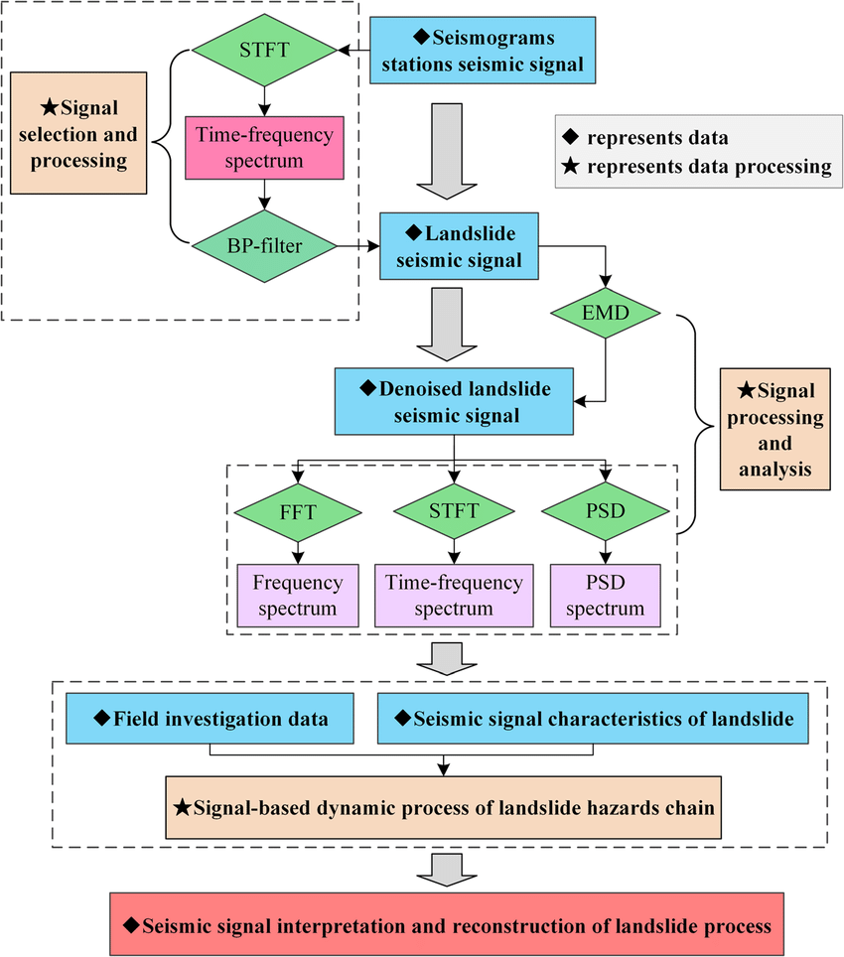
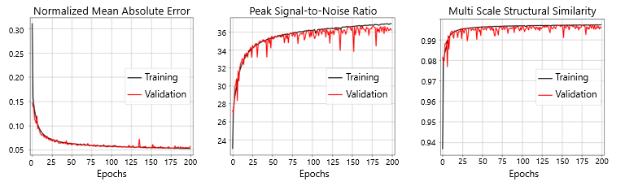
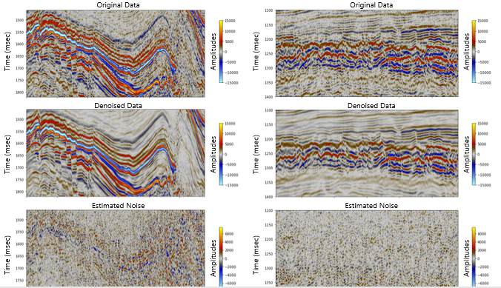

The application of artificial intelligence in exploration seismology
Babayev G.R., Malikov R.I., Aliyev M.M.
Geology and Geophysics Institute
Ministry of Science and Education of Azerbaijan
P3.5-144
Exploration seismology = key tool for hydrocarbon and mineral resource exploration
Challenges: huge datasets, complex noise, ambiguous interpretation
AI = emerging solution to enhance accuracy and efficiency
Why Artificial Intelligence?
Handles large, multidimensional seismic datasets
Learns hidden patterns beyond statistical methods
Improves prediction of subsurface structures
Reduces human bias in interpretation
AI Techniques in Seismology
Machine Learning (ML): pattern recognition, classification
Deep Learning (DL): CNNs for seismic imaging
Fuzzy Logic & Expert Systems: uncertainty handling
Reinforcement Learning: optimizing seismic acquisition
Case of Azerbaijan
Rich petroleum geology: Caspian Basin, Absheron peninsula, Kur Depression
Challenges: salt tectonics, exploration costs, complex structures
AI potential: hydrocarbon trap identification, imaging under salt domes, reservoir quality prediction
AI Studies in Azerbaijan
ANN-based ground motion models
Neural networks for seismic attributes
ML models: velocity prediction in offshore Caspian
Ongoing research: deep learning for reservoir characterization
DISCLAIMER: This presentation has been generated for illustration purposes only

