Slide 1


P3.5-689
Understanding phase classification throughout the International Data Centre pipeline
Braden Walsh¹ and Tiago Oliveira¹
¹Preparatory Commission for the Comprehensive Nuclear-Test-Ban Treaty Organization, Vienna, Austria
Here, we analyze the number of phase changes for each of the SHI technologies and compare the number of detections in each processing stage to examine how a detection contributes to building an event. The numbers and types of phases are also compared to the number of operating stations in the network through time. We show through the percentage of noise detections converted during the interactive review stage, the workload of analysts and the efficiency of the SHI automatic pipeline. Ultimately, the results of this analysis can be used to improve the automatic IDC pipeline for phase classification and building events.
DISCLAIMER The views expressed herein are those of the authors and do not necessarily reflect the views of the CTBTO Preparatory Commission. The Commission itself takes no responsibility for the content of this presentation.

Slide 2
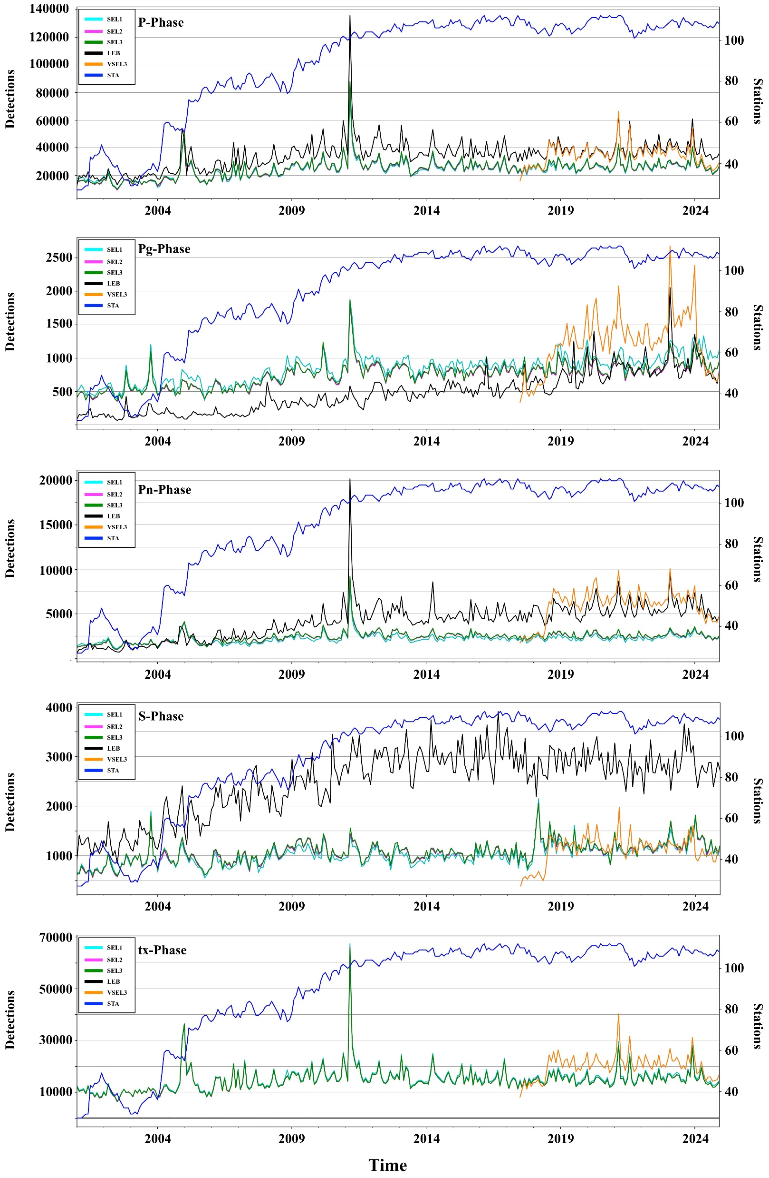
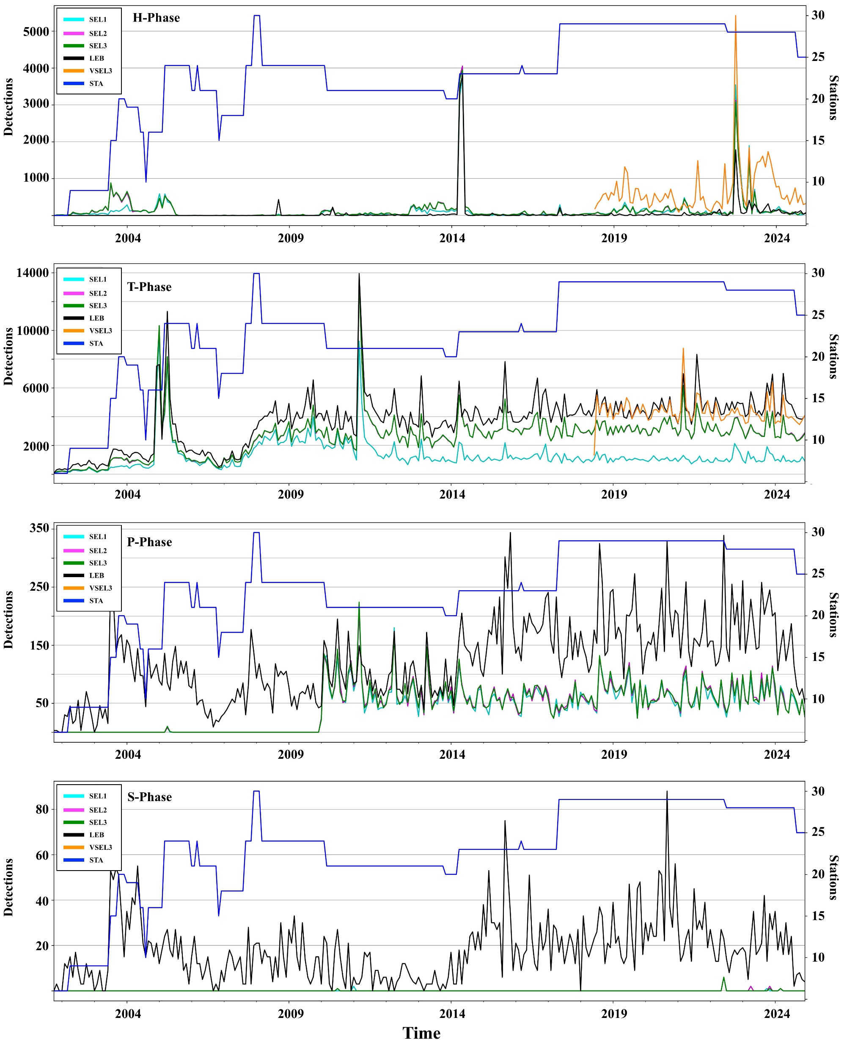
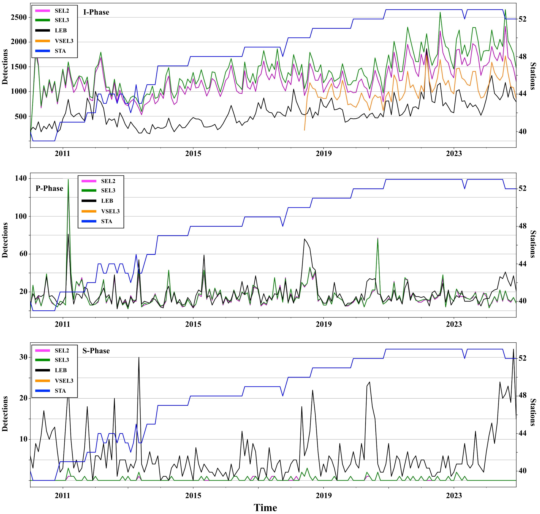

Understanding phase classification throughout the International Data Centre pipeline
P3.5-689
Seismic
Hydroacoustic
Infrasound
SHI phase classification for the association and review stage of the IDC pipeline.
Seismic: NET-VISA produces more Pg-phases than GA/analysts. Analysts create a lot more S-phases than GA/NET-VISA
Hydroacoustic: NET-VISA classifies more H-phases. Analysts change or create more P- and S-phases to help build earthquake events.
Infrasound: NET-VISA has fewer I-phases than GA, LEB has the least. Analysts create more S-phases. NET-VISA does not label seismic phases on infrasound.

Slide 3
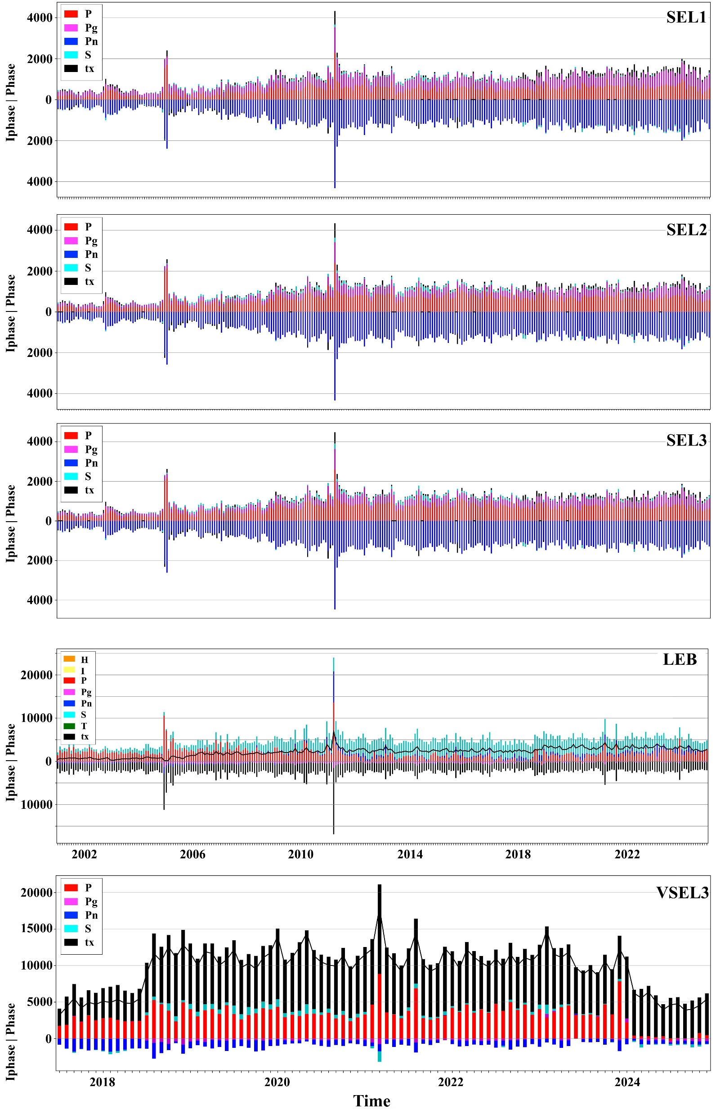
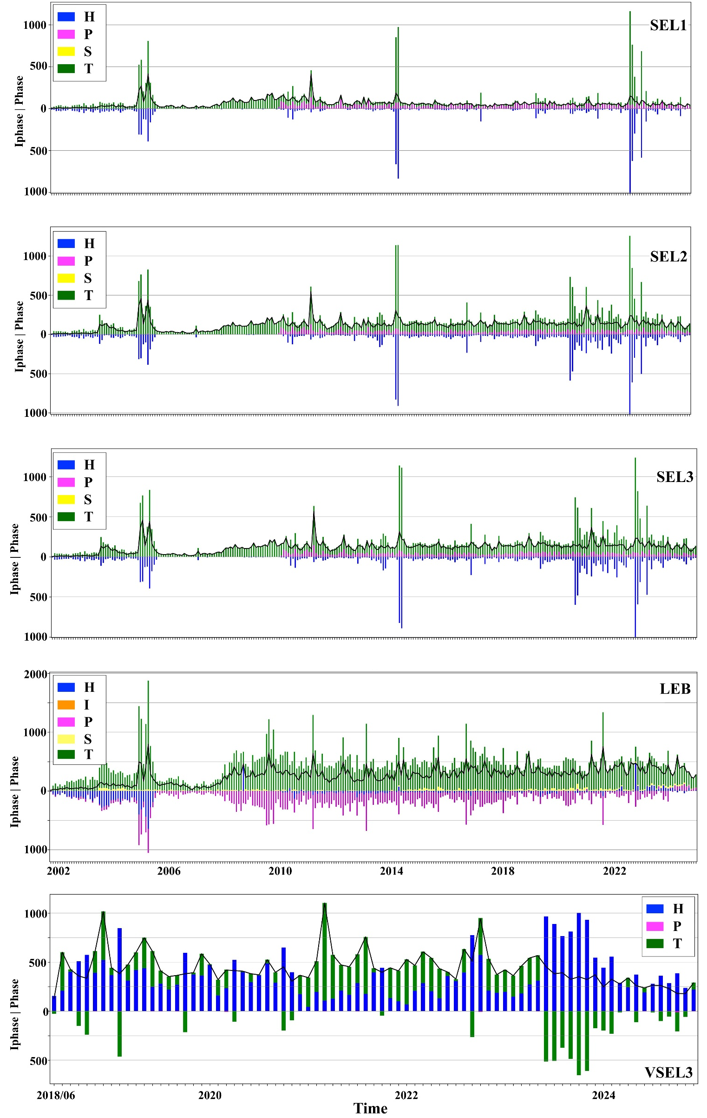
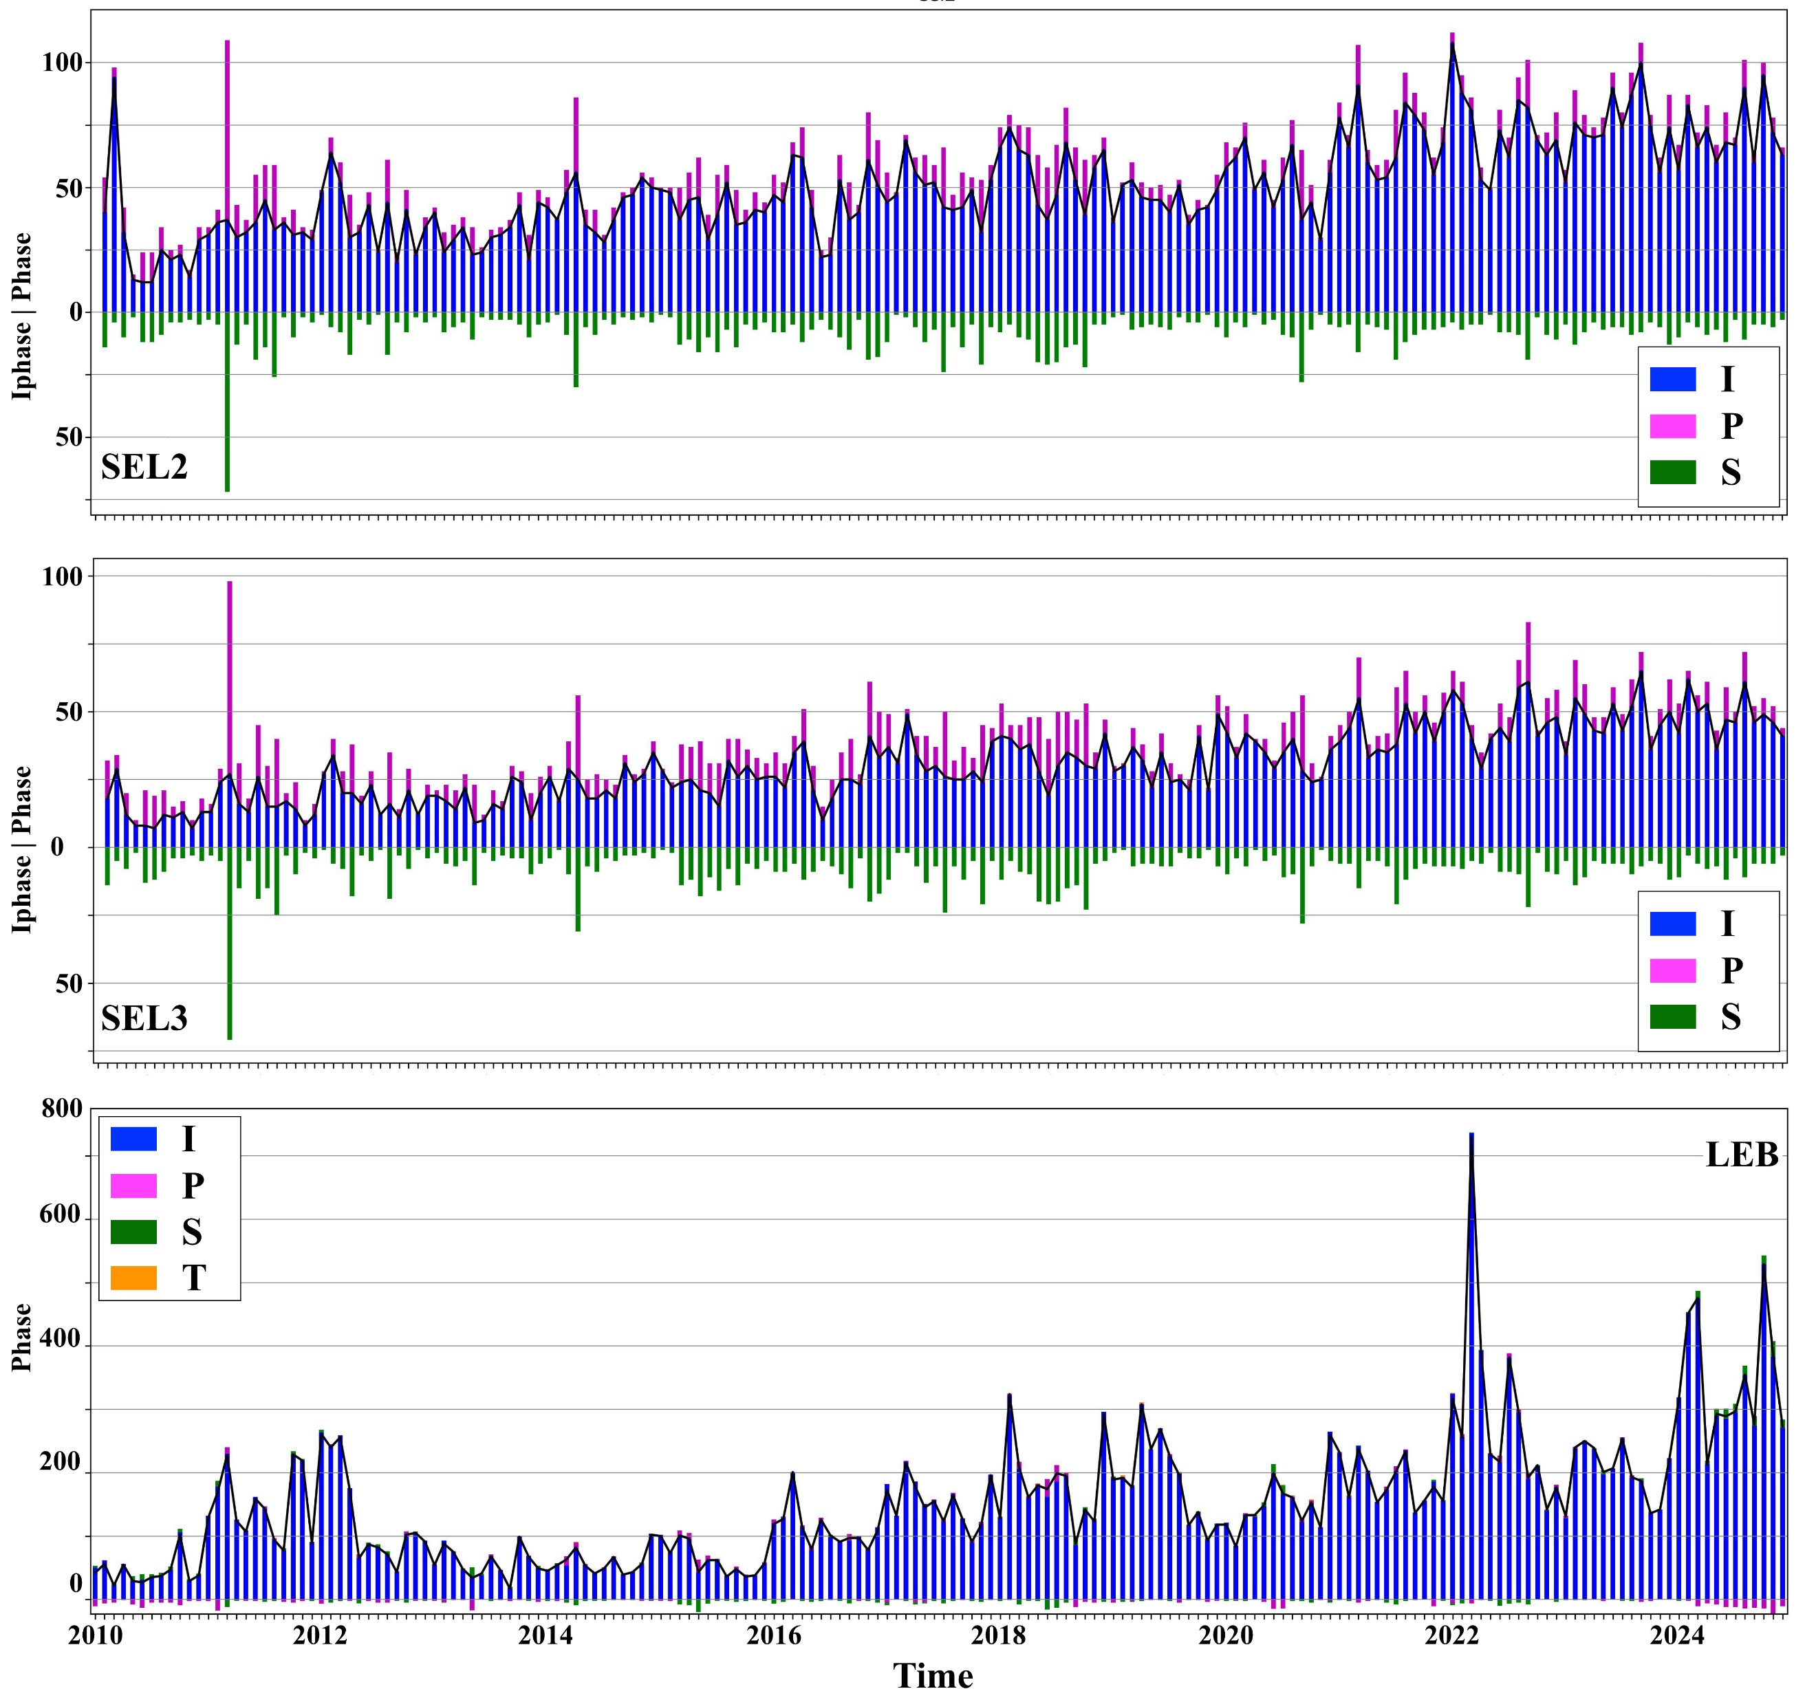
Understanding phase classification throughout the International Data Centre pipeline
P3.5-689
Seismic
Hydroacoustic
Infrasound
SHI phase classification difference for each stage of the IDC pipeline. Bars are calculated by: PHASE(x)-IPHASE(x) (e.g. GA-StaPro).
Seismic: In GA majority of Pn from IPHASE are not being used or converted. The analysts are converting tx-phases mostly to S-phases
Hydroacoustic: Analysts use P-phase as a place holder before making correct phase identification. GA has a reduction of H-phases where NET-VISA has an increase in PHASE
Infrasound: Many S-phases are removed or converted to other phases by analysts

Slide 4
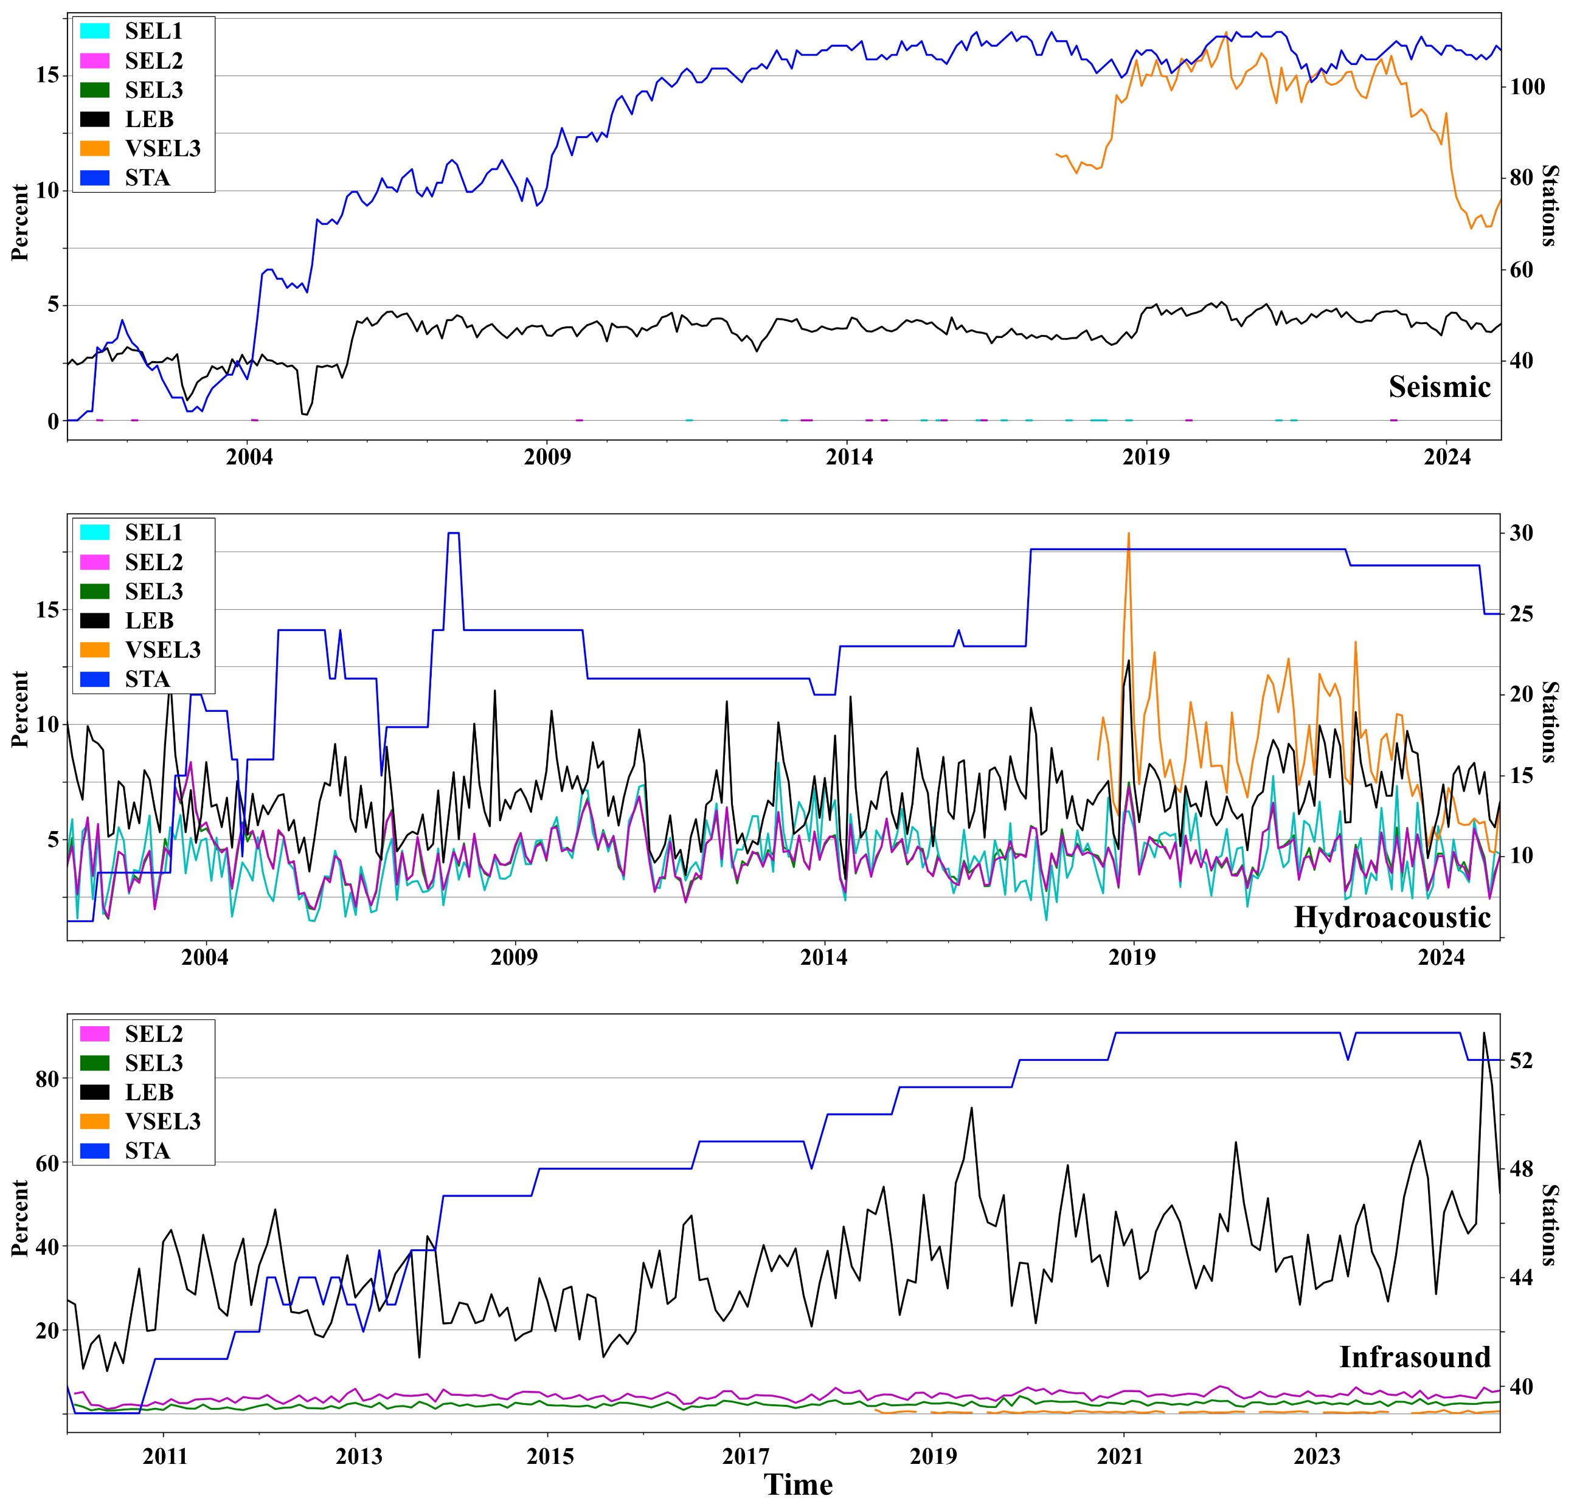
Understanding phase classification throughout the International Data Centre pipeline
P3.5-689
Percentage of noise (N-phase) detections converted and used for each stage of the IDC pipeline.
Seismic: GA converts below 1% of N-phases. The analysts (LEB) convert on average about 4% of IPHASE N-phases to other phases and NET-VISA was converting ~15% of N-IPHASES between 2018-2022 before a steep decrease to only about 7-10% starting in 2023.
Hydroacoustic: GA converts about 5% of N-IPHASES to other detections. This is the lowest in the pipeline due to the analysts converting slightly more at ~7% and NET-VISA converting ~10% before 2023. After 2023 NET-VISA decreased to about 7% in converting N-IPHASES.
Infrasound: GA converts around 2-4% of N-IPHASES to I-detections. NET-VISA converts even less at ~0.5%. Conversely, 40-60% of all infrasound events built by analysts (LEB) contain a converted IPHASE “N”.
While the hydroacoustic pipeline closely matches the LEB, seismic and infrasound do not. For seismic, NET-VISA uses ~10% more IPHASE “N”s than the analysts do, which is significant considering NET-VISA is trained on the LEB. Infrasound is even more extreme, where analysts are converting 40-60% of IPHASE “N”s to build events. This means StaPro itself or the thresholds placed on infrasound classification inside StaPro and GA are very limiting. Due to this, the workload for analysts examining infrasound data is high and needs to be addressed.
Seismic
Hydroacoustic
Infrasound

Slide 5
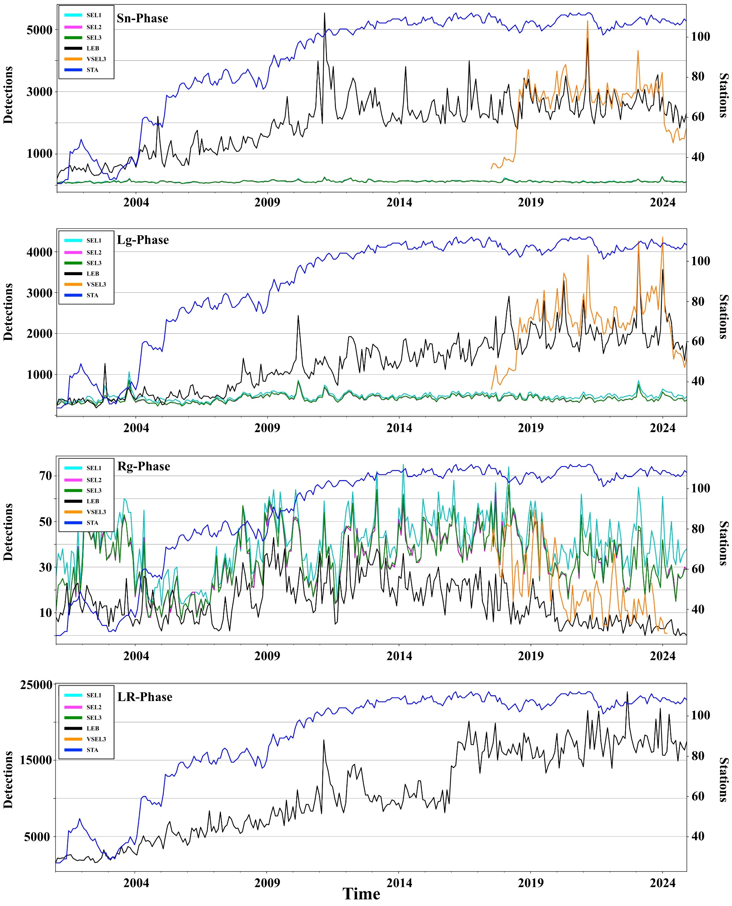


Understanding phase classification throughout the International Data Centre pipeline
P3.5-689
Bonus slide:
More seismic
phases
www.ctbto.org/resources/for-researchers-experts/vdec
Contact point: vdec@ctbto.org

