Slide 1

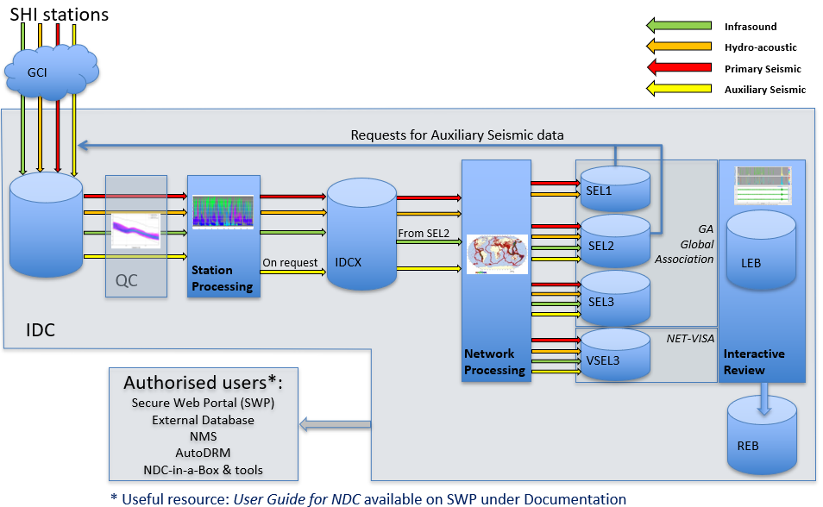


Understanding phase classification throughout the International Data Centre pipeline
P3.5-689
Braden Walsh and Tiago Oliveira
Preparatory Commission for the Comprehensive Nuclear-Test-Ban Treaty Organization, Vienna, Austria
Review
Exploration of how SHI detections are classified and how phases are changed, added, or removed throughout the IDC SHI pipeline
Categorization
Association
Review
DISCLAIMER The views expressed herein are those of the authors and do not necessarily reflect the views of the CTBTO Preparatory Commission. The Commission itself takes no responsibility for the content of this presentation.

