Slide 1

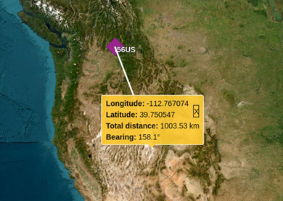
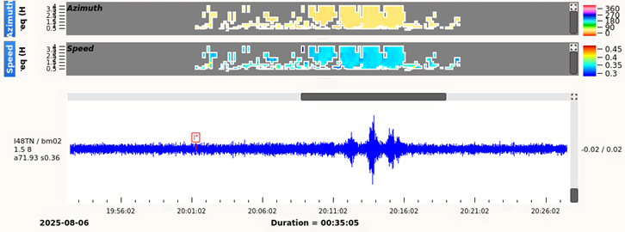
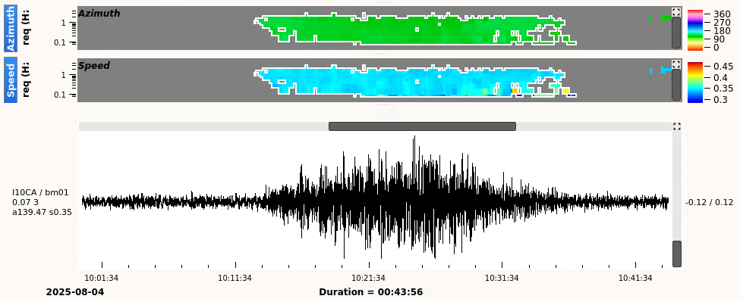

Infrasound analysis in the International Data Centre Operations
M. Villarroel, E. Qorbani Chegeni, P. Bittner, P.P. Tun, O. Ntibinyane, S. P. Quintero Colorado
International Data Center, CTBTO, Vienna, 1400 Austria
P3.5-676
Our presentation focuses on the procedures used to analyse infrasound events in IDC Operations, along with examples of challenges encountered during infrasound analysis.
We show specific difficult situations - like signal identification, volcano eruptions or scanning for missed events - and how the analysts tackle them in their daily work.
We outline suggestions to help improve the quality of the automatic infrasound bulletin and at the same time reduce the workload of the analysts.
The views expressed on this e-poster are those of the author and do not necessarily reflect the view of the CTBTO

