Slide 1

Introduction Slide Title goes here [Font: Arial Bold/Size: 16]
P3.5-683
Infrasound analysis in the International Data Centre Operations
M. Villarroel, E. Qorbani Chegeni, P. Bittner, P.P. Tun, O. Ntibinyane, S. P. Quintero Colorado
Comprehensive Nuclear-Test-Ban Treaty Organization (CTBTO)
Since the beginning of routine analysis of infrasound data (2010), analysts at the International Data Centre have reviewed approximately 125,000 automatically built SEL3 infrasound events and included more than 68,000 events in the Late Event Bulletin (LEB).
This presentation focuses on the procedures used to analyse infrasound events in IDC Operations, along with examples of challenges encountered during infrasound analysis.
DISCLAIMER:The views expressed on this e-poster are those of the author and do not necessarily reflect the view of the CTBTO

Slide 2
Infrasound analysis in the International Data Centre Operations
M. Villarroel, E. Qorbani Chegeni, P. Bittner, P.P. Tun, O. Ntibinyane, S. P. Quintero Colorado
Procedures
P3.5-683
Introduction
Analysis of SEL3 events
Further tasks
Routine analysis of infrasound data began in early 2010. Since then, analysts at the International Data Centre (IDC) have reviewed approximately 125,000 automatically built SEL3 infrasound events and included more than 68,000 events in the Late Event Bulletin (LEB). Of these, more than 37,000 events met the Reviewed Event Bulletin (REB) event criteria.
Analysing infrasound data presents several challenges. These include distinguishing between noise and signal, obtaining a preliminary location based on one-station observations, or identifying signals generated by the same source that travelled different paths to the detecting stations. Most of the events included in the REB are seismic in nature, originating from stationary short-duration sources such as earthquakes or mining blasts. Another challenge in infrasound event analysis is that infrasound sources often move (i.e. bolides) or produce long-duration signals (i.e. erupting volcanoes).
The last automatic product, Standard Event List (SEL3), serves as a starting point for analyst review. Analysis of events detected at infrasound stations includes:
Validation and improvement of events built from infrasound observations
Validation of infrasound detections associated to seismic seeds
The majority of SEL3 infrasound seed events are bogus and rejected.
Reasons for rejection:
Detections belong to a long-duration activity (i.e. microbaroms)
Local source detection is associated at a large distance
Signals are of interest but have closer source appearances; analysts attempt to find corroborating detections for wrongly associated signals of interest to find a missed event
Split event – one LEB event may be presented as a few SEL3 events
Accepted events require improvement:
Invalid detections are removed
Associated detections may need modification
Additional infrasound detections are identified and added to the event solution
If a surface explosion is suspected, the seismic seed is found to constrain the location
Data are scanned for missed events.
Analysts add a significant number of infrasound seed LEB events.
The current automatic products are the result of the Global Association (GA) algorithm. An alternative automatic bulletin (VSEL3) is generated using a Bayesian approach to network processing. Analysts have not yet verified the VSEL3 results; however, spot checks have yielded positive results.
Seismic seed events are checked for additional infrasound associations.
Infrasound detections associated to local mining events may promote the event to the REB.
Infrasound detections associated to large seismic events identify the source of the infrasound signal.

Slide 3
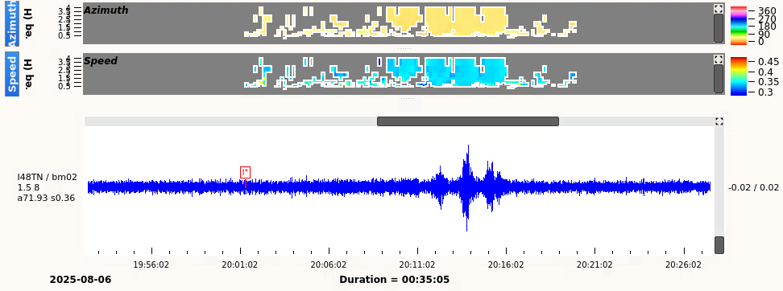
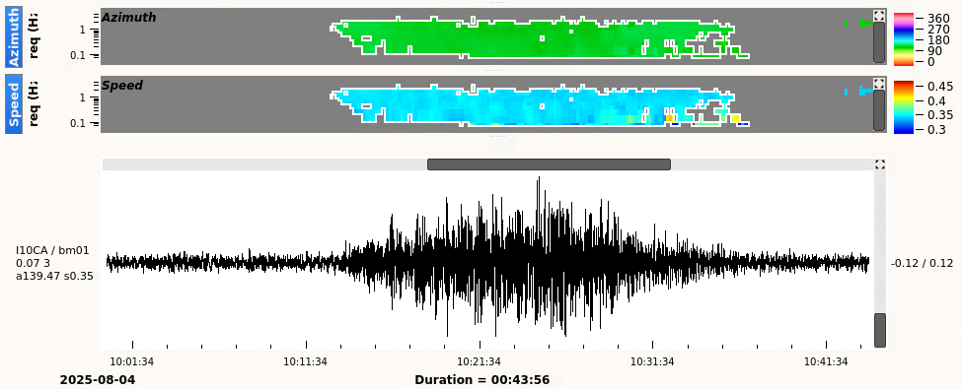
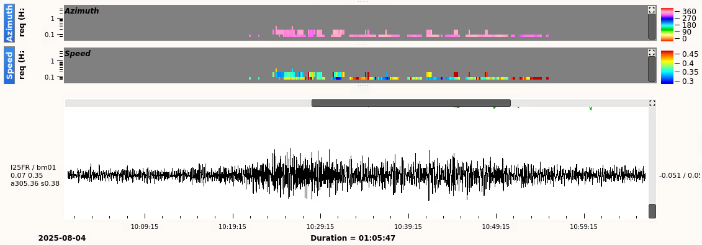
Infrasound analysis in the International Data Centre Operations
M. Villarroel, E. Qorbani Chegeni, P. Bittner, P.P. Tun, O. Ntibinyane, S. P. Quintero Colorado
P3.5-683
Challenges introduced by different propagation conditions
Identification of signal at background of noise
Propagation conditions influence the received signal’s appearance and its frequency content. Signals travelling in the altitude wind direction arrive with a larger Signal-to-Noise Ratio (SNR) and a broader frequency spectrum. The following example shows signals received at two stations, located roughly 2,500 km from the source (a Falcon 9 launch from Cape Canaveral, Florida, US). One station is situated west of the launch place, and the other east of it. The launch occurred on August 4, in summer conditions, with the prevailing westward direction of the altitude wind in the Northern Hemisphere.
The signal received at IS10 in Canada has a larger SNR and a broader frequency range than the signal received at IS25 in Guadeloupe, France. Analysts must expect that the same source may be viewed differently at different stations, unlike when analysing seismic events at teleseismic distance.
Detection of seismic signals is based on an increase in amplitude. Due to the emergent onsets of infrasound signals and the influence of local wind, infrasound signal detection is based on signal correlation along the infrasound array. In the presence of ongoing activity with a similar frequency and azimuth to the signal of interest, an infrasound detection may be assigned to both the signal of interest and what would be perceived as noise (i.e., microbaroms, waterfall, etc.). The example below illustrates a signal of interest superimposed on ongoing activity. A detection is placed at the beginning of the ongoing activity. An analyst needs to identify the onset of the signal of interest and modify the detection`s azimuth.
I
Fig.3.Signal of interest mixed with ongoing activity at IS48. Signal detection is earlier than the onset and needs to be modified.
Fig.1. Launch from Florida, US, observed at IS10 in Canada; event took place on 4 August 2025
Fig.2. Launch from Florida, US, observed at IS25 in Guadelupe, France; event took place on 4 August 2025

Slide 4
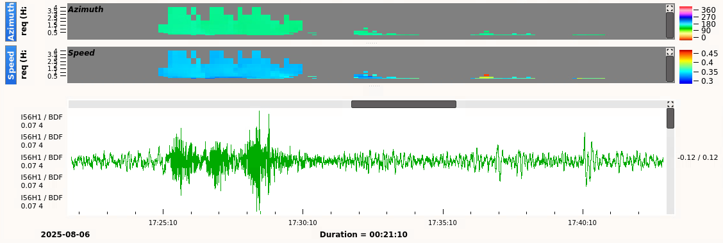
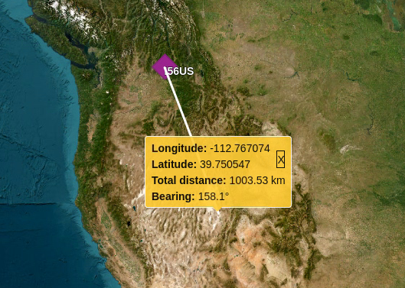
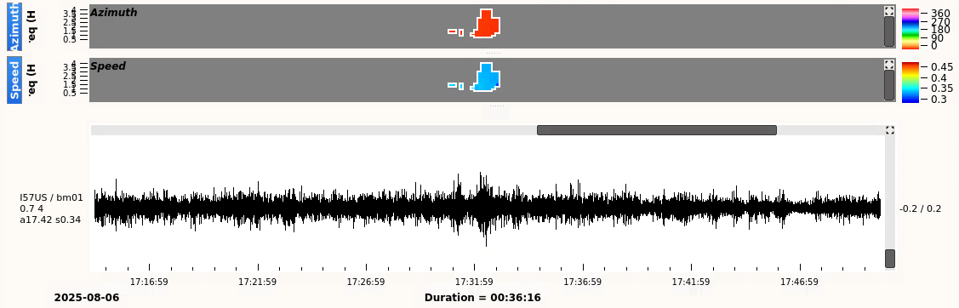
Infrasound analysis in the International Data Centre Operations
M. Villarroel, E. Qorbani Chegeni, P. Bittner, P.P. Tun, O. Ntibinyane, S. P. Quintero Colorado
P3.5-683
Finding the initial event location based on one signal of interest
Even one seismic phase is sufficient to locate an event based on arrival time, azimuth and slowness; the last parameter allows for estimating the distance from the source to the station. Slowness cannot be used to locate atmospheric events. The distance of an infrasound source may be estimated from the signal appearance (dispersion). To be correctly associated to an event, a phase must show characteristics relevant to the distance, i.e. an analyst would not expect a short-duration, impulsive signal at a large distance from the source. The following example illustrates how to determine the initial event location based on a single infrasound detection.
Fig.4. Signal of interest observed at IS56. The distance of the source could be estimated as 1000 km based on the signal’s appearance.
Fig.5. Estimated source location for search of signals corroborating with IS56
Fig.6. Results from the tool used for the identification of possible corroborating signals.
A signal of interest has been detected at IS56, as shown in Fig. 4. Several peaks within the waveform indicate that the source was located at a distance between 500 and 1000 km. Based on the azimuth value, the initial location of the source is fixed at 39.75 N, 112.76 W (Fig.5) and the origin time is assumed to be 1 hour before the arrival time (infrasound travel time). With a tool used to identify possible corroborating signals, the analyst displays waveforms at a few stations and identifies a corroborating signal at IS57 (Fig. 7). IS56 and IS57 locate an event close to a known cluster of explosive sources; therefore, seismic stations are searched for a corresponding seismic seed. Once corroborating seismic signals are identified, an event is located and included in the LEB.
Fig.7. Detection at IS57, which matches signal of interest observed at IS56

Slide 5
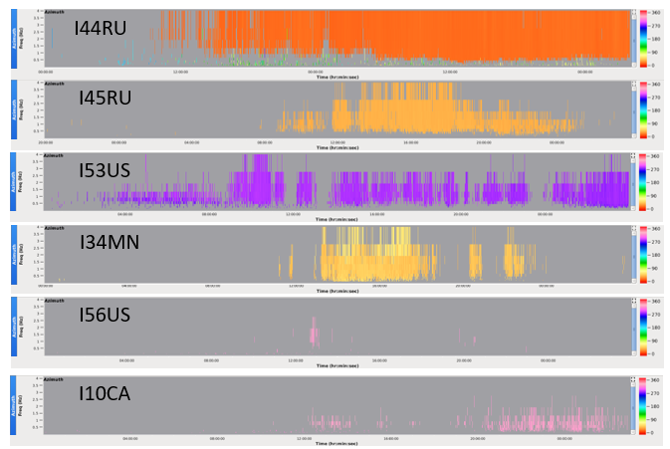
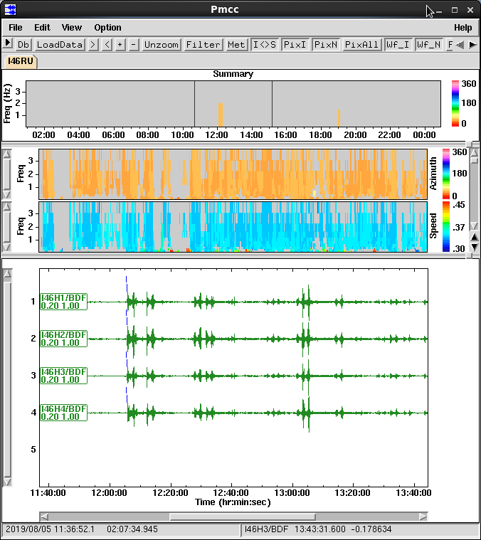
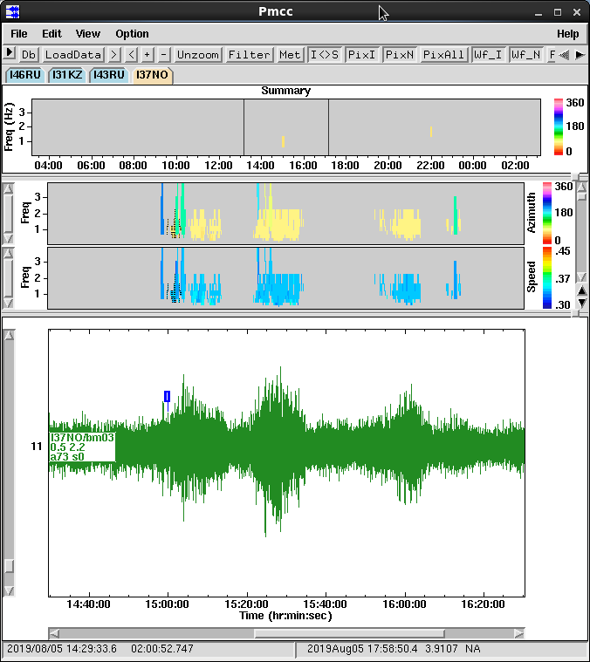
Infrasound analysis in the International Data Centre Operations
M. Villarroel, E. Qorbani Chegeni, P. Bittner, P.P. Tun, O. Ntibinyane, S. P. Quintero Colorado
P3.5-683
Volcano eruptions recorded as long-duration activity
Analysis of a sequence of explosions
Volcanic activity may last for several days and be characterised as a long-duration signal of fluctuating amplitude. This type of activity is challenging to include in the IDC bulletins, which typically contain events that occur at a specific time. An event may mark the beginning or increase of volcanic activity. The latter may be recorded at more International Monitoring System (IMS) stations, which may help to include the event in the REB. Event location based on information from many IMS stations is more accurate with a smaller area of the 90% confidence ellipse.
Accidents at ammunition depots can cause a sequence of explosions. Signals that propagate over large distances will extend their duration; therefore, one detection at a distant station may encompass several corresponding detections at a nearby station. One of the challenges is identifying separate events in a complex signal. Explosions may also trigger seismic events, posing another challenge to the fusion of seismic and infrasound observations. Activity related to a sequence of explosions is illustrated below.
The Kliuchevskoi eruption, which took place in October 2013, is an example of long-duration activity. An event related to this eruption was located based on detections at seven infrasound stations. Fig.8. shows an overview of daily detections at 6 of them. The closest station, IS44, is 350 km from the volcano. On 18 October 2013, IS44 recorded a continuous infrasound signal generated by the Kliuchevskoi eruption. Other stations detected several intervals of signal related to Kliuchevskoi activity. An event included in the REB was combined from detections within the activity recorded at associated stations. It shows that the volcano was erupting, but it by no means describes the complexity of the signals recorded by each station.
Fig.9. Activity recorded at the closest and most distant infrasound station (I46RU – 420 km and I37NO – 3700 km).
Fig.8. Daily plot of detections recorded at 6 infrasound stations on 18/10/2013. All traces include a signal related to the Kliuchevskoi eruption; trace for I44RU and I45RU starts on the previous day

Slide 6
Infrasound analysis in the International Data Centre Operations
M. Villarroel, E. Qorbani Chegeni, P. Bittner, P.P. Tun, O. Ntibinyane, S. P. Quintero Colorado
Concluding remarks
P3.5-683
Quality of automatic infrasound bulletins
The majority of SEL3 infrasound seed events are rejected as bogus, and analysts find a significant number of LEB events while scanning infrasound data. An alternative automatic bulletin (VSEL3), generated using a Bayesian approach to network processing, may improve the quality of the automatic infrasound bulletin. The number of VSEL3 infrasound events is smaller than the number of infrasound SEL3 events. Spot checks during routine analysis reveal that some LEB events missing in SEL3 are included in VSEL3.
One example is an infrasound LEB event on 15 August 2025, at 07:35. It was not listed in SEL3. VSEL3 contained this event, detected by three infrasound stations. The LEB event included observations from two additional infrasound and five seismic stations.
Performance of the infrasound VSEL3 should be assessed by interactive analysis of a few data days and comparison between SEL3/VSEL3 and LEB.
Improvement of the quality of automatic infrasound bulletins will reduce analysis efforts.
Some challenges encountered during infrasound analysis
Scanning of infrasound data
Looking for missed events is one of the most time-consuming analyst efforts. Slowness, which is used to estimate the distance for seismic events, cannot be used to locate atmospheric events. The distance of an infrasound source can be estimated from the appearance of the signal. Tools which facilitate estimating event parameters for signals of interest will reduce analysis efforts.
Analysis of long-duration activity
Seismic signals are identified by the STA/LTA (Short Term Average/ Long Term Average) detector, based on an increase in signal amplitude. Infrasound signal detection is based on signal correlation along the infrasound array, which is necessary because a local wind burst will increase waveform amplitude. In the case of long-duration acoustic activity, this method fails to identify all signals of interest. This necessitates adjusting detection parameters in cases where signals are mixed with noise. In the case of a sequence of volcanic eruptions and accidental explosions, the detection azimuth is correct; however, the onset time needs to be adjusted to coincide with the amplitude increase. Considering amplitude in the correlated infrasound signal may improve the quality of automatic detections.

