Slide 1

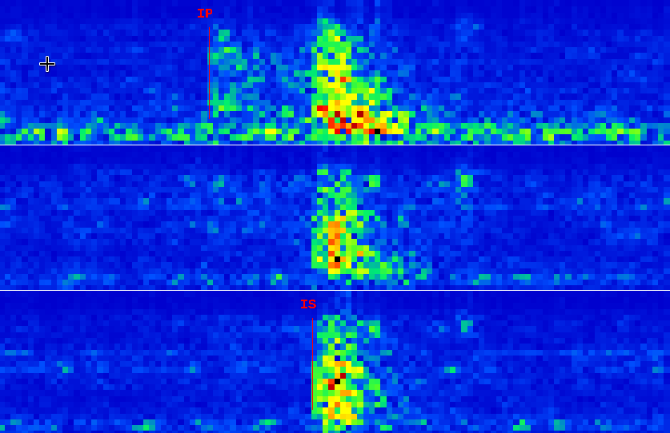
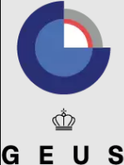


P3.5-628
Seismic event processing using the IDC FDSN webservice and SEISAN
Peter Voss(1), Gonzalo Antonio Fernandez(2), Jens Havskov(3) and Tine B. Larsen(1)
1: Geological Survey of Denmark and Greenland (GEUS), 2: Observatorio San Calixto, Bolivia, 3: University of Bergen, Norway
Our e-poster gives examples on how to use the FDSN Web Service provided by the CTBTO
Access to IDC seismic bulletins
Access to IMS collected seismic waveforms
Examples on using CTBTO seismic data in SEISAN (Earthquake analysis software package)
  Event catalogue reviewing
  Waveform plotting
NDC Forum
  https://ndc-forum.ctbto.org/
  #seisan

