Slide 1




P3.5-628
Seismic event processing using the IDC FDSN webservice and SEISAN
Peter Voss⁽¹⁾, Gonzalo Antonio Fernandez⁽²⁾, Jens Havskov⁽³⁾ and Tine B. Larsen⁽¹⁾
1: Geological Survey of Denmark and Greenland (GEUS)
2: Observatorio San Calixto, Bolivia
3: University of Bergen, Norway
This presentation demonstrates how to use the IDC FDSN web service to download and analyze seismic data, integrating IMS waveforms and phase picks with local datasets to determine event locations and magnitudes.
We use the SEISAN software package, popular among small seismic networks, students, researchers, and several NDCs, for processing data from both permanent and temporary networks.

Slide 2
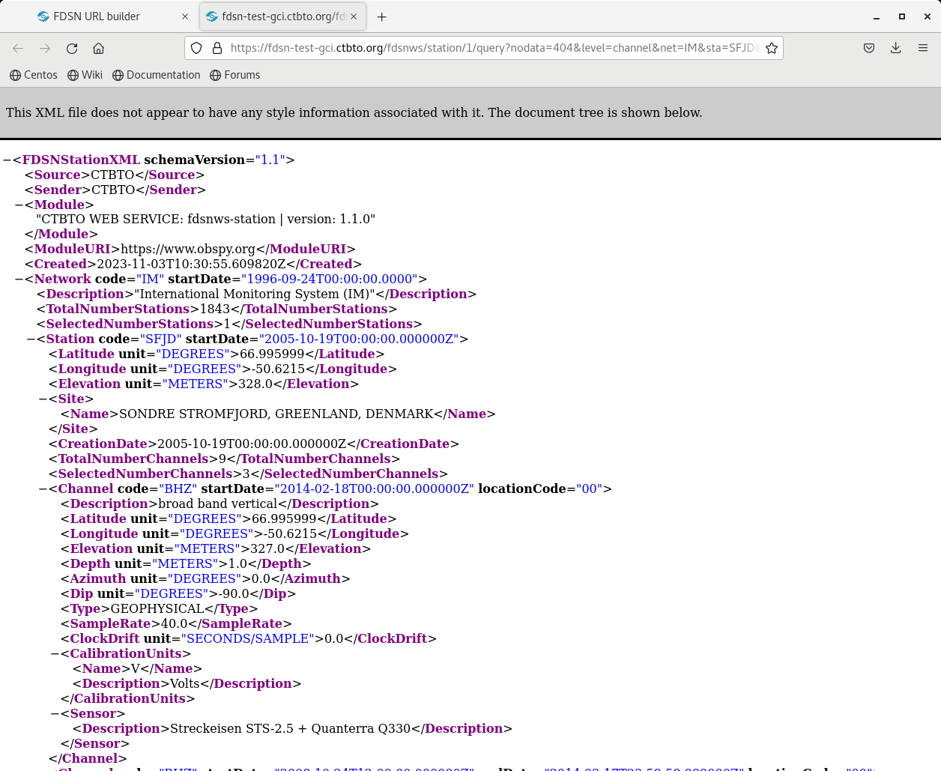
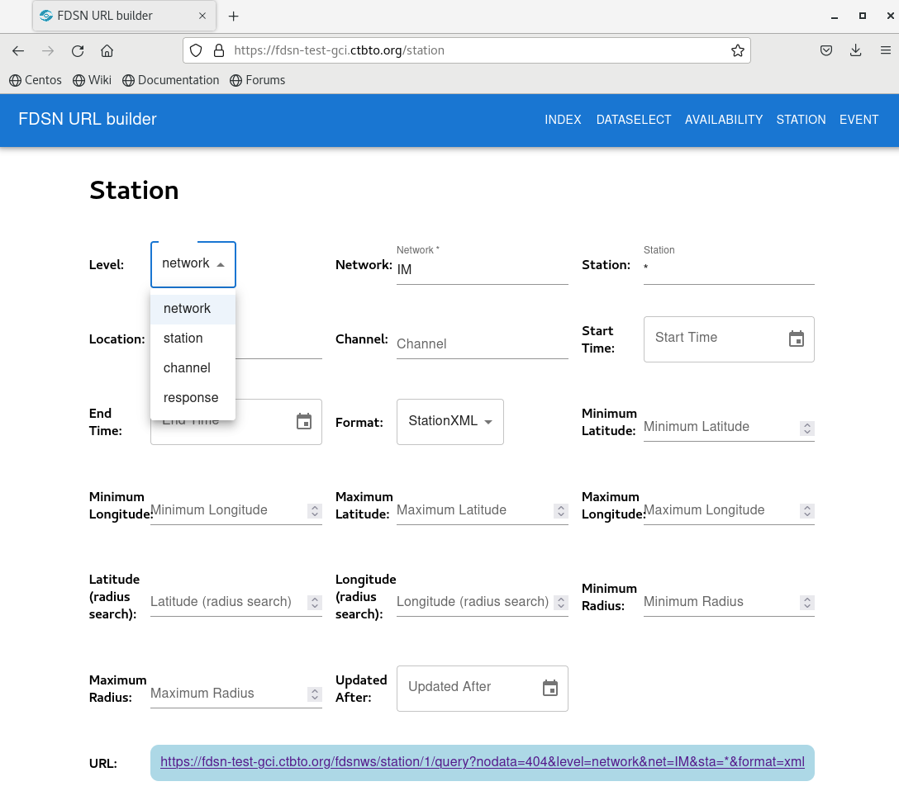
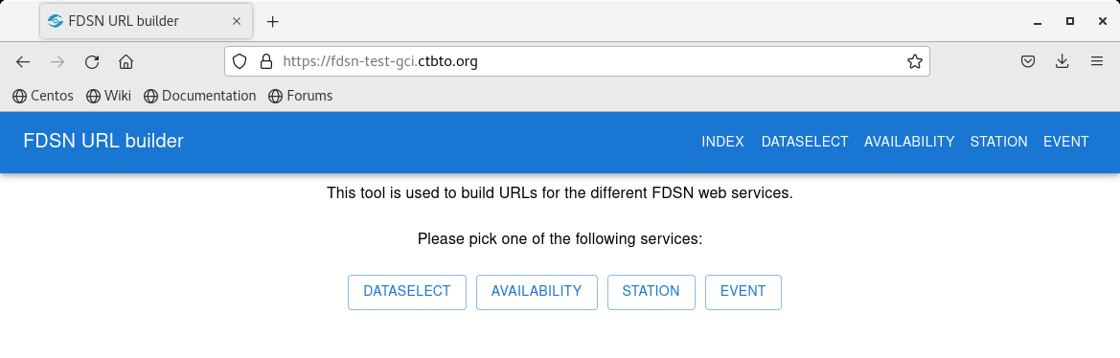
PLEASE DON‘T FORGET TO PUT THE E-POSTER TITLE AND YOUR NAME IN THE PRESENTATION HEADER.
DUPLICATE THIS SLIDE IF YOUR E-POSTER HAS MORE THAN 1 PAGE
P3.5-628
Seismic event processing using the IDC FDSN webservice and SEISAN
Peter Voss, Gonzalo Antonio Fernandez, Jens Havskov and Tine B. Larsen
The IDC FDSN web services
Station Metadata
StationXML
The IDC FDSN web services for GCI connected NDCs offers a browser based FDSN URL builder. In the FDSN URL builder one has four main options to send request to; the dataselect service, the availability service, the station service and the event service. Open the following URL at a GCI connected computer to access the FDSN URL builder:
https://fdsn-gci.ctbto.org
Requests to the IDC FDSN web services can also be send using command line commands, in the following examples are given using a Linux computer connected to the GCI.
The following IDC FDSN web services are supported:
fdsnws-station
fdsnws-dataselect
fdsnws-event
fdsnws-availability
The URL builder for station metadata is seen below. The ULR builder provide several search options, output can be StationXML, SEED (dataless) or the SeisComP version of Station XML.
The above example is the requested station metadata is received in the FDSN Station XML format. Request for Station information can also be send using command like:
wget -q -O IM_BORG_BHZ.xml "https://fdsn-test-gci.ctbto.org/fdsnws/station/1/query?network=IM&station=BORG&channel=BHZ&level=response"

Slide 3
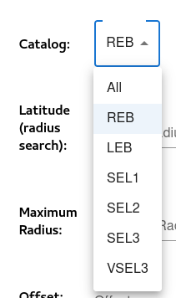
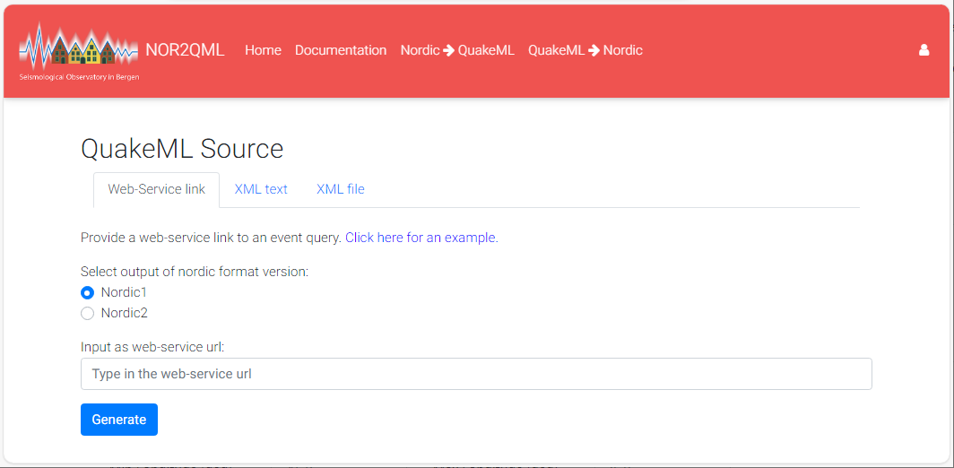
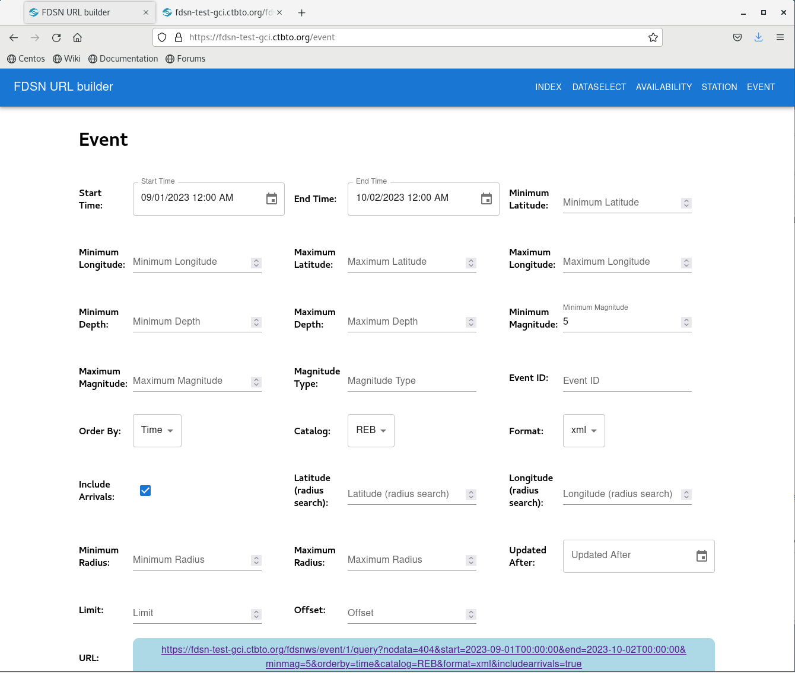
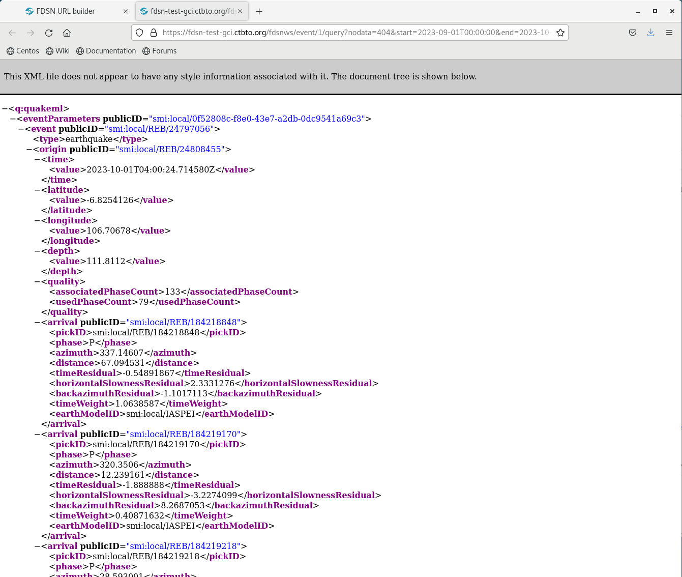
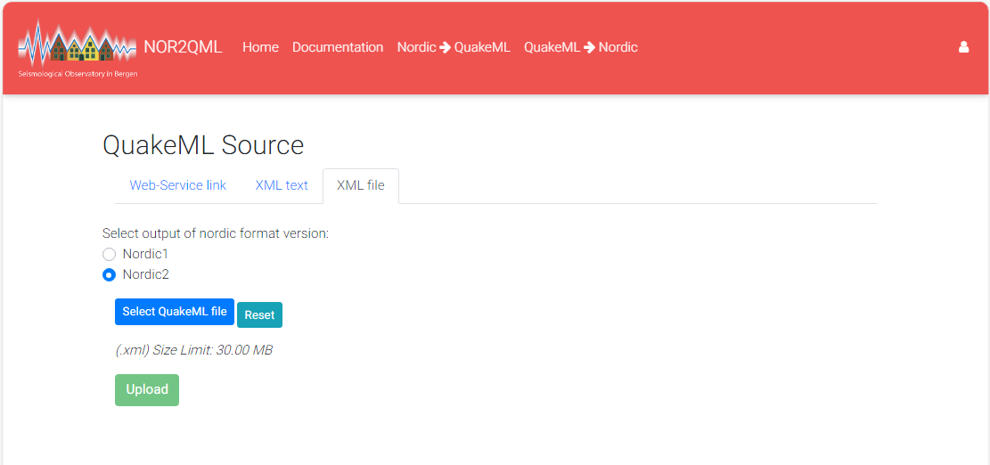
PLEASE DON‘T FORGET TO PUT THE E-POSTER TITLE AND YOUR NAME IN THE PRESENTATION HEADER.
DUPLICATE THIS SLIDE IF YOUR E-POSTER HAS MORE THAN 1 PAGE
P3.5-628
Seismic event processing using the IDC FDSN webservice and SEISAN
Peter Voss, Gonzalo Antonio Fernandez, Jens Havskov and Tine B. Larsen
Bulletins in QuakeML
QuakeML format
Conversion to SEISAN format
The IDC FDSN web service Event provide parametric data on events located by the IDC. Below is an example on how the request station meta data using the web service in a browser and on command line.
In a browser open the IDC FDSN URL builder:
IDC provide several different
catalogs that the user can select.
The figure to the right show the
way to select the required catalog:
An example of the parametric data received in QuakeML formal is seen below:
University of Bergen provide an online service to generate SEISAN format from QuakeML. Directly from a FDSN type web-service as seen above or if the QuakeML file is uploaded as a file as seen below:

Slide 4
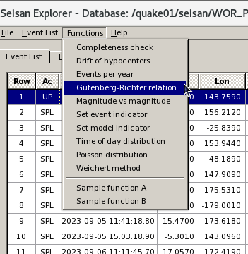
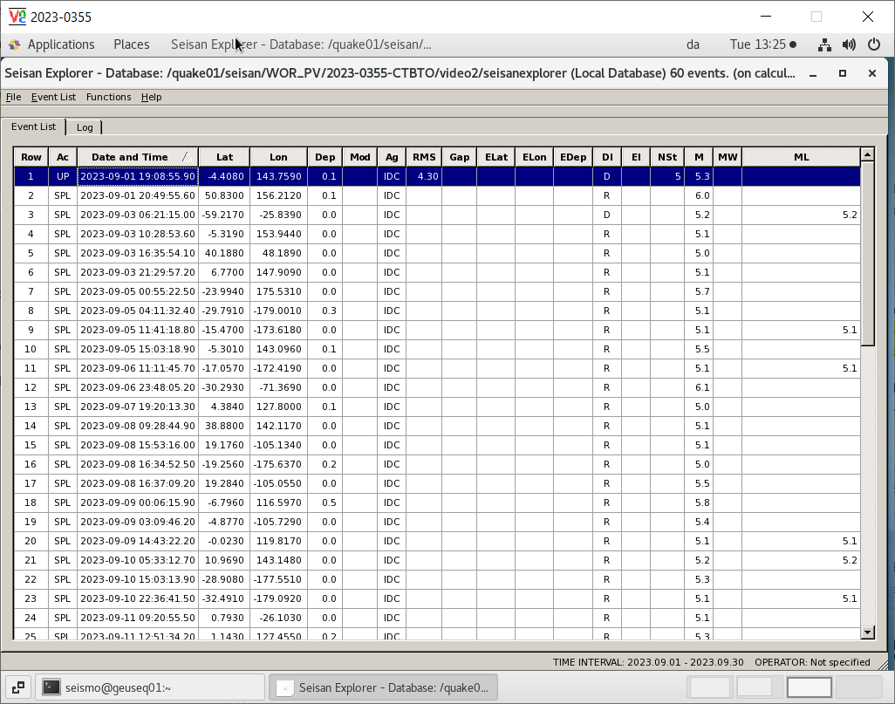
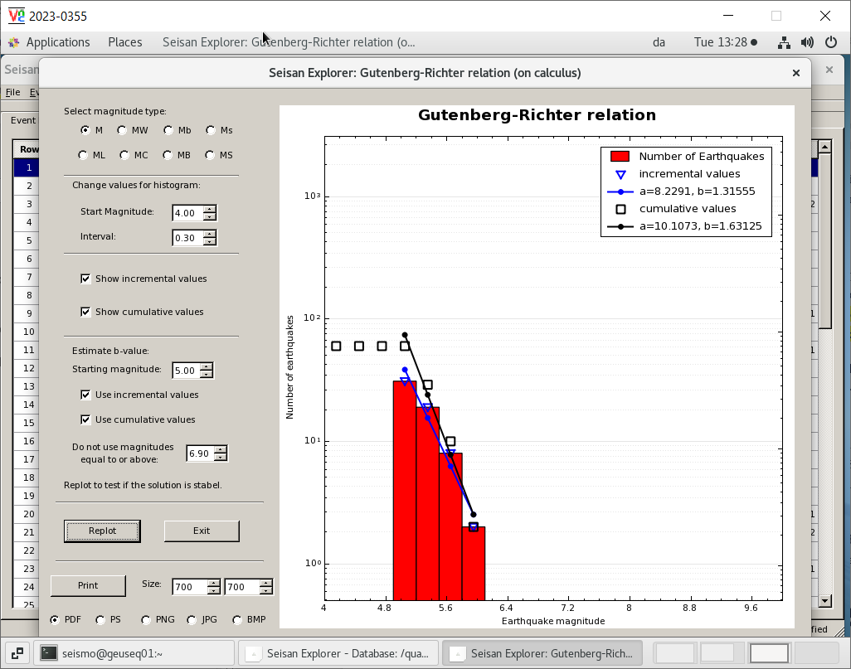
PLEASE DON‘T FORGET TO PUT THE E-POSTER TITLE AND YOUR NAME IN THE PRESENTATION HEADER.
DUPLICATE THIS SLIDE IF YOUR E-POSTER HAS MORE THAN 1 PAGE
P3.5-628
Seismic event processing using the IDC FDSN webservice and SEISAN
Peter Voss, Gonzalo Antonio Fernandez, Jens Havskov and Tine B. Larsen
Viewing Bulletins in SEISAN
Functions
Example – Gutenberg Richter
Once the parametric data have been converted to Nordic format SEISAN provides many different tools to examine and analyze the data. The figure below shoe the GUI SEISAN Explorer, a tool to list and visualize multiple seismic events.
SEISAN Explorer offers sorting and filtering opportunities. Furthermore, one can apply different functions to the data as seen above.
In addition to the GUI SEISAN can be used and automized with several command line tools.
The figure below illustrates an example of a tool in SEISAN Explorer.
The figure shows the standard tool for analyzing earthquake catalogues; plotting and estimating parameters on a Gutenberg-Richter relations plot.

Slide 5
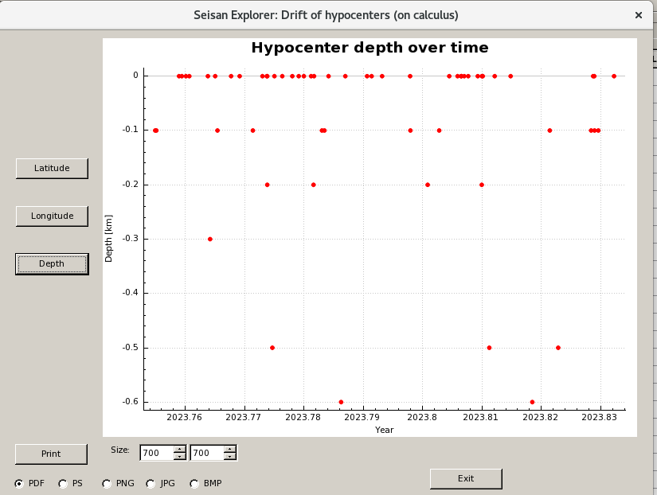
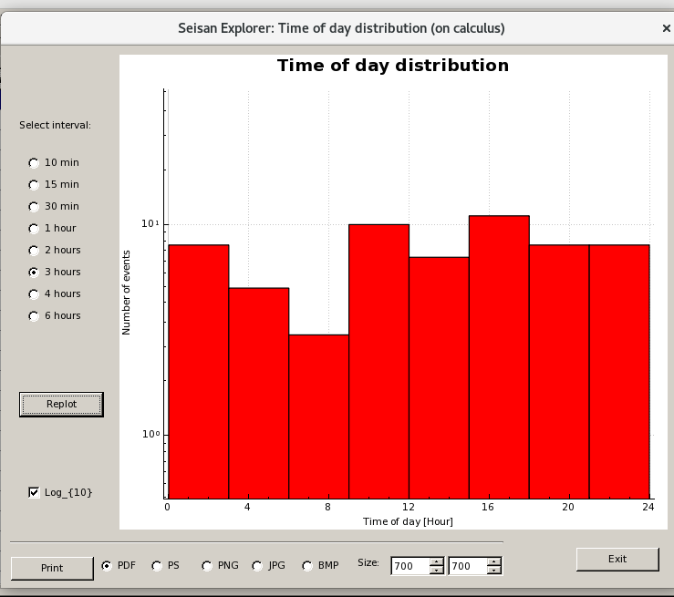
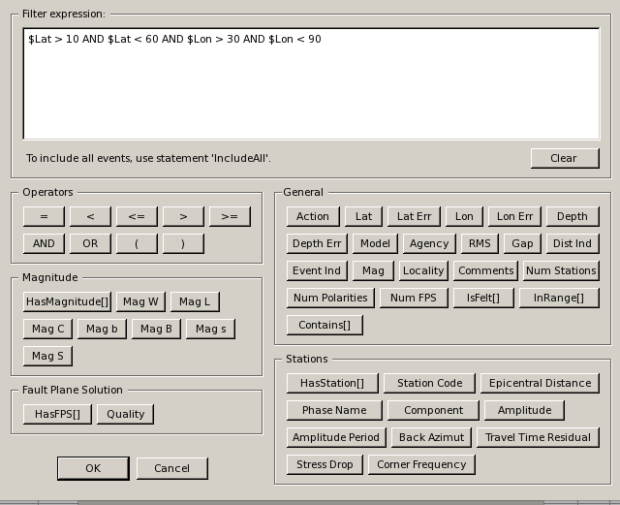
PLEASE DON‘T FORGET TO PUT THE E-POSTER TITLE AND YOUR NAME IN THE PRESENTATION HEADER.
DUPLICATE THIS SLIDE IF YOUR E-POSTER HAS MORE THAN 1 PAGE
P3.5-628
Seismic event processing using the IDC FDSN webservice and SEISAN
Peter Voss, Gonzalo Antonio Fernandez, Jens Havskov and Tine B. Larsen
Example – time of day
Example – depth vs time
Example - filtering
The figure below shows a tool often used for identifying explosions in earthquakes catalogues. The plot gives number of events in time windows, since explosions are often conducted mid-day it is not uncommon to see a peak around 12 o’clock.
The figure above shows a tool often used for identifying explosions in earthquakes catalogues. The plot gives the depth of events versus the time of the events, since explosions often are conducted in weekdays and not during vacation times, the plot assisted identifying them.
After loading a catalogue of seismic events into SEISAN it is often required to filter subsets of events for further examination, the figure below show the many filter options and an example on a filter expression:

Slide 6
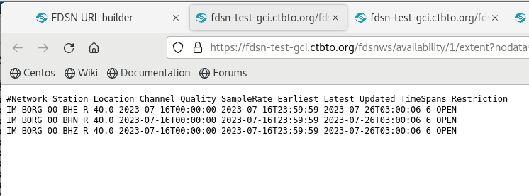
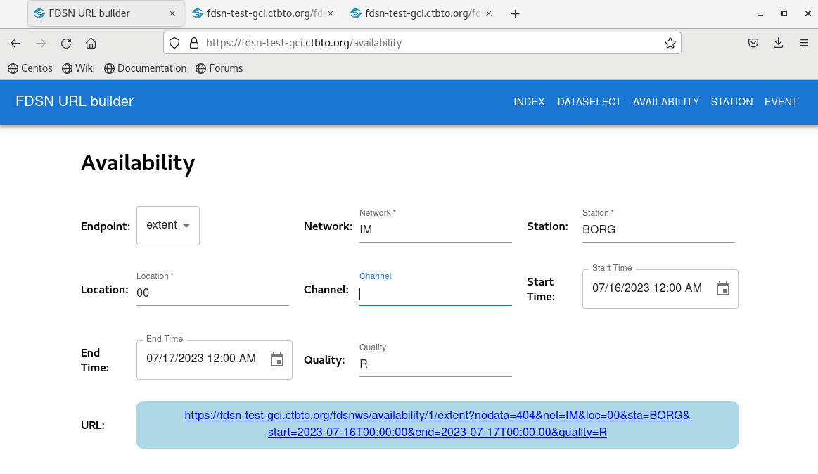
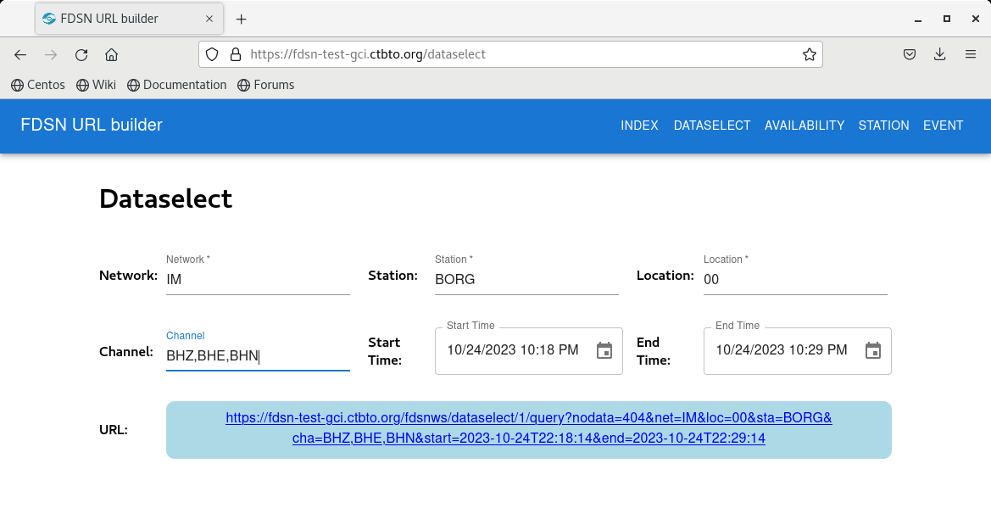
PLEASE DON‘T FORGET TO PUT THE E-POSTER TITLE AND YOUR NAME IN THE PRESENTATION HEADER.
DUPLICATE THIS SLIDE IF YOUR E-POSTER HAS MORE THAN 1 PAGE
P3.5-628
Seismic event processing using the IDC FDSN webservice and SEISAN
Peter Voss, Gonzalo Antonio Fernandez, Jens Havskov and Tine B. Larsen
Waveform data availability
Data availability listing
Requesting Waveform Data
The FDSN web service provides information on data availability. This is a useful tool to be applied before requesting data, especially in the case of data gaps.
In a browser open the FDSN URL builder as seen below.
An example of the listing of available
data is given above.
To request data one can, use the FDSN web service Dataselect. With Dataselect one provide the requested network, station(s), location and channel(s) codes, and start and end times.
In a browser open the FDSN URL builder as seen below.
The request will provide the waveform data in miniseed format for download.

Slide 7
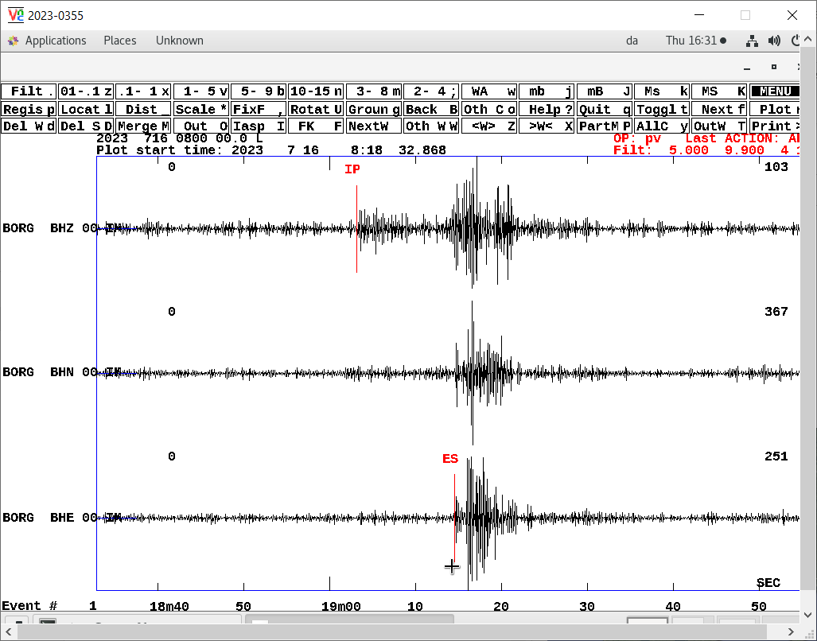
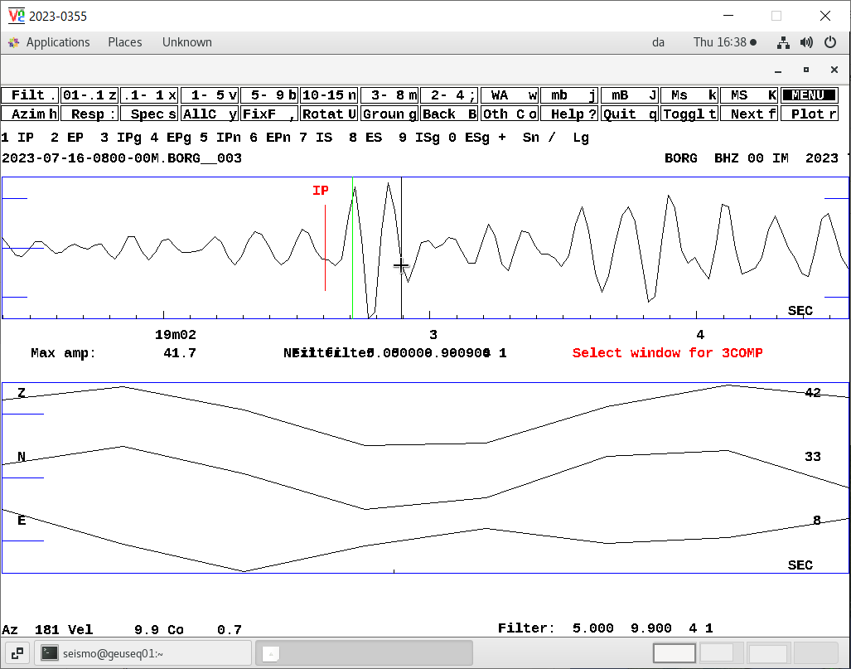
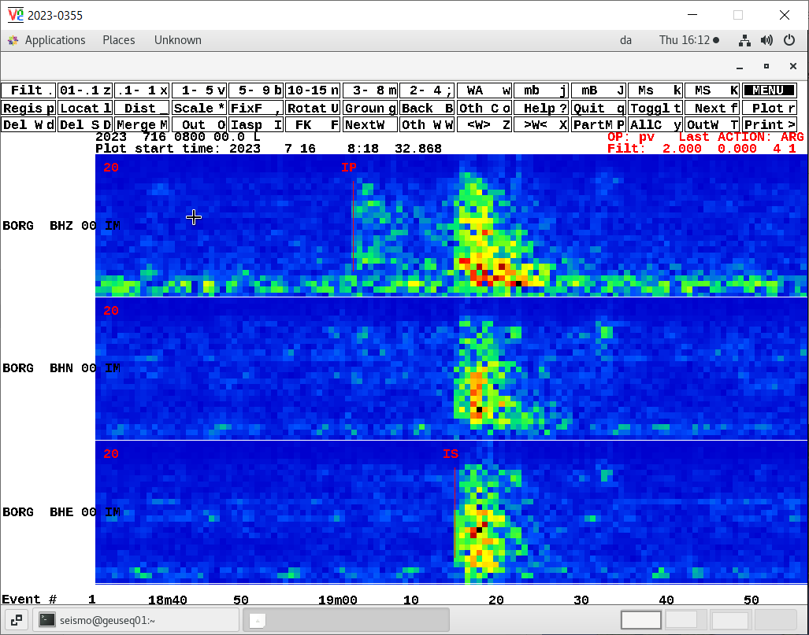
PLEASE DON‘T FORGET TO PUT THE E-POSTER TITLE AND YOUR NAME IN THE PRESENTATION HEADER.
DUPLICATE THIS SLIDE IF YOUR E-POSTER HAS MORE THAN 1 PAGE
P3.5-628
Seismic event processing using the IDC FDSN webservice and SEISAN
Peter Voss, Gonzalo Antonio Fernandez, Jens Havskov and Tine B. Larsen
Waveform Data plotting
Waveform spectrogram
Waveform Azimuth
Once waveform data has been downloaded from CTBTO, they can be plotted in SEISAN. The example below show the SEISAN GUI for waveform plotting, with the data from a small seismic event recorded and the Icelandic station BORG on three components.
A useful tool for visual identification of earthquakes and explosions is by comparing the seismic energy of the p-wave relative to the s-wave, in a spectrogram. The example below shows the relative seismic energy in the seismic signal on the seismic record in the figure to the left.
xx

Slide 8
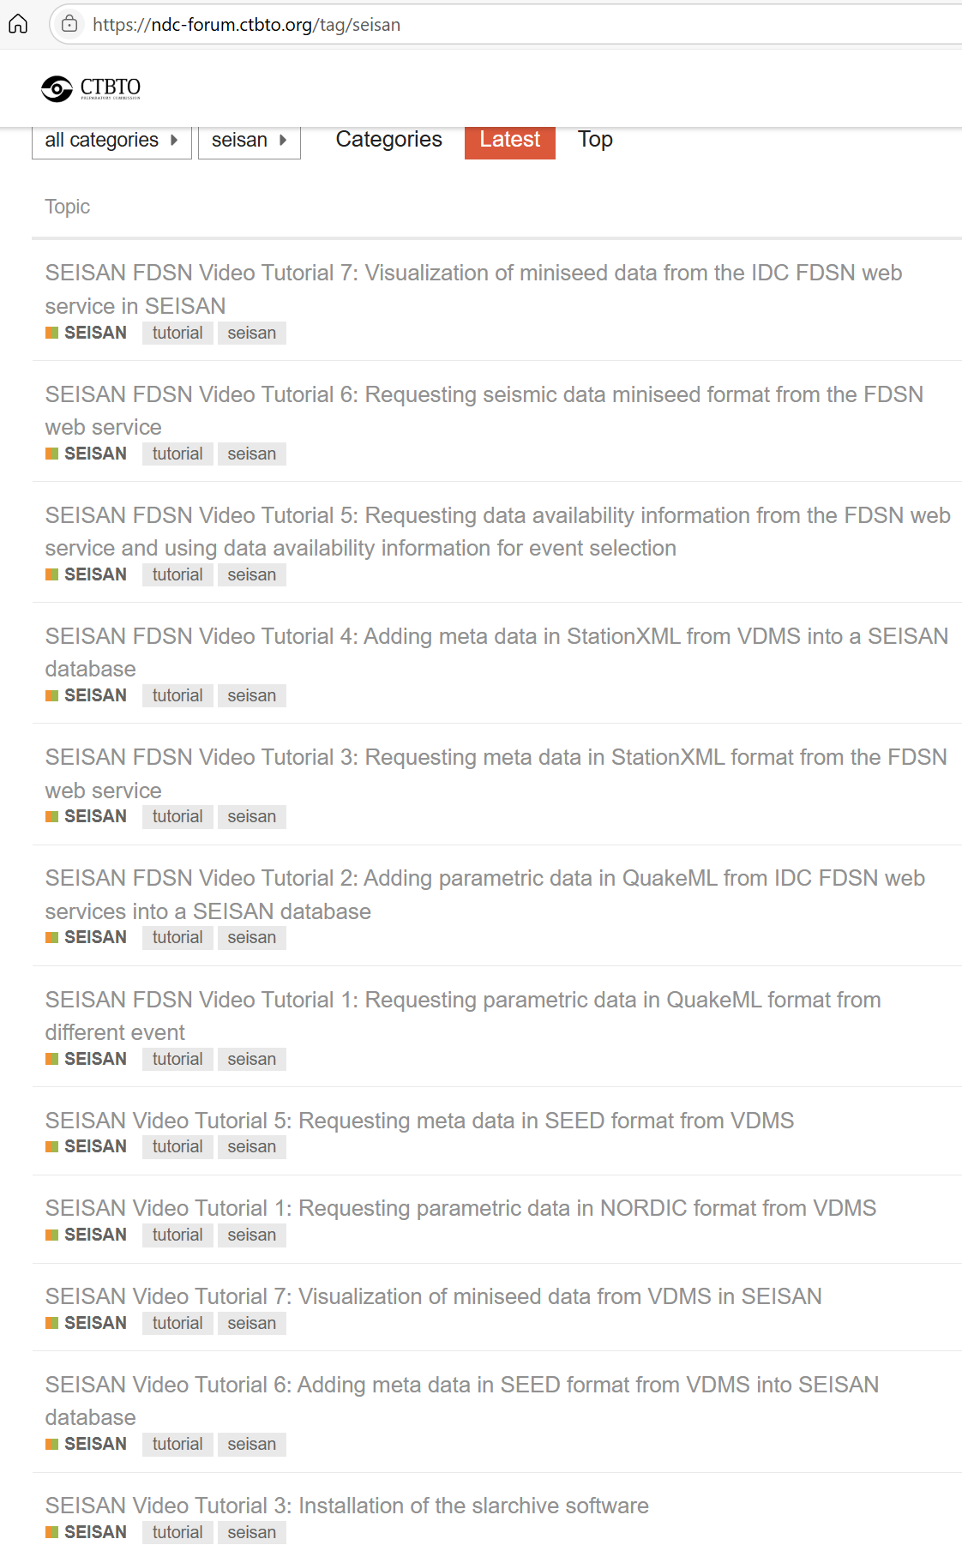
PLEASE DON‘T FORGET TO PUT THE E-POSTER TITLE AND YOUR NAME IN THE PRESENTATION HEADER.
DUPLICATE THIS SLIDE IF YOUR E-POSTER HAS MORE THAN 1 PAGE
P3.5-628
Seismic event processing using the IDC FDSN webservice and SEISAN
Peter Voss, Gonzalo Antonio Fernandez, Jens Havskov and Tine B. Larsen
Tutorials
#SEISAN
Acknowledgement
Much more information is provided as tutorials and video presentation at the NDC Forum:
https://ndc-forum.ctbto.org/
At the NDC Forum used the seisan tag to list the many tutorails as seen below
Professor Lars Ottemoller, University of Bergen, and all the SEISAN users, including many from NDCs, that for more than 30 yrs have provided feedback and helping to improve the SEISAN software. The SHI NDC-in-a-Box team for enabling access to IMS and IDC data via FDSN web services.
Thank you for your attention

