Slide 1

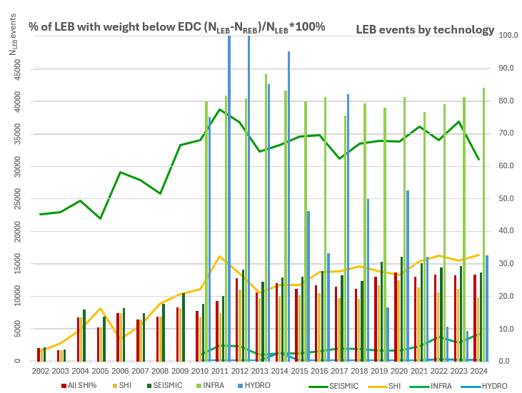
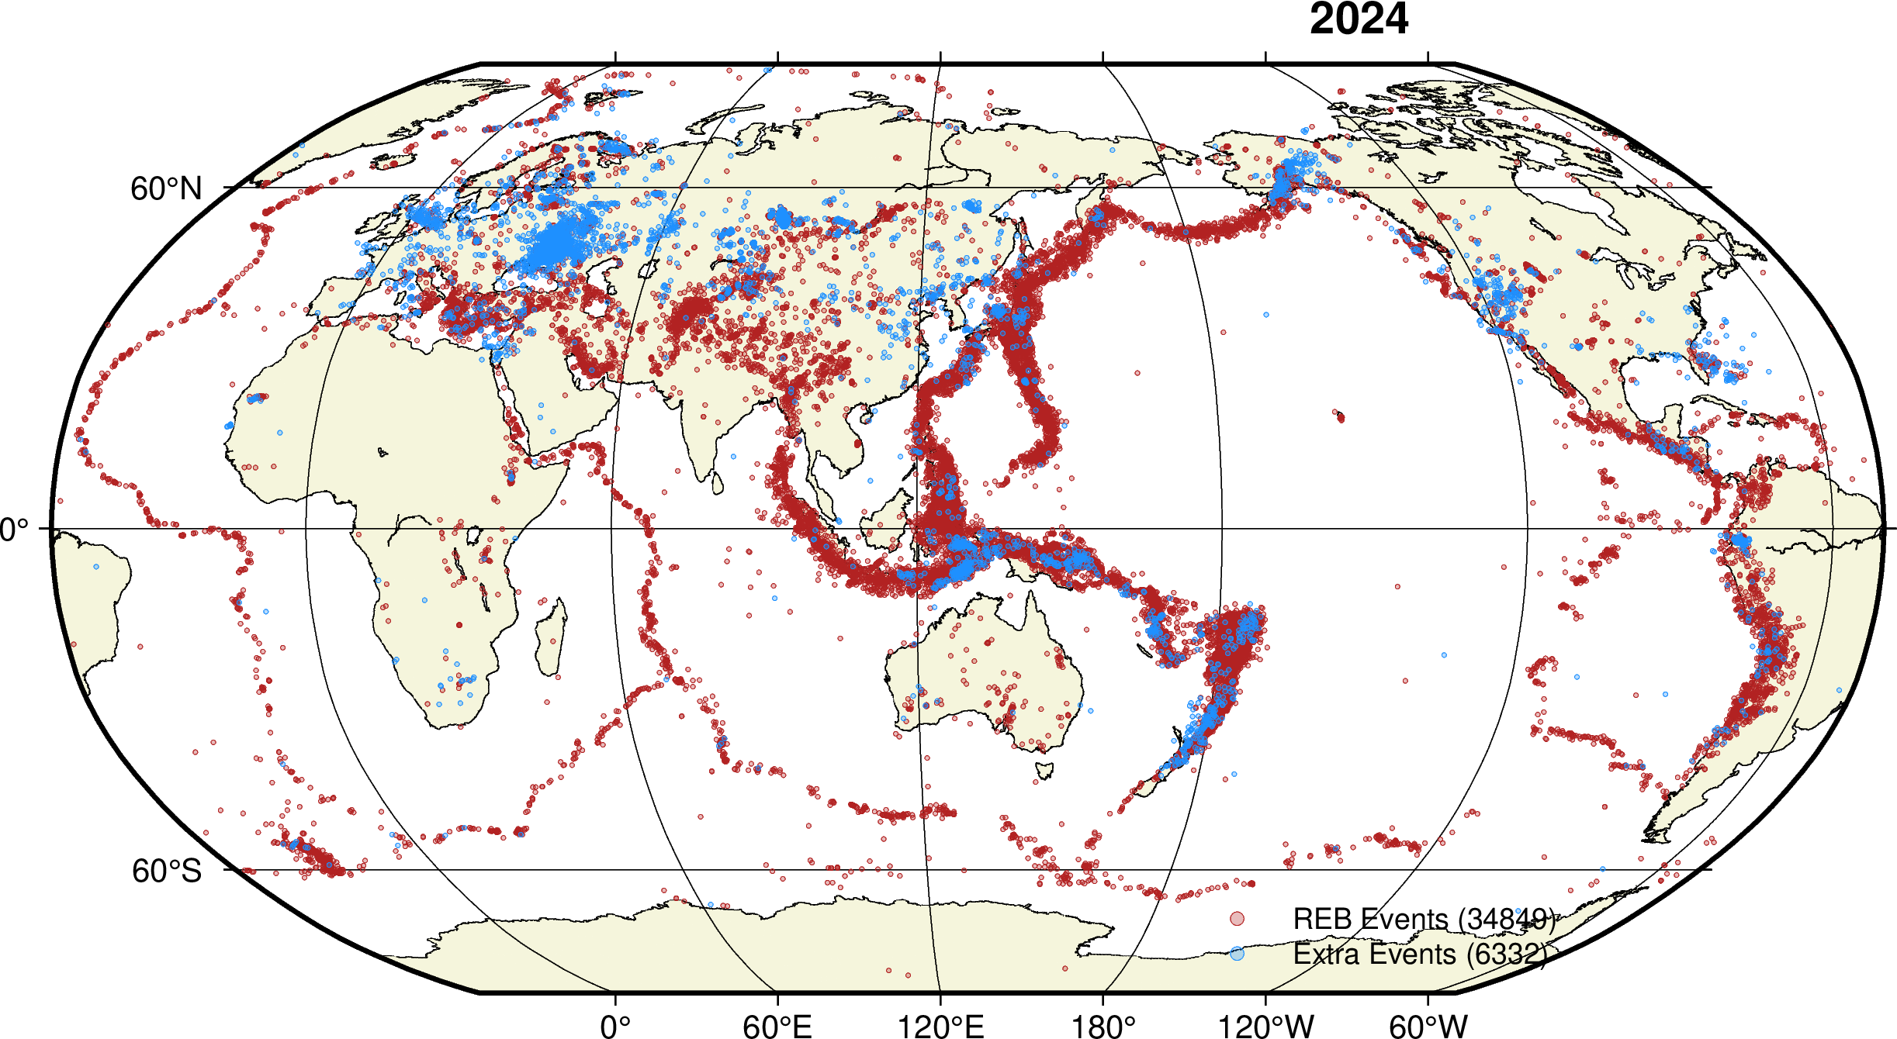

Influence of Event Definition Criteria (EDC) on IDC SHI products and possible approaches to optimize it
Svetlana Nikolova, Spiro Spiliopoulos
Geoscience Australia
P3.5-818
Come to see us Zeremoniensaal 11 Sept 2025, 11:00, board 56
EDC how it works and how many SHI events it filters LEB events over the yeas
  by technology;
  in time. Last 5 years 26.5% of SHI events did not meet EDC criteria.
Replication of EDC and applying different EDC conditions
  How we did it and validation of approach;
  New proposed EDC and results - around 10-15% increase in REB events;
It is time to open discussion and review EDC impact on SHI products by experts.
DISCLAIMER: This presentation has been generated for illustration purposes only

