Slide 1

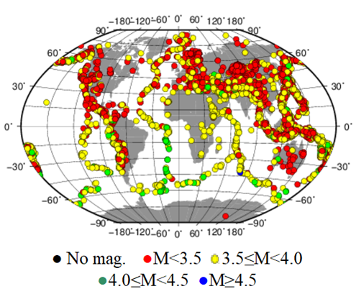

Evaluating the Contribution of Scanning Processes to the International Data Centre Seismic Event Bulletins
Sherif M. Ali , and Fekadu K. Alamneh
P3.5-869
Our poster is about the role of scanning in improving the completeness of the Reviewed Event Bulletin (REB).
Scanning is crucial for treaty verification by adding valid seismic events missed by automatic processing.
Scanning identifies patterns in missed events to enhance algorithms for signal detection, onset-time picking, and phase identification in the automatic processing pipeline.
Results support improvements in detection algorithms, station maintenance, and integration of advanced Machine learning tools.
WELCOME TO OUR POSTER TO LEARN MORE
DISCLAIMER: The views expressed on this e-poster are those of the author and do not necessarily reflect the views of the CTBTO

