Slide 1


P3.5-869
Evaluating the Contribution of Scanning Processes to the International Data Centre Seismic Event Bulletins
Sherif M. Ali , and Fekadu K. Alamneh
Comprehensive Nuclear-Test-Ban Treaty Organization (CTBTO)
IDC seismic bulletins (LEB, REB) are vital for CTBTO monitoring. This study examines scanning in interactive analysis for detecting missed events and integrating them into LEB/REB. Analysis of event geographic distribution, size, depth, and station contributions shows scanning greatly improves bulletin completeness. Recommendations to optimize SEL3 automatic production process aim to reduce missed events, lower analyst workload, and maintain high-quality seismic monitoring.
DISCLAIMER: The views expressed on this e-poster are those of the author and do not necessarily reflect the views of the CTBTO

Slide 2
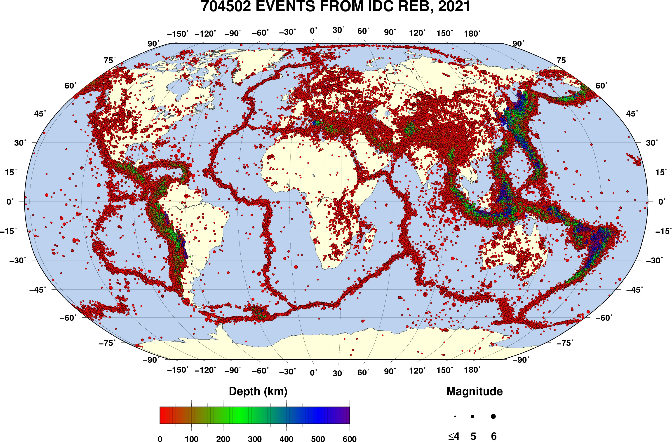
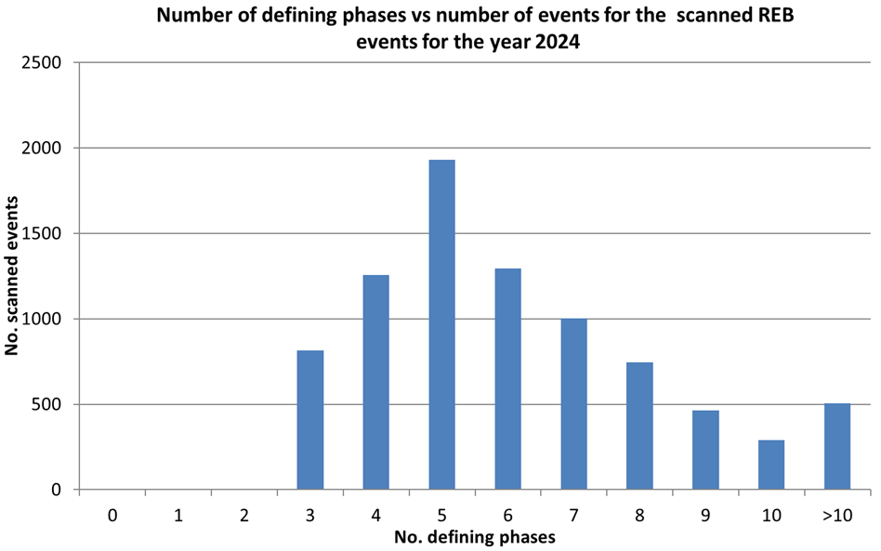
Evaluating the Contribution of Scanning Processes to the International Data Centre Seismic Event Bulletins
Sherif M. Ali , and Fekadu K. Alamneh
Introduction
Data and Analysis
P3.5-869
The International Data Centre (IDC) of the CTBTO verifies nuclear test bans by producing high-quality bulletins: the Reviewed Event Bulletin (REB) and Late Event Bulletin (LEB). These are generated through a multi-stage process starting with automated Standard Event Lists (SEL1, SEL2, SEL3). However, automatic processing has limited performance. It produces false associations and, crucially, miss valid events. To ensure accuracy, analysts perform waveform scanning to detect missed seismic, hydroacoustic, and infrasound (SHI) events. This study evaluates scanning’s role in enhancing REB completeness and reliability and explores how its results can improve both automated processing and interactive analysis efficiency.
The analysis is based on the extensive operational data generated during the production of IDC bulletins.
Data Sources: The primary data sources are the automatic SEL3 bulletin, and the subsequent REB bulletins produced by analysts.
Key Metrics for Comparison:
Event Addition Rate (via Scanning): The percentage of events added to the bulletin through interactive scanning (approximately 17-21%).
Event Attributes: For scanned events, key attributes are analyzed, including:
Geographic Distribution: Where in the world are missed events most common? (Often in regions with high background noise).
Magnitude (Size): What is the magnitude-frequency distribution of missed events? (Typically, smaller events (mb < 4.0) are more commonly missed).
Depth: Are certain depth ranges harder for automatic processing to detect?
Station Performance: The contribution of individual primary seismic IMS stations to the detection of scanned events is examined. This identifies high-value stations critical for detection and stations with lower performance that may require technical review.
Figure 2. Magnitude-based distribution of scanned events
Figure 1: REB solutions in the period from 01 Jan. 2000 to 31 Dec.2024: 815005 REB events/1019870 LEB events
DISCLAIMER: The views expressed on this e-poster are those of the author and do not necessarily reflect the views of the CTBTO

Slide 3
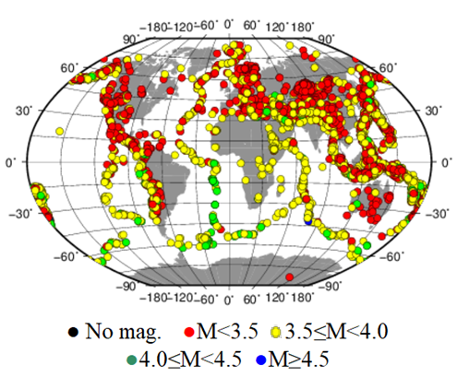
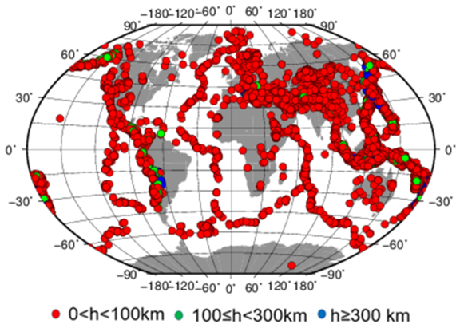
Evaluating the Contribution of Scanning Processes to the International Data Centre Seismic Event Bulletins
Sherif M. Ali , and Fekadu K. Alamneh
Methods
P3.5-869
Tools for Scanning: Analysts employ a suite of specialized tools to find missed events:
Theoretical Scanner: Tools that display theoretical travel times for seismic phases across the global network, helping analysts look for coherent signals at expected times.
NET-VISA Scanner button: A machine learning model that uses a probabilistic framework of events and detections to suggest likely missed events and associations.
Manual Waveform Scanning: Visual review of raw waveform data and unassociated automatic detections, especially following large events (aftershock sequences) or in regions of interest.
The entire process is governed by strict rules and guidelines related to phase naming, arrival time residuals, azimuth/slowness consistency, and magnitude estimates to ensure the technical validity of every added event.
Figure 3. Magnitude-based distribution of scanned events
Figure 4. Depth-based distribution of scanned events

Slide 4
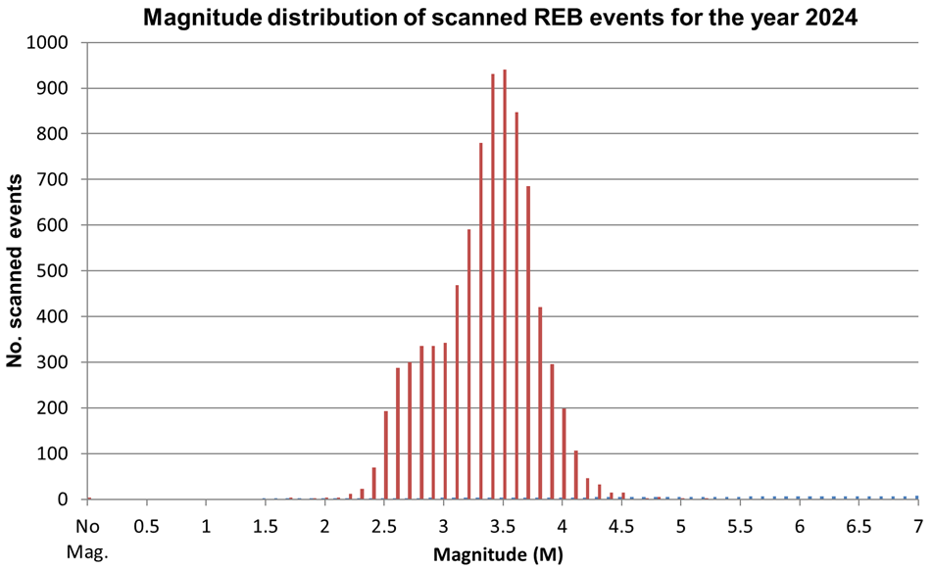
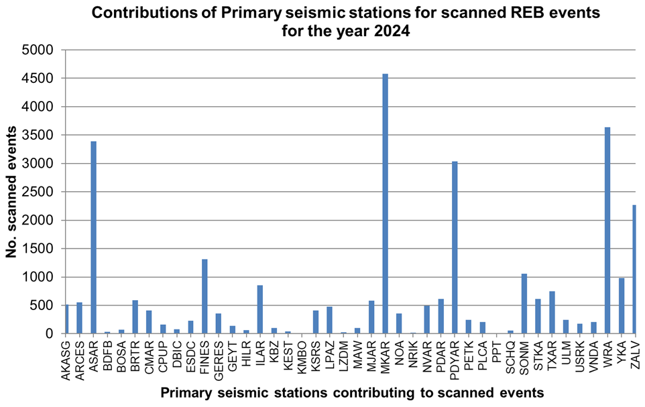
Evaluating the Contribution of Scanning Processes to the International Data Centre Seismic Event Bulletins
Conclusion
P3.5-869
Results and Discussion
Scanning effectively identifies and adds many valid seismic events missed by automatic processing.
This significantly improves the completeness and reliability of the final Reviewed Event Bulletin (REB).
Most scanned events have less than 8 defining phases.
A great majority of scanned events have magnitudes less than 4.0.
The primary seismic stations MKAR, WAR, and ASAR contribute most significantly to scanned REB events.
Scanning adds a substantial number of valid events (~17% of the final REB) that would otherwise be missed. This directly translates to a complete and more accurate picture of global seismicity, which is crucial for treaty verification.
The consistent pattern of missed events (e.g., specific magnitude ranges, geographic areas) provides a clear diagnostic tool. It pinpoints the weaknesses in the SEL3 automatic algorithms, such as limitations in signal detection, onset-time picking, or phase association logic.
The analysis reveals which IMS stations are most frequently responsible for providing the key data that allows analysts to build missed events. This information is vital for network maintenance and prioritizing station quality improvements.
Figure 5. Magnitude distribution of scanned REB events for the year 2024
Key Recommendations
Identify patterns in missed events to enhance algorithms for signal detection, onset-time picking, and phase identification in the automatic processing pipeline.
Prioritize the development of:
Advanced tools for scanning data and aftershock sequences.
Integration of successful machine learning models, such as NET-VISA, into the automatic processing workflow.
Figure 6. Contribution of primary seismic stations for scanned REB events for the year 2024

