Slide 1

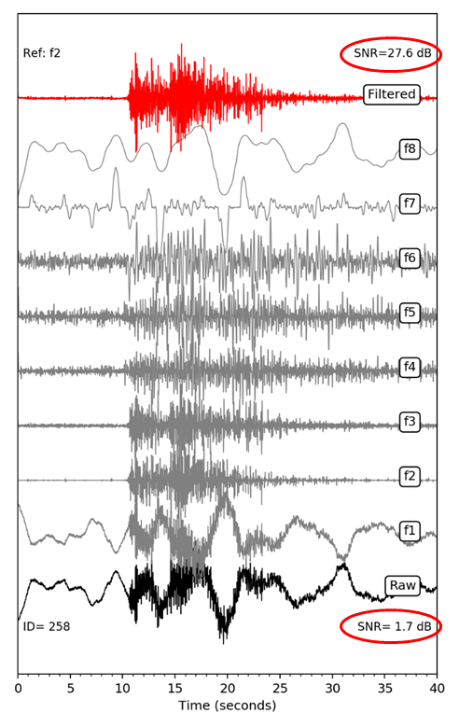
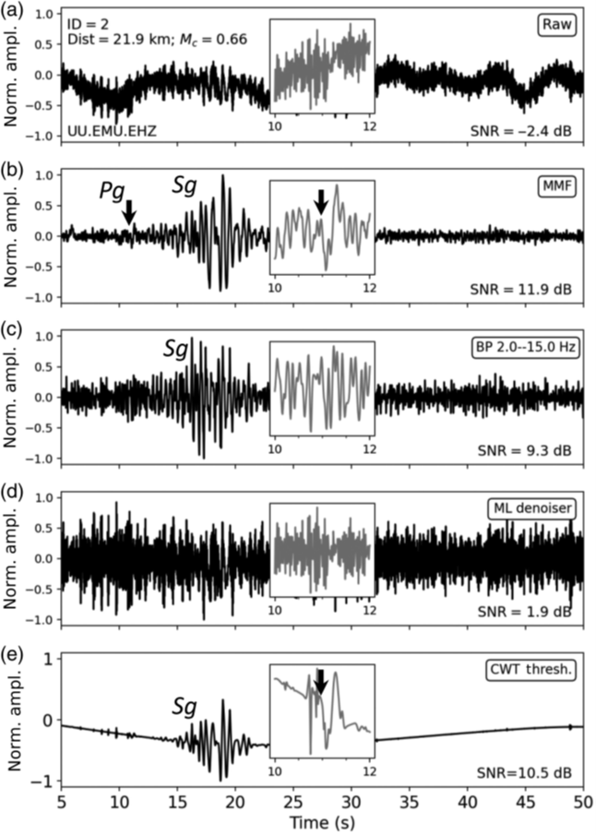
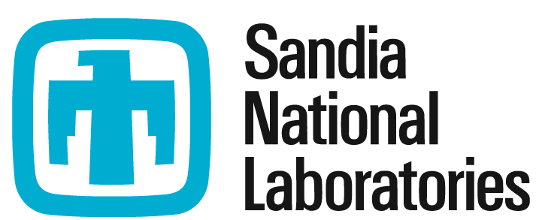

Mathematical Morphological Filtering with a Self-adaptive Reconstruction Technique and Application to Local Seismic Data
Rigobert Tibi
Sandia National Laboratories (SNL)
P3.5-177
Come over to see our poster if you would like to find more about:
Mathematical morphological filtering (MMF) as a viable method for noise suppression in seismic data,
The advantage of MMF over established noise suppression methods, and
Why MMF could help detect signals in problematic low-SNR data, which are currently being missed particularly when using FF alone.
ACKNOWLEDGMENTS: Sandia National Laboratories is a multimission laboratory managed and operated by National Technology and Engineering Solutions of Sandia, LLC, a wholly owned subsidiary of Honeywell International, Inc., for the U.S. Department of Energy’s National Nuclear Security Administration under contract DE-NA-0003525. The views expressed here do not necessarily reflect the views of the United States Government, the United States Department of Energy. This research was funded by the National Nuclear Security Administration, Defense Nuclear Nonproliferation Research and Development (NNSA DNN R&D). SAND2025-11154C
.

