Slide 1




P3.5-177
Mathematical Morphological Filtering with a Self-adaptive Reconstruction Technique and Application to Local Seismic Data
Rigobert Tibi
Sandia National Laboratories (SNL)
Mathematical morphological filtering (MMF) stems from the branch of mathematics referred to as mathematical morphology, which is based on set-theoretic concepts. MMF is efficient for low SNR data, and significantly outperforms frequency filtering (FF) in that SNR range. The results suggest that in an operational setting, MMF cannot replace FF; however, detection can be improved if MMF is used to supplement FF in some scenarios.
ACKNOWLEDGMENTS: Sandia National Laboratories is a multimission laboratory managed and operated by National Technology and Engineering Solutions of Sandia, LLC, a wholly owned subsidiary of Honeywell International, Inc., for the U.S. Department of Energy’s National Nuclear Security Administration under contract DE-NA-0003525. The views expressed here do not necessarily reflect the views of the United States Government, the United States Department of Energy. This research was funded by the National Nuclear Security Administration, Defense Nuclear Nonproliferation Research and Development (NNSA DNN R&D). SAND2025-11155C

Slide 2
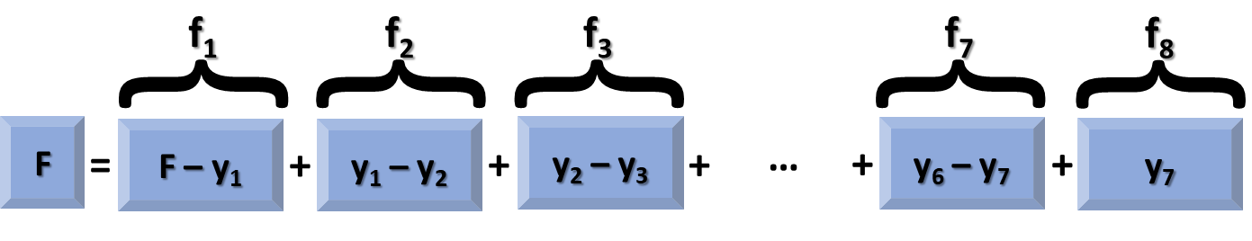
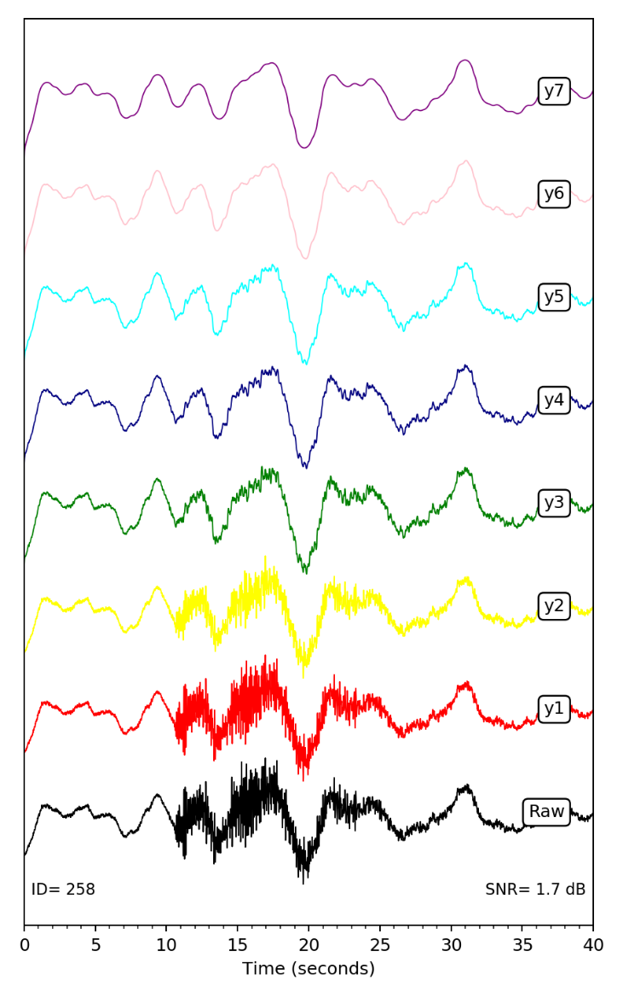
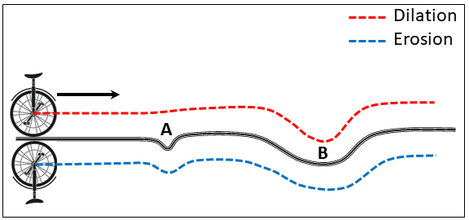
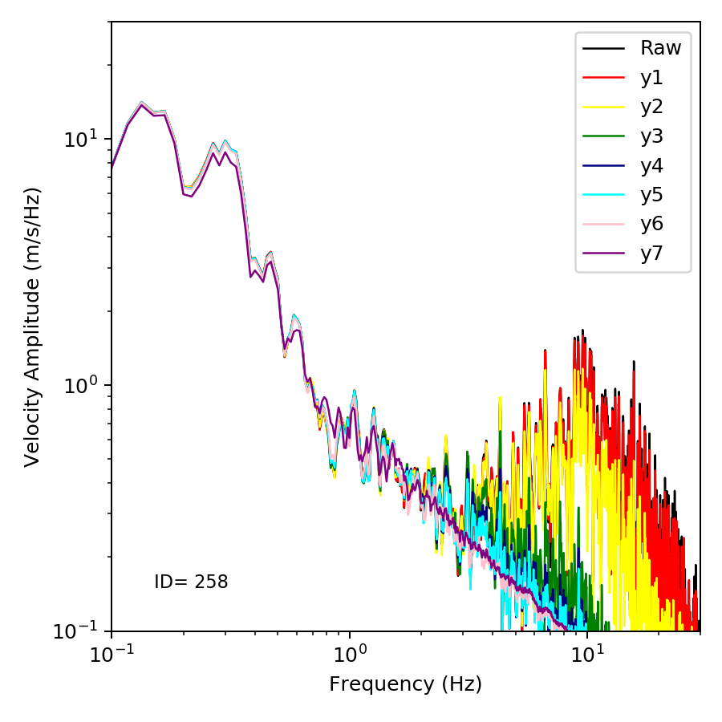
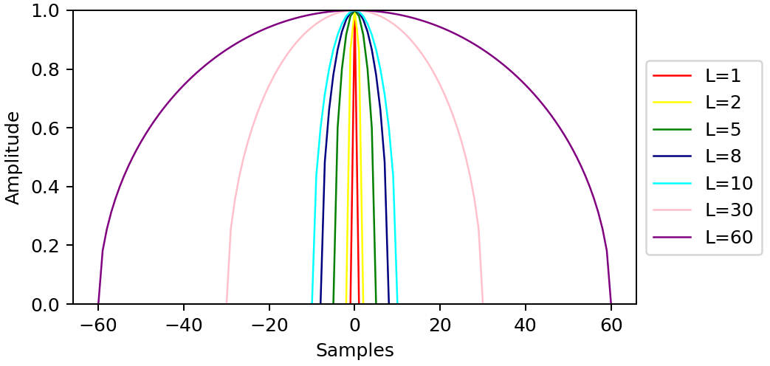
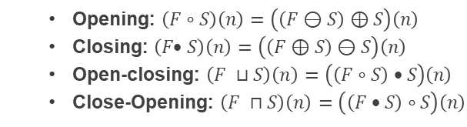
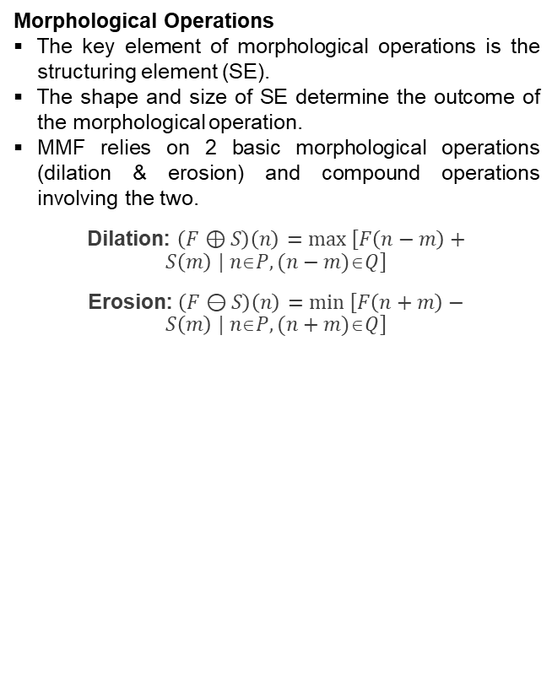
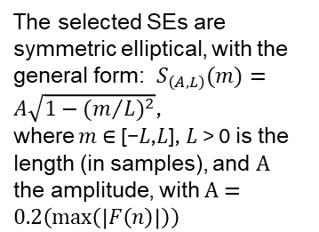

Mathematical Morphological Filtering with a Self-adaptive Reconstruction Technique and Application to Local Seismic Data
Rigobert Tibi
P3.5-177
Introduction
Methods
Methods (continued)
Mathematical morphological filtering (MMF) is a less known method of noise suppression.
It stems from the branch of mathematics referred to as mathematical morphology, which is based on set-theoretic concepts.
In contrast to frequency filtering (FF), which operates on frequency information and hence requires Fourier transforms, MMF leverages waveform shape and works entirely in the time domain.
Morphological Operations
The key element of morphological operations is the structuring element (SE).
The shape and size of SE determine the outcome of the morphological operation.
MMF relies on 2 basic morphological operations (dilation & erosion) and compound operations involving the two.
Dilation: $\left(F⊕S\right)\left(n\right)=max \left[F\left(n−m\right)+S\left(m\right) | nP, (n−m)Q\right]$
Erosion: $\left(F⊖S\right)\left(n\right)=min \left[F\left(n+m\right)−S\left(m\right) | nP, (n+m)Q\right]$
Multi-scale Morphological Decomposition
  Opening: $\left(F∘S\right)\left(n\right)=\left(\left(F⊖S\right)⊕S\right)\left(n\right)$
  Closing: $\left(F• S\right)\left(n\right)=\left(\left(F⊕S\right)⊖S\right)\left(n\right)$
  Open-closing: $\left(F ⊔S\right)\left(n\right)=\left(\left(F∘S\right) • S\right)\left(n\right)$
  Close-Opening: $\left(F ⊓S\right)\left(n\right)=\left(\left(F • S\right)∘S\right)\left(n\right)$
$y_{i}\left(n\right)=\frac{\left(F ⊔{ S}_{i}\right)\left(n\right)+\left(F ⊓ S_{i})(n\right)}{2}$, $i=1,…,7$
$\left\{\begin{aligned}f_{1}\left(n\right)=F\left(n\right)−y_{1}\left(n\right) \\ f_{i}\left(n\right)=y_{i−1}\left(n\right)−y_{i}\left(n\right) \\ f_{8}\left(n\right)=y_{7}\left(n\right) \end{aligned}\right.$, $i=2,…,7$
Objectives
Noise Suppression Method | Drawbacks
Frequency filtering | Inadequate when signal and noise share the same frequency band; causes significant distortion in amplitudes
Machine learning denoising | Requires pre-trained model for the region of interest, which necessitates a lot of resources
Wavelet-based thresholding | Causes significant distortion in amplitudes; can introduce artefacts in the waveforms
        The selected SEs are symmetric elliptical, with the general form: $S_{\left(A,L\right)}(m)=A\sqrt{1−({m/L)}^{2}}$,
        where $m$∈ [−𝐿,𝐿], 𝐿 > 0 is the length (in samples), and $A$ the amplitude, with $A=0.2\left(\max\left(\left|F\left(n\right)\right|\right)\right)$
The purpose of this work is to improve signals from local-distance events (both earthquakes and explosions) and avoid issues associated with other noise suppression methods.
ACKNOWLEDGMENTS: Sandia National Laboratories is a multimission laboratory managed and operated by National Technology and Engineering Solutions of Sandia, LLC, a wholly owned subsidiary of Honeywell International, Inc., for the U.S. Department of Energy’s National Nuclear Security Administration under contract DE-NA-0003525. The views expressed here do not necessarily reflect the views of the United States Government, the United States Department of Energy. This research was funded by the National Nuclear Security Administration, Defense Nuclear Nonproliferation Research and Development (NNSA DNN R&D).

Slide 3
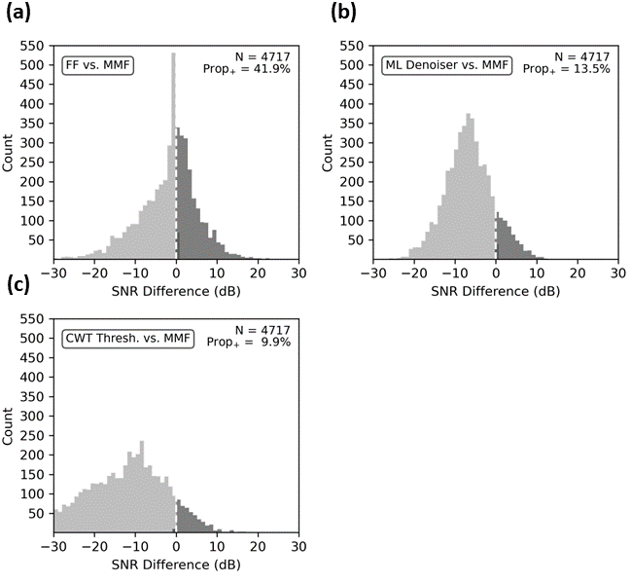
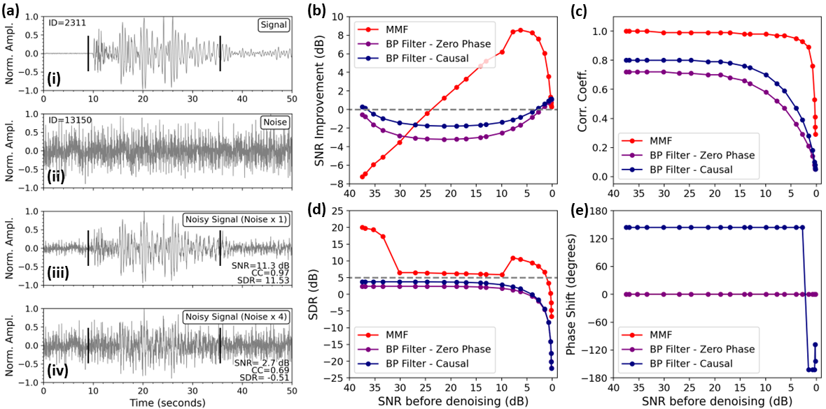
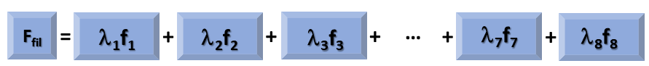
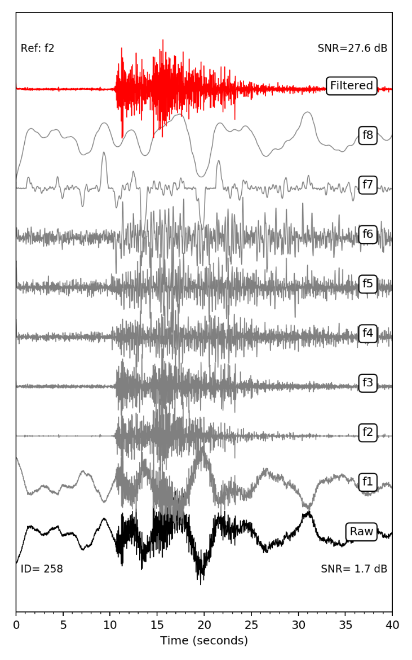
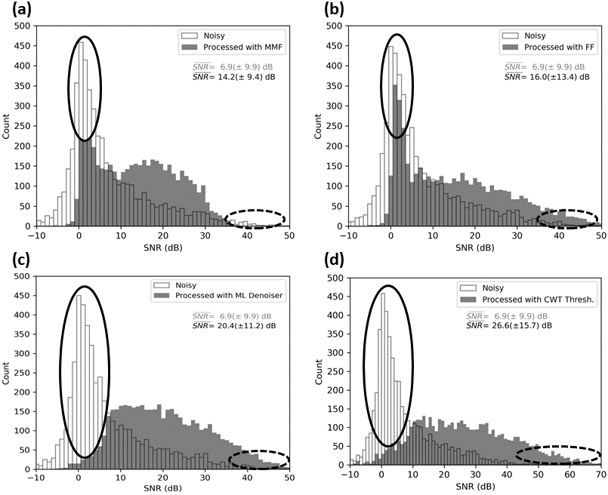
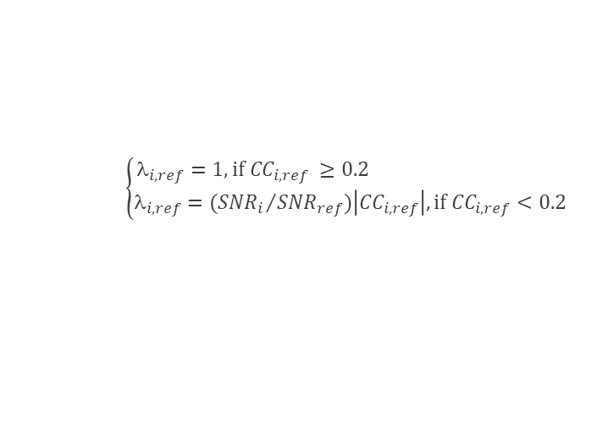

Mathematical Morphological Filtering with a Self-adaptive Reconstruction Technique and Application to Local Seismic Data
Rigobert Tibi
P3.5-177
Methods (continued)
Results
Results (continued)
Morphological Reconstruction & MMF
Effect of Input Seismogram Quality
Comparison with some Established Noise Suppression Methods
For ~42% of the dataset, MMF outperforms FF; and the SNR gain achieved by MMF is as high as ~23 dB.
This proportion is only ~ 10%−14% for ML denoising and CWT thresholding.
      $$F_{fil}\left(n\right)=\sum_{i=1}^{8}{λ_{i}f_{i}}(n)$$
$$\left\{\begin{aligned}_{i,ref}=1, if{ CC}_{i,ref} ≥0.2 \\ _{i,ref}={{(SNR}_{i}}/{{SNR}_{ref}})\left|{CC}_{i, ref}\right|, if{ CC}_{i,ref}<0.2\end{aligned}\right.$$
Conclusions
As noise suppression method, MMF is efficient for low-SNR data and significantly outperforms FF in that SNR range.
For most of waveforms, FF, ML denoising, and CWT thresholding result in higher SNRs compared with MMF; however, for ~42% of the waveforms, MMF outperforms FF.
Compared to ML denoising and CWT thresholding, this proportion drops to ~10%–14%.
The results suggest that in an operational setting, MMF cannot replace the other noise suppression methods; however, detection can be improved if MMF is used to supplement them in some scenarios.
MMF could help detect signals in problematic low-SNR data, which are currently being missed particularly when using FF alone.
MMF is efficient for low input SNR, and significantly outperforms FF in that SNR range.
Average improvements in SNR are about 7, 9, 13, and 20 dB for MMF, FF, ML denoising, and CWT thresholding, respectively.
Compared with FF, however, the other approaches, including MMF improve the SNR for low-quality data, reducing the number of low-SNR waveforms
ACKNOWLEDGMENTS: Sandia National Laboratories is a multimission laboratory managed and operated by National Technology and Engineering Solutions of Sandia, LLC, a wholly owned subsidiary of Honeywell International, Inc., for the U.S. Department of Energy’s National Nuclear Security Administration under contract DE-NA-0003525. The views expressed here do not necessarily reflect the views of the United States Government, the United States Department of Energy. This research was funded by the National Nuclear Security Administration, Defense Nuclear Nonproliferation Research and Development (NNSA DNN R&D).
Comparison based on a dataset of >4700 constructed noisy waveforms.

