Slide 1


P3.5-226
Effect of atmospheric entry angle on uncertainties in the observed infrasound signal back-azimuths
Elizabeth A. Silber
Sandia National Laboratories, Albuquerque, NM, 87123
Infrasound signals from energetic moving events often deviate from predicted directions. Modeling reveals shallow-entry events (~10°) yield azimuth deviations up to ~46° within 1000 km, whereas steep entries (≥60°) show minimal deviations (<5° at 1000 km, <1° at 5000 km), redefining geolocation uncertainty and aiding planetary defense applications.
SNL is managed and operated by NTESS under DOE NNSA contract DE-NA0003525. The views expressed here do not necessarily reflect the opinion of the United States Government, the United States Department of Energy, or NTESS. SAND2025-11111C

Slide 2
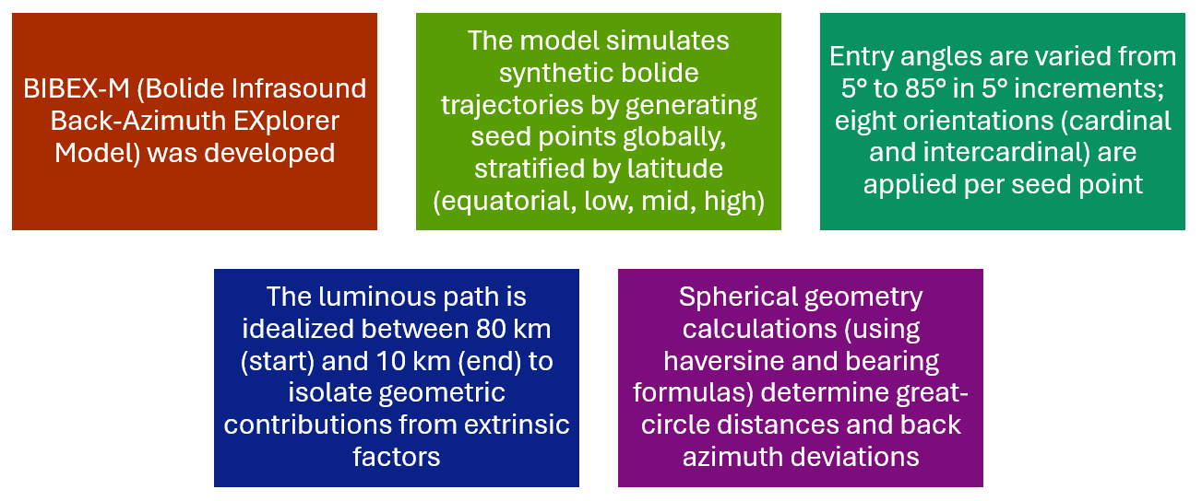
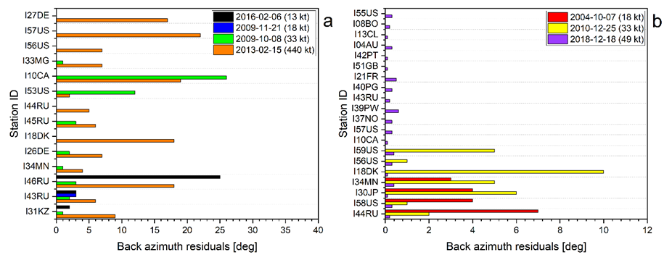
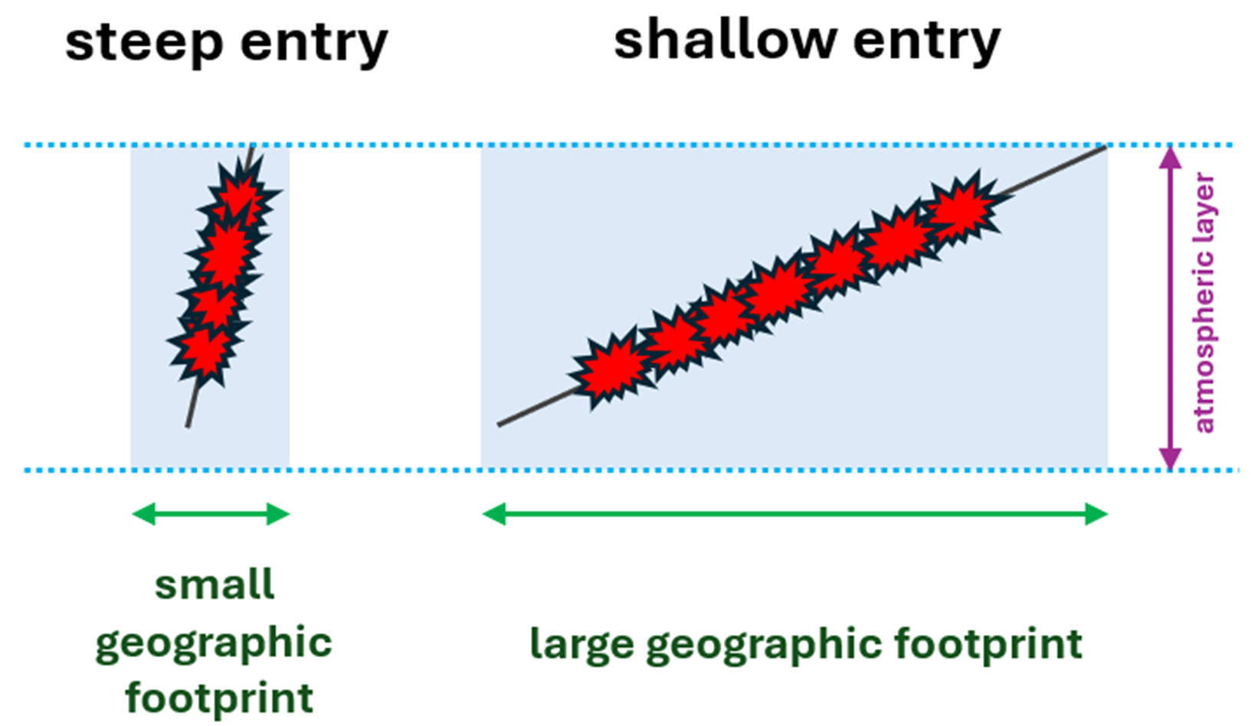
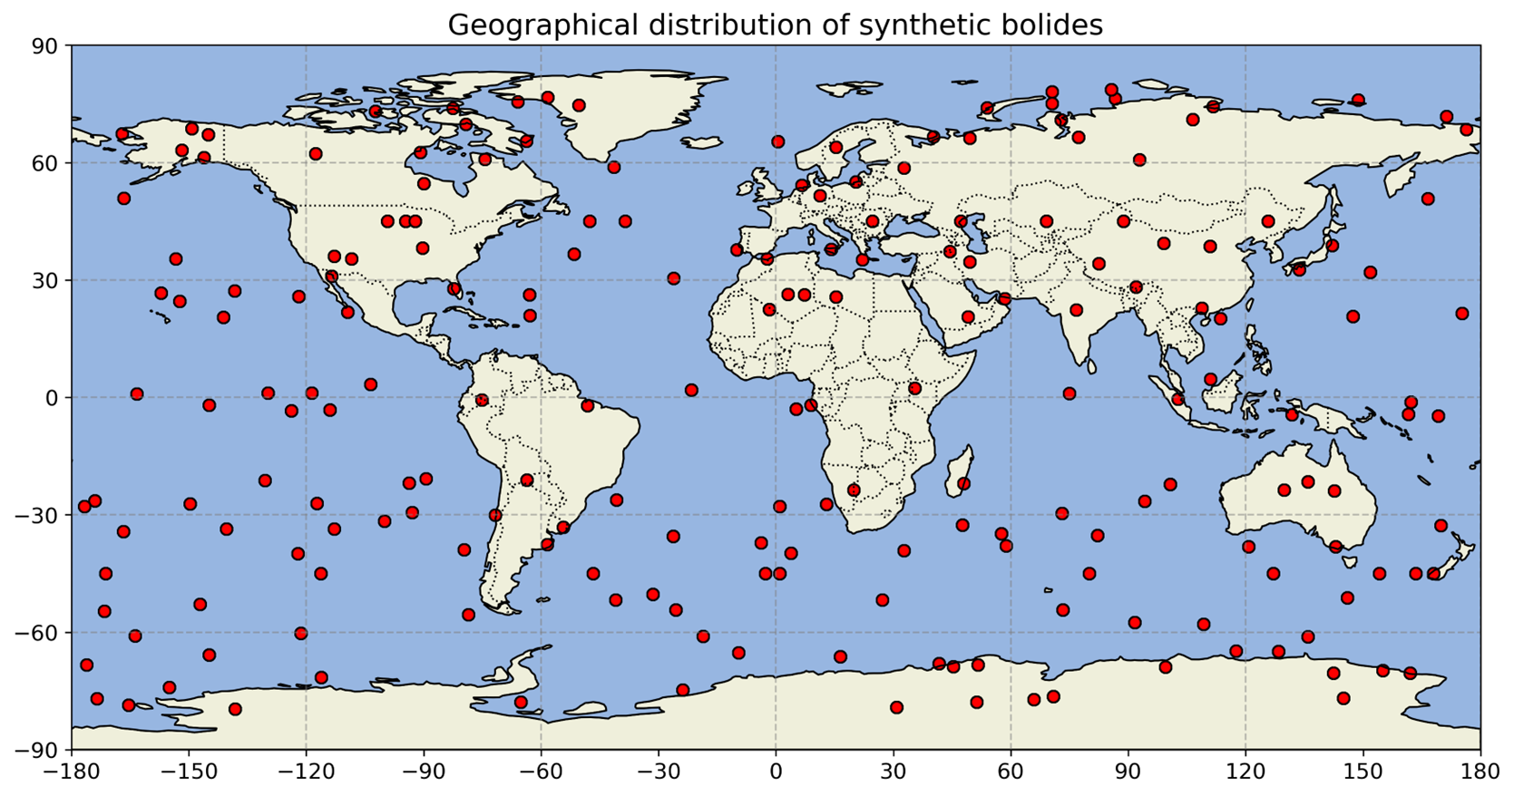
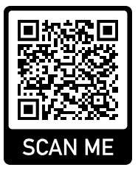
P3.5-226
Effect of atmospheric entry angle on uncertainties in the observed infrasound signal back-azimuths
Elizabeth A. Silber
Introduction
Observations
Model Development
Infrasound sensing is critical for detecting and geolocating bolides and other high-energy, extended trajectory events [1].
Infrasound monitoring has traditionally assumed that bolides can be approximated as point sources at sufficiently large distances [2].
Bolides and reentry events can generate shock wave along extended paths as shown below, often resulting in non-negligible discrepancies between observed infrasound back azimuths and theoretical predictions derived from the object's peak brightness location, notably during shallow-angle atmospheric entries [3-5].
This study aims to quantify the geometric effects on infrasound signal arrival directions and improve bolide geolocation accuracy.
Seven most energetic bolides detected by both US government sensors and infrasound were examined to determine variability in observed back azimuths (plotted below).
Shallow entry angle events tend to exhibit higher back azimuth residuals.
This motivated the development of a modeling framework to determine maximum possible back azimuth deviations that would arise due to the trajectory geometry alone.
Quantifying the contribution of trajectory geometry alone is essential to isolate it from other influences such as atmospheric propagation and station-specific effects.
A theoretical framework, the Bolide Infrasound Back-Azimuth EXplorer Model (BIBEX‑M), was developed to compute predicted back azimuths solely from geometric considerations.
Simulations using synthetic bolides explore back azimuth deviations as a function of entry angle and station distance up to 15,000 km.
SNL is managed and operated by NTESS under DOE NNSA contract DE-NA0003525. The views expressed here do not necessarily reflect the opinion of the United States Government, the United States Department of Energy, or NTESS. SAND2025-11111C

Slide 3
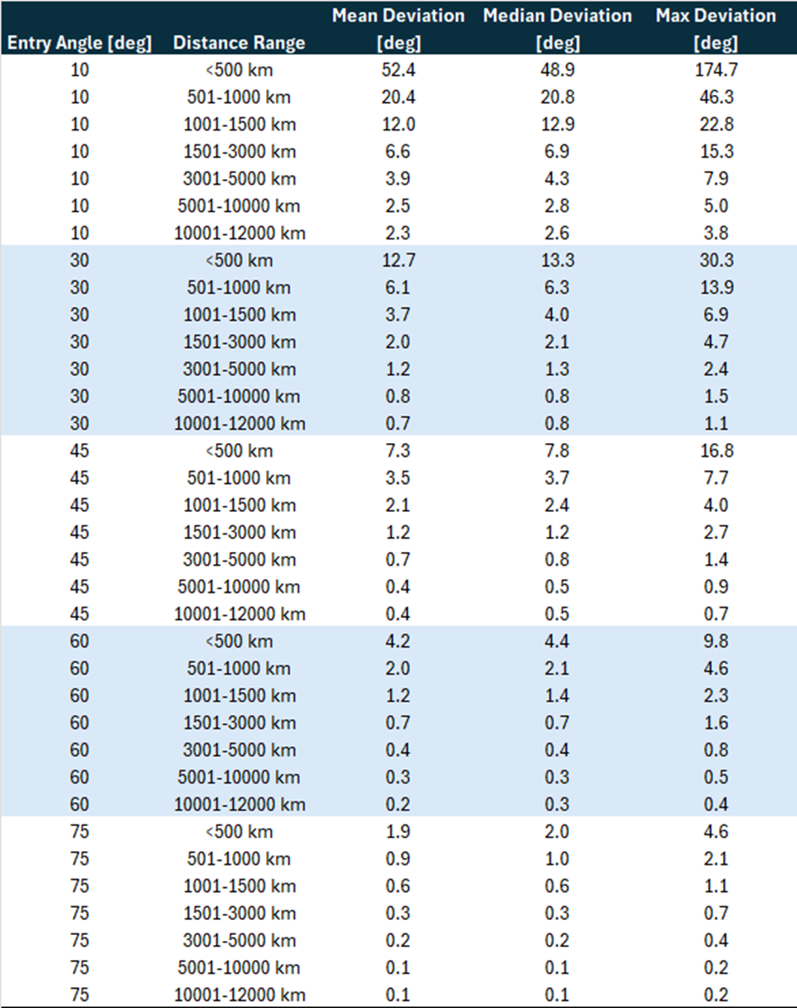
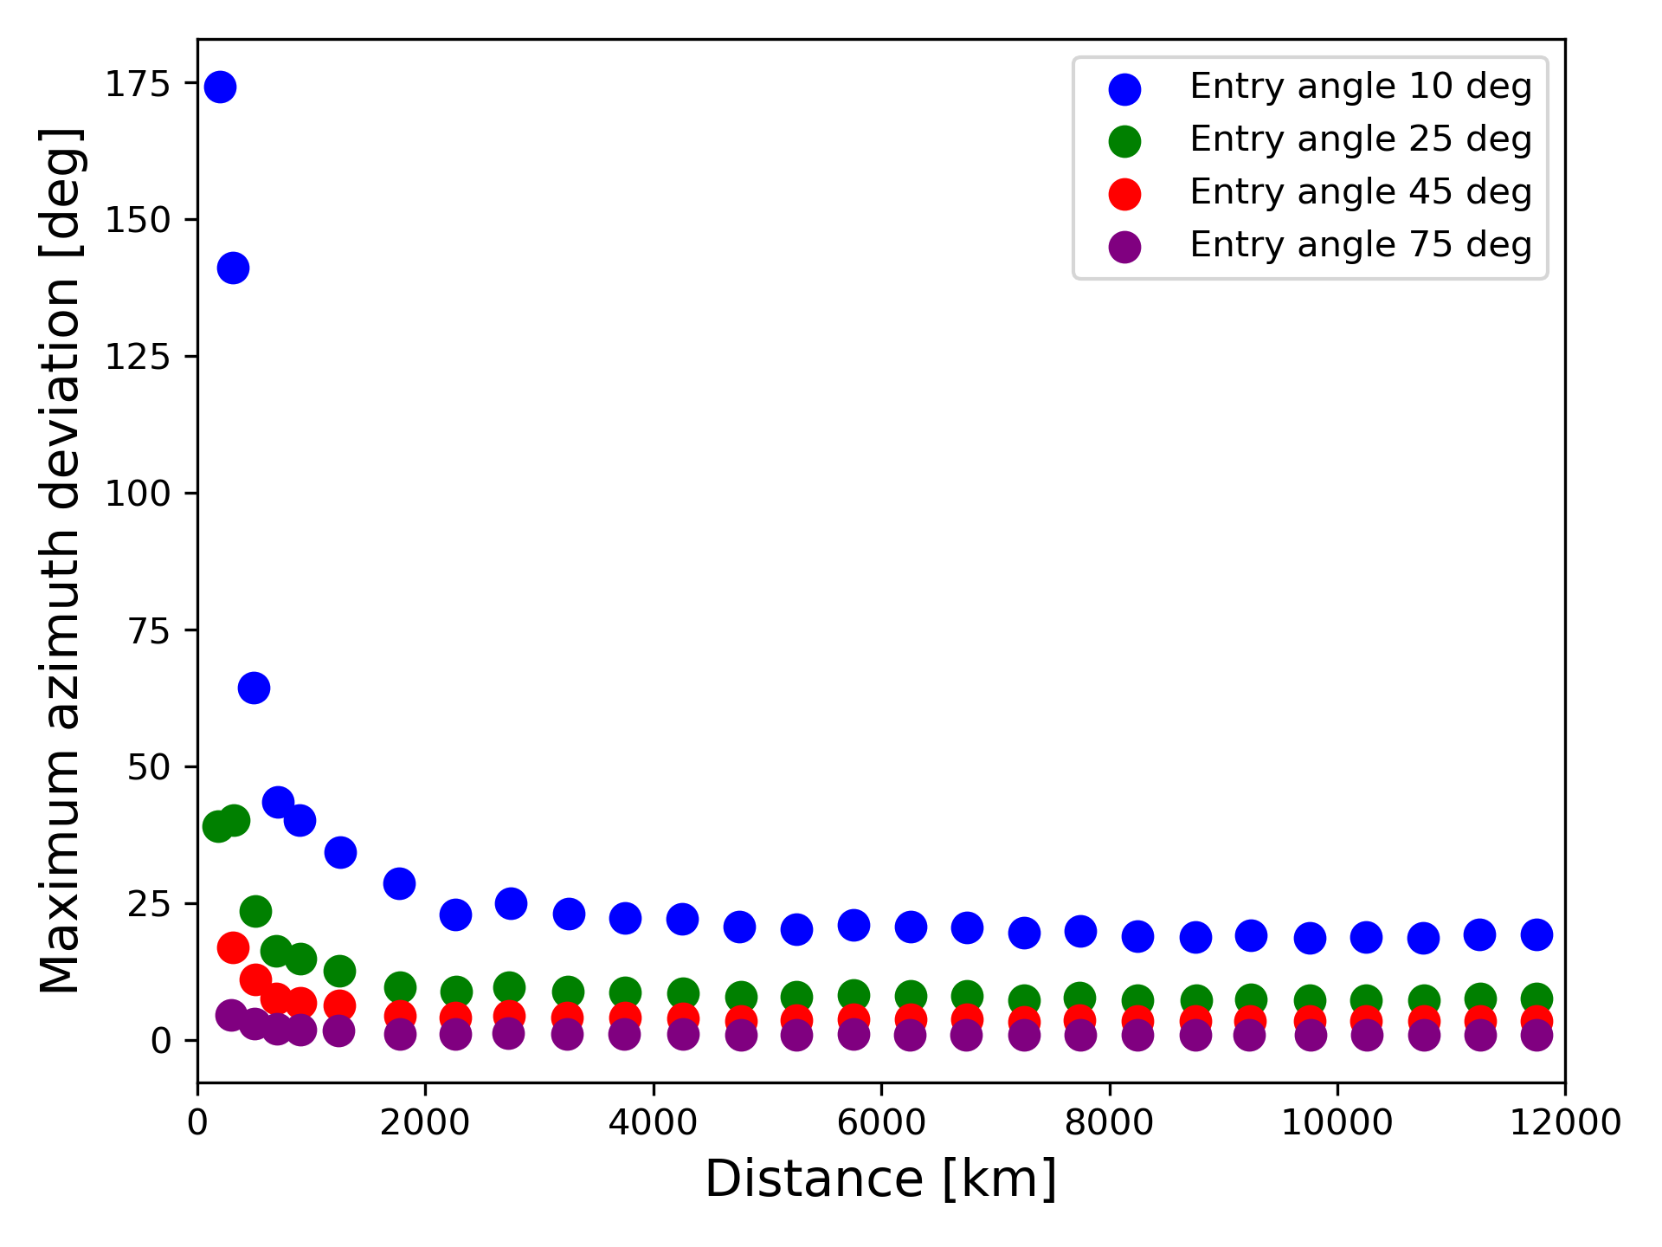
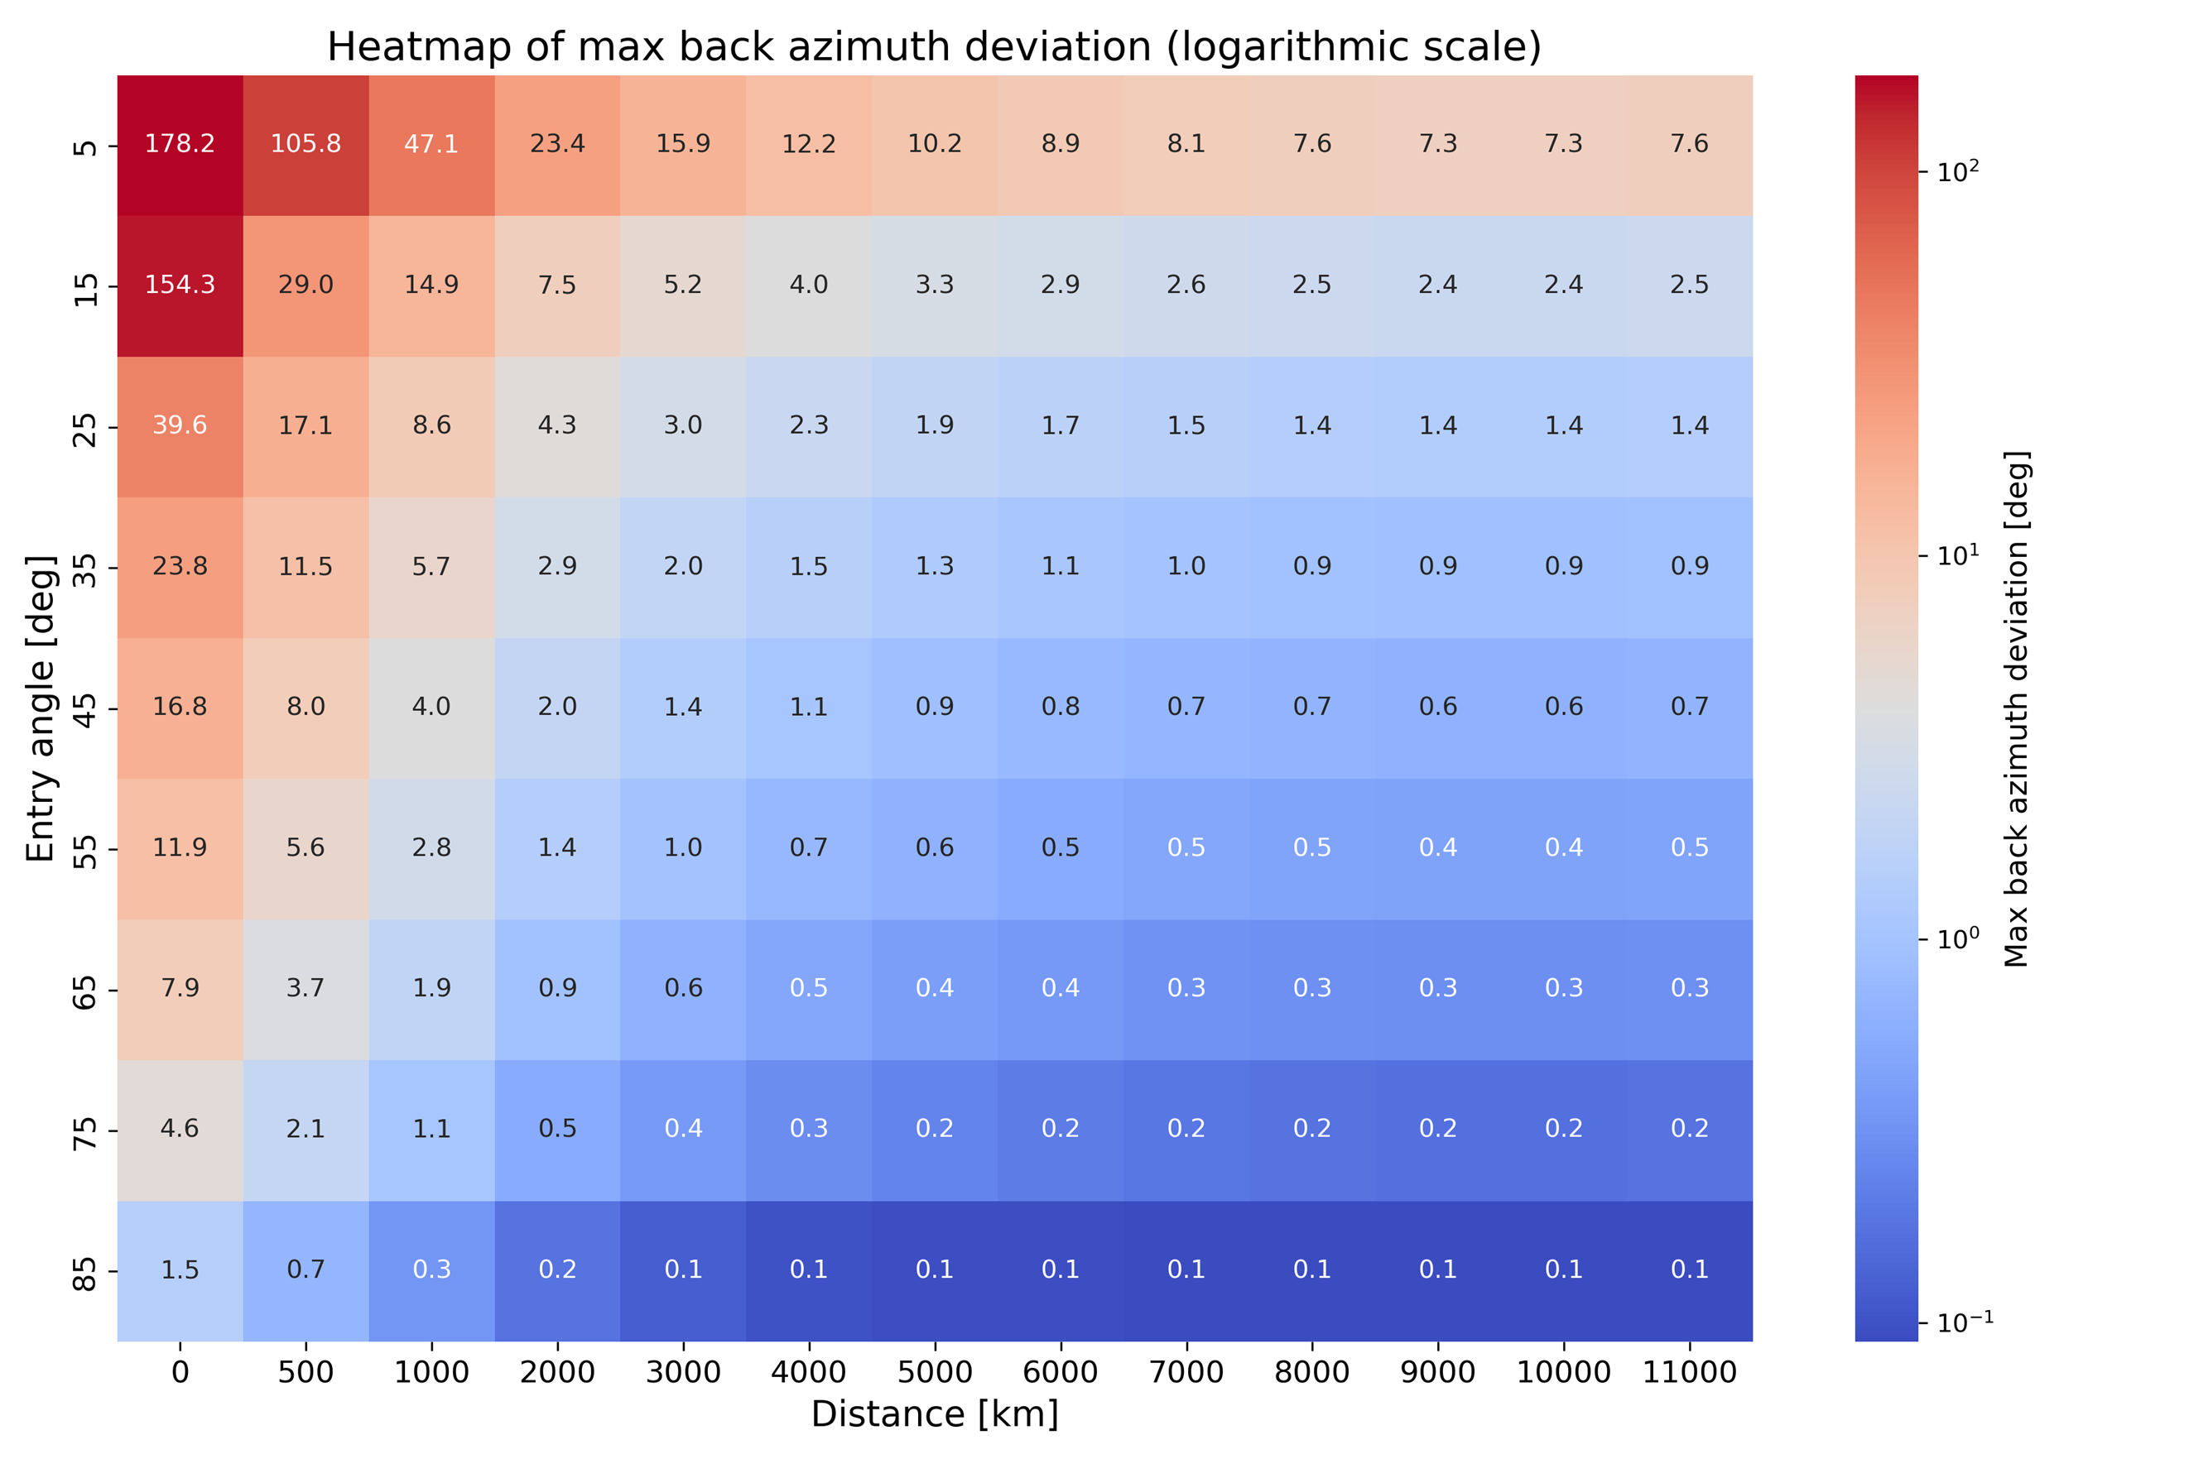
P3.5-226
Effect of atmospheric entry angle on uncertainties in the observed infrasound signal back-azimuths
Elizabeth A. Silber
Results
Results
Conclusions
Simulations reveal that shallow-entry bolides (≤10°) produce large back azimuth deviations, up to ~46° within 1000 km.
Steeper trajectories (≥60°) consistently result in deviations below ~5° at 1000 km and less than ~1° beyond 5000 km.
A global heatmap visualization systematically quantifies maximum geometric deviations in back azimuth across entry angles and source-to-station distances, providing a practical global reference table for interpreting observed infrasound signals.
A scatter plot of maximum azimuth deviations versus distance for representative entry angles (10°, 25°, 45°, and 75°) illustrates the dependence of azimuth residuals on entry angle and source-to-receiver distance, confirming variability especially evident in shallow angle scenarios.
These results provide quantitative benchmarks for evaluating back azimuth measurements of real extended trajectory events.
The findings indicate that large observed deviations should not be automatically classified as anomalies or data errors.
Instead, they might naturally arise from trajectory geometry, particularly for shallow-angle entries, thus improving the robustness of future infrasound-based bolide characterizations..
By isolating the purely geometric contributions using the BIBEX‑M framework, concrete numerical bounds on the maximum possible back azimuth deviations for a variety of plausible entry scenarios up to distances of 15,000 km were established.
Highly relevant for reentry phenomena (e.g., space missions, orbital debris), illustrating the broader applicability of this framework in refining and improving detection, geolocation, and characterization.
References:
[1] Silber (2025) Investigating the Relationship Between Bolide Entry Angle and Apparent Direction of Infrasound Signal Arrivals. Pure Appl. Geophys. [2] ReVelle (1976) On meteor-generated infrasound. Journal of Geophysical Research, 81, 1217–1230. [3] Ens et al. (2012) Infrasound production by bolides: A global statistical study. Journal of Atmospheric and Solar-Terrestrial Physics, 80, 208–229 [4] Gi & Brown (2017) Refinement of bolide characteristics from infrasound measurements. Planetary and Space Science, 143, 169–181. [5] Silber et al. (2009) An estimate of the terrestrial influx of large meteoroids from infrasonic measurements. Journal of Geophysical Research, 114, E08006.
SNL is managed and operated by NTESS under DOE NNSA contract DE-NA0003525. The views expressed here do not necessarily reflect the opinion of the United States Government, the United States Department of Energy, or NTESS. SAND2025-11111C

Slide 4

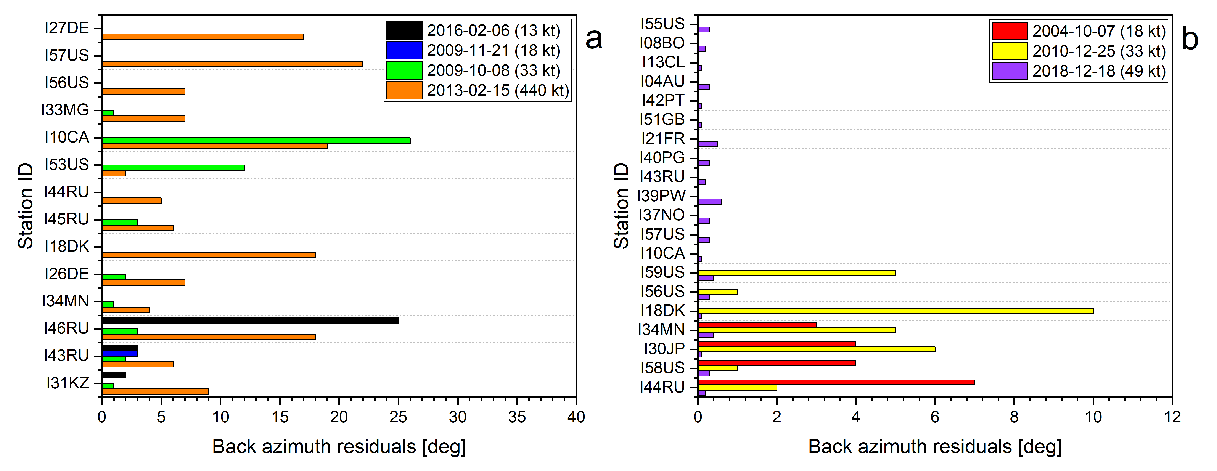
P3.5-226
Effect of atmospheric entry angle on uncertainties in the observed infrasound signal back-azimuths
Elizabeth A. Silber
Sandia National Laboratories, Albuquerque, NM, 87123, USA
Infrasound sensing is critical for detecting and geolocating high-energy, extended trajectory events, but has traditionally approximated emitters as stationary point sources at large distances
However, moving elevated sources can generate shock wave along extended paths, thereby causing significant deviations in observed back azimuths
This study focuses on the geometric contribution to quantify how event trajectory affects infrasound signal arrival directions
To learn more about this work, visit my poster!
SNL is managed and operated by NTESS under DOE NNSA contract DE-NA0003525. The views expressed here do not necessarily reflect the opinion of the United States Government, the United States Department of Energy, or NTESS. SAND2025-11111C

