Slide 1
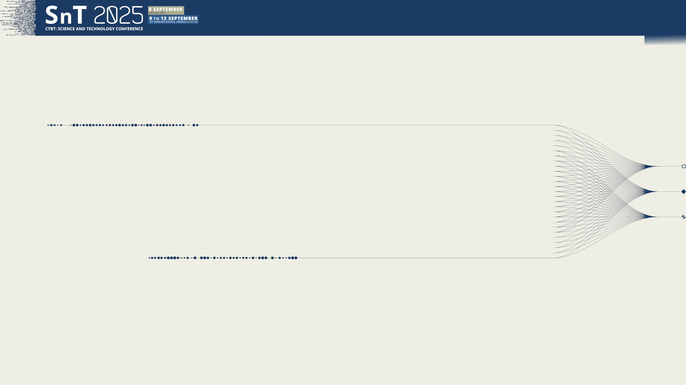

O3.5-061
The Multi-Channel Maximum-Likelihood (MCML) method: extension to multisource estimation and evaluation
B. Poste¹, J. Vergoz¹, K. Abed-Meraim², M. Charbit³, A. Le Pichon¹
CEA DAM DIF, French NDC
PRISME laboratory, Orleans University, France
Institut Mines-Telecom, France
Presentation Date: 09 September 2025

Slide 2
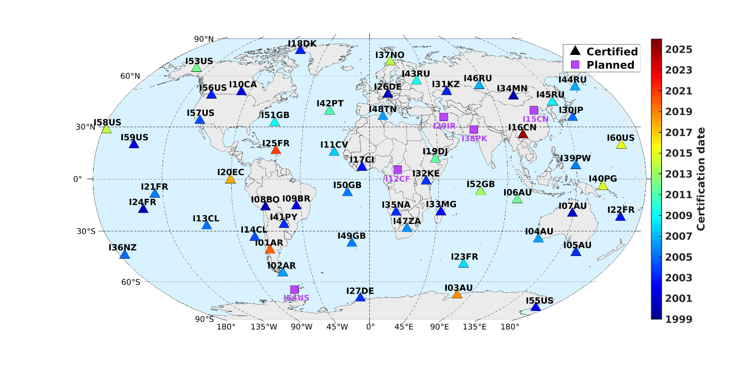
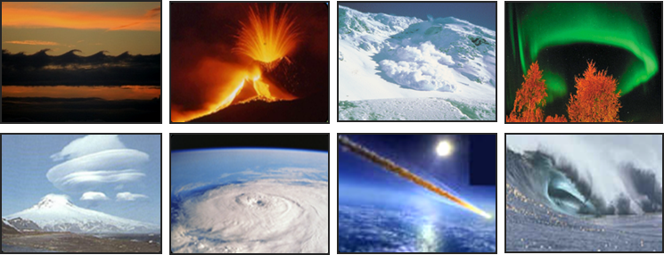
Detecting explosions from diverse sources with low signal-to-noise ratios remains a key challenge
O3.5-061
The Multi-Channel Maximum-Likelihood (MCML) method: extension to multisource estimation and evaluation
B. Poste, J. Vergoz, K. Abed-Meraim, M. Charbit, A. Le Pichon
Introduction on the infrasound technology
The international monitoring system (IMS) is designed to detect explosion of 1 kT eq. TNT everywhere at anytime
Today, 90% (54/60) of infrasound stations are operational on a total of 60 planned
A wide range of natural and anthropogenic sources are detected
Detecting explosions with low signal-to-noise ratio from diverse sources is a key challenge
©J.Vergoz

Slide 3
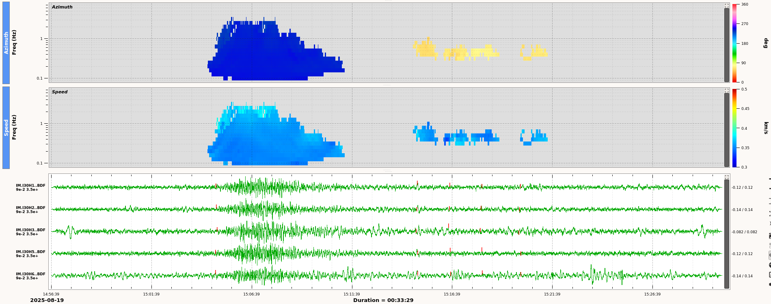
O3.5-061
The Multi-Channel Maximum-Likelihood (MCML) method: extension to multisource estimation and evaluation
B. Poste, J. Vergoz, K. Abed-Meraim, M. Charbit, A. Le Pichon
Overview of existing signal processing methods
Developments over time:
F-detector, commonly used in NDCs (e.g. Arrowsmith et al., 2009)
Principally used in a single frequency band
Large variety of signals covering a wide frequency band
Progressive Multi-Channel Correlation (Cansi, 1995; Garcés, 2013): detector (consistency) and estimator (TDOA)
Used operationally since 2000 at the IDC and distributed to our NDC partners
Feedbacks: loss of detection and estimation errors under unfavorable observation conditions
DTK-GPMCC view, Come visit us at the DTK stand !
Fireball above Japan in 19/08/2025, detected at I30JP

Slide 4
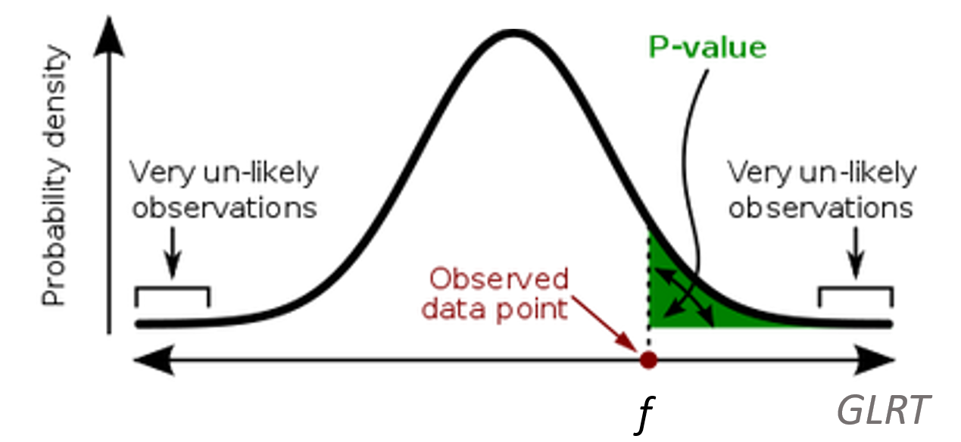

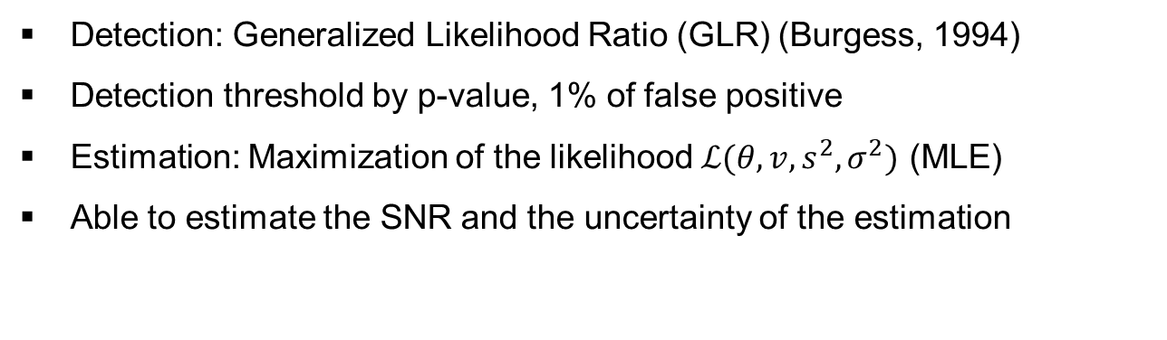
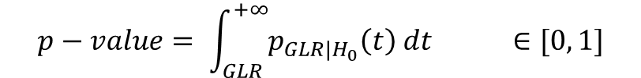


O3.5-061
The Multi-Channel Maximum-Likelihood (MCML) method: extension to multisource estimation and evaluation
B. Poste, J. Vergoz, K. Abed-Meraim, M. Charbit, A. Le Pichon
A new signal processing method: Multi-Channel Maximum Likelihood (MCML, Poste et. al (2023))
Detection: Generalized Likelihood Ratio (GLR) (Burgess, 1994)
Detection threshold by p-value, 1% of false positive
Estimation: Maximization of the likelihood $ℒ(θ,v,s^{2},σ^{2})$ (MLE)
Able to estimate the SNR and the uncertainty of the estimation
$$GLR=2\max_{θ,v}{(ℒ_{∗}−ℒ_{0∗})}$$
$$p−value= \int_{GLR}^{+∞}{p_{GLR|H_{0}}\left(t\right) dt ∈[0, 1]}$$
H0 distribution of GLR
with
$$𝒯=\left[\begin{matrix}−v\cos{(θ)} & v sin⁡(θ) \\ v^{2} sin⁡(θ) & v^{2}\cos{(θ)}\end{matrix}\right]$$
$$R\left(θ,v\right)=𝒯Γ_{0}𝒯$$
$$Γ_{0}=\frac{3\left(M×SNR+1\right)}{8π^{2}×MSNR^{2}({\left(f_{max}\right)}^{3}−{{(f}_{min})}^{3})(t_{max}−t_{min})}{\left(Z^{T}∏_{M}^{⊥}Z\right)}^{−1}$$
GLR

Slide 5
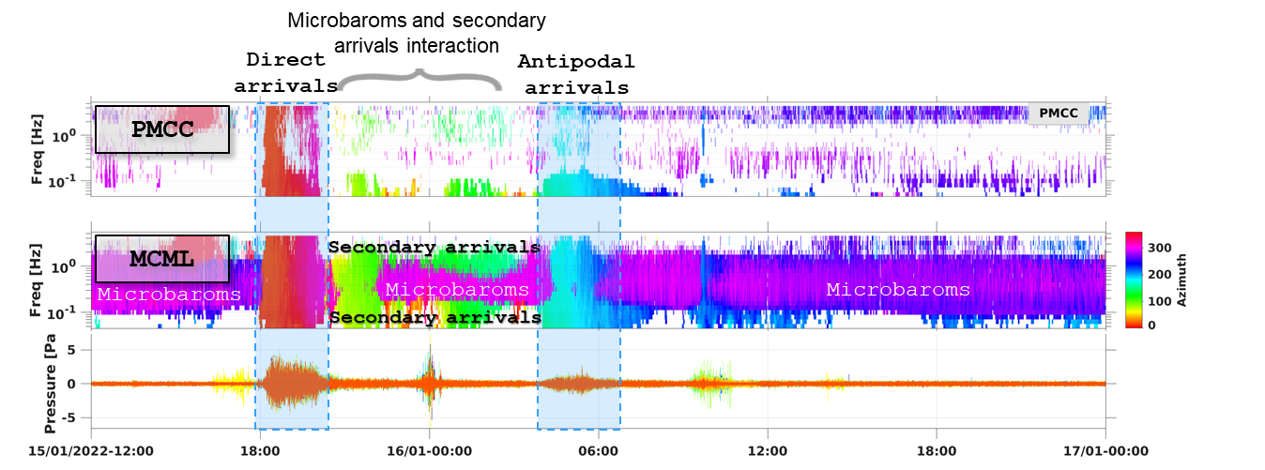
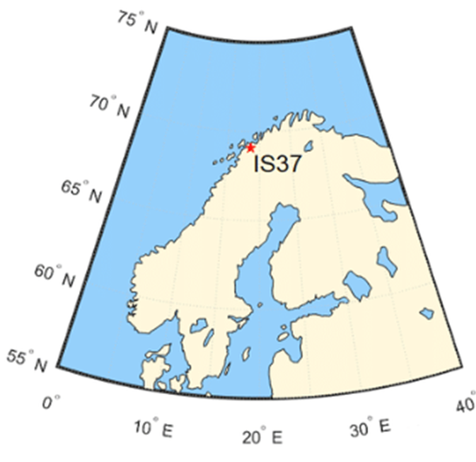
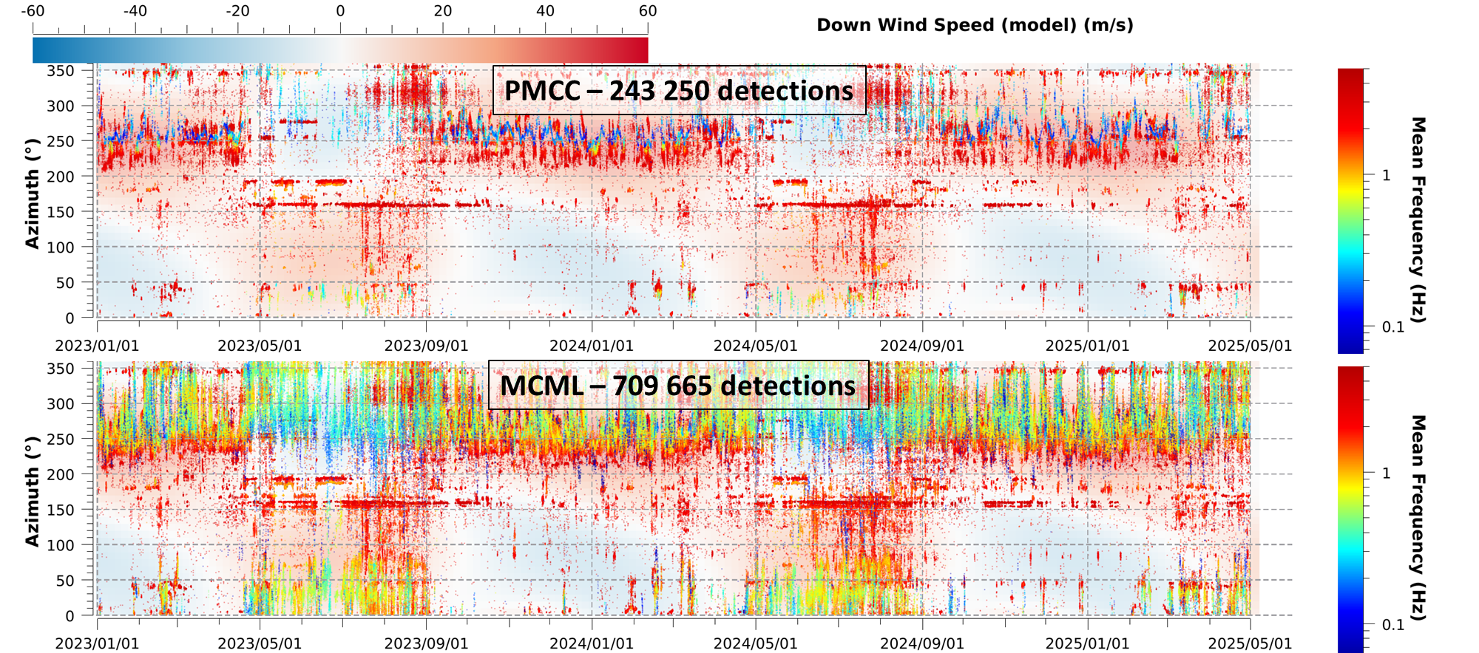
O3.5-061
The Multi-Channel Maximum-Likelihood (MCML) method: extension to multisource estimation and evaluation
B. Poste, J. Vergoz, K. Abed-Meraim, M. Charbit, A. Le Pichon
A new signal processing method : Multi-Channel Maximum Likelihood (MCML)
MCML enhances the detection of events of interest (Tonga arrivals) amid multiple coherent sources
MCML enables more numerous and continuous detections revealing seasonal variations of stratospheric guides under low SNR conditions
15 January 2022 Tonga eruption (IS37)
©norsar
Signal processing from 2023 to 2025 at IS37

Slide 6
O3.5-061
The Multi-Channel Maximum-Likelihood (MCML) method: extension to multisource estimation and evaluation
B. Poste, J. Vergoz, K. Abed-Meraim, M. Charbit, A. Le Pichon
Development of MCML-based method for multisource estimation
MCML outperforms PMCC under unfavorable recording conditions (SOI interferences, low SNR)
MCML has been optimised for real time processing and implemented in the same time-frequency space as PMCC
Single source hypothesis is not valid in reality, MCML detects the dominant source
Several multisource algorithms exist (MUSIC, Schmidt 1986; CLEAN from: Wang et al 2004 or Den Ouden et al 2020), need to be implemented for real time processing
→ Towards a cost effective method: develop and evaluate multisource algorithms to the state-of-the-art

Slide 7
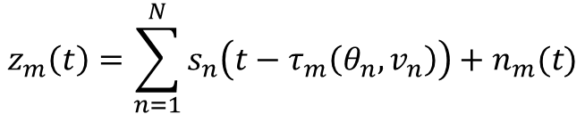


O3.5-061
The Multi-Channel Maximum-Likelihood (MCML) method: extension to multisource estimation and evaluation
B. Poste, J. Vergoz, K. Abed-Meraim, M. Charbit, A. Le Pichon
Development of MCML-based method for multisource estimation
The signal model includes N infrasound sources recorded at a station with M sensors
, be the noise at the sensor m.
Multi peak selection method:
Using a 2D peak finder (C.A.V. Aguilera, 2016) to select maxima on the monosource likelihood function
Iterative source signal deflation method:
Estimation of the first source and SOI:
$$z_{m}\left(t\right)=\sum_{n=1}^{N}{s_{n}\left(t−τ_{m}\left(θ_{n},v_{n}\right)\right)+n_{m}(t)}$$
$$n_{m}(t)$$
$$z_{m}\left(t+τ_{m}\left(\hat{θ_{1}},\hat{v_{1}}\right)\right)=s_{1}\left(t\right)+n_{m}^{′}(t)$$

Slide 8
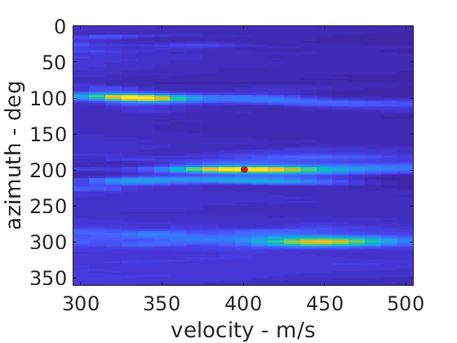
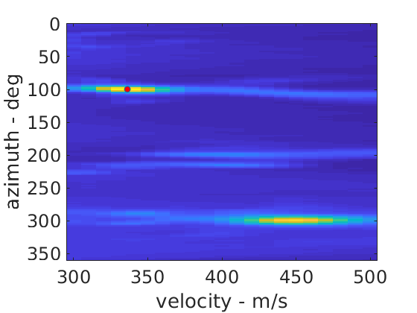
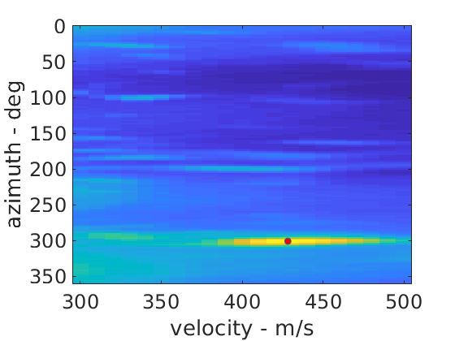
O3.5-061
The Multi-Channel Maximum-Likelihood (MCML) method: extension to multisource estimation and evaluation
B. Poste, J. Vergoz, K. Abed-Meraim, M. Charbit, A. Le Pichon
Development of MCML-based method for multisource estimation
Subtract a percentage of the SOI (i.e 25%, Wang et al. 2004) and then iterate
View of the likelihood function on synthetic signal (red dot represents the maximum)
MLE classic
2nd iteration
3rd iteration

Slide 9
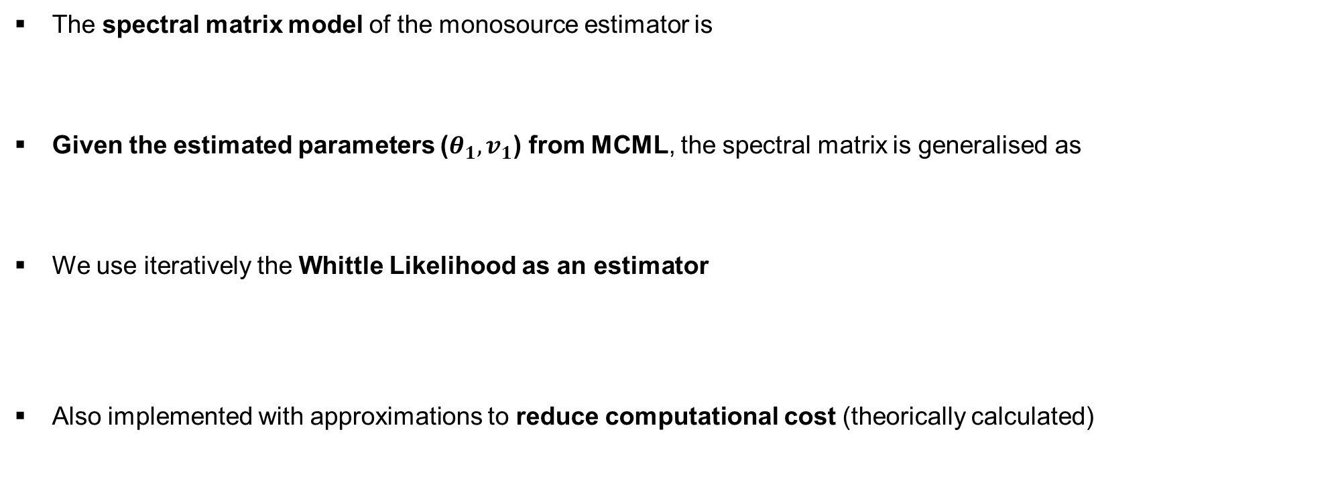
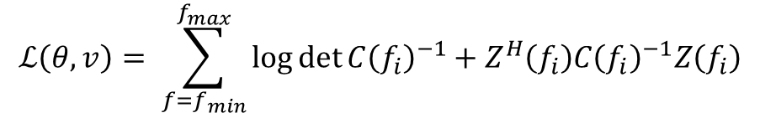
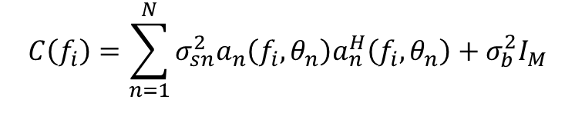
O3.5-061
The Multi-Channel Maximum-Likelihood (MCML) method: extension to multisource estimation and evaluation
B. Poste, J. Vergoz, K. Abed-Meraim, M. Charbit, A. Le Pichon
Development of MCML-based method for multisource estimation
The spectral matrix model of the monosource estimator is
Given the estimated parameters ($θ_{1},v_{1}$) from MCML, the spectral matrix is generalised as
We use iteratively the Whittle Likelihood as an estimator
Also implemented with approximations to reduce computational cost (theorically calculated)
$$C_{1}\left(f_{i}\right)=a\left(f_{i},θ_{1},v_{1}\right)σ_{s1}^{2}a^{H}\left(f_{i},θ_{1},v_{1}\right)+σ_{b}^{2}I_{M}$$
where $σ_{s1}^{2}$ the power of the first source, $σ_{b}^{2}$ the power of the noise, $I_{M}$ the identity matrix
$$C\left(f_{i}\right)=\sum_{n=1}^{N}{{σ_{sn}^{2}a}_{n}\left(f_{i},θ_{n}\right)a_{n}^{H}\left(f_{i},θ_{n}\right)}+σ_{b}^{2}I_{M}$$
$$ℒ\left(θ,v\right)= \sum_{f=f_{min}}^{f_{max}}{\log{\det{C{\left(f_{i}\right)}^{−1}+Z^{H}\left(f_{i}\right)C{\left(f_{i}\right)}^{−1}Z\left(f_{i}\right)}}}$$
where $Z\left(f_{i}\right)$ is the DFT of the received signal

Slide 10
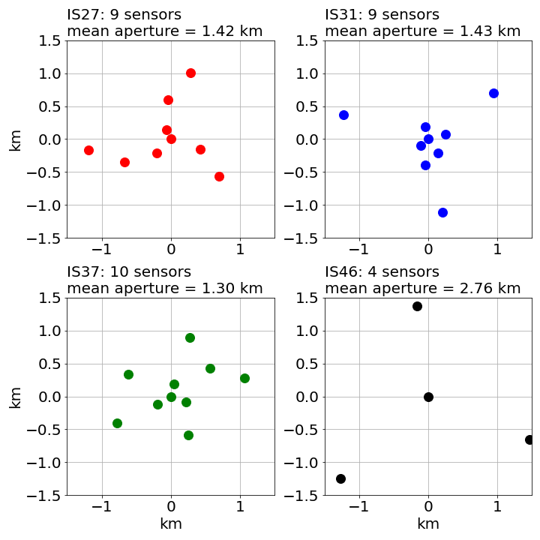
O3.5-061
The Multi-Channel Maximum-Likelihood (MCML) method: extension to multisource estimation and evaluation
B. Poste, J. Vergoz, K. Abed-Meraim, M. Charbit, A. Le Pichon
Comparison and selection of a cost effective multisource estimator
Protocol:
3 sources in one signal with random azimuthal and velocity distribution
Known number of sources
Different frequency bands: [0.1 – 0.12] Hz, [0.5 – 0.65] Hz, [3.2 – 4] Hz
Different geometries: IS31, IS46
Different SNR between the sources: 5, 0, -5 dB
A false estimation rate is determined by identifying the fraction of azimuth and trace velocity errors larger than the two-sigma theoretical uncertainty of MLE
1000 simulations for statistics significance

Slide 11
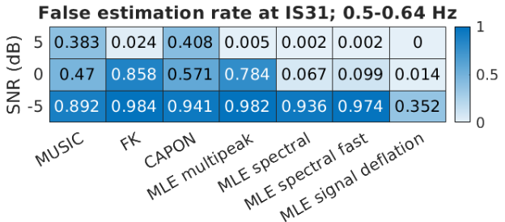
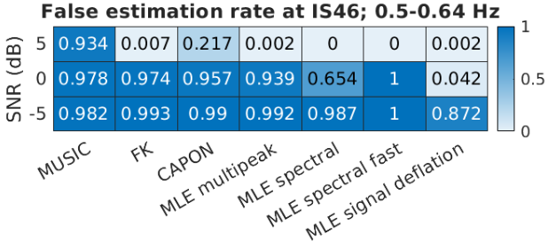
O3.5-061
The Multi-Channel Maximum-Likelihood (MCML) method: extension to multisource estimation and evaluation
B. Poste, J. Vergoz, K. Abed-Meraim, M. Charbit, A. Le Pichon
Comparison and selection of a cost effective multisource estimator
False estimation rate in function of the SNR of sources and different algorithms for IS31 and IS46
MLE signal deflation with lowest false estimation rate
Lower false estimation rate with increasing number of sensors
MUSIC struggles with poor number of sensor
Other results: Lower false estimation rate with increasing frequency

Slide 12
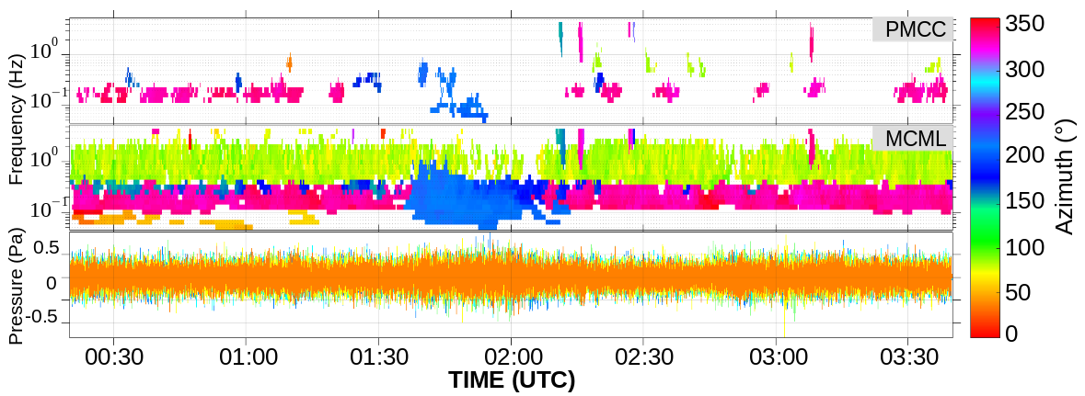
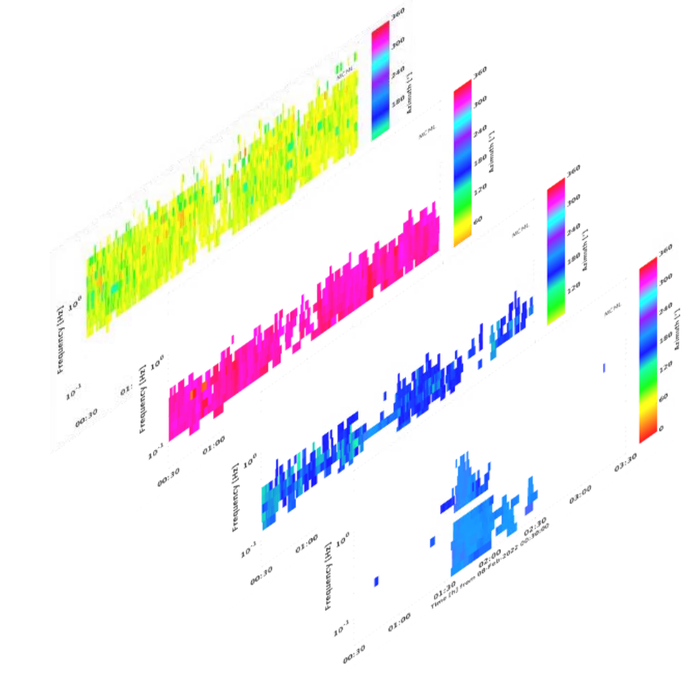
O3.5-061
The Multi-Channel Maximum-Likelihood (MCML) method: extension to multisource estimation and evaluation
B. Poste, J. Vergoz, K. Abed-Meraim, M. Charbit, A. Le Pichon
Comparison and selection of a cost effective multisource estimator
Detection of the fragmentation of a meteor 500 km off the Namibia coast (February, 7th 2022) at IS19 (Djibouti)
Removing 2 defective sensors allows PMCC to detect
Several sources interfering detected continuously: microbaroms (Atlantic & Indian now detected), surf noise and the meteor

Slide 13
O3.5-061
The Multi-Channel Maximum-Likelihood (MCML) method: extension to multisource estimation and evaluation
B. Poste, J. Vergoz, K. Abed-Meraim, M. Charbit, A. Le Pichon
Conclusion
MCML outperforms PMCC, especially at low SNR and amid multiple interfering SOIs
Currently undergoing operational testing at the French NDC
MCML is slated for implementation in DTK tools in 2026-2027 becoming the new operational detector
This improvement leads to the development of multiple sources estimators
MCML with iterative signal deflation offers a cost-effective solution for real time processing
Optimise the proportion α of subtracted signal in MCML multisource
More systematic evaluations are needed on reference events
Need of a robust post-processing method (pixel clustering) to build event

Slide 14
O3.5-061
The Multi-Channel Maximum-Likelihood (MCML) method: extension to multisource estimation and evaluation
B. Poste, J. Vergoz, K. Abed-Meraim, M. Charbit, A. Le Pichon
Thanks for listening !
References:
Arrowsmith, S. J., Whitaker, R., Katz, C., & Hayward, C. (2009). The F-detector revisited: An improved strategy for signal detection at seismic and infrasound arrays. Bulletin of the Seismological Society of America, 99(1), 449-453. DOI: https://doi.org/10.1785/0120080180
C. A. V. Aguilera. Search all extrema points of a time series or a surface with/without NaN’s, 2016. Website: https://fr.mathworks.com/matlabcentral/fileexchange/12275-extrema-m-extrema2-m
Burgess, K. A., & Van Veen, B. D. (1994, April). A subspace GLRT for vector-sensor array detection. In Proceedings of ICASSP'94. IEEE International Conference on Acoustics, Speech and Signal Processing (Vol. 4, pp. IV-253). IEEE. DOI: https://doi.org/10.1109/ICASSP.1994.389828
Cansi, Y. (1995). An automatic seismic event processing for detection and location: The PMCC method. Geophysical research letters, 22(9), 1021-1024. DOI: https://doi.org/10.1029/95GL00468
Den Ouden, O. F., Assink, J. D., Smets, P. S., Shani-Kadmiel, S., Averbuch, G., & Evers, L. G. (2020). CLEAN beamforming for the enhanced detection of multiple infrasonic sources. Geophysical Journal International, 221(1), 305-317. DOI: https://doi.org/10.1093/gji/ggaa010
Garces, M. A. (2013). On infrasound standards, Part 1 time, frequency, and energy scaling. DOI: http://dx.doi.org/10.4236/inframatics.2013.22002
Poste, B et al (2023). The multichannel maximum-likelihood (MCML) method: a new approach for infrasound detection and wave parameter estimation. Geophysical Journal International, 232(2), 1099-1112. DOI: https://doi.org/10.1093/gji/ggac377
Poste, B. (2024). Statistical signal processing for multiple sources separation on antennas (Doctoral dissertation, Université d'Orléans). HAL ID: https://theses.hal.science/tel-04901267/
Schmidt, R. (1986). Multiple emitter location and signal parameter estimation. IEEE transactions on antennas and propagation, 34(3), 276-280. DOI: https://doi.org/10.1109/TAP.1986.1143830
Wang, Y., Li, J., Stoica, P., Sheplak, M., & Nishida, T. (2004). Wideband RELAX and wideband CLEAN for aeroacoustic imaging. The Journal of the Acoustical Society of America, 115(2), 757-767. DOI: https://doi.org/10.1121/1.1639906

