Slide 1


P3.3-097
Main VNIIA Focus Areas Related to the CTBT Technologies
O.A. Gerasimchuk, G.S. Zasimov, A.M. Pischimov
Federal State Unitary Enterprise «All-Russian Research Institute of Automatics» (FSUE «VNIIA»), ROSATOM
The presentation presents a description and results of VNIIA ongoing research on CTBT-related areas: scientific-methodological support and hardware/software for on-site inspections activities; analysis of a possible CTBT non-compliance events; data analytics system for CTBT monitoring; seismic complex for technical support development; seismic/infrasound data processing.

Slide 2
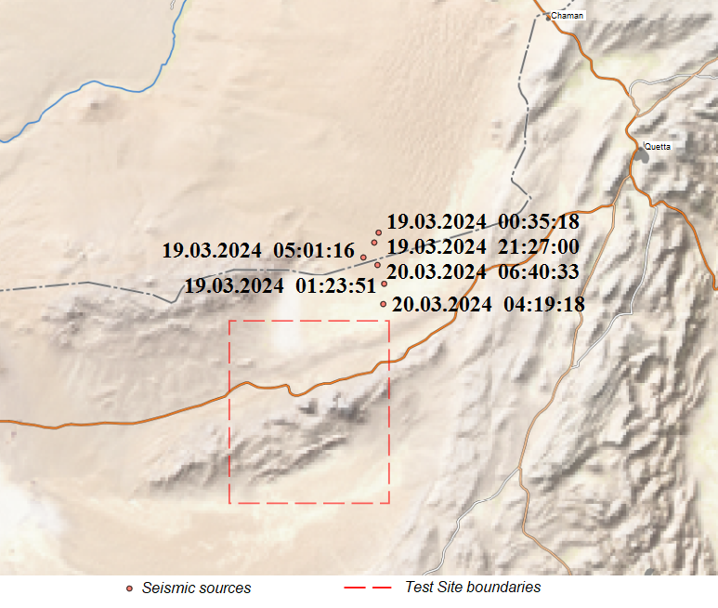
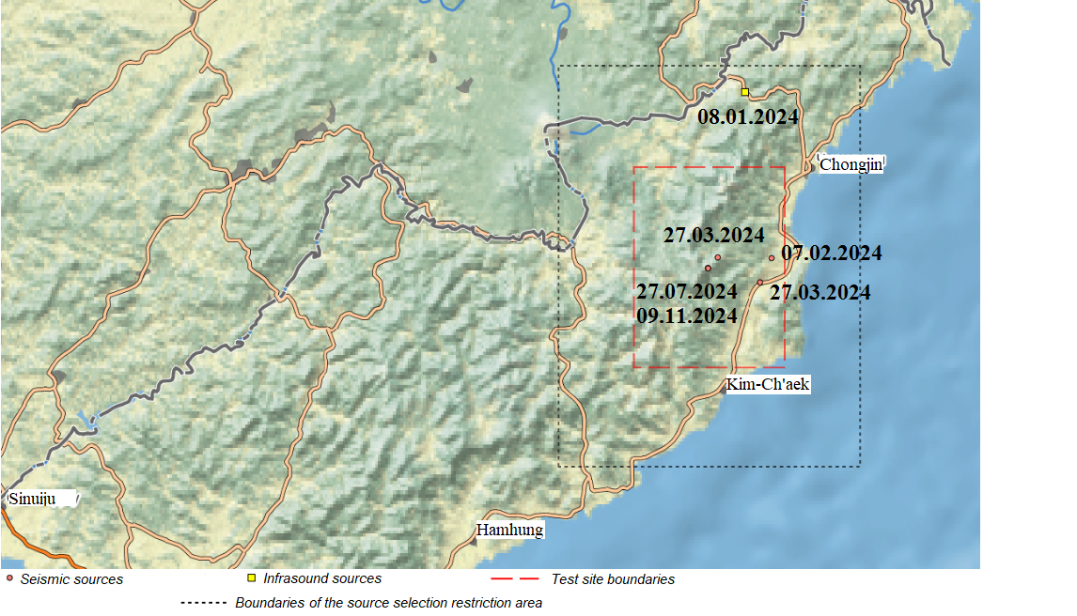
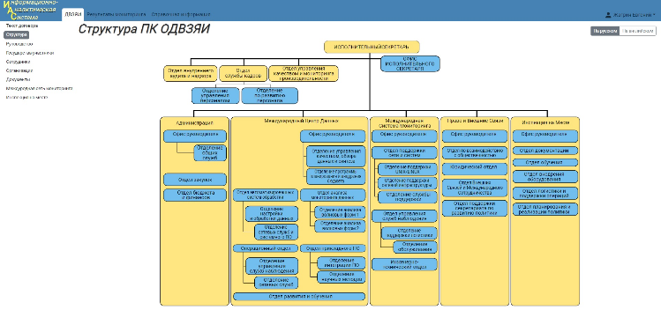
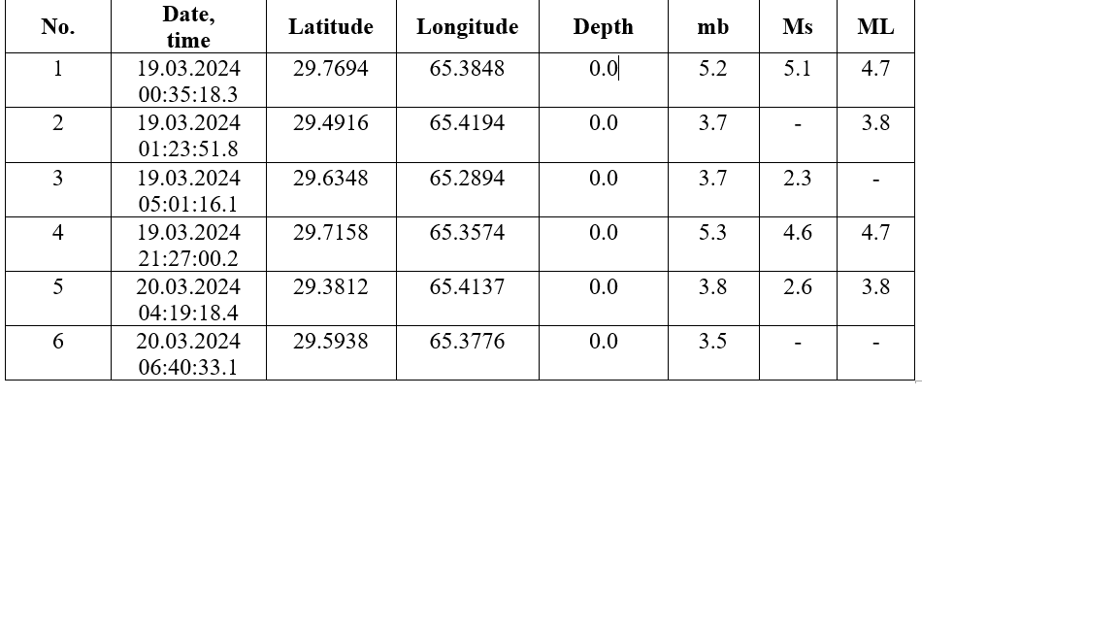
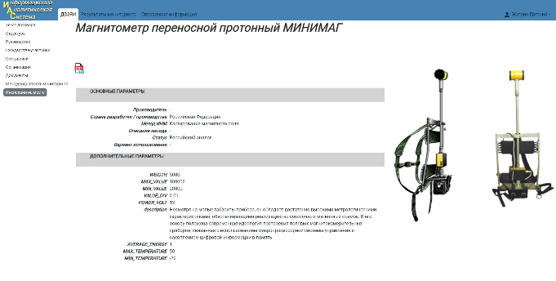
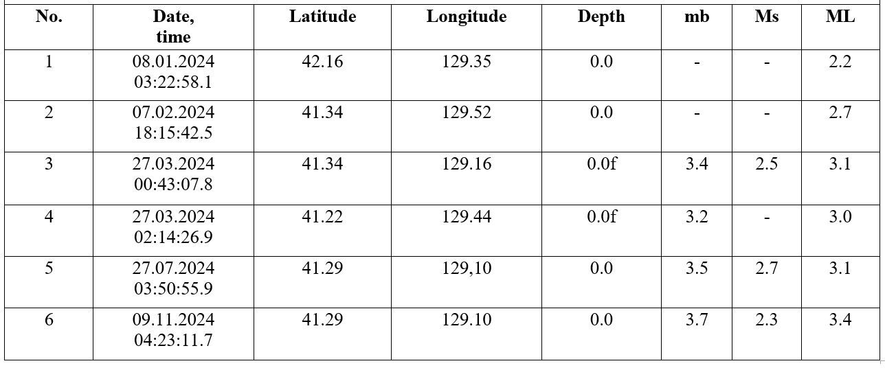
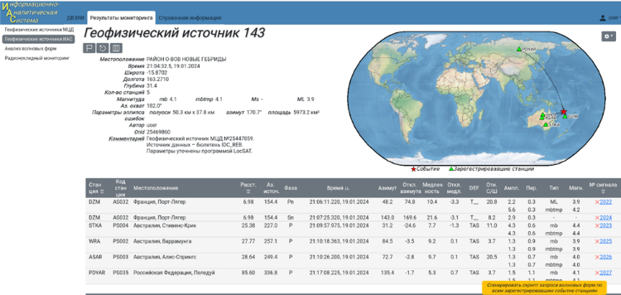
P3.3-097
Main VNIIA Focus Areas Related to the CTBT Technologies
O.A. Gerasimchuk, G.S. Zasimov, A.Yu. Eltekov.
Development of Methodological, Hardware and Software Support of CTBT On-Site Inspection, Enhancement of Information Analytical System
Analysis of IMS Monitoring Data Published
by IDC
VNIIA develops methodological support for inspection activities and the negotiation process of the Russian Federation related to the CTBT.
As a part of these efforts, the Information Analytical System (IAS) has been upgraded. It is used in applied research to ensure that Rosatom implements its functions related to the CTBT.
The IAS is developed using WEB-technologies and ensures:
VNIIA analyses data published by the IDC to identify seismic and infrasound events, as well as the radiation environment on the globe.
North Korea Punggye-ri Test Site
Pakistan Chagai Test Site

Slide 3
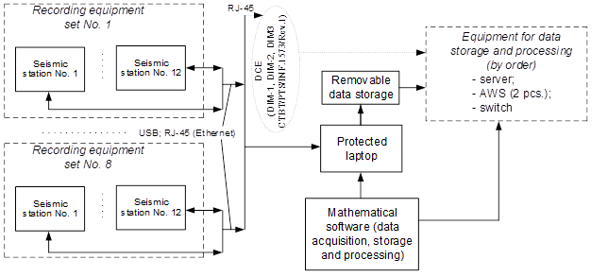
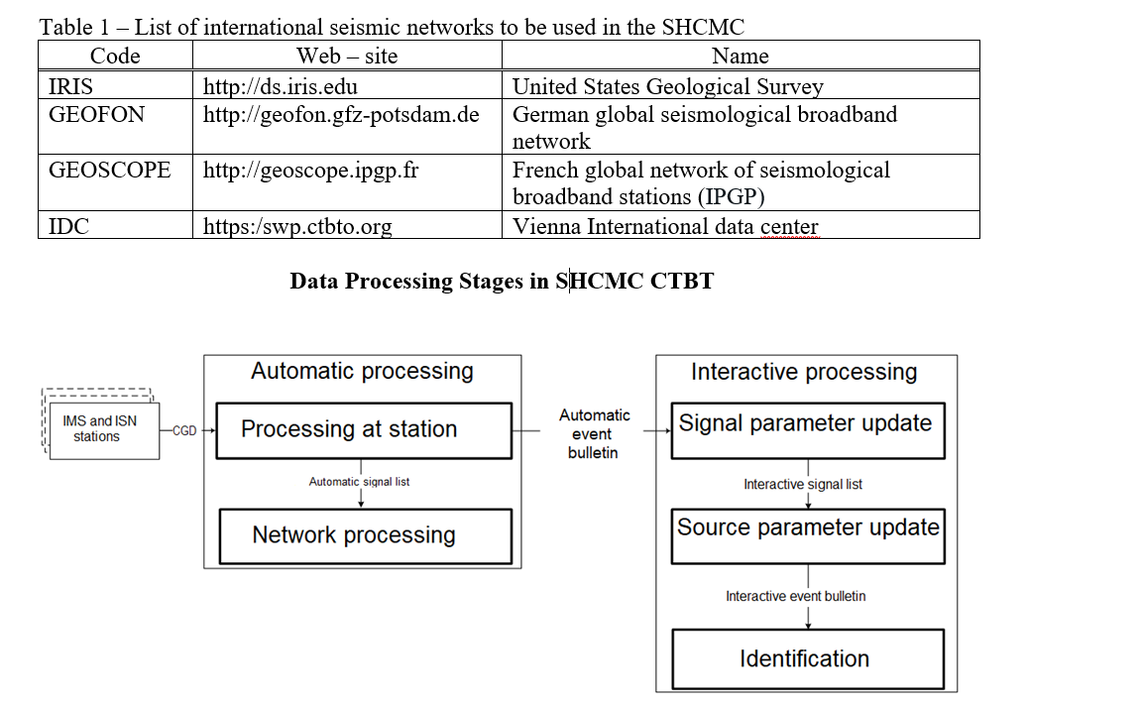
P3.3-097
Main VNIIA Focus Areas Related to the CTBT Technologies
O.A. Gerasimchuk, G.S. Zasimov, A.Yu. Eltekov.
Seismic Recording System for Carrying out CTBT OSI by the Aftershock Passive Seismic Monitoring and Passive Resonance Seismic Methods
Software and Hardware Complex for Monitoring Compliance with CTBT
VNIIA develops the seismic recording system (SRS).
The SRS is designed to carry out CTBT OSI by the aftershocks passive seismic monitoring (PSM) and passive resonance seismic (RES) methods. It ensures:
- independent recording of a microseismic background and signals from natural and anthropogenic sources, including signals from aftershocks, by a regular network of three-component digital seismic stations;
- transfer of recording data from seismometers to removable data storages for subsequent processing;
transmission of recording data via Ethernet using the SeedLink or CD1.1 protocol;
processing of recoding data using developed mathematical software.
The recording functions of the SRS are implemented by a suite of recording equipment sets (one to eight), each of which contains 12 three-component digital seismic stations.
There are two SRS variants – on the base of broadband or short-period seismic stations. The specifications of the analog and digital components of seismometers meet the requirements for seismic equipment specified in the draft List of OSI Equipment (CTBT/PTS/INF.1573/Rev.1) in terms of the PSM and RES equipment.
VNIIA develops a software and hardware complex to monitor compliance with the CTBT that implements a complete cycle of the seismic and infrasound continuous geophysical data (CGD) processing, including receiving data from seismic and infrasound stations, automatic data processing to detect signals and their sources, and interactive analysis of automatic data processing results to determine the reliability of the recorded events and identify them.
Table 1 lists the largest international seismic networks (ISN), the data from which is planned to be used in the SHCMC.

Slide 4


P3.3-097
Main VNIIA Focus Areas Related to the CTBT Technologies
O.A. Gerasimchuk, G.S. Zasimov, A.Yu. Eltekov.
Software and Hardware Complex for Monitoring Compliance with CTBT
The developed software components for automatic detection of seismic and infrasound events include station and network processing of geophysical data [Coyne, 2012].
The station processing consists of the automatic detection of signals, calculation of their parameters, and quantitative estimation of these parameters’ determination errors, as well as preliminary determination of signal phase types.
The network processing of geophysical data consists of automatic association of seismic and infrasound signals to the event and calculation of their parameters (time of occurrence, coordinates, depth and magnitude for seismic events), as well as quantitative estimation of the event parameters determination errors.
Station processing of infrasound data differs from seismic data processing by the type of the signal detector used. The progressive multichannel cross-correlation (PMCC) algorithm [Cansi, 1995] based on cross-correlation analysis between the array elements is used to detect infrasound signals and measure their parameters on the basis of data from the IMS infrasound arrays.
.
The identification parameters (discriminants) are as follows [O.K. Kedrov, 2005]:
maximum amplitudes ratios (S/P and LR/P) in form of:
D(S/P) = lg(S/P) – a_{m} m_{b} – b_{D}lgΔ
D(LR/P) = lg(LR/P) – a_{m} m_{b} – b_{D}lgΔ)
2) magnitude differences (m_{b}–M_{S}) in form of:
D(m_{b}–M_{S}) = lg(m_{b}–M_{S}) – a_{m} m_{b} – b_{D}lgΔ
3) ratios of sums, S_{i,,} of the spectral wave amplitudes, Р, in three frequency bands
0.3–0.6 Hz (S₁) , 1.3–3.0 Hz (S₂), and 3.0–6.0 Hz (S₃) in form of:
D(G_{1,2}) = lgS₁ – a_{m1}m_{b} – lgS₂ + a_{m2}m_{b} – b_{D}lgΔ
D(G_{1,3}) = lgS₁ – a_{m1}m_{b} – lgS₃ + a_{m3}m_{b} – b_{D}lgΔ,
where a_{m} and b_{D} are coefficients estimated for the Eurasia region on the base of the underground nuclear explosions (UNE) and earthquakes records.
The association is a generation of all possible event hypotheses. Since the same signal can belong to different hypotheses, a conflict shall be resolved to generate an event bulletin.

Slide 5
P3.3-097
Thank you for your attention!

