Slide 1

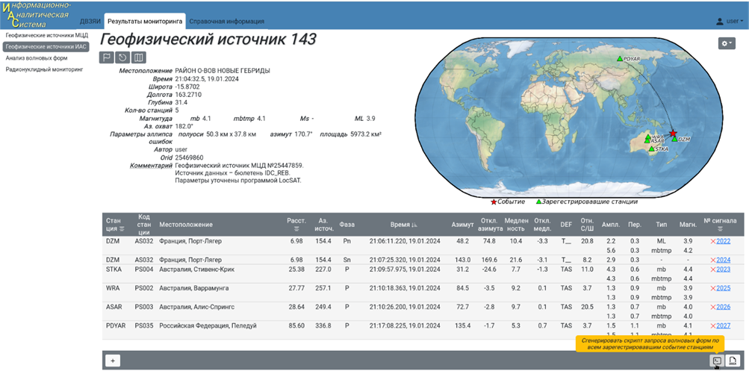

P3.3-097
Main VNIIA Focus Areas Related to the CTBT Technologies
O.A. Gerasimchuk, G.S. Zasimov, A.M. Pischimov, A.V. Popov, P.M Utkin
Federal State Unitary Enterprise «All-Russian Research Institute of Automatics» (FSUE «VNIIA»), ROSATOM
Poster describes VNIIA developments in the following areas:
  Methodological, hardware and software support of CTBT OSI activities
  Analysis of events indicating possible non-compliance with the CTBT by State Parties, using geophysical and radionuclide data collection based on IDC products
  Development of a seismic system for technical support of the CTBT OSI, using the seismic monitoring methods (passive seismic (PMS), resonance seismic (RES))
  Development of software and hardware for CTBT compliance monitoring, based on the up-to-date algorithms of digital geophysical data processing, which provides a full cycle of continuous seismic and infrasound geophysical data processing
If you want to find out more, come over for a chat in front of our poster

