Slide 1


P3.3-629
Noble gas measurements in an OSI, lessons learned from field measurements and BuE24
Mattias Aldener, Tomas Fritioff, Henrik Olsson and Klas Elmgren.
FOI, Swedish Defence Research Agency
Since IFE14 development of methods and systems has improved the capacity for xenon detection. New features of the SAUNA Field system are: rapid deployment configuration in a flight pod, integration with the OSI software and routines (GIMO), and an automatic inlet for multiple samples. These new features were tested during the build-up exercise BuE24.
Notes:
Measurements of radioactive noble gases, i.e. isotopes of xenon and argon, are an important part for an on-site inspection (OSI) in detecting an underground nuclear explosion. The first integrated field exercise where the capacity to collect and analyse noble gases were exercised was in Jordan, 2014(IFE14). Since then the development of methods and systems has improved the capacity for xenon detection. Here details on the SAUNA Field system is presented, including a rapid deployment configuration (in a flight pod), integration with the OSI software and routines (GIMO), and an automatic inlet. The latter allows for multiple samples to be added simultaneously to the system at the same time freeing time for the OSI inspectors. These features were tested during the build-up exercise field test in Hungary, 2024(BuE24). Lesson learned from this, and earlier field measurements, as well as potential improvements for collection and analysis of noble gas during an OSI will be presented.

Slide 2
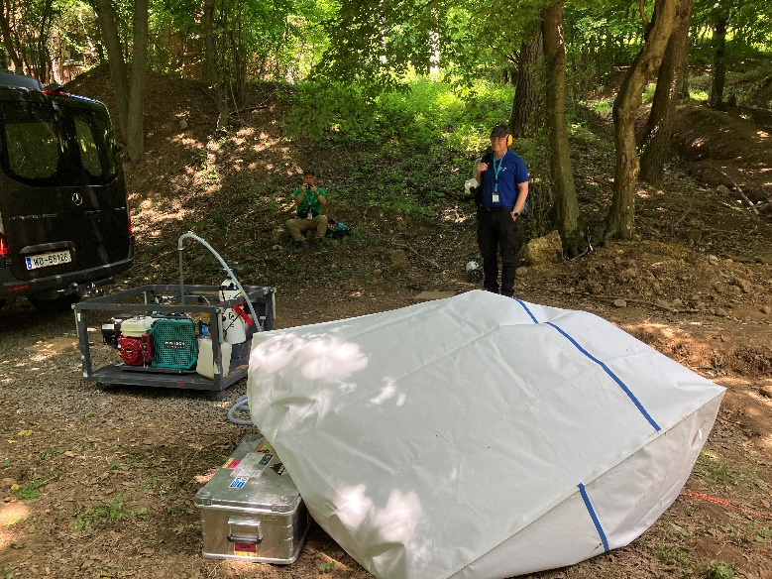
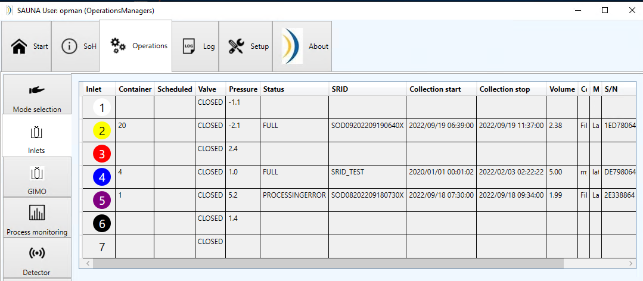
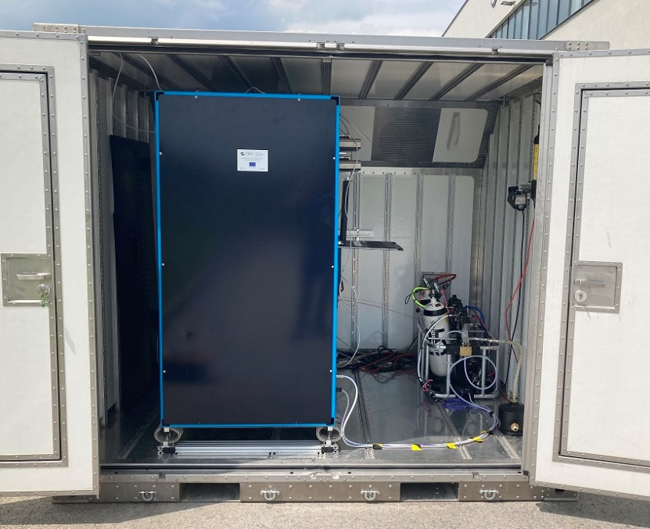
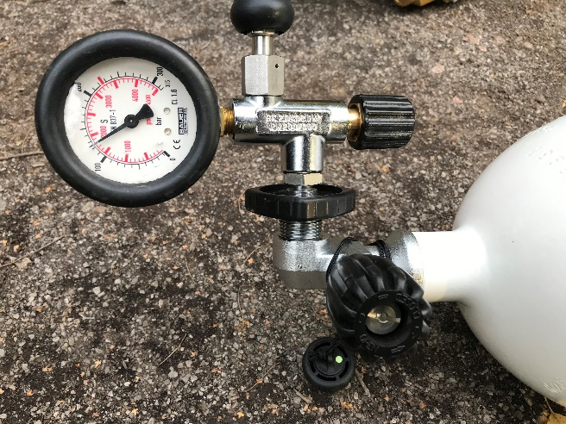
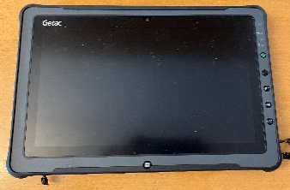
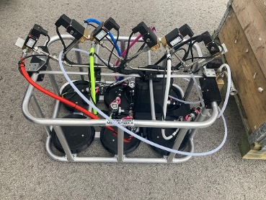
PLEASE DON‘T FORGET TO PUT THE E-POSTER TITLE AND YOUR NAME IN THE PRESENTATION HEADER.
DUPLICATE THIS SLIDE IF YOUR E-POSTER HAS MORE THAN 1 PAGE
Noble gas measurements in an OSI, lessons learned from field measurements and BuE24
Mattias Aldener, Tomas Fritioff, Henrik Olsson and Klas Elmgren
P3.3-629
Sampling and processing
Multi-sample inlet and flight pod
Software/function integration
For BuE24 the SAUNA Field system was equipped with a new inlet which can hold and automatically process and analyze up to six samples, increasing the efficiency of the operation greatly.
Each sample position automatically reads the SCUBA RFID tag, which is checked against the GIMO information.
The pressure valve on the bottles needs to be manually opened, otherwise the operation is fully automated.
Each inlet tube is colour-coded, this is matched in the GUI.
The system was modified and installed in a flight pod to make it ready for use on arrival.
The sample information is sent from the OSI laboratory control software to the SAUNA Field system.
Only samples from the laboratory can be selected and processed.
The SCUBA tanks are equipped with RFID tags that can store sample information and gives each bottle a unique ID.
These tags can be read and checked with the field tablets and synchronized with GIMO to keep track of the samples.
The latest sample inlet on the SAUNA Field system can also read and write this information. This allow the user to verify that the right sample bottle is processed and if the bottle has been processed and it is empty.
Sampling of noble gases from the soil can be done using different techniques of which auguring a hole or tarping are the most common.
For both techniques soil gas is sampled at a low flow, usually overnight, from a source which is sealed from atmospheric intrusion.
The sample is collected into large volumes which are pressurized into SCUBA bottles by the inspectors.
The pressurized bottles are shipped to the base of operation (BoO) where they are processed in the xenon processing system, SAUNA Field.
It is important to track the chain-of custody in all these steps to makes sure the data can be trusted.
SAUNA Field - A sensitive system for analysis of radioxenon in soil gas samples https://doi.org/10.1016/j.jenvrad.2021.106761
Notes:
Saknar Bue24…. Lessons learned etc

Slide 3
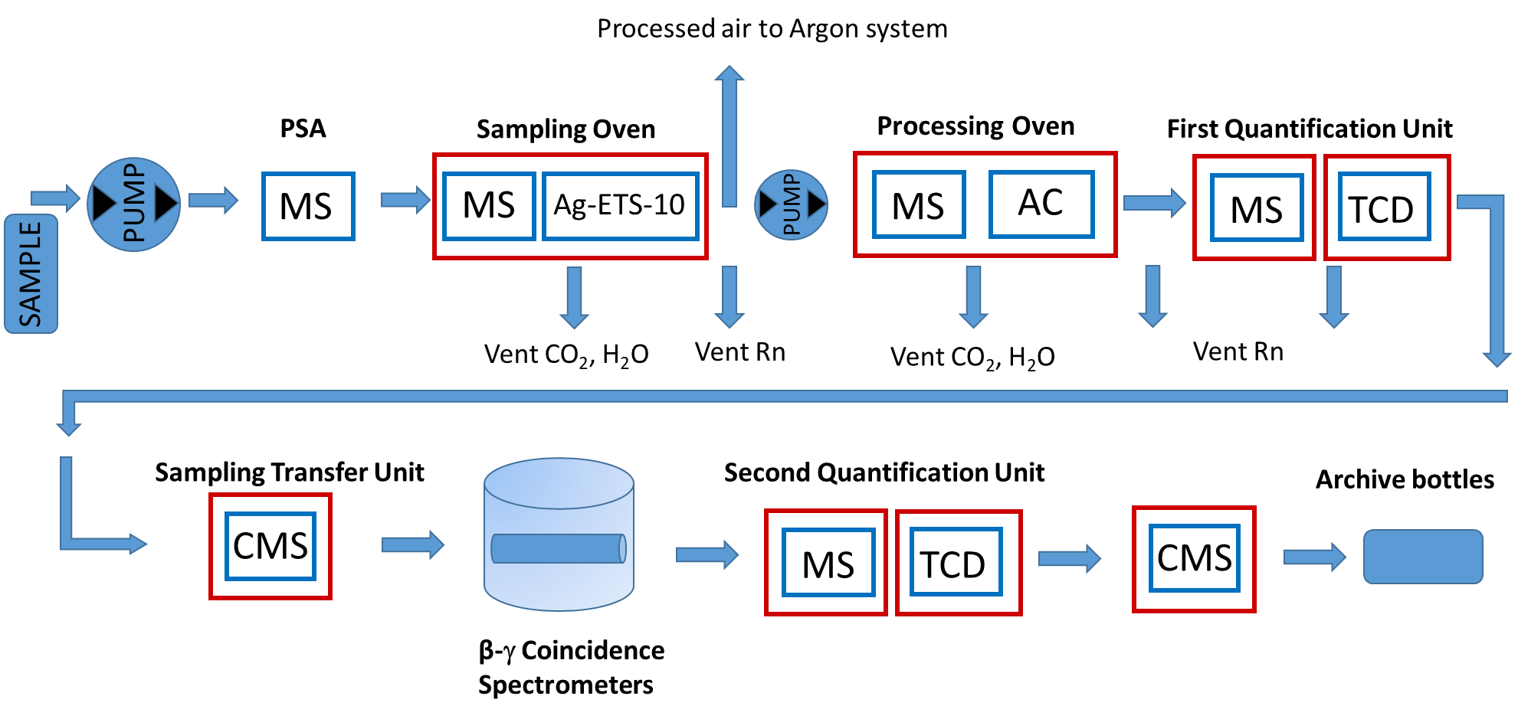
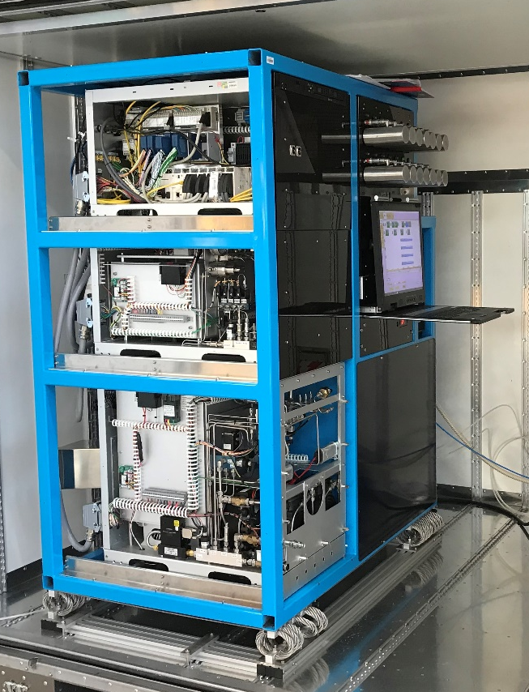
PLEASE DON‘T FORGET TO PUT THE E-POSTER TITLE AND YOUR NAME IN THE PRESENTATION HEADER.
DUPLICATE THIS SLIDE IF YOUR E-POSTER HAS MORE THAN 1 PAGE
Noble gas measurements in an OSI, lessons learned from field measurements and BuE24
Mattias Aldener, Tomas Fritioff, Henrik Olsson and Klas Elmgren
P3.3-629
SAUNA FIELD process
Operation
Specifications
The system is connected to the RN lab software so that only samples received and processed in the receiving area can be processed in the system.
The system is fully automatic and up to six samples can be attached and scheduled.
The system processes the sample, measures the activity concentration, archive the samples and automatically sends a report to the OSI control software.
The spectra is analysed in the RN laboratory to create a measurement report which will the be transferred to the working area in the base of operation.
The system is designed to process several soil gas samples per day.
The process is fully automated, the operator only need to attach the sample and schedule it in the GUI.
The system can handle high concentrations of CO₂, H₂O and Rn, found in high levels in soil gas.
The high efficiency of the system ensures that most of the sample is analysed.
The high sensitivity of the system makes it possible to measure xenon activity concentrations down levels close to the natural background.
The xenon in the sample is separated from other components, especially CO₂, H₂O and radon, in several steps.
All collection is made on room temperature traps and, except for the first (PSA) stage, the transfer is made at elevated temperatures.
Nitrogen gas, with a tank located outside the pod, is used in all steps to transfer the xenon sample.
The amount of stable xenon, which is used to calculate the corresponding sample volume, is directly measured using a TCD detector in the gas chromatograph. This is made before and after the measurement in the detector to account for any potential losses.
The activity in the pure xenon sample is measured using a sensitive β-γ coincidence detector system.
SAUNA Field - A sensitive system for analysis of radioxenon in soil gas samples https://doi.org/10.1016/j.jenvrad.2021.106761

Slide 4

PLEASE DON‘T FORGET TO PUT THE E-POSTER TITLE AND YOUR NAME IN THE PRESENTATION HEADER.
DUPLICATE THIS SLIDE IF YOUR E-POSTER HAS MORE THAN 1 PAGE
Noble gas measurements in an OSI, lessons learned from field measurements and BuE24
Mattias Aldener, Tomas Fritioff, Henrik Olsson and Klas Elmgren
P3.3-629
Processing samples during BuE24
Lessons learned from operation
Future improvements
The transfer of information between the system and the laboratory worked well.
The cooling of the system was sufficient. The high humidity caused some initial condensation which was solved by changing the AC air circulation.
The space in the pod is limited and could easily get crowded. This can be solved by moving the sample inlet out of the pod. This will also facilitate the handling of the SCUBA bottles.
The stable xenon used for calibration checks leaked out during shipment, routines for checking the system before shipment should be updated.
No good storage of the full SCUBA bottles in the RN laboratory, this might be a problem for larger exercises with more samples.
Air samples at the BoO operation can not be collected directly with the system with the current lab control software and GIMO.
Integrate RFID in all equipment, e.g. samplers and compressors, to ensure a fully automated chain of custody.
Incorporate the atmospheric sampling functionality of the SAUNA system with GIMO software and mission planning.
The RFID reader in the field tablets had functionality problems during Bue24, One solution could be to use external RFID readers.
The methodology on how to the use the system and understanding the results can further be developed and trained on.
The sample flow in the laboratory could benefit from moving out the sample holder from the pod and adding a gas sample storage.
Soil gas was collected and then pressurized in the the inspection area, usually during night.
The pressurized samples were taken back to the BoO for analysis.
RFID tags on the SCUBA bottles were checked with the field tablets to ensure the chain of custody.
The new inlet with six positions were sufficient for the scope of the exercise.
The sample information was processed in the inspector data flow and transferred to the SAUNA Field system.
After analysis the spectra were transferred back to the RN Lab control software for analysis and reporting.
SAUNA Field - A sensitive system for analysis of radioxenon in soil gas samples https://doi.org/10.1016/j.jenvrad.2021.106761
Notes:
Saknar Bue24…. Lessons learned etc
-: utbildning i analys, kondens, läckage Xe i frakt, GC kalibrering (gör systemet redo för användande) ta luftprover fungerade inte. Inge bra förvaring för Xe flaskor

