Slide 1

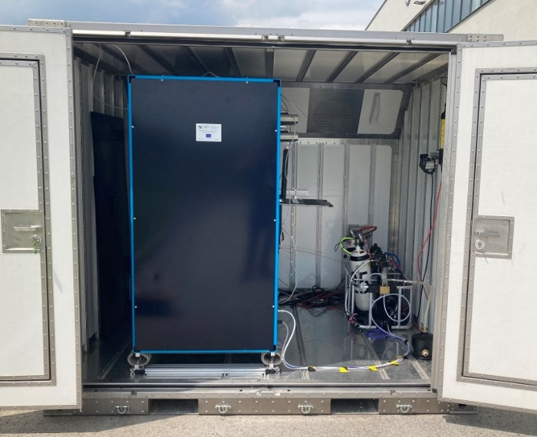
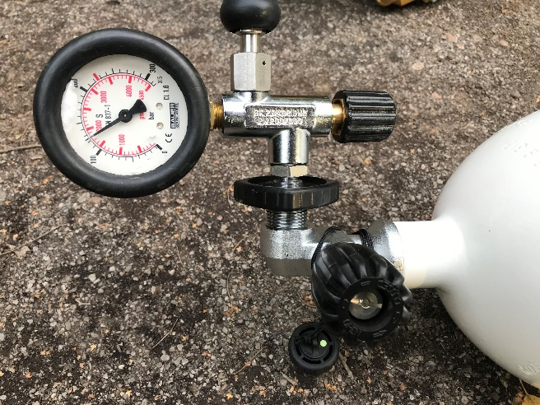
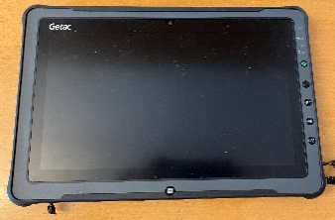
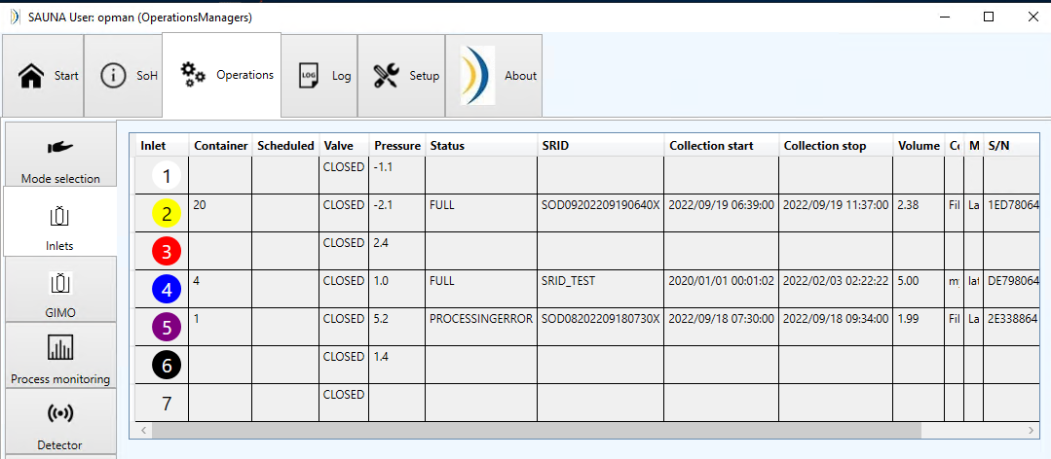
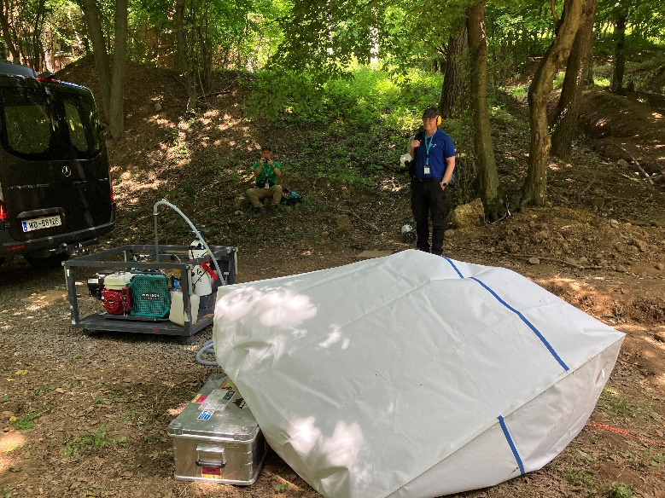
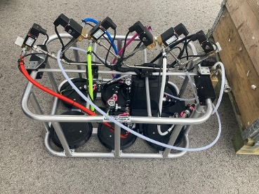

P3.3-629
Noble gas measurements in an OSI, lessons learned from field measurements and BuE24
Mattias Aldener, Tomas Fritioff, Henrik Olsson and Klas Elmgren
FOI, Swedish Defence Research Agency
Learn about noble gas sampling and processing in an OSI
The SUANA Field system is use for xenon measurements
The system was modified before BuE24 to support the inspectors
Integration with GIMO – how did it work?
What did we learn from its use during Bue24?

