Slide 1

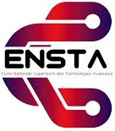
P3.3-007
The open-source software GPRmax for simulating GPR scenarios relevant to OSI missions
Abdelhalim ZAOUI
National Higher School of Advanced Technologies (ENSTA), Algiers, Algeria
Ground Penetrating Radar (GPR) is a key tool for the CTBTO during On-Site Inspections to detect underground anomalies linked to nuclear tests. This study explores the use of gprMax , an open-source simulator based on the Finite-Difference Time-Domain method, to model electromagnetic wave propagation in various geological settings. gprMax simulations can take into account the detection of tunnels, cavities, and other features indicative of nuclear activity. gprMax allows customization of antenna frequency, soil type, and target composition, aiding in system optimization. As an open-source tool, it can plays a crucial role in the training phase of CTBTO inspectors, providing them with realistic virtual scenarios to practice interpretation, enhance their decision-making skills, and gain experience in recognizing complex subsurface signatures before engaging in actual inspections.
DISCLAIMER (if any) [Arial Regular/ Font Size 8]
remerciment

Slide 2
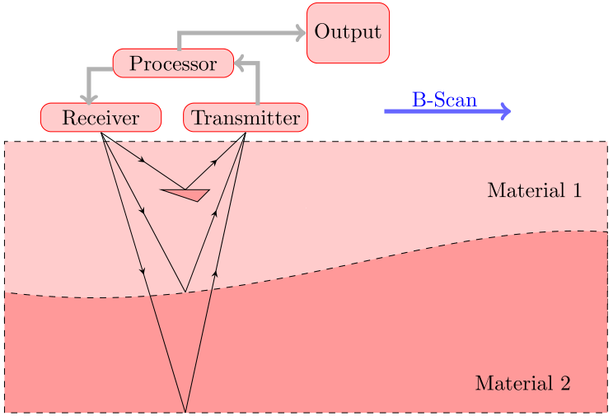
P3.3-007
The open-source software GPRmax for simulating GPR scenarios relevant to OSI missions
Abdelhalim ZAOUI
1. Introduction
2. Background on OSI and GPR Use
3. Fundamentals of GPR
Ground Penetrating Radar (GPR) is a critical geophysical method that supports subsurface imaging by transmitting electromagnetic pulses and detecting reflected signals from buried structures. Its role in international security has grown, particularly through the work of the Comprehensive Nuclear-Test-Ban Treaty Organization (CTBTO), which uses GPR during On-Site Inspections (OSI) to locate and characterize underground anomalies. These anomalies may include cavities, tunnels, or disrupted geological layers that signal potential nuclear testing activities. GPR is favored for OSI missions due to its non-invasive nature, portability, and adaptability to varied terrains. However, successful GPR deployment depends on optimal parameter settings, geological conditions, and operator experience. Since actual test environments are often unpredictable and complex, simulation has become an indispensable preparatory tool. Simulations can enhance understanding of radar signal behavior in diverse subsurface conditions, train inspectors, and inform mission planning. This work presents a detailed exploration of “gprMax”, an open-source simulation tool, demonstrating its value in modeling GPR scenarios for OSI applications and advancing the effectiveness of nuclear test verification efforts.
The Comprehensive Nuclear-Test-Ban Treaty (CTBT) aims to eliminate nuclear weapons testing by establishing a global monitoring and verification regime. One of its most powerful mechanisms is the On-Site Inspection (OSI), which investigates suspicious seismic or geophysical events to determine if a nuclear explosion occurred. Within an OSI, GPR is deployed as a non-destructive method for subsurface investigation. Its goal is to detect anomalies such as man-made voids, backfilled tunnels, or disrupted soil layers that could result from underground nuclear detonations. The GPR system used by CTBTO must perform in diverse terrains and under strict time constraints. Since OSI sites may present unpredictable geological compositions, effective use of GPR requires prior knowledge and preparedness. GPR operators must interpret radargrams rapidly and accurately, distinguishing between natural geological features and potential evidence of testing activity. Given the limitations of field-based trial-and-error, simulation tools have become essential. They allow inspectors to preview likely outcomes under different scenarios, better interpret field data, and optimize system parameters, all while adhering to strict inspection protocols.
Ground Penetrating Radar (GPR) emits short, high-frequency electromagnetic pulses into the ground. Reflections occur when waves meet materials with different electrical properties, revealing subsurface features’ depth and composition. Sensitive to dielectric permittivity contrasts, GPR detects air cavities, disturbed soil, and solid materials like metal or concrete. Antenna frequency determines resolution and penetration: low frequencies penetrate deeper with less detail, high frequencies give finer resolution but shallower reach. In On-Site Inspections (OSI), GPR operates in survey or targeted modes. Data interpretation is complex, requiring expertise, environmental knowledge, and simulation tools like gprMax to predict radar responses in challenging conditions.
Fig-1 : GPR operating principle

Slide 3

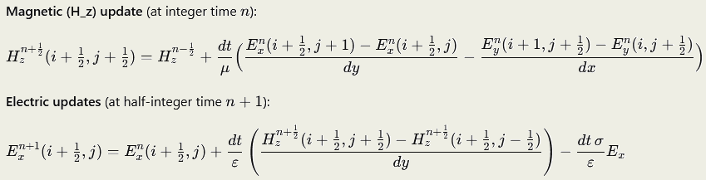

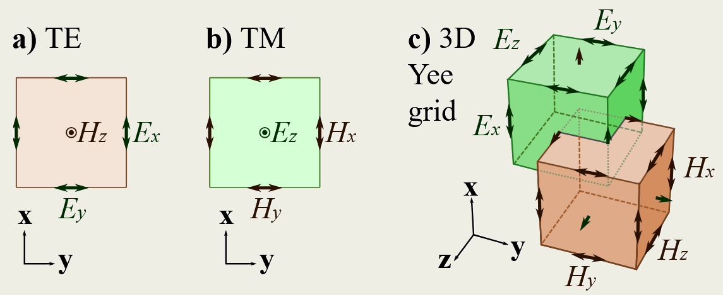



P3.3-007
The open-source software GPRmax for simulating GPR scenarios relevant to OSI missions
Abdelhalim ZAOUI
4. Maxwell’s Equations — Summary
5. Finite-Difference Time-Domain Method
In a linear, isotropic medium with permittivity ε, permeability μ, and conductivity σ:
1. Gauss’s law (electric): Electric charges produce an electric field.
2. Gauss’s law for magnetism: There are no magnetic monopoles; magnetic field lines are continuous.
3. Faraday’s law of induction:A changing magnetic field induces an electric field.
4. Ampère–Maxwell law: Magnetic fields are generated by electric currents and by changing electric fields.
Constitutive relations:
In free space:
1. Purpose: FDTD is a numerical method to directly solve Maxwell’s curl equations in the time domain for the electric field E and magnetic field H, allowing simulation of wave propagation, scattering, and interaction with materials.
2. Starting point — Maxwell’s curl equations in a medium:
3. Discretization — Yee grid:
Space is divided into a grid with staggered E and H components. E and H are offset in time by half a time step (Δt/2) for leapfrog updating.
Spatial derivatives are approximated by central finite differences.
4. Update equations:
Each time step:
Update H using curl of E.
Update E using curl of H and material parameters.
Apply source conditions and boundary conditions.
5. Stability (CFL condition):
Time step must satisfy:
​
6. Boundaries:
Use absorbing layers such as Perfectly Matched Layers (PML) to avoid reflections.
7. Applications:
GPR modeling, antenna design, radar cross-section, optical waveguides, microwave devices, etc.

Slide 4
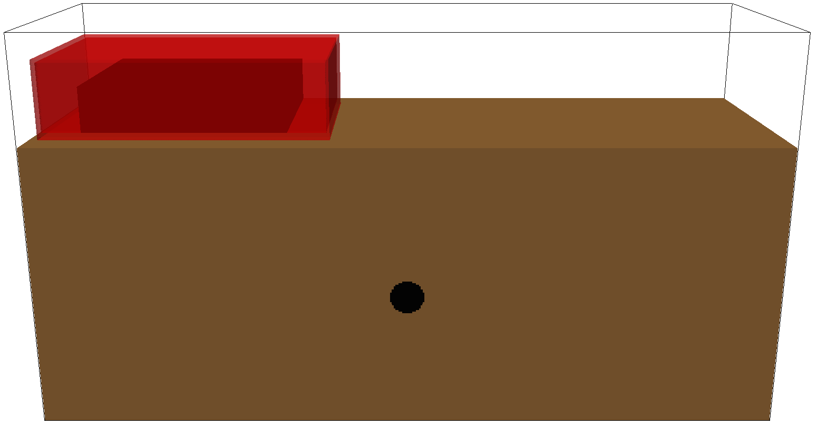
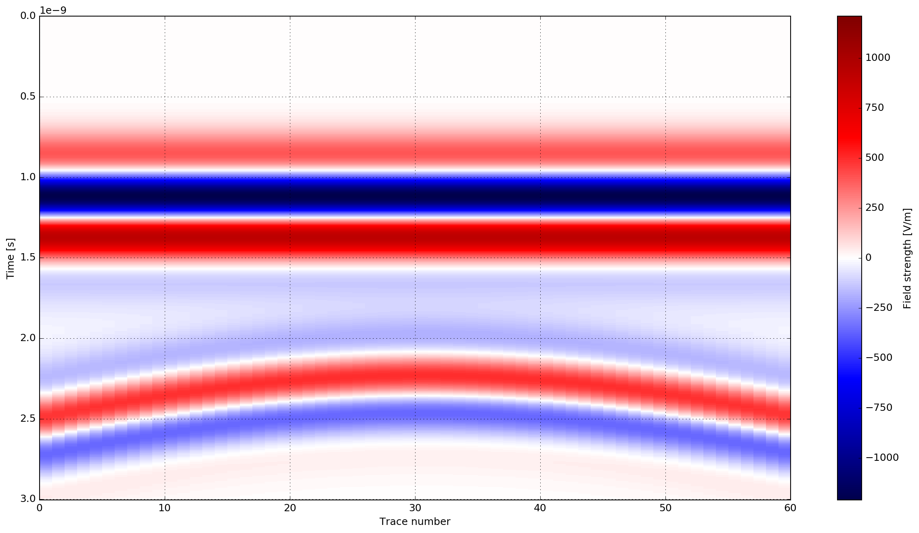
P3.3-007
The open-source software GPRmax for simulating GPR scenarios relevant to OSI missions
Abdelhalim ZAOUI
6. Simulation exemple
7. Input file command
8. Post process
An input file has to be supplied to gprMax which should contain all the necessary information to run a GPR model. The input file is an ASCII text file which can be prepared with any text editor :
#command_name: parameter1 parameter2 parameter3 ...​
Fig-2 : Geometric model
#title: B-scan from a metal cylinder buried in a dielectric half-space
#domain: 0.240 0.210 0.002
#dx_dy_dz: 0.002 0.002 0.002
#time_window: 3e-9
#material: 6 0 1 0 half_space
#waveform: ricker 1 1.5e9 my_ricker
#hertzian_dipole: z 0.040 0.170 0 my_ricker
#rx: 0.080 0.170 0
#src_steps: 0.002 0 0
#rx_steps: 0.002 0 0
#box: 0 0 0 0.240 0.170 0.002 half_space
#cylinder: 0.120 0.080 0 0.120 0.080 0.002 0.010 pec
To run the model to create a B-scan we must pass an optional argument to specify the number of times the model should be run. In this case this is the number of A-scans (traces) that will comprise the B-scan. For a B-scan over a distance of 120mm with a step of 2mm that is 60 A-scans.
python -m gprMax cylinder_Bscan_2D.in -n 60
We should have produced 60 output files, one for each A-scan, with names cylinder_Bscan_2D1.out, cylinder_Bscan_2D2.out etc… These can be combined into a single file using the command:
python -m tools.cylinder_Bscan_2D
We can now view an image of the B-scan using the command:
python -m tools.plot_Bscan cylinder_Bscan_2D_merged.out Ez
Fig-3 : shows the B-scan (of the field component). Again, the initial part of the signal (~0.5-1.5 ns) represents the direct wave from transmitter to receiver. Then comes the refelected wave (~2-3 ns) from the metal cylinder which creates the hyperbolic shape.

Slide 5
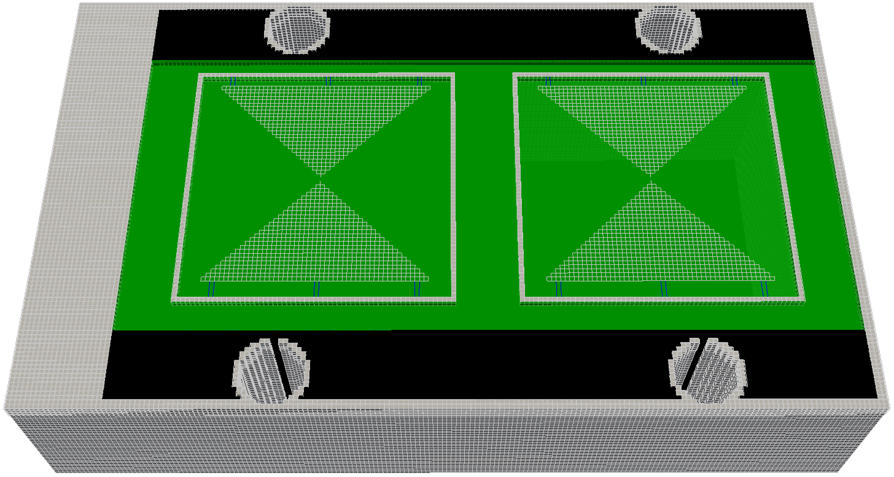
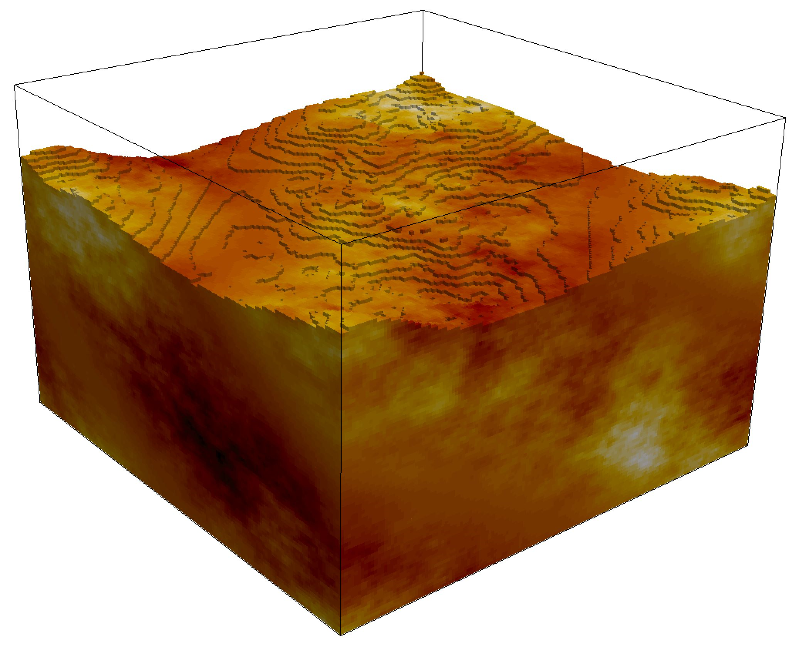
P3.3-007
The open-source software GPRmax for simulating GPR scenarios relevant to OSI missions
Abdelhalim ZAOUI
9. Advanced features
10. Conclusion and Future Outlook
11. References
gprMax offers advanced simulation capabilities for Ground Penetrating Radar studies. It supports detailed antenna modeling, enabling realistic representation of transmission and reception patterns.
Fig-4 : FDTD geometry mesh
showing an antenna model
similar to MALA 1.2GHz
Users can define heterogeneous soils with varying dielectric, conductive, and magnetic properties,. Additionally, gprMax allows the inclusion of rough surfaces to simulate realistic terrain or material interfaces, improving accuracy in scattering and reflection predictions. These features make gprMax a powerful tool for designing experiments, interpreting GPR data, and testing scenarios before field deployment.
Fig-5 : FDTD geometry
mesh showing a
heterogeneous soil model
with a rough surface [7].
gprMax can be an essential simulation platform for advancing the use of Ground Penetrating Radar in CTBTO’s On-Site Inspections.
The software's flexibility in defining materials, targets, and system configurations allows inspectors to simulate a broad range of realistic OSI scenarios.
gprMax can plays a crucial role in the training phase of CTBTO inspectors, providing them with realistic virtual scenarios to practice interpretation, enhance their decision-making skills, and gain experience in recognizing complex subsurface signatures.
In OSI, simulation with gprMax enables inspectors to :
  optimize planning surveys,
  predict radar responses in complex environments,
  reducing uncertainties before field deployment,
  check the interpretation proposals, and interpret data more accurately after field operations.
  Further developments could include :
  integration with machine learning for anomaly detection, real-time data analysis, or fusion with other geophysical methods.
  Acceleration of computation by using GPU-based solver (NVIDIA CUDA programming model).
H. M. Jol, Ground Penetrating Radar Theory and Applications. Amsterdam, Netherlands: Elsevier, 2008.
A. P. Annan, “Ground-penetrating radar principles, procedures, and applications,” Geological Survey of Canada, Information Circular 8, 2005.
gprMax User Guide : https://docs.gprmax.com/en/latest/
L. B. Conyers, Interpreting Ground-Penetrating Radar for Archaeology. Walnut Creek, CA, USA: Left Coast Press, 2012.
C. Warren, A. Giannopoulos, and I. Giannakis, “gprMax: Open source software to simulate electromagnetic wave propagation for Ground Penetrating Radar,” Computers & Geosciences, vol. 93, pp. 75–85, 2016.
A. Giannopoulos, “Modelling ground penetrating radar by GPRMAX,” Construction and Building Materials, vol. 19, no. 10, pp. 755–762, 2005.
N. R. Peplinski, all. "Dielectric properties of soils in the 0.3-1.3-GHz range," in IEEE Transactions on Geoscience and Remote Sensing, vol. 33, no. 3.

