Slide 1


P3.2-223
Application of Indirect Quantification of ^{133m}Xe to Calibration of HPGe Detector
Troy Robinson, PhD
Idaho National Laboratory (USA)
The indirect quantification of ^{133m}Xe was applied to detector calibration.
The indirect quantification method yielded comparable results to previously used calibration techniques.
There was no savings in laboratory labour, detector utilisation time, or data analysis achieved over other methods.
Although not superior for use in calibration, the indirect quantification method excels at reducing detector utilisation time in some quantification tasks.

Slide 2
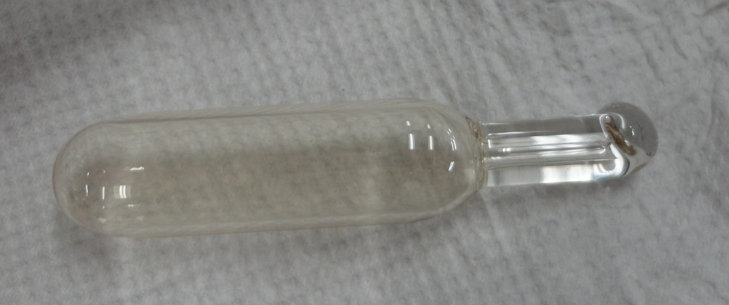
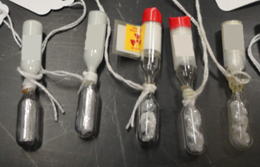
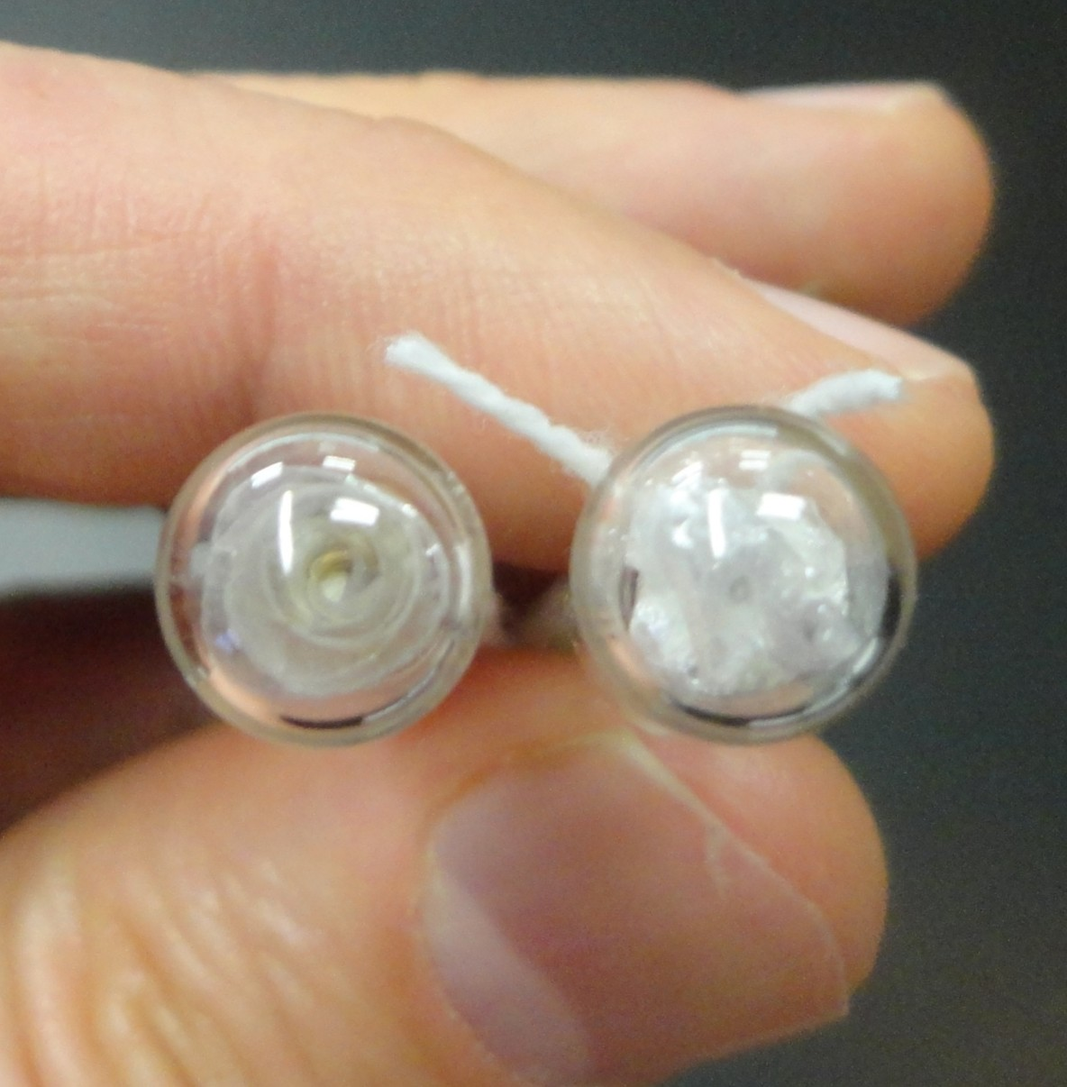
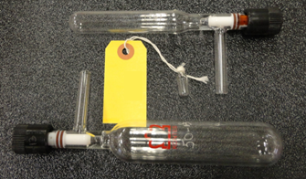
PLEASE DON‘T FORGET TO PUT THE E-POSTER TITLE AND YOUR NAME IN THE PRESENTATION HEADER.
DUPLICATE THIS SLIDE IF YOUR E-POSTER HAS MORE THAN 1 PAGE
P3.2-223
Application of Indirect Quantification of ^{133m}Xe to
Calibration of HPGe Detectors
Troy Robinson, PhD
Introduction
Methods of HPGe Calibration
^{133m}Xe is an important analyte to the CTBTO PTS because of its production through nuclear fission. This radionuclide is used with the other fission product xenon radionuclides (^{131m}Xe, ¹³³Xe, ¹³⁵Xe) in isotope ratio plots to characterize the detections by the international monitoring system (IMS) as benign or illicit. Xenon radionuclides are chemically inert and gaseous which both contribute to relative ease of detection (even in underground nuclear tests) compared to particulate radionuclides.
^{133m}Xe is a challenge when it comes to quantification due to various factors. There are no commercial sources of ^{133m}Xe calibration standards due to the short half-life (T_{1/2} = 2.198 d). ^{133m}Xe produces ¹³³Xe (T_{1/2} = 5.2475 d) through decay, which often leads to samples that exhibit more photon emissions from ¹³³Xe than from ^{133m}Xe. Samples can have as much as 50x more ¹³³Xe counts than ^{133m}Xe in a gamma spectra. This creates low count-rates for ^{133m}Xe that can exhibit high dead-time problems due to the ¹³³Xe emissions.
Proper quantification of ^{133m}Xe is important to the INL Noble Gas Laboratory (NGL) during the production of Quality Control and laboratory intercomparison samples. Accurate calibration is critical in preparation of test samples.
Metrology Laboratory Certified Radioxenon Standard
This method is preferred, but not currently available. Historically NIST (USA) has offered a ¹³³Xe certified standard in a glass sealed ampoule. The sample gas was transferred to a container used for radioxenon assay (bean or Schlenk tube) and assayed. The observed counts were standardized using the certified standard activity value to determine the detector efficiency. These standards stopped being available after 2016. These samples were only ever available for the ¹³³Xe isotope. All other radionuclides required other methods of calibration.
Glass Ampoule containing NIST ¹³³Xe certified gas sample
Schlenk Tubes (15mL and 50mL) and “bean” gas containers
Commercial Multi-Energy Calibration
Multi-energy gamma sources can be purchased from commercial calibration laboratories. It is important to replicate the sample under analysis (both geometry and sample density) when requesting/creating a calibration source. For xenon calibration samples, low-density cellophane or poly-styrene beads are stippled with a multi-isotope solution and allowed to dry. The stippled cellophane or poly-styrene is then transferred to the glass container used (flame seal ampoule “bean” or Schlenk tube). Multi-energy gamma standards work well in low-geometric efficiency situations such as distances greater than 4cm from the detector face. Under high-geometric efficiency, summing can cause calibration errors
Mutli-energy “bean” samples with rolled and bunched, stippled cellophane

Slide 3
PLEASE DON‘T FORGET TO PUT THE E-POSTER TITLE AND YOUR NAME IN THE PRESENTATION HEADER.
DUPLICATE THIS SLIDE IF YOUR E-POSTER HAS MORE THAN 1 PAGE
P3.2-223
Application of Indirect Quantification of ^{133m}Xe to
Calibration of HPGe Detector
Troy Robinson, PhD
Methods of HPGe Calibration (cnt’d)
Calibration Transfer
An alternate method to Multi-energy calibration is to transfer a calibration at one geometry or detector to another geometry or detector. This method works well in high geometric efficiency conditions such as within the well of a well-type detector. The multi-energy gamma sources can have radionuclides that experience summing that can lead to calibration errors.
Instead, an aliquot of radioxenon can be quantified at a far distance (i.e. 24cm) using the multi-energy calibration. This source can then be used to calibrate closer geometries (12cm, 4cm, 0cm, in well).
due to ingrowth of the longer lived ¹³³Xe in the sample
Chain-Step Calibration (^{133m}Xe only)
The chain-step method was developed specifically with ^{133m}Xe in mind. Because the calibration transfer method is unsuitable due to excessive ¹³³Xe counts from the ^{133m}Xe sample, a modified method has been developed.
Instead of quantifying the ^{133m}Xe sample at 24cm for use at all other geometries (12cm, 4cm, 0cm, in well); aliquots of ^{133m}Xe are only counted in couples of adjacent distances. The samples are not certified, but
Indirect Certification Method
This method utilizes the ratio of 133m:133 in a sample to certify the ^{133m}Xe activity and compares that to the observed count rate at a geometry to calibrate the detector.
First, a batch of ^{133m}Xe is assayed at distance (24cm or 12cm) and the ratio is calculated for the batch of material.
Next, this batch of material is split into samples whose activity is ideally matched to the geometry being calibrated. This strikes a balance between high ^{133m}Xe count rate and low detector dead-time (preferably <5%). These samples are then counted a sufficient time to accumulate >20K counts in the ^{133m}Xe (233.221 keV) region of interest.
The sample ^{133m}Xe activity is then calculated from the decay corrected 133m:133 ratio that is multiplied by the ¹³³Xe activity. This requires a very complicated function that accounts for decay during acquisition, as well as ¹³³Xe ingrowth from ^{133m}Xe decay.
The short half-life radioxenon isotopes enable using a single sample that is quantified at 24cm and counted at the nearer geometries. When dead-time is too high at close geometries, the sample is allowed to decay for hours or days until the activity is well-suited to the detector geometry.
This method works well for ^{131m}Xe, ¹³³Xe, and ¹³⁵Xe, but not for ^{133m}Xe
but rather a ratio of count rates at the distances is determined.
The multi-energy gamma efficiency at 24cm is then used as the certified value, and the count rate ratios are used to calculate the efficiencies at the closer distances.
Indirect Method
Chain Step Method
Ratio Assay
50cm
24cm
Cal Assay
12cm
24cm
24cm
4cm
0cm
12cm
12cm
Well
HPGe
4cm
4cm
0cm
0cm
Well
Well
HPGe
HPGe

Slide 4
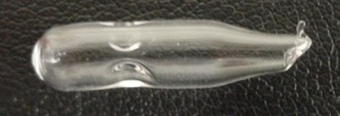
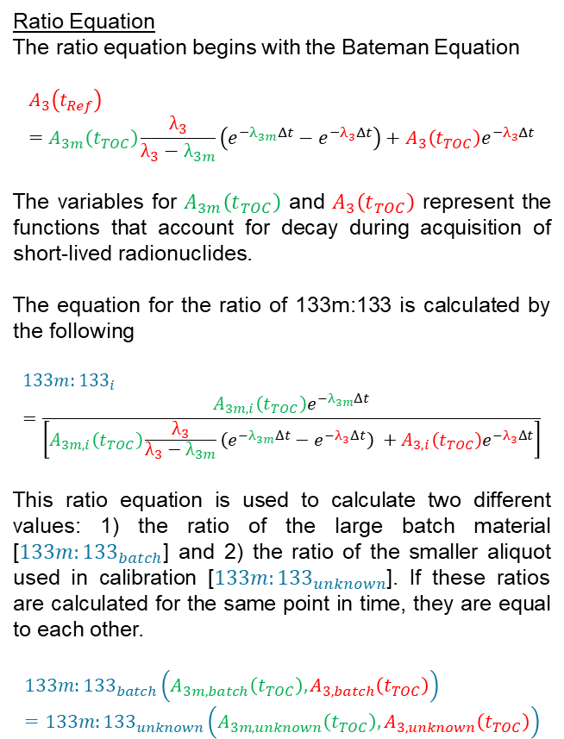
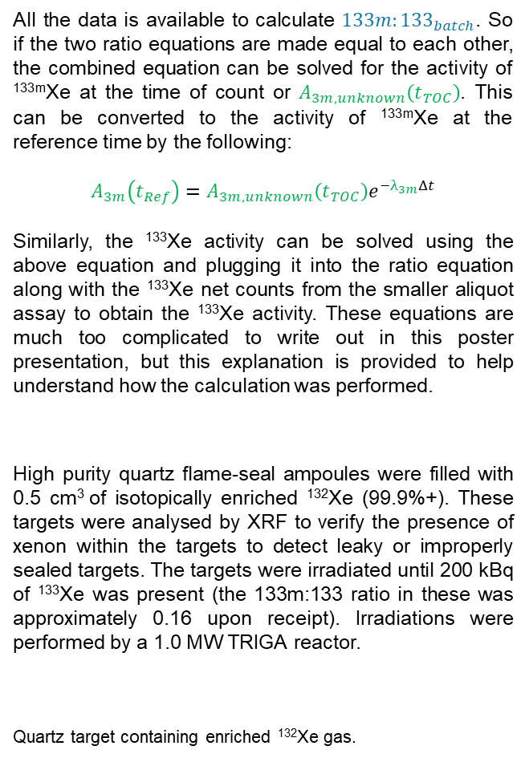
PLEASE DON‘T FORGET TO PUT THE E-POSTER TITLE AND YOUR NAME IN THE PRESENTATION HEADER.
DUPLICATE THIS SLIDE IF YOUR E-POSTER HAS MORE THAN 1 PAGE
P3.2-223
Application of Indirect Quantification of ^{133m}Xe to
Calibration of HPGe Detector
Troy Robinson, PhD
Derivation of Indirect Quantification
of ^{133m}Xe Equation
All the data is available to calculate ${133m:133}_{batch}$. So if the two ratio equations are made equal to each other, the combined equation can be solved for the activity of ^{133m}Xe at the time of count or $A_{3m,unknown}\left(t_{TOC}\right)$. This can be converted to the activity of ^{133m}Xe at the reference time by the following:
$$A_{3m}\left(t_{Ref}\right)=A_{3m,unknown}\left(t_{TOC}\right)e^{−λ_{3m}Δt}$$
Similarly, the ¹³³Xe activity can be solved using the above equation and plugging it into the ratio equation along with the ¹³³Xe net counts from the smaller aliquot assay to obtain the ¹³³Xe activity. These equations are much too complicated to write out in this poster presentation, but this explanation is provided to help understand how the calculation was performed.
High purity quartz flame-seal ampoules were filled with 0.5 cm³ of isotopically enriched ¹³²Xe (99.9%+). These targets were analysed by XRF to verify the presence of xenon within the targets to detect leaky or improperly sealed targets. The targets were irradiated until 200 kBq of ¹³³Xe was present (the 133m:133 ratio in these was approximately 0.16 upon receipt). Irradiations were performed by a 1.0 MW TRIGA reactor.
Quartz target containing enriched ¹³²Xe gas.
Mutli-energy gamma calibration sources were obtained from Eckert and Ziegler (USA). These were prepared in the “bean” configuration using cellophane as the internal matrix to create what is known as a “Simulated Gas Calibration Standard”. Two samples were created: a 37kBq and 3.7 kBq. The larger sample was assayed at the farther distances (24cm, 12cm, 4cm, 0cm) and the smaller sample at near distances (4cm, 0cm, in Well). Photos of samples created in the past are shown in the “Commercial Multi-Energy Calibration” under “Methods of HPGe Calibration” section.
Three methods are being compared in this work: Mutli-energy gamma calibration, Chain-step calibration, and indirect quantification calibration. Samples were assayed by HPGe until all ROIs contained a minimum of 25K net counts.
Where peaks interfered with peak fitting, peak deconvolution using gaussian peak fitting was performed to calculate net peak area.
Ratio Equation
The ratio equation begins with the Bateman Equation
$$A_{3}\left(t_{Ref}\right)=A_{3m}\left(t_{TOC}\right)\frac{λ_{3}}{λ_{3}−λ_{3m}}\left(e^{−λ_{3m}Δt}−e^{−λ_{3}Δt}\right)+A_{3}\left(t_{TOC}\right)e^{−λ_{3}Δt}$$
The variables for $A_{3m}\left(t_{TOC}\right)$ and $A_{3}\left(t_{TOC}\right)$ represent the functions that account for decay during acquisition of short-lived radionuclides.
The equation for the ratio of 133m:133 is calculated by the following
$${133m:133}_{i}=\frac{A_{3m,i}\left(t_{TOC}\right)e^{−λ_{3m}Δt}}{\left[A_{3m,i}\left(t_{TOC}\right)\frac{λ_{3}}{λ_{3}−λ_{3m}}\left(e^{−λ_{3m}Δt}−e^{−λ_{3}Δt}\right) +A_{3,i}\left(t_{TOC}\right)e^{−λ_{3}Δt}\right]}$$
This ratio equation is used to calculate two different values: 1) the ratio of the large batch material [${133m:133}_{batch}$] and 2) the ratio of the smaller aliquot used in calibration [${133m:133}_{unknown}$]. If these ratios are calculated for the same point in time, they are equal to each other.
$${133m:133}_{batch}\left(A_{3m,batch}\left(t_{TOC}\right),A_{3,batch}\left(t_{TOC}\right)\right)={133m:133}_{unknown}\left(A_{3m,unknown}\left(t_{TOC}\right),A_{3,unknown}\left(t_{TOC}\right)\right)$$
Data Collection
Materials

Slide 5
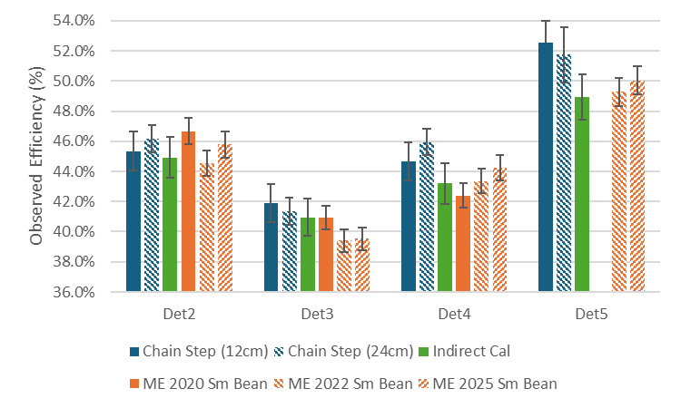
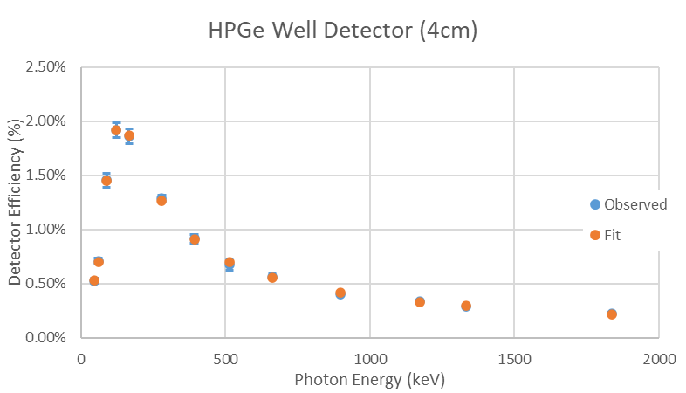
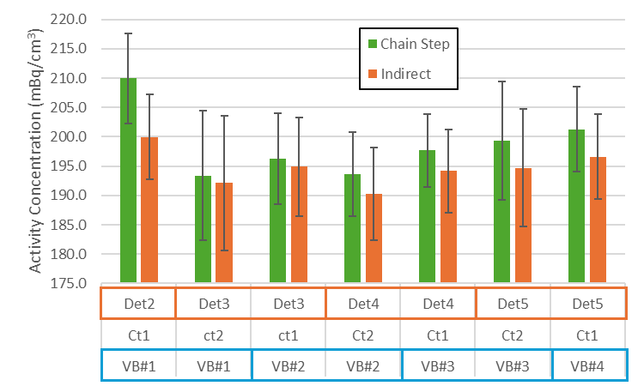
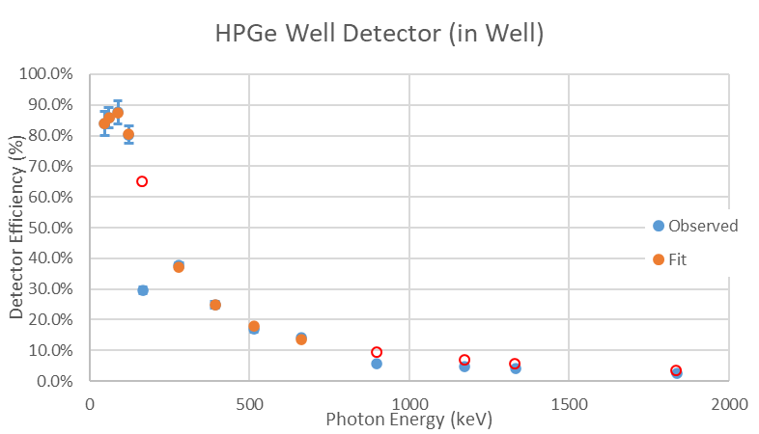
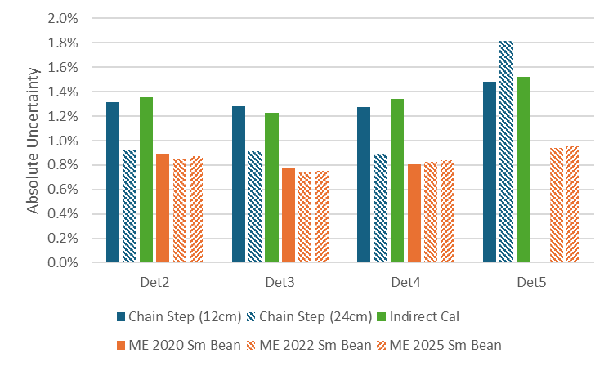
PLEASE DON‘T FORGET TO PUT THE E-POSTER TITLE AND YOUR NAME IN THE PRESENTATION HEADER.
DUPLICATE THIS SLIDE IF YOUR E-POSTER HAS MORE THAN 1 PAGE
P3.2-223
Application of Indirect Quantification of ^{133m}Xe to
Calibration of HPGe Detector
Troy Robinson, PhD
Calibration Results
Commercial Multi-Energy Calibration
Multi-energy calibrations were performed. Outside of the Well and 0cm geometries, there was no summing distortions in the spectra or observed data points. All collected data points were used to fit the polynomial fit of the calibration data.
In the well geometry there was significant deviation of ¹³⁹Ce (165.9 keV) from the trend in the other radionuclides. Also, ⁸⁸Y and ⁶⁰Co showed spectral signs of summing losses. All of these datapoints were excluded from the polynomial fit of the efficiency data.
Comparison of Calibration Results
Calibration results show good agreement between methods within the same detector. Different detectors will naturally show different efficiencies.
Absolute uncertainties from different methods tend to show slightly lower uncertainty for the Multi-energy (ME) calibration but larger for chain-step and indirect calibration method. A larger uncertainty is not necessarily bad as this can reflect some of the challenge of calibrating the ^{133m}Xe isotope.
Application of Calibration Results to Actual Data
A sample of spiked radioxenon was prepared with a target concentration of 200 mBq/cm³. Four approximately identical samples were prepared and each was assayed on a HPGe detector in the well geometry. Count rates required an assay for 2 days for the first assay. The samples were then moved to another detector and a second assay of 3 days was performed. Results were calculated using two sets of detector efficiencies: the chain-step efficiencies and the indirect method efficiencies. The results are shown below for comparison.
 | Chain Step | Indirect | %Bias
Avg (mBq/cm³) | 198.8 | 194.7 | 2.1%
Avg unc (1σ) (mBq/cm³) | ±8.2 | ±8.5
wtAvg (mBq/cm³) | 199.0 | 195.1 | 2.0%
WtAvg Unc (1σ) (mBq/cm³) | ±7.7 | ±8.0
Stdev (mBq/cm³) | 5.7 | 3.1

Slide 6
PLEASE DON‘T FORGET TO PUT THE E-POSTER TITLE AND YOUR NAME IN THE PRESENTATION HEADER.
DUPLICATE THIS SLIDE IF YOUR E-POSTER HAS MORE THAN 1 PAGE
P3.2-223
Application of Indirect Quantification of ^{133m}Xe to
Calibration of HPGe Detector
Troy Robinson, PhD
Discussion
Well Calibration Results
Calibration of the well geometry is a challenge due to the high geometric efficiency, and the resulting problems with high dead-times and summing. It follows that a method that doesn’t involve multi-energy gamma standards is preferable. Although, the efficiency results obtained in this work for 233 keV (^{133m}Xe) do not appear to suffer from these issues. For other energies, the multi-energy gamma calibration may not be as reliable.
The chain-step method and the indirect calibration method require approximately the same amount of preparation and detector utilisation time. For the impatient researcher or those who do not need to calibrate the full suite of distances preferred by INL NGL (Well, 0cm, 4cm, 12cm, 24cm) the indirect quantification calibration method can be used to skip having to calibrate all the intermediate distances between the far geometry and the well. If this is the approach desired, then the indirect method will provide a time savings (in detector utilisation time) to achieve calibration of the Well geometry.
Although the indirect quantification method doesn’t provide a time or effort savings over the chain-step method in calibration, it does achieve a detector utilization time savings of a factor of 50 when
quantifying samples taken from a batch of known 133m:133 ratio.
There is the question of the 2.1(±4.5)% negative bias between the data calculated from the indirect quantification detector efficiencies and the chain-step method. Looking at the propagated uncertainty this difference is negligible. But it would be good to understand what leads to this off-set in values.
In the dataset analysed by both efficiency sets, it appears that the Det2 results deviate from the other detectors. But looking at the efficiency results, Det2 shows the least variation between the different methods. Typically, agreement between different methods provides confidence in a result. The efficiency of Det2 looks to be in good agreement between the different methods. But when it is applied to real world data, it looks like a bit of an outlier.
Detector Geometry Suite used by INL NGL
It has been questioned by previous researchers why is it necessary to calibrate so many geometries at the INL NGL. This question coming from a measurement laboratory makes sense in that environmental samples all have relatively low activities, and thus only the well geometry would be required.
The INL NGL is a gas standard production laboratory. During operations samples of different ranges of activity must be quantified during different stages of sample production.
Freshly irradiated targets arrive with activities as high as 400 kBq (~10.8 μCi) each. From these targets, smaller aliquots (spike samples) of between 2-2,000 Bq (at a future reference time) are produced and must be quantified. These samples are then diluted in natural xenon to achieve the final requested activity concentration. These samples can be as low as 100 mBq/cm³.
To quantify these samples at each step of the production, geometries as far out as 24cm and as close as in the well are needed to prevent excessive detector dead-time. By calibrating from 24cm to the well, the INL NGL creates a measurement capability with a sensitivity with approximately ~650x different between the extremes. A few R&D exercises have required even more sensitivity spread, so a 50cm distance was calibrated to enable ~2400x sensitivity difference.

Slide 7
PLEASE DON‘T FORGET TO PUT THE E-POSTER TITLE AND YOUR NAME IN THE PRESENTATION HEADER.
DUPLICATE THIS SLIDE IF YOUR E-POSTER HAS MORE THAN 1 PAGE
P3.2-223
Application of Indirect Quantification of ^{133m}Xe to
Calibration of HPGe Detector
Troy Robinson, PhD
Conclusions
The indirect quantification method for ^{133m}Xe was applied to detector calibration. This method yielded results comparable to the chain-step method and the Multi-energy gamma calibration method for the 233keV (^{133m}Xe) gamma energy.
Uncertainty was slightly higher from the indirect quantification method than the other two calibration methods.
There was no significant savings in laboratory preparations, detector utilisation time, or data analysis requirements between the chain-step method and the indirect quantification method. The Multi-energy gamma calibration method was not included in this analysis because the preparation of these samples is performed by an outside laboratory.
Utilizing the indirect quantification calibration efficiencies shows a negligible negative bias in the final calculated results when compared with the chain-step method calculated results. The observed bias in the 4 detector assay average was -2.1(±4.5)%.

